Slide 1
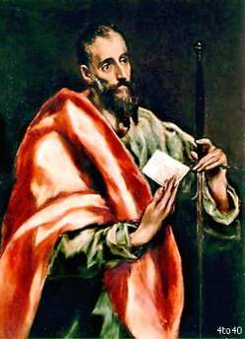
St. Paul as Organizer of Missionary Disciples
Religious Education Congress
Archdiocese of Los Angeles
Feb. 21, 2020 – Session 2.12
Fr. Felix Just, SJ, PhD
http://catholic-resources.org

Slide 2

T H A N K Y O U !
For participating in R.E. Congress!
For sharing our faith as catechists!
For helping in many other ministries!
For being a disciple of Jesus Christ!

Slide 3
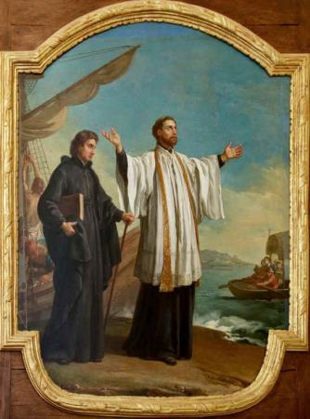
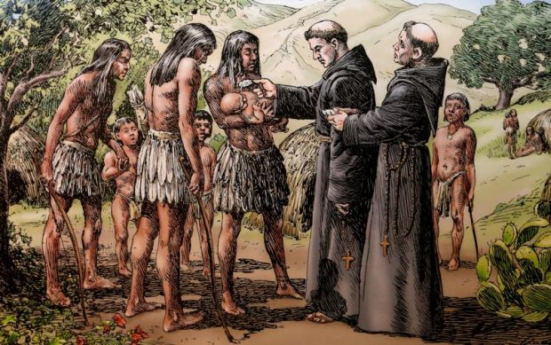
What Are “Missionary Disciples”?
Past / Traditional View:
  Special “Missionaries” went to the (foreign) “missions”!
  Other Christians just supported
  them with prayer and donations.

Slide 4
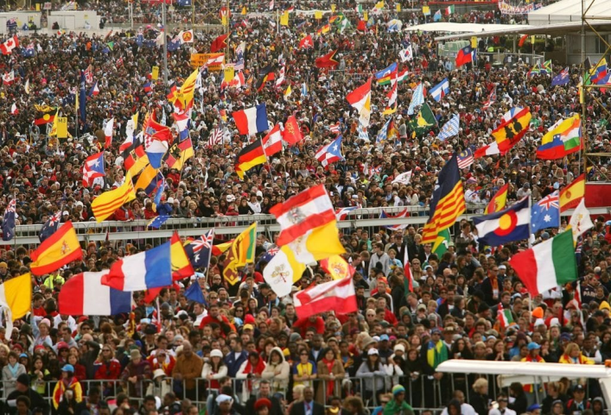
What Are “Missionary Disciples”?
  Pope Francis: ALL Christians are called to be
  “missionary disciples” (discípulos misioneros)

Slide 5

The Joy of the Gospel:
On the Proclamation of the Gospel in Today’s World (Evangelii Gaudium)
Pope Francis: Apostolic Exhortation – Nov. 24, 2013
Intro: A joy ever new, a joy which is shared
Ch. One – The Church’s Missionary Transformation
Ch. Two – Amid the Crisis of Communal Commitment
Ch. Three – The Proclamation of the Gospel
Ch. Four – The Social Dimension of Evangelization
Ch. Five – Spirit-Filled Evangelizers

Slide 6
Evangelii Gaudium: The Joy of the Gospel
Chapter Three – The Proclamation of the Gospel (110-175)
I. THE ENTIRE PEOPLE OF GOD PROCLAIMS THE GOSPEL [111-134]
A people for everyone [112-114]
A people of many faces [115-118]
We are all missionary disciples [119-121]
The evangelizing power of popular piety [122-126]
Person to person [127-129]
Charisms at the service of a communion which evangelizes [130-131]
Culture, thought and education [132-134]
II. THE HOMILY [135-144]
III. PREPARING TO PREACH [145-159]
IV. EVANGELIZATION AND THE DEEPER UNDERSTANDING OF THE KERYGMA [160-175]

Slide 7

“We are all missionary disciples”
120. In virtue of their baptism, all the members of the People of God have become missionary disciples (cf. Mt 28:19). All the baptized, whatever their position in the Church or their level of instruction in the faith, are agents of evangelization, and it would be insufficient to envisage a plan of evangelization to be carried out by professionals while the rest of the faithful would simply be passive recipients. The new evangelization calls for personal involvement on the part of each of the baptized.
Every Christian is challenged, here and now,
to be actively engaged in evangelization; indeed,
anyone who has truly experienced God’s
saving love does not need much time or lengthy
training to go out and proclaim that love.

Slide 8
“We are all missionary disciples”
120b. Every Christian is a missionary to the extent that he or she has encountered the love of God in Christ Jesus: we no longer say that we are “disciples” and “missionaries”, but rather that we are always “missionary disciples”. If we are not convinced, let us look at those first disciples, who, immediately after encountering the gaze of Jesus, went forth to proclaim him joyfully: “We have found the Messiah!” (Jn 1:41). The Samaritan woman became a missionary immediately after speaking with Jesus and many
Samaritans come to believe in him “because of the
woman’s testimony” (Jn 4:39). So too, Saint Paul,
after his encounter with Jesus Christ, “immediately
proclaimed Jesus” (Acts 9:20; cf. 22:6-21).
So what are we waiting for?

Slide 9
“We are all missionary disciples”
121. Of course, all of us are called to mature in our work as evangelizers. We want to have better training, a deepening love and a clearer witness to the Gospel. In this sense, we ought to let others be constantly evangelizing us. But this does not mean that we should postpone the evangelizing mission; rather, each of us should find ways to communicate Jesus wherever we are.
All of us are called to offer others an explicit witness to the saving love of the Lord, who despite our imperfections offers us his closeness, his word and his strength, and gives meaning to our lives. In your heart you know that it is not the same to live without him; what you have come to realize, what has helped you to live and given you hope, is what you also need to communicate to others. Our falling short of perfection should be no excuse; on the contrary, mission is a constant stimulus not to remain mired in mediocrity but to continue growing. The witness of faith that each Christian is called to offer leads us to say with Saint Paul: “Not that I have already obtained this, or am already perfect; but I press on to make it my own, because Christ Jesus has made me his own” (Phil 3:12-13).

Slide 10
Vatican II: Apostolicam Actuositatem
“Decree on the Apostolate of the Laity”
(Promulgated by Pope Paul VI on Nov. 18, 1965)
Introduction (§1)
Chapter I: The Vocation of the Laity to the Apostolate (§§2-4)
Chapter II: Objectives (§§5-8)
Chapter III: The Various Fields of the Apostolate (§§9-14)
Chapter IV: The Various Forms of the Apostolate (§§15-22)
Chapter V: External Relationships (§§23-27)
Chapter VI: Formation for the Apostolate (§§28-32)
Exhortation (§33)

Slide 11
“Missionary Disciples” / “Lay Apostolate”
Assumptions of Vatican II’s Decree Apost.Act.
  Clergy & Religious serve within Church structures
  Laity serve “in the world”: business, politics, health care, education, farming, factories, service industries, etc.
Actual Practice since Vatican II
  “Lay Ministries” are often within the Church:
  liturgical ministries, catechetical, social, charitable, etc.
  “The World” is secular and/or pluralistic:
  many Catholics hesitate “imposing” our beliefs on others,
  sharing our faith, or even talking about God or Jesus!

Slide 12
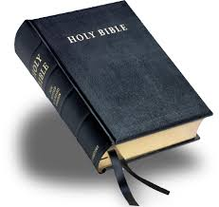
What Are “Missionary Disciples”?
NT Greek Vocabulary:
Mathētēs = disciple, student, pupil, learner
Apostolos = apostle, missionary, emissary;
lit. someone who is “sent out”
Evangelistēs = evangelist, herald, preacher;
lit. proclaimer of “good news”
Related words: servants, ministers, deacons,
elders, presbyters, bishops, teachers, etc.

Slide 13
Progression of Ministries (in Gospels)
Jesus Calls People to Become Disciples
  Calls four fishers (Mark 1:16-20)
  Calls tax collector Levi (Mark 2:14)
  Calls the Twelve (Mark 3:13-19) – but not yet sent out!
Jesus Sends Them Out as Apostles
  Mark 6:7-13 – “He summoned the Twelve and began to send them out two by two and gave them authority over unclean spirits…. ¹² So they went off and preached repentance. ¹³ They drove out many demons, and they anointed with oil many who were sick and cured them.”
Jesus Commissions Them as Evangelists
  Matt 28:19-20 – “Go, therefore, and make disciples of all nations,
  baptizing them in the name of the Father, and of the Son, and of the holy Spirit,
  ²⁰ teaching them to observe all that I have commanded you.
  And behold, I am with you always, until the end of the age."

Slide 14
Progression of Ministries
Disciple → Apostle → Evangelist
  Start as “disciples”:
  students, who follow & learn from the master/teacher
  Then be “apostles”:
  emissaries, “sent out” on a mission to preach, heal, serve
  Finally become “evangelists”:
  teachers, who proclaim “good news”
Goal: Becoming “Missionary Disciples”
  Includes ALL of the above steps
  Putting faith into action
  (in joyful living and in loving service and in sharing good news)

Slide 15
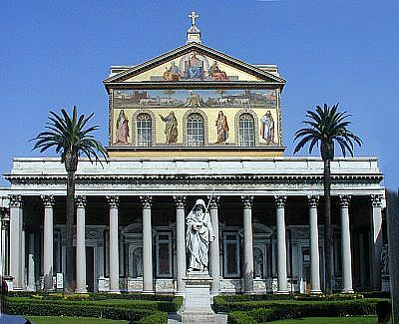
St. Paul Outside the Walls (Rome)

Slide 16

St. Paul to Christians in Rome
Rom 10:13-14
¹³ For "everyone who calls on the name of the Lord will be saved."
¹⁴ But how can they call on him in whom they have not believed?
And how can they believe in him of whom they have not heard?
And how can they hear without someone to preach?
It’s all about salvation thru evangelization!
(Sharing with others the joy of being saved!)

Slide 17
Paul to Christians in Rome (Rom 10:4-17)
Context: Paul writes about the “mystery” that many Jews don’t believe in Jesus:
“For Christ is the end of the law for the justification of everyone who has faith."
Moses writes about the righteousness that comes from the law,
"The one who does these things will live by them." [Lev 18:5; Gal 3:12]
But the righteousness that comes from faith says, "Do not say in your heart, 'Who will go up into heaven?' (that is, to bring Christ down)
or 'Who will go down into the abyss?' (that is, to bring Christ up from the dead).
But what does it say?
"The word is near you, in your mouth and in your heart" [Deut 30:14],
that is, the word of faith that we preach,
for, if you confess with your mouth that Jesus is Lord
and believe in your heart that God raised him from the dead,
you will be saved.
For one believes with the heart and so is justified,
and one confesses with the mouth and so is saved.”

Slide 18
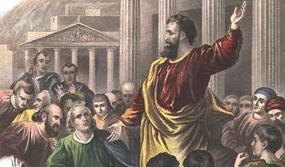
St. Paul to the Romans
For the scripture says, "No one who believes in him
will be put to shame." [Isa 28:16; 1 Pet 2:6]
For there is no distinction between Jew and Greek;
the same Lord is Lord of all, enriching all who call upon him.
For "everyone who calls on the name of the Lord will be saved." [Joel 3:5]
But how can they call on him in whom they have not believed?
And how can they believe in him of whom they have not heard?
And how can they hear without someone to preach?
And how can people preach unless they are sent? As it is written,
"How beautiful are the feet of those who bring the good news!" [Isa 52:7; Nah 2:1]
But not everyone has heeded the good news;
for Isaiah says, "Lord, who has believed what was heard from us?" [Isa 53:1]
Thus faith comes from what is heard,
and what is heard comes through the word of Christ.”

Slide 19
Paul Preaches the Gospel
Rom 1:14-16 – “To Greeks and non-Greeks alike, to the wise and the ignorant, I am under obligation; ¹⁵ that is why I am eager to preach the gospel also to you in Rome. ¹⁶ For I am not ashamed of the gospel.
It is the power of God for the salvation of everyone who believes: for Jew first, and then Greek.”
Q: Am I “eager” to preach the Gospel (in word and deed),
or am I sometimes “ashamed”?
Q: Do I recognize the Gospel as the “power of God”
for the “salvation for all people”?

Slide 20
Paul Preaches the Gospel
1 Cor 9:16-18 – “If I preach the gospel, this is no reason for me to boast, for an obligation has been imposed on me, and woe to me if I do not preach it! ¹⁷If I do so willingly,
I have a recompense, but if unwillingly, then I have been entrusted with a stewardship. ¹⁸What then is my recompense? That, when I preach, I offer the gospel free of charge so as not to make full use of my right in the gospel.”
Q: Do I recognize my “obligation” to preach the Gospel?
Or do I think “preaching” is only for priests & missionaries?
Q: Do I preach “willingly” & “freely”? In words and in deeds?

Slide 21
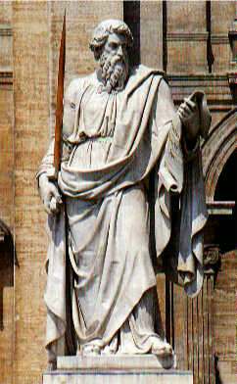
Handout for this Workshop (2.12)
“Pauline Chronology:
The Life and Missionary
Work of St. Paul of Tarsus”
  Traditional View:
  “Three Missionary Journeys”
  More Accurate:
  “Five Main Phases of Paul’s Life”
On RE Congress Website:
  http://www.recongress.org/

Slide 22
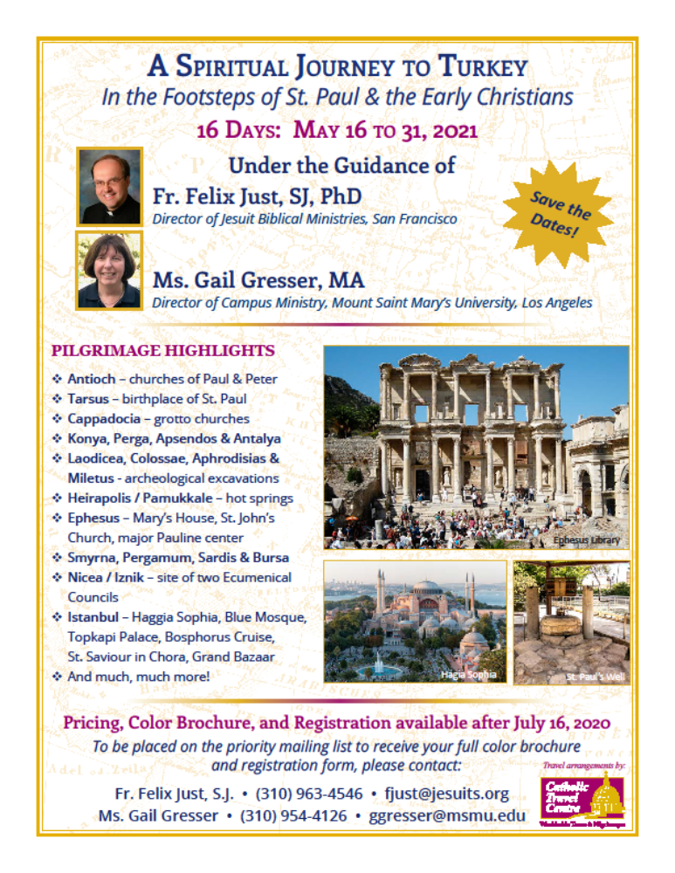
Pilgrimages: In the Footsteps of
St. Paul in Turkey and Greece
May 2021:
Pauline Turkey
May 2022: Holy Land
May 2023:
Pauline Greece
If interested, Email me:
fjust@jesuits.org

Slide 23
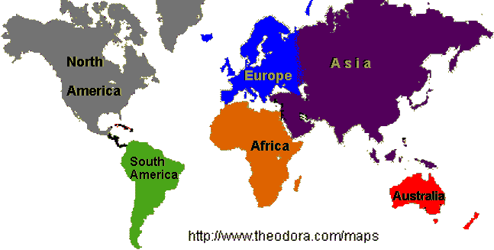
World & Continents

Slide 24
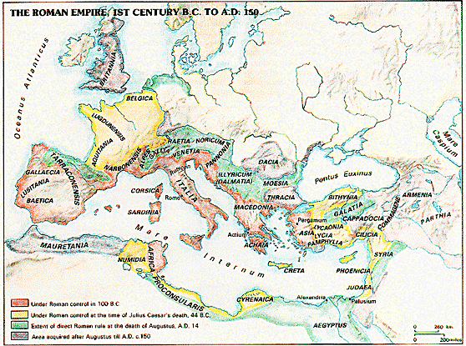
Roman Empire

Slide 25
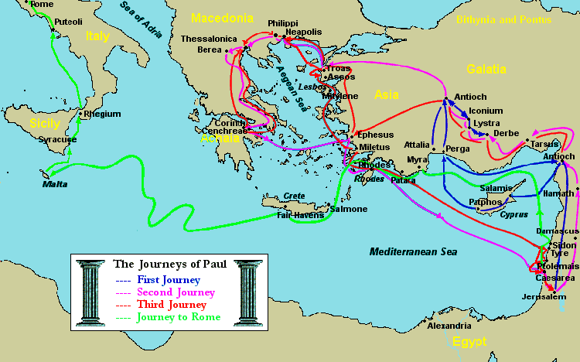
Paul's Journeys: Traditional View

Slide 26
Paul’s Three Missionary Journeys?
Traditional (but Inaccurate) Division:
  1) Acts 13–14: Journey through Cyprus, Pamphylia, and Pisidia (today's South-Central Turkey)
  2) Acts 15:39–18:22: Journey through Macedonia and Achaia (modern Greece) and Asia Minor (Western Turkey)
  3) Acts 18:23–21:16: Another Journey through Asia Minor, Macedonia, and Achaia, ending in Jerusalem
  R) Acts 22–28: After being arrested in Jerusalem and imprisoned in Caesarea, Paul is taken by ship to Rome
  [See handout]

Slide 27
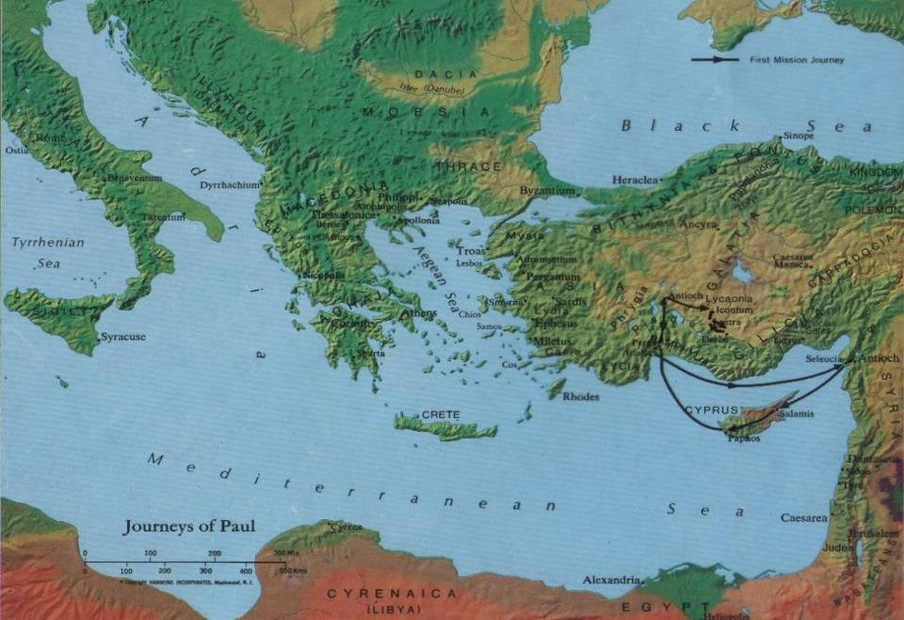
Paul's 1st Journey (Acts 13–14)?

Slide 28
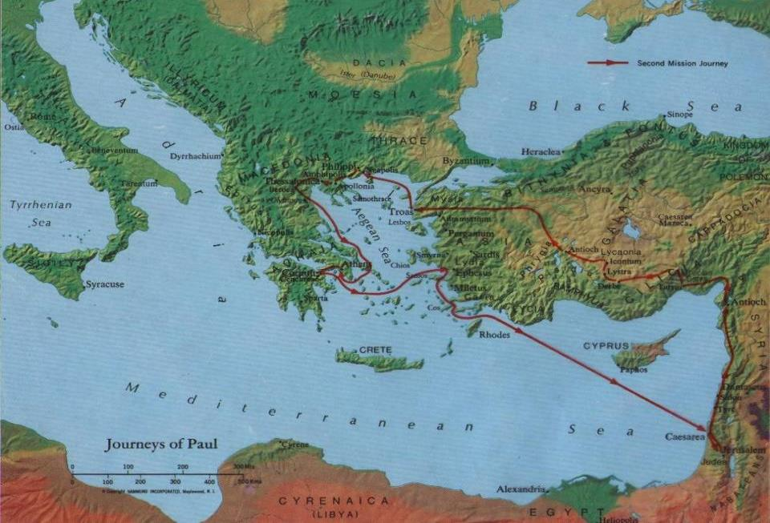
Paul's 2nd Journey (Acts 15–18)?

Slide 29
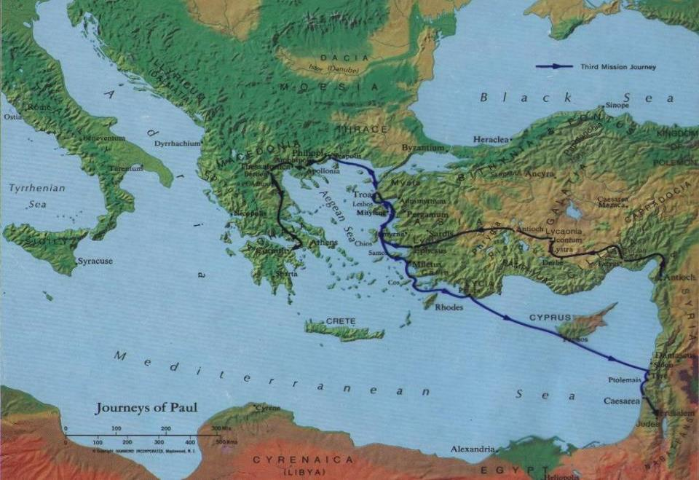
Paul's 3rd Journey (Acts 18–21)?

Slide 30
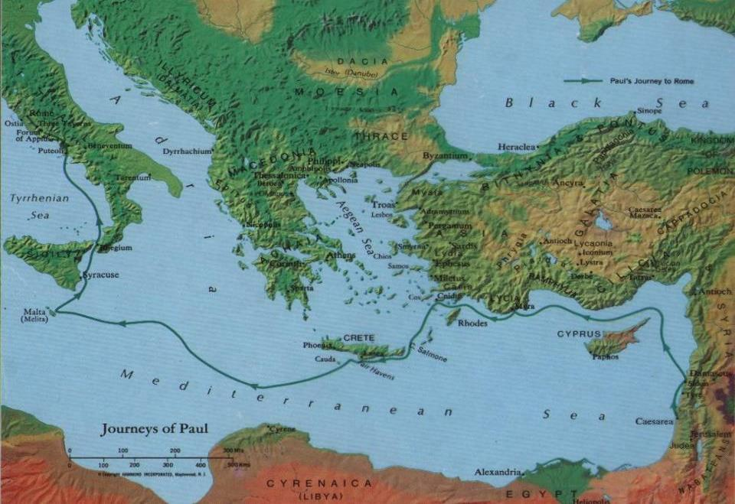
Paul's Journey to Rome (Acts 27–28)

Slide 31
Problems with Traditional View
Paul is not in charge during the first journey:
  Barnabas is the leader; Paul is his assistant.
  Acts 9:27; 11:25-30; 13:1-3 – Barnabas has priority over Saul
  Acts 13–14 – Order of names: “Barnabas & Saul/Paul”
  Acts 14:12 – Barnabas is “Zeus”; Paul is “Hermes”
After Paul & Barnabas separate, he is never alone:
  Acts 15:39-40; 16:1-3 – travels with Silas and Timothy;
  also 1 Thess 1:1; 2 Cor 1:19 – Paul, Silvanus, Timothy
  More and more associates over time (see esp. Rom 16)
  Beginnings of Paul’s letters usually mention co-authors.
  Endings of his letters include many individual greetings.

Slide 32
Problems with “Three Journeys”
So-called 2nd and 3rd “journeys” are not circle-trips,
they don’t start and end in Syrian Antioch:
  Acts 18:22-23 – “Upon landing at Caesarea, he went up and greeted the church and then went down to Antioch. After staying there some time, he left and traveled in orderly sequence through the Galatian country and Phrygia, bringing strength to all the disciples.”
Is this really the end of trip 2, and the start of trip 3?
  NO! It’s just a short stop while visiting his old haunts.
  When Paul returned to Antioch, it was only for a brief visit;
  he no longer “belongs to” nor is “sent out” by that church.

Slide 33
Problems with “Three Journeys”
Paul make a definite break with Barnabas
and the Church at Antioch. But WHY?
  Acts 15:39-40 – a dispute with Barnabas about John Mark?
  Galatians 2:11-14 – “And when Kephas came to Antioch,
  I opposed him to his face because he clearly was wrong.
  ¹² For, until some people came from James, he used to eat with the Gentiles; but when they came, he began to draw back and separated himself, because he was afraid of the circumcised.
  ¹³ And the rest of the Jews also acted hypocritically along with him, with the result that even Barnabas was carried away by their hypocrisy. ¹⁴ But when I saw that they were not on the right road in line with the truth of the gospel, I said to Kephas in front of all, ‘If you, though a Jew, are living like a Gentile and not like a Jew, how can you compel the Gentiles to live like Jews?’ ”

Slide 34
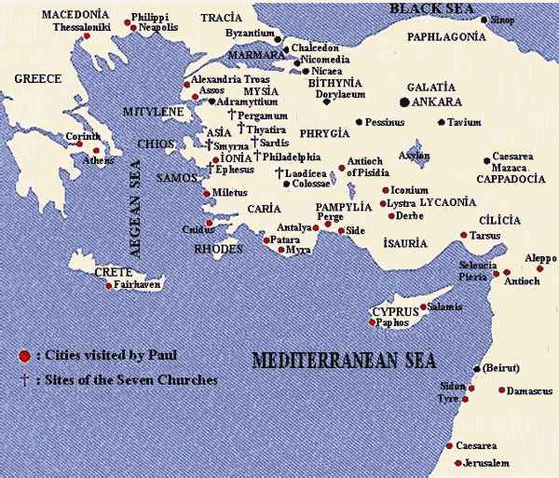

Slide 35
Corrections to the Traditional View
Paul’s first “missionary” work was as assistant
to Barnabas, to Cyprus & south-central Turkey.
After leaving Antioch, Paul and new companions spend several years preaching and establishing Churches in Macedonia & Achaia, esp. in Corinth.
A few years later, they leave Corinth and make Ephesus, in Asia Minor, the main base of their missionary operations for several more years.

Slide 36
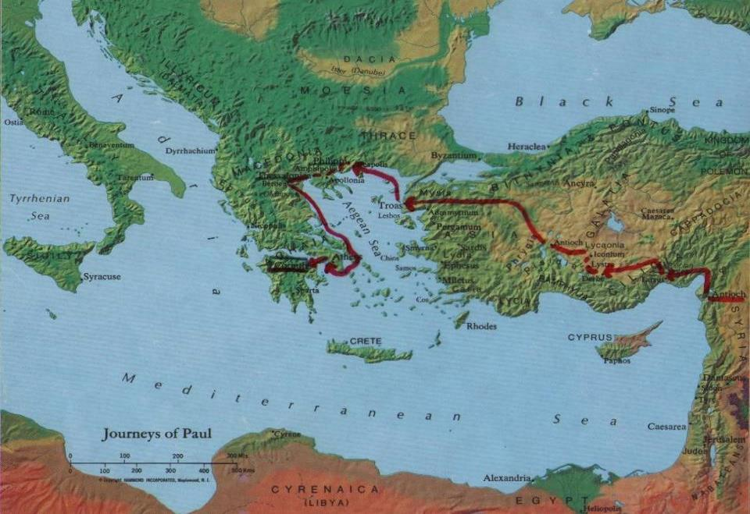
Paul leaves Antioch, settles in Corinth

Slide 37
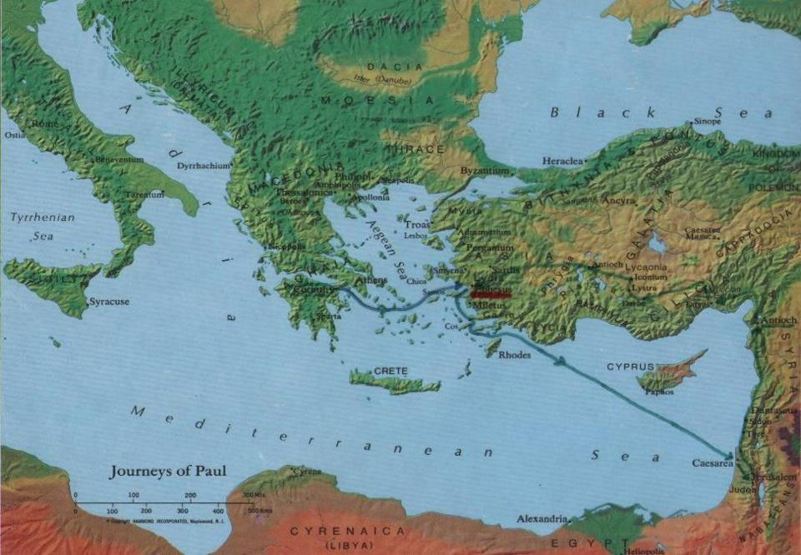
Paul moves from Corinth to Ephesus

Slide 38
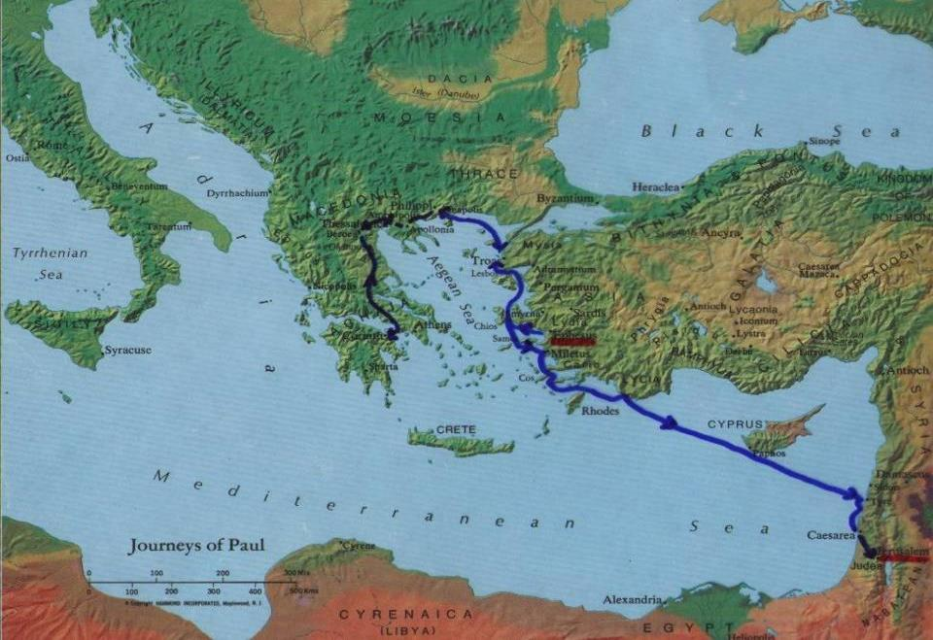
Paul prepares to visit Jerusalem

Slide 39
Five Main Phases of Paul's Life
0) Pre-Christian Phase (ca. AD 10–35)
1) Paul’s New Christian Life:
in the EAST (ca. AD 35–49)
2) Early Independent Missionary Phase:
in MACEDONIA & ACHAIA (ca. AD 50–52)
3) Mature Missionary Leadership Phase:
in ASIA (Minor) (ca. AD 53–57)
4) Final Missionary Travel Phase:
plans to go further WEST (ca. AD 58–62/64)
X) After Paul’s Death: his legacy continues
(AD 60's - 90's and beyond)

Slide 40

Main Phases of Paul's Life

Slide 41
0) Paul’s Pre-Christian Life (ca. AD 10–35)
Jew, born in Tarsus, capital of CILICIA (Acts 9:11, 30; 11:25; 21:39); possibly educated in Jerusalem (Acts 22:3).
Hebrew, born of Hebrew parents (Phil 3:5; 2 Cor 11:22);
probably also a Roman citizen (Acts 22:25-29; 23:27).
Bi-lingual (Hebrew/Aramaic & Greek) and bi-cultural (Jewish & Hellenistic/Greek); ideal “transition figure” for spreading Christianity from Palestine to rest of empire.
First named “Saul” (Acts 7:58–13:9; 22:7; 26:14; cf. Rom 11:1);
later changed to “Paul” (see Acts 13:9ff and all his Epistles).
Pharisee, very zealous for Torah & Jewish traditions (Phil 3:5; Acts 23:6-9; 26:5).
Persecutes followers of Jesus (Gal 1:13-14; Phil 3:5-6; 1 Cor 15:9; Acts 7:58; 8:1; 9:1-2; 22:3-5; 26:4-12).

Slide 42
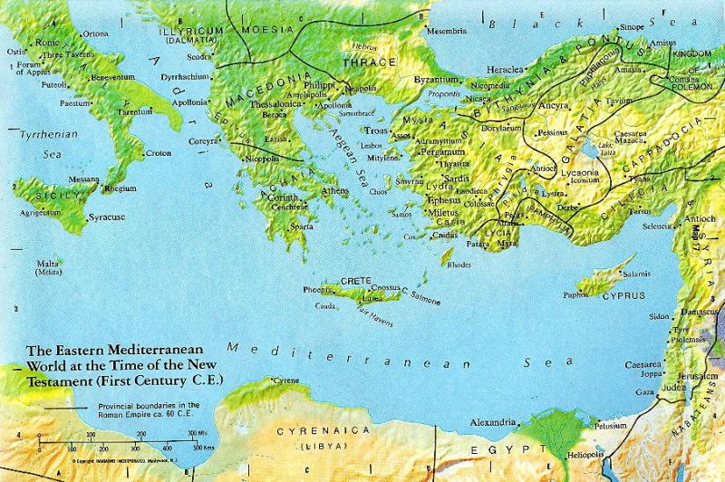
Paul’s Youth

Slide 43
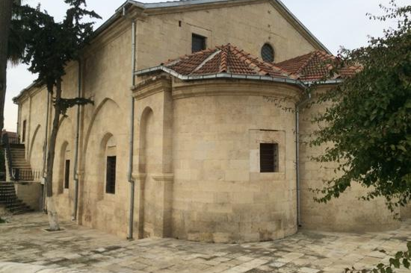
St. Paul Church in Tarsus, Turkey

Slide 44
1) Paul’s New Christian Life (ca. AD 35–49)
Jesus is “revealed” to Paul (the so-called “conversion”)
while Paul is on road to Damascus, in southern SYRIA
Acts 9:3-30; 22:6-21; 26:12-18 – three accounts: blinding light
1 Cor 9:1a – “Am I not free? Am I not an apostle?
Have I not seen Jesus our Lord?”
1 Cor 15:8 – “Last of all, as to one born abnormally,
he [Jesus] appeared to me.”
Gal 1:11-16 – “God was pleased to reveal his Son to me.”
Cf. 2 Cor 4:6 – “For God who said, ‘Let light shine out of darkness,’
has shone in our hearts to bring to light
the knowledge of the glory of God on the face of Jesus Christ.”

Slide 45
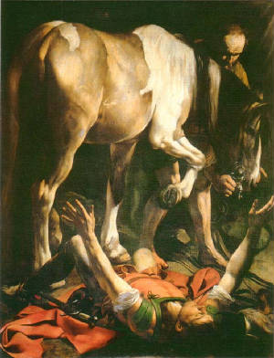
The "Conversion" of Saint Paul ?
(Caravaggio, 1600)
Is a horse
mentioned in the biblical accounts?
[ Hint: NO! ]

Slide 46
Paul in Syria (Acts 9; Gal 1)

Slide 47
1) Paul’s New Christian Life (ca. AD 35–49)
Jesus is “revealed” to Paul as being “God’s Son.”
Paul begins preaching in Arabia, Damascus, Syria,
and Cilicia, with some opposition (Gal 1:17-24; 2 Cor 11:23-33).
Barnabas takes an interest in Paul, helps him,
introduces him to other Xns (Acts 9:26-30; 11:25-30; 12:25).
Sent out by church of Antioch, in northern SYRIA,
Barnabas & Paul go preach in Cyprus, Pamphylia, Phrygia (Acts 13–14); Barnabas is leader, with Paul as his assistant (esp. Acts 14:12, Barnabas = “Zeus,” Paul = “Hermes”).
Barnabas & Paul participate in “Council of Jerusalem”
(ca. AD 49, possibly later; compare Gal 2:1-10 and Acts 15)

Slide 48
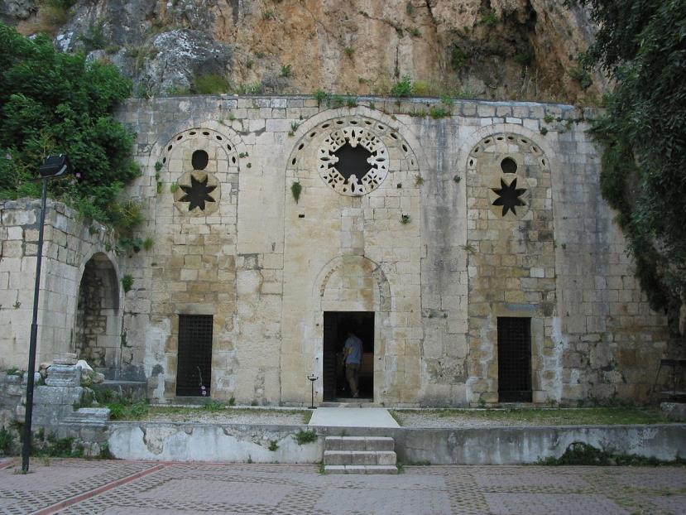
Cave Church of St. Peter
Syrian Antioch (now Antakya, Turkey)

Slide 49
2) Early Missionary Phase (ca. AD 50–52)
Paul breaks with Barnabas: “Incident at Antioch” (contrast Gal 2:11-14 with Acts 15:36-41)
Paul, Silas, Timothy cross from ASIA to MACEDONIA; start churches in Philippi & Thessalonica & Beroea
(Acts 16:1–17:15)
  Conversion/Baptism of Lydia & her household
  Conversion/Baptism of Philippian Jailer & his household
  Pattern: Preach, Get Arrested, Jailed, Released, Move On

Slide 50
Paul, Silas & Timothy (Acts 16-17)

Slide 51
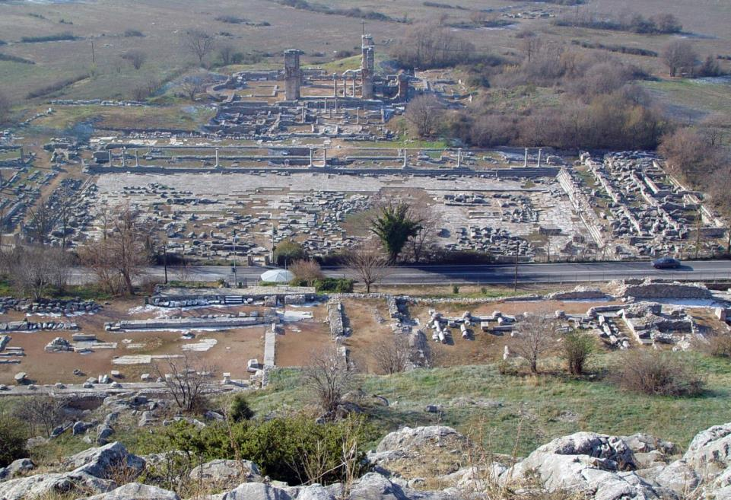
Ruins of Philippi (Macedonia, Northern Greece)

Slide 52
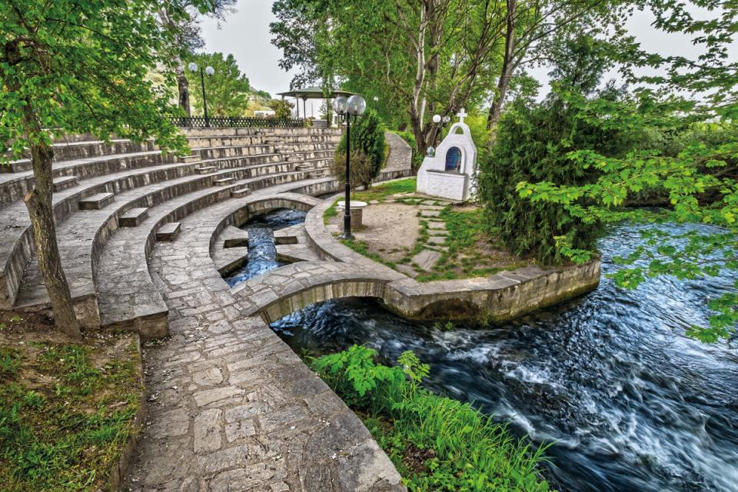
Baptismal Site in Philippi (Macedonia, Northern Greece)

Slide 53
2) Early Missionary Phase (ca. AD 50–52)
Paul breaks with Barnabas…
Paul, Silas, Timothy go to MACEDONIA…
Kicked out of Macedonian cities, they go to ACHAIA; Paul briefly visits Athens, with little success (Acts 17:16-34)
They go to Corinth, capital of ACHAIA, for 18+ months (Acts 18:11, 18); meet Prisca & Aquila after Emperor Claudius had expelled Jews from Rome (AD 49; Acts 18:2)
Paul tried before Gallio (Acts 18:12-17), who was Proconsul of Achaia only AD 51–52; only fixed date for Paul’s life.
From Corinth, Paul & companions write 1 Thess, and probably also 2 Thess (see 1 Thess 3:1-6)

Slide 54
Paul, Silas & Timothy (Acts 17-18)

Slide 55
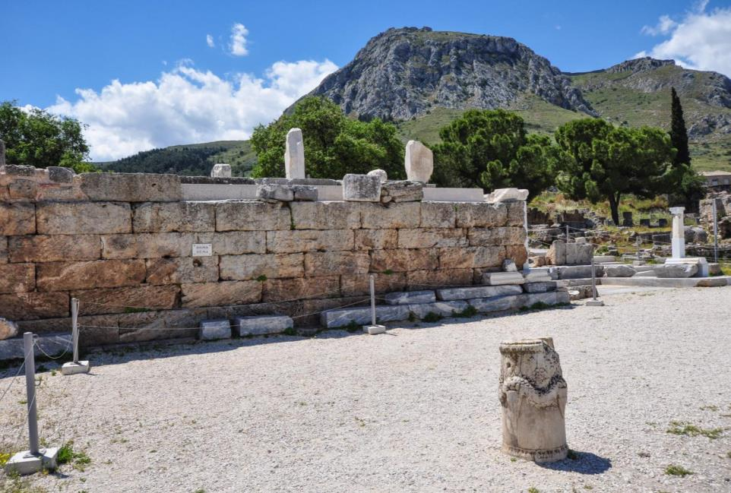
The Bema in Corinth (with Acro-Corinth in Background)

Slide 56
3) Missionary Leadership (ca. AD 53–57)
Travels thru Asia to Syria (brief visits to Jerusalem & Antioch?), and back to Ephesus, capital of ASIA (Acts 18:18–19:41).
Remains in Ephesus at least 27 months, or longer (Acts 19:8, 10, 22); Ephesus becomes “missionary headquarters.”
Paul travels and sends/receives messengers & letters back & forth from Ephesus to Macedonia, Corinth, parts of Asia Minor, etc. (1 Cor 16:5-12; 2 Cor 8-9; Phil 2:19-30; 4:10-20).
Associates found other Xn communities in Asia Minor; e.g., Epaphras establishes church in Colossae (Col 1:7).
Paul encounters opposition; blamed for riot of silversmiths in Ephesus (see Acts 19:26); probably jailed there briefly.
From Ephesus, Paul & his companions write 1 Cor, 2 Cor, Phil, Phlm, and probably Gal (see 1 Cor 15:32; 16:8; 16:19).

Slide 57
Paul & Companions (Acts 19-20)

Slide 58
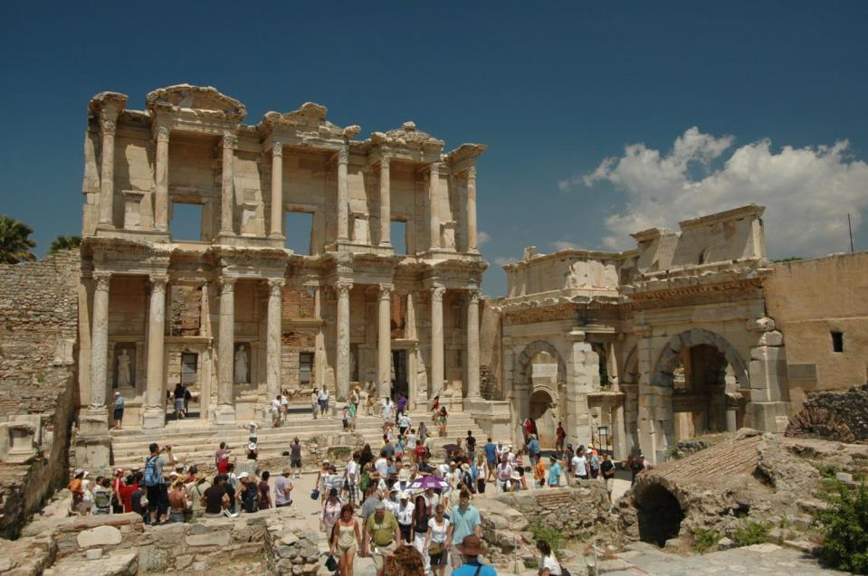
Library of Celsus in Ephesus

Slide 59
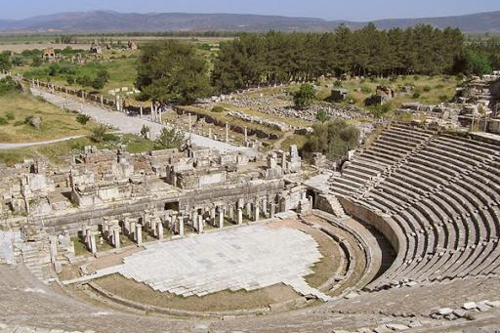
Roman Theater in Ephesus

Slide 60
Contacts between Pauline Churches

Slide 61
4) Final Mission Travels (ca. AD 58–62/64)
Wants to go to Rome & Spain, but first deliver money to Jerusalem Christians (1 Cor 16:1-4; Rom 15:22-32; Acts 19:21); stays in Corinth 3 months (Acts 20:3); writes to Romans.
Paul and associates deliver this collection to Jerusalem; soon he is arrested in Temple (Acts 20–21).
Under arrest ca. 2 years in Caesarea; appeals to Caesar; taken to Rome; remains under house-arrest 2 more years (Acts 22–28); possibly writes Col from prison in Caesarea.
What’s next? Nothing else written in Acts: either tried, found guilty, and executed; or tried, found innocent and released, so maybe (?) went to preach in Spain.
Paul was executed during Nero’s reign; at end of first Roman imprisonment (AD 62), or after returning from Spain (AD 64); death not recorded in Acts of the Apostles.

Slide 62
Roman Empire

Slide 63
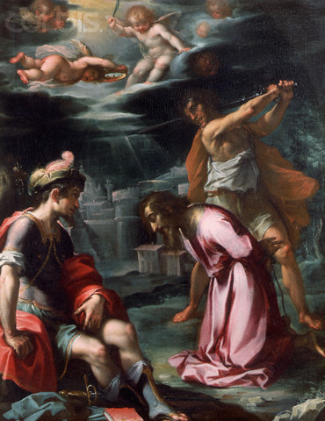
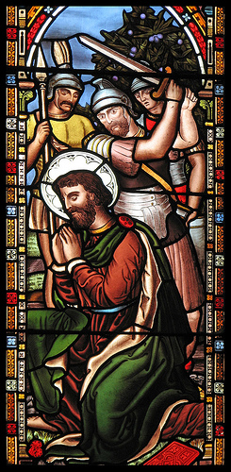
Death of Paul: Beheaded by Sword

Slide 64
X) After Paul’s Death (AD 60’s - 90’s and on)
Paul’s associates continue to preach, gain converts, build up Christian churches, address problems, write letters, etc.
1 Tim, 2 Tim, Tit, and Eph probably pseudepigraphic (i.e., written in Paul’s name, by his followers, after his death).
Ephesus and Colossae remain strong centers of Pauline-style Christianity, possibly led by Timothy and Onesimus.
Someone begins collecting & editing Paul’s letters (cf. 2 Pet 3:15-16); by late 1st century, ca. 10 letters circulate together; Ephesians possibly functions as a “cover letter.”
Eventually, thirteen letters attributed to Paul are deemed “canonical” (sometimes also “Letter to the Hebrews”?).
Other legends about Paul develop, as found in non-canonical works (e.g., “Acts of Paul”; “Acts of Paul and Thecla”).

Slide 65
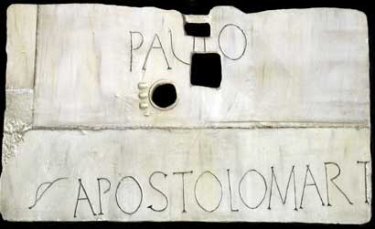
Tomb of St. Paul: Lapida

Slide 66
Paul’s Skill in Organizing Churches
Gradual start with long apprenticeship
Organization expands over time
Good relationships with clients/converts
Recognizes gifts & leadership of women
Collaborates with other leaders
Leadership by inspirational example
Willing both to praise and to challenge
Financial responsibility and planning
Maintaining good communications
Centrality of prayer & thanksgiving

Slide 67
Paul’s Organizing Skills
1) Gradual start with long apprenticeship
14 years in regions of the Eastern Medit.
  Gal 1:17-21 – Arabia, Damascus, Syria, Cilicia
Learns primarily from the risen Jesus
  2 Cor 12:1-7a – Visions & Revelations?
Member of Xn communities in Syria
  2 Cor 1:32; Gal 1:17; 2:11 – Damascus, Antioch
Assistant to Barnabas for a time
  Gal 2:1 – “I went to Jerusalem with Barnabas”

Slide 68
Paul’s Organizing Skills
2) Organization expands over time
Recruits more and more associates
  Silas, Timothy, Titus, Philemon, Onesimus, Gaius, Aquila & Prisca, Phoebe, Tertius, etc.
Founds more and more communities
  Philippi, Thessalonica, Beroea, Corinth, Ephesus, Troas, Miletus, etc.
Always wants to expand to new areas
  Rom 15:23-24 – “Now, since I no longer have any opportunity in these regions and since I have desired to come to you for many years, I hope to see you in passing as I go to Spain…”

Slide 69
Paul’s Organizing Skills
3) Good relationships with clients/converts
Cares for his “children” like a “Father”
  1 Cor 4:15 – “I became your father in CJ thru the gospel.”
Sometimes scolds them as immature
  1 Cor 3:2 – “I fed you milk, not solid food…”
Stresses relations as “brothers/sisters”
  Adelphoi – most common address in all his letters
Appeals for reconciliation of disputes
  Phil 4:2 – “I urge Euodia and I urge Syntyche to come to a mutual understanding in the Lord.”

Slide 70
Paul’s Organizing Skills
4) Recognizes gifts & leadership of women
Lydia is the first convert in Europe!
  Acts 16:11-15 – she prevails on Paul to stay with her
Prisca/Priscilla & Aquila are Paul’s close companions
  Acts 18:2-26; Rom 16:3; 1 Cor 16:19; 2 Tim 4:19
Phoebe is a “deacon” highly commended by Paul
  Rom 16:1 – a “deacon” of the church at Cenchreae;
  and may have been the one to deliver this letter to Rome
Apphia, Claudia, Chloe, Damaris, Eunice & Lois, Euodia & Syntyche, Nympha, Julia, Junia, Mary…
  See http://catholic-resources.org/Bible/Pauline_Associates.htm

Slide 71
Paul’s Organizing Skills
5) Collaborates with other leaders
Apostles are “servants/slaves” of God/Christ
  Gk. douloi – Rom 1:1; 1 Cor 7:22; Gal 1:10; Phil 1:1
Stresses lack of rivalry with other apostles
  Gal 2:9 – partners; 1 Cor 3:4-23 – God’s co-workers
Although he sometimes challenges them
  Gal 2:11-14 – “Incident at Antioch”
Stresses need for unity in communities
  1 Cor 1:10-13 – Paul, Apollos, Cephas, Christ?

Slide 72
Paul’s Organizing Skills
6) Leadership by inspirational example
Followers should “imitate” him and others,
since they “imitate” Jesus (esp. in suffering)
  1 Cor 11:1 – “Be imitators of me, as I am of Christ.”
  1 Cor 4:16-17 – “Therefore, I urge you, be imitators of me. For this reason I am sending you Timothy, who is my beloved and faithful son in the Lord; he will remind you of my ways in Christ (Jesus), just as I teach them everywhere…”
  1 Thess 1:6-7 – “You became imitators of us and of the Lord, receiving the word in great affliction, with joy from the holy Spirit, so that you became a model for all the believers in Macedonia and in Achaia.” (also Phil 3:17; 2 Thess 3:7-9)

Slide 73
Paul’s Organizing Skills
7) Willing both to praise and to challenge
Often praises Thessalonians & Philippians
  1 Thess 1:2-3 – “We give thanks to God always for all of you, remembering you in our prayers, unceasingly calling to mind your work of faith and labor of love and endurance in hope…”
Harshly scolds the Galatians
  Gal 1:6-7 – “I am amazed…”; 3:1 “O foolish Galatians!”
Deals with many problems in Corinth
  “I urge you…” (5x); “Do you not know…” (10x)

Slide 74
Paul’s Organizing Skills
8) Financial responsibility and planning
Stresses the need for everyone to work
  1 Thess 4:10-12 “…we urge you… to work with your own hands, as we instructed you…” (1 Thess 2:9; 1 Cor 4:12)
Accepts financial support from older churches
  Phil 4:10-20; 2 Cor 11:8-9 – no burden for present church
Organizes large collection for the poor in Judea
  1 Cor 16:1-4; 2 Cor 8:1-24; 9:1-15 – detailed instructions
  Rom 15:25-28 – “I am going to Jerusalem to minister to the holy ones. For Macedonia and Achaia have decided to make some contribution for the poor among the saints…”

Slide 75
Paul’s Organizing Skills
9) Maintaining good communications
Send letters & messengers if unable to visit
  While in jail: Phlm 1, 9, 23; Col 4:3, 10
  Sends Emissaries: Timothy, Titus, Epaphroditus, etc.
Prefers personal visits, when possible
  Phlm 22 – “prepare a guest room for me”
  Rom 1:9-13 – Paul’s long-time plans to visit Rome
Answers questions, addresses problems
  1 Cor 1:11; 5:1 – Oral reports received
  1 Cor 5:9; 7:1; 2 Cor 2:3-4; 7:8-12 – Other letters

Slide 76
Paul’s Organizing Skills
10) Centrality of Prayer & Thanksgiving
Begins each letter with a formal greeting
  “Grace to you and peace from God the Father and our Lord Jesus Christ.” (most letters)
Usually has a long “Thanksgiving” section
  “I give thanks to my God at every remembrance of you,
  ⁴ praying always with joy in my every prayer for all of you,
  ⁵ because of your partnership for the gospel from the first day until now.” (Phil 1:3-5)
Ends each letter with Prayer and/or Doxology
  “To our God and Father, glory forever and ever. Amen….
  ²³ The grace of the Lord Jesus Christ be with your spirit.”
  (Phil 4:20, 23)

Slide 77
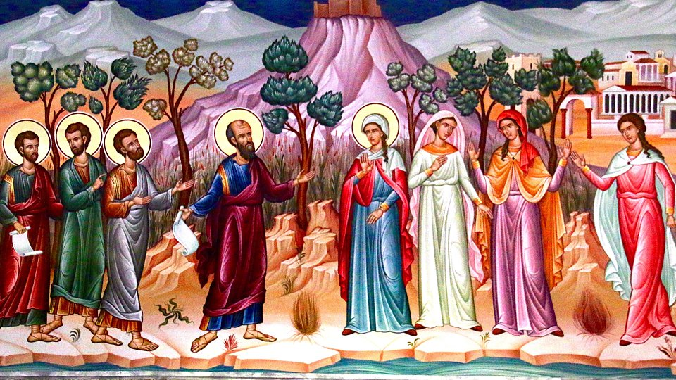
Paul & Companions / Lydia & Companions

Slide 78
Summary & Applications
Paul never worked or traveled alone
  We too need to work in teams
Paul started as a junior assistant
  We also need to mentor younger ministers
Paul had more and more associates over time
  We also need to recruit and train new volunteers
Paul valued the leadership roles of women
  We too need to be much more inclusive

Slide 79
Summary & Applications
Paul cooperated with many other missionaries
  We also need to collaborate on many levels
Paul stressed the need for unity among Christians
  We need to avoid forming cliques and factions
Paul was both “Father” and “Brother” to his converts
  We need to combine authority and companionship
Paul stressed hard work and financial responsibility
  We need to contribute our time, talent, and treasure

Slide 80
Summary & Applications
Paul organized a collection for the poor
  We also need to help the needy of our own day
Paul was “all things to all people”
  We need to be adaptable in different situations
Paul stressed both theology and ethics
  We need to focus on both faith and morals
Paul both praised and scolded, as necessary
  We need to balance encouragement and challenge

Slide 81
Summary & Application
Paul told people to imitate his life and actions
  We need to set a good example for others to follow
Paul both preached orally and wrote letters
  We need to supplement teaching w/ written materials
Paul frequently quoted and applied scriptures
  We need to read and use the Bible regularly
Paul maintained his close connection with Jesus
  We need to pray and attend liturgy regularly

Slide 82
How Can I Learn More?
http://catholic-resources.org
Fr. Felix Just's Biblical/Theological Website
(if you forget the URL, just Google my name!)
Catholic Bible Institute(s)
  Archdiocese of Los Angeles
  Diocese of Orange
  Diocese of San Bernardino
  Diocese of Tucson

Slide 83
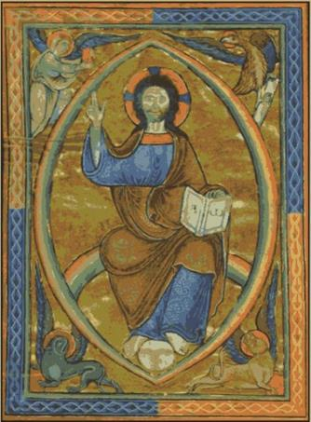
Audio CD Programs by Fr. Felix
The New Testament: A Guided Tour
The Lectionary: A Treasure for Liturgy & Prayer
What Is Faith? Gift, Mystery, Life!
A Retreat with the Gospel of Matthew
A Retreat with the Gospel of Mark
A Retreat with the Gospel of Luke
A Retreat with the Gospel of John
Available from Fr. Felix or
“Learn 25 / Now You Know Media”

Slide 84
Pilgrimages: In the Footsteps of
St. Paul in Turkey and Greece
May 2021:
Pauline Turkey
May 2022: Holy Land
May 2023:
Pauline Greece
If interested, Email me:
fjust@jesuits.org

Slide 85
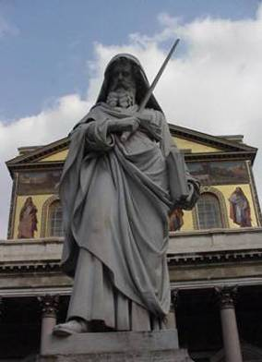
Concluding Blessing
“Finally, brothers and sisters, rejoice.
Mend your ways,
encourage one another,
agree with one another,
live in peace, and
the God of love and peace
will be with you.”
(2 Cor 13:11)

Slide 86

    Questions? Comments?
    THANK YOU for Attending Congress!
May your desire grow daily to be
a joyful missionary disciple of Jesus Christ!

