Slide 1
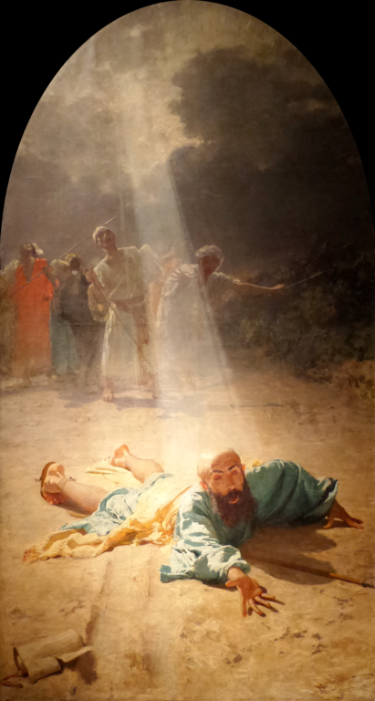
St. Paul’s Experience of God’s Mercy and
His Call to Holiness
L.A. Religious
Education Congress,
Feb. 22, 2020 – Session 4.17
Fr. Felix Just, SJ, PhD
http://catholic-resources.org

Slide 2
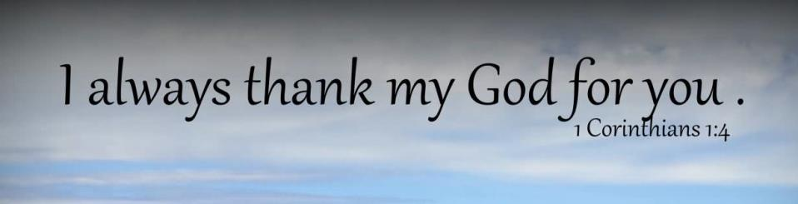
T H A N K Y O U !
For participating in R.E. Congress!
For sharing our faith as catechists!
For helping in many other ministries!
For being a disciple of Jesus Christ!

Slide 3
Pope Francis: Year of Mercy
“Jubilee Year of Mercy” was Dec. 8, 2015 – Nov. 20, 2016
Theme of 2016 RE Congress: “Boundless Mercy”
“Jesus Christ is the face of the Father’s mercy. These words might well sum up the mystery of the Christian faith. Mercy has become living and visible in Jesus of Nazareth, reaching its culmination in him. The Father, “rich in mercy” (Eph 2:4), after having revealed his name to Moses as “a God merciful and gracious, slow to anger, and abounding in steadfast love and faithfulness” (Exod 34:6), has never ceased to show, in various ways throughout history, his divine nature…. Jesus of Nazareth, by his words, his actions, and his entire person reveals the mercy of God.” (Misericordiae Vultus, §1; April 11, 2015)

Slide 4
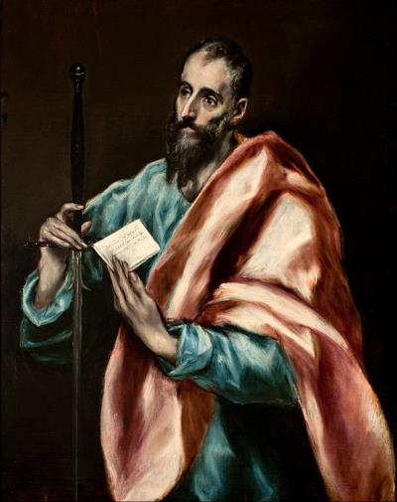
Handout for this Workshop (4.17)
“St. Paul’s Experience
of God’s Mercy and
His Call to Holiness”
  Two pages, PDF file
On RE Congress Website:
  http://www.recongress.org/

Slide 5
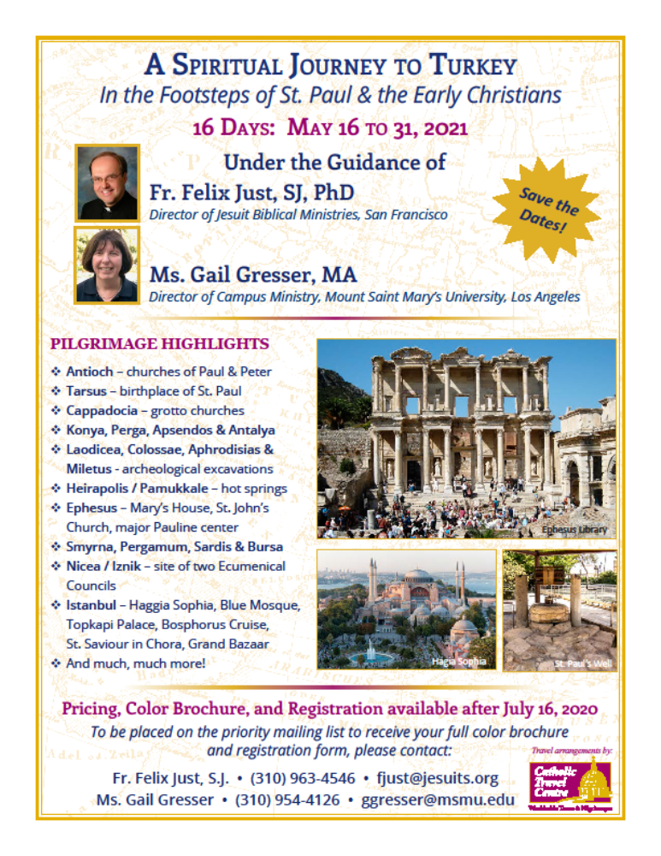
Pilgrimages: In the Footsteps of
St. Paul in Turkey and Greece
May 2021:
Pauline Turkey
May 2022: Holy Land
May 2023:
Pauline Greece
If interested, Email me:
fjust@jesuits.org

Slide 6
Five Phases of Paul's Life (HO 2.12)
0) Pre-Christian Phase: Tarsus & Jerusalem (ca. AD 10–35)
1) Paul’s New Christian Life:
in the EAST: esp. Damascus & Antioch (ca. AD 35–49)
2) Early Independent Missionary Phase:
in MACEDONIA & ACHAIA, esp. Corinth (ca. AD 50–52)
3) Mature Missionary Leadership Phase:
in ASIA (Minor), esp. Ephesus (ca. AD 53–57)
4) Final Missionary Travel Phase:
plans to go further WEST (ca. AD 58–62/64)
X) After Paul’s Death (in Rome): his legacy continues
(AD 60's - 90's and beyond)

Slide 7
Paul’s Pre-Christian Life (ca. AD 10–35)
Jew, born in Tarsus, capital of CILICIA (Acts 9:11,30; 11:25; 21:39); possibly educated in Jerusalem (Acts 22:3).
Hebrew, born of Hebrew parents (Phil 3:5; 2 Cor 11:22);
probably also a Roman citizen (Acts 22:25-29; 23:27).
Bi-lingual (Hebrew/Aramaic & Greek) and bi-cultural
(Jewish & Hellenistic/Greek); so he’s an ideal “transition figure”
for the spread of Christianity from Palestine to rest of the empire.
First named “Saul” (Acts 7:58–13:9; 22:7; 26:14; cf. Rom 11:1);
later changed to “Paul” (see Acts 13:9ff and all his Epistles).
Pharisee, very zealous for Torah/Law & Jewish traditions
(Phil 3:5; Acts 23:6-9; 26:5).
Persecuted followers of Jesus – BUT WHY?
(Gal 1:13-14; Phil 3:5-6; 1 Cor 15:9; Acts 7:58; 8:1; 9:1-2; 22:3-5; 26:4-12).

Slide 8

Foundational Commands of the Hebrew-Christian Bible
Deut 6:4 –
“Hear, O Israel!
The LORD is our God,
the LORD alone!”
  “You shall not have other gods beside me.”
  (Decalogue: Exod 20:3; also Deut 5:7)
  Penalty for idolatry (worshipping other gods)
  is being stoned to death (Lev 17:2-7)

Slide 9
Another Core of Biblical Judaism
Leviticus 19:2b – “You shall be holy,
for I the LORD your God am holy.”
  First Reading: 7th Sunday of Ord. Time (this Sun!)
  God speaking thru Moses to all the Israelites
  Repeated in Lev 11:44-45; 20:26; 21:28.
  Cited in 1 Peter 1:16 – “You shall be holy, for I am holy.”
  Expanded in 1 Peter 2:9 – “You are a chosen race,
  a royal priesthood, a holy nation, a people of his own…”

Slide 10
Foundational Core of
Judaism and Christianity
Lev 19:2b – “You shall be holy,
for I the LORD your God am holy.”
Variations by Jesus:
Matt 5:48 – “Be perfect, therefore,
as your heavenly Father is perfect.”
Luke 6:36 – “Be merciful,
just as your Father is merciful.”
In other words: “Be just like God ” (cf. Eph 5:1)

Slide 11
Questions to Discuss:
What does “holy” mean?
What does “mercy” mean?
What does “perfect” mean?
Please talk briefly
with a neighbor.

Slide 12
Biblical Vocabulary: Holy
Heb. qadosh / Gk. hagios
  “holy, sacred, special, set apart, consecrated”
  closely related to “pure, unblemished, blameless”
“holy/sacred” can apply to many things:
  times, seasons: feast days, special periods
  places, buildings: mountains, temples, sanctuaries
  objects: furniture, vessels, dishes
  foods, drinks: anything offered in the temple
  people: priests (the high priest)
  GOD! – who is “set apart” from the world!

Slide 13
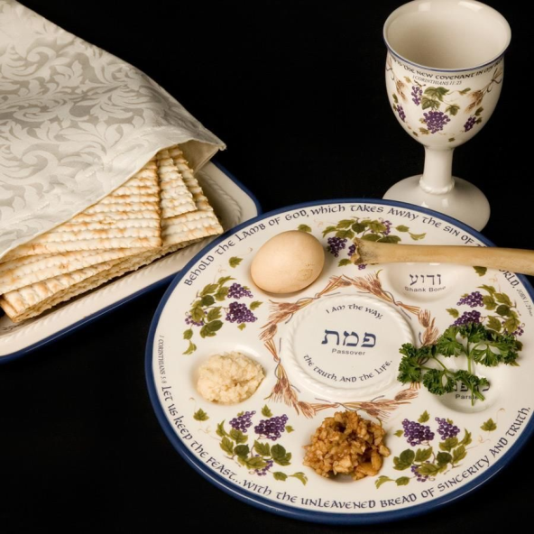
Holy = “Special, Set Apart”

Slide 14
Vatican II
“Universal Call to Holiness in the Church”
  Chap. 5 of LUMEN GENTIUM,
  “Dogmatic Constitution on the Church” (Nov. 21, 1964)
1 Pet 2:9-11
  “But you are ‘a chosen race, a royal priesthood, a holy nation, a people of his own, so that you may announce the praises’ of him who called you out of darkness into his wonderful light. ¹⁰ Once you were ‘no people’ but now you are God's people; you ‘had not received mercy’ but now you have received mercy. ¹¹ Beloved, I urge you as aliens and sojourners to keep away from worldly desires that wage war against the soul.”

Slide 15
Biblical Vocabulary: Mercy
Heb. hesed / Gk. eleios (“Kyrie, eleison”!)
Heb. racham / Gk. splagthna (innards; guts; womb)
  “merciful; compassionate”
    related to “loving kindness; steadfast love; forgiveness”
  opposites: “judgmental, harsh, vengeful, vindictive, punishing”
Common Conception of GOD in OT:
  “The LORD is gracious and merciful, slow to anger and abounding in mercy.” (Ps 145:8; etc.)

Slide 16
Mercy vs. Justice
Justice:
  Everyone gets what they deserve. (rewards or punishments)
  No one gets what they don’t deserve. (unfair, unearned)
Mercy:
  We don’t get what we deserve. (punishment for our sins)
  We do get what we don’t deserve. (forgiveness, salvation)
How Are These Related?
  Humans may insist on Justice; God prefers Mercy!
  Key to Mercy: Repentance!

Slide 17
God Is Holy & Merciful
Hos 11:9 – “I will not give vent to my blazing anger, I will not destroy Ephraim again; For I am God and not a man, the Holy One present among you; I will not come in wrath.”
Isa 55:6-9 – “Seek the LORD while he may be found, call upon him while he is near. ⁷ Let the wicked forsake their way, and sinners their thoughts; Let them turn to the LORD to find mercy; to our God, who is generous in forgiving.
⁸ For my thoughts are not your thoughts, nor are your ways my ways-- oracle of the LORD. ⁹ For as the heavens are higher than the earth, so are my ways higher than your ways, my thoughts higher than your thoughts.”

Slide 18
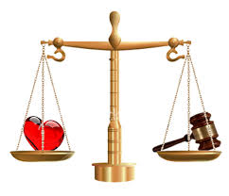
Mercy vs. Justice
“To be merciful to the unjust
is to be unjust to the merciful“?
Is it better to be just or merciful?
Is it worse to be unjust or merciless?

Slide 19
Biblical Vocabulary: Perfect?
Heb. tamim / Gk. teleios
  “perfect; whole, entire, complete, mature, adult”
    but not modern “perfectionism”!
  Opposite: “partial, incomplete, immature, childish”
    related Gk. verb teleiow – “to finish, complete”
Example of contrasts:
  1 Cor 13:9-10 – “For we know only in part, and we prophesy only in part; but when the complete comes, the partial will come to an end.”
  1 Cor 14:20 – “…do not be children in your thinking; rather,
  be infants in evil, but in thinking be adults.” (or “be mature”)

Slide 20
Teleios = “Mature” (not “Perfect”)
1 Cor 2:6 – “Yet among the mature we do speak wisdom, though it is not a wisdom of this age or of the rulers of this age, who are doomed to perish.”
Eph 4:13 – “until all of us come to the unity of the faith and of the knowledge of the Son of God, to maturity, to the measure of the full stature of Christ.”
Phil 3:15 – “Let those of us then who are mature be of the same mind;
and if you think differently about anything, this too God will reveal to you.”
Col 1:28 – “It is he whom we proclaim, warning everyone and teaching everyone in all wisdom, so that we may present everyone mature in Christ.”
Col 4:12 – “He [Epaphras] is always wrestling in his prayers on your behalf, so that you may stand mature and fully assured in everything that God wills.”

Slide 21
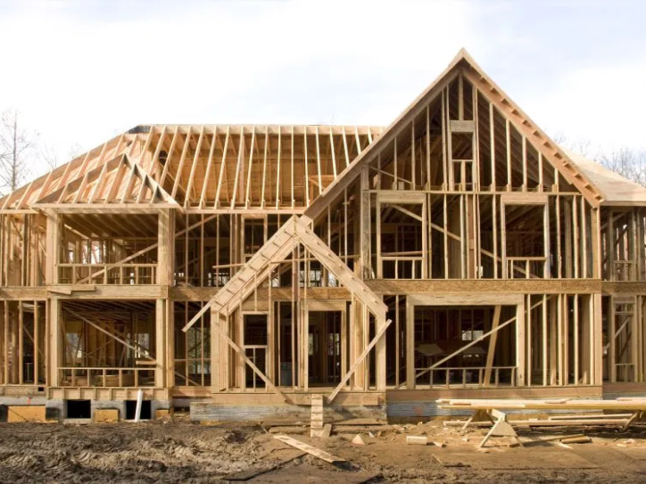
Construction Analogy
When is it “complete”? When is it “perfect”?

Slide 22
How Can We “Be Perfect”?
Are we all “sinners”?
  “Be perfect doesn’t mean never making a mistake!
KEY: How do we act/react after we sin?
  Immature Kids: hide it, deny it, blame others!
  Mature Adults: admit it, accept responsibility, apologize, make amends, try to do better!
  Analogy 1: If we fall down?
  Analogy 2: If we break something?

Slide 23
Young Paul’s Desire or Goal
To be “holy” and “perfect” and “blameless”
  Following God’s law meticulously
To defend Judaism’s belief in Monotheism
  Persecuting any “idolaters” or “blasphemers”
To promote “Justice” (rewards & punishments)
  But did he forget about God’s “mercy”?

Slide 24
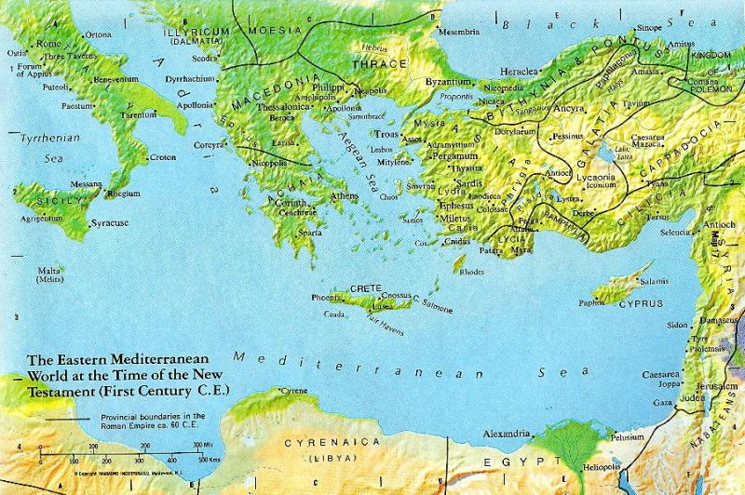
Paul’s Youth

Slide 25
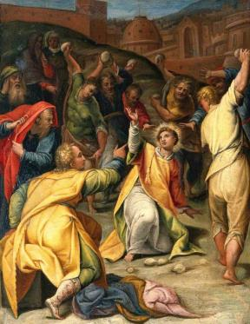
Paul’s Early Life
“Torah-Observant” Jew
  “Zealous” Pharisee
  “Blameless” in Observing God’s Law!
  So also a Persecutor of Christians!
Acts 22:3-4 – “I am a Jew, born in Tarsus in Cilicia, but brought up in this city [Jerusalem]. At the feet of Gamaliel I was educated strictly in our ancestral law and was zealous for God, just as all of you are today.
⁴ I persecuted this Way to death, binding both men and women and delivering them to prison.”

Slide 26
Paul’s Pre-Christian Life (in his own words)
Phil 3:4b-6 – If anyone else thinks he can be confident in flesh, all the more can I. ⁵ Circumcised on the eighth day, of the race of Israel, of the tribe of Benjamin, a Hebrew of Hebrew parentage, in observance of the law a Pharisee, ⁶ in zeal
I persecuted the church, in righteousness based on the law
I was blameless.
Gal 1:13-14 – For you heard of my former way of life in Judaism, how I persecuted the church of God beyond measure and tried to destroy it, ¹⁴ and progressed in Judaism beyond many of my contemporaries among my race, since I was even more a zealot for my ancestral traditions.
1 Cor 15:9 – “For I am the least of the apostles, not fit to be called an apostle, because I persecuted the church of God.”

Slide 27
WHY Did He Persecute Christians?
Jewish Monotheism:
There is only ONE God, and God alone is HOLY
  God is Creator of the World, but “separate from” Creation
  God is not Human, and Humans are not God!
  Claiming that any created thing is “God” is “idolatry”!
  Claiming that any human being is “God” is “blasphemy”!
Christian Proclamation:
  Jesus is not just a teacher, healer, prophet, or the Messiah
  Jesus is the Son of God, divine, equal to God!
  Strict Jews consider this blasphemy… punishable by death!

Slide 28
Paul Was “Zealous” for God!
KILL those who insult God ! ?
  Paul thought killing “blasphemers” was pleasing to God!
    “Do I not hate, LORD, those who hate you? Those who rise against you, do I not loathe? With fierce hatred I hate them, enemies I count as my own. (Ps 139:21-22)
  Thought he was doing God’s will, protecting God’s holiness!
  Comes to see that opposing Jesus means opposing God!
Misguided Zeal? – throughout history & today?
  “Radical/Fundamentalist” Interpretations of (any) Religion?
  “Radical Israelite” – OT Books of Joshua, Judges, Kings
  “Radical Judaism” – Books of Maccabees
  “Radical Christianity” – Crusades, KKK?
  “Radical Islam” – Al Qaeda, ISIS, Boko Haram?

Slide 29
Paul’s “Conversion”
Three Accounts in Acts of the Apostles:
  Incident on the Road to Damascus (southern SYRIA)
  Bright light, voice of Jesus, temporary blindness
Acts 9:3-30
  Luke’s Initial Narrative Account
Acts 22:6-21
  Paul’s Speech to a crowd of Jews in Jerusalem
Acts 26:12-18
  Paul’s Self-Defense on Trial before King Agrippa

Slide 30
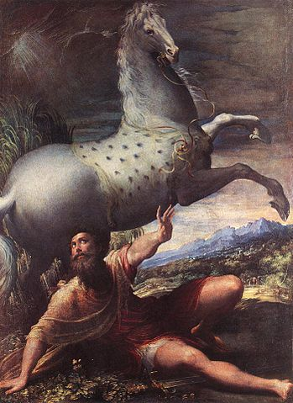
The "Conversion" of Saint Paul ?
(by Parmigianino, 1527)
Is a horse mentioned in the biblical accounts?

Slide 31
Acts 22:3-16
³ "I am a Jew, born in Tarsus in Cilicia, but brought up in this city. At the feet of Gamaliel I was educated strictly in our ancestral law and was zealous for God, just as all of you are today. ⁴ I persecuted this Way to death, binding both men and women and delivering them to prison.
⁵ Even the high priest and the whole council of elders can testify on my behalf. For from them I even received letters to the brothers and set out for Damascus to bring back to Jerusalem in chains for punishment those there as well.
⁶ "On that journey as I drew near to Damascus, about noon a great light from the sky suddenly shone around me. ⁷ I fell to the ground and heard a voice saying to me, 'Saul, Saul, why are you persecuting me?' ⁸ I replied, 'Who are you, sir?' And he said to me, 'I am Jesus the Nazorean whom you are persecuting.'
⁹ My companions saw the light but did not hear the voice of the one who spoke to me.

Slide 32
Acts 22:3-16
¹⁰ I asked, 'What shall I do, sir?' The Lord answered me, 'Get up and go into Damascus, and there you will be told about everything appointed for you to do.' ¹¹ Since I could see nothing because of the brightness of that light, I was led by hand by my companions and entered Damascus.
¹² "A certain Ananias, a devout observer of the law, and highly spoken of by all the Jews who lived there, ¹³ came to me and stood there and said, 'Saul, my brother, regain your sight.' And at that very moment I regained my sight and saw him.
¹⁴ Then he said, 'The God of our ancestors designated you to know his will, to see the Righteous One, and to hear the sound of his voice; ¹⁵ for you will be his witness before all to what you have seen and heard. ¹⁶ Now, why delay? Get up and have yourself baptized and your sins washed away, calling upon his name.'

Slide 33
Paul’s New Christian Life (ca. AD 35–49)
Jesus is “revealed” to Paul as God’s Son
  Three accounts in Acts 9:3-30; 22:6-21; 26:12-18
  On road to Damascus, blinding light, voice of Jesus
1 Cor 9:1a – “Am I not free? Am I not an apostle?
Have I not seen Jesus our Lord?”
1 Cor 15:8 – “Last of all, as to one born abnormally,
he [Jesus] appeared to me.”
Gal 1:11-16 – “God was pleased to reveal his Son to me”
Cf. 2 Cor 4:6 – “For God who said, ‘Let light shine out of darkness,’ has shone in our hearts to bring to light the knowledge of the glory of God on the face of Jesus Christ.”

Slide 34
Jesus’ “Revelation” to Paul
Gal 1:11–2:1 – “Now I want you to know, brothers, that the gospel preached by me is not of human origin. ¹² For I did not receive it from a human being, nor was I taught it, but it came through a revelation of Jesus Christ. ¹³ For you heard of my former way of life in Judaism… ¹⁵ But when God, who from my mother’s womb had set me apart and called me through his grace, was pleased ¹⁶ to reveal his Son to me, so that I might proclaim him to the Gentiles, I did not immediately consult flesh and blood, ¹⁷ nor did I go up to Jerusalem to those who were apostles before me; rather, I went into Arabia and then returned to Damascus. ¹⁸ Then after three years I went up to Jerusalem to confer with Kephas and remained with him for fifteen days…
²¹ Then I went into the regions of Syria and Cilicia…
^{2:1} Then after fourteen years I again went up to Jerusalem with Barnabas, taking Titus along also…

Slide 35
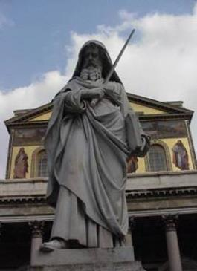
Paul’s “Conversion”
NOT “changing religions”
  Not switching from Judaism
  to Christianity! Earliest “Christians”
  were Jews who believed in Jesus
Rather, he “changed his thinking” (and his heart!)
  Before: Those who say Jesus is Messiah & Son of God are not only wrong, but blasphemers (insulting God!), and thus deserving of punishment!
  After: Proclaiming Jesus as Messiah & Son of God is right! Christians are proclaiming the truth about God and Jesus!

Slide 36
Paul’s New Christian Life (ca. AD 35–49)
Jesus is “revealed” to Paul as God’s Son.
Paul begins preaching Jesus in Arabia, Damascus, Syria, and Cilicia, with some opposition (Gal 1:17-24; 2 Cor 11:23-33).
Barnabas takes an interest in Paul, helps him, introduces him to other Christians (Acts 9:26-30; 11:25-30; 12:25).
Sent out by church of Antioch, in northern SYRIA,
Barnabas & Paul go preach in Cyprus, Pamphylia, Phrygia (Acts 13–14); Barnabas is leader, with Paul as his assistant (esp. Acts 14:12, Barnabas = “Zeus,” Paul = “Hermes”).
Barnabas & Paul participate in “Council of Jerusalem”
(ca. AD 49, possibly later; compare Gal 2:1-10 and Acts 15)

Slide 37
Paul in Syria (Acts 9; Gal 1)

Slide 38
“Revelation” to Paul as God’s Grace
1 Cor 15:8-10 – “Last of all, as to one untimely born, he [Jesus] appeared also to me. ⁹ For I am the least of the apostles, unfit to be called an apostle, because I persecuted the church of God. ¹⁰ But by the grace of God I am what I am, and his grace toward me has not been in vain. On the contrary, I worked harder than any of them….”
Eph 3:1-3 – “This is the reason that I Paul am a prisoner for Christ Jesus for the sake of you Gentiles— ² for surely you have already heard of the commission of God’s grace that was given me for you, ³ and how the mystery was made known to me by revelation, as I wrote above in a few words.”
DEF: Grace = “gift”; something undeserved, freely given

Slide 39
Paul’s Experience of God’s Grace as “Mercy”
2 Cor 4:1 – “Therefore, since it is by God’s mercy that we are engaged in this ministry, we do not lose heart.”
1 Tim 1:13-16 – “I was once a blasphemer and a persecutor and an arrogant man, but I have been mercifully treated because I acted out of ignorance in my unbelief. ¹⁴ Indeed, the grace of our Lord has been abundant, along with the faith and love that are in Christ Jesus. ¹⁵ This saying is trustworthy and deserves full acceptance: Christ Jesus came into the world to save sinners. Of these I am the foremost. ¹⁶ But for that reason I was mercifully treated, so that in me, as the foremost, Christ Jesus might display all his patience as an example for those who would come to believe in him for everlasting life.”

Slide 40
Mercy: An Attribute of God
Rom 9:15-16 – “For he [God] says to Moses, ‘I will have mercy on whom I have mercy, and I will have compassion on whom I have compassion.’ ¹⁶ So it depends not on human will or exertion, but on God who shows mercy…”
Rom 11:30-32 – “Just as you were once disobedient to God but have now received mercy because of their disobedience, ³¹ so they have now been disobedient in order that, by the mercy shown to you, they too may now receive mercy. ³² For God has imprisoned all in disobedience so that he may be merciful to all.”

Slide 41
Mercy: An Attribute of God
2 Cor 1:3 – “Blessed be the God and Father of our Lord Jesus Christ, the Father of mercies and the God of all consolation,”
Phil 2:27 – “He was indeed so ill that he nearly died. But God had mercy on him, and not only on him but on me also, so that I would not have one sorrow after another.”

Slide 42
Mercy: An Attribute of God
2 Tim 1:16 – “May the Lord grant mercy to the household of Onesiphorus, because he often refreshed me and was not ashamed of my chain;”
Titus 3:5 – “he saved us, not because of any works of righteousness that we had done, but according to his mercy, through the water of rebirth and renewal by the Holy Spirit.”

Slide 43
Mercy: An Attribute of God
Eph 2:4-7 – “But God, who is rich in mercy,
out of the great love with which he loved us
⁵ even when we were dead through our trespasses, made us alive together with Christ—by grace you have been saved— ⁶ and raised us up with him and seated us with him in the heavenly places in Christ Jesus,
⁷ so that in the ages to come he might show the immeasurable riches of his grace in kindness toward us in Christ Jesus.”

Slide 44
We Are Called to Be Merciful
Phil 1:8 – “For God is my witness, how I long for all of you with the compassion of Christ Jesus.”
Phil 2:1-2 – “If then there is any encouragement in Christ, any consolation from love, any sharing in the Spirit, any compassion and sympathy, make my joy complete: be of the same mind, having the same love, being in full accord and of one mind.”

Slide 45
We Are Called to Be Merciful
Col 3:12-14 – “Put on then, as God's chosen ones, holy and beloved, heartfelt compassion, kindness, humility, gentleness, and patience, ¹³ bearing with one another and forgiving one another, if one has a grievance against another; as the Lord has forgiven you, so must you also do. ¹⁴ And over all these put on love, that is, the bond of perfection.”
Eph 4:32 – “and be kind to one another, tenderhearted, forgiving one another,
as God in Christ has forgiven you.”

Slide 46
We Are Called to Be Holy
Rom 1:7a – “to all the beloved of God in Rome, called to be holy.”
1 Cor 1:2 – “to the church of God that is in Corinth, to you who have been sanctified in Christ Jesus, called to be holy, with all those everywhere who call upon the name of our Lord Jesus Christ, their Lord and ours.”
2 Cor 7:1 – “Since we have these promises, beloved, let us cleanse ourselves from every defilement of flesh and spirit, making holiness perfect in the fear of God.”

Slide 47
We Are Called to Be Holy
1 Thess 3:13 – “so as to strengthen your hearts, to be blameless in holiness before our God and Father at the coming of our Lord Jesus with all his holy ones. Amen.”
1 Thess 5:23 – “May the God of peace himself make you perfectly holy and may you entirely, spirit, soul, and body, be preserved blameless for the coming of our Lord Jesus Christ.”

Slide 48
We Are Called to Be Holy
2 Tim 1:9 – “He saved us and called us to a holy life, not according to our works but according to his own design and the grace bestowed on us in Christ Jesus before time began,”
Eph 1:4 – “as he [God] chose us in him [Christ], before the foundation of the world, to be holy and without blemish before him…” (cf. 5:27)

Slide 49
Paul Often Refers to Believers as “Holy Ones” or “Saints”
2 Cor 1:1-2 – “Paul, an apostle of Christ Jesus by the will of God, and Timothy our brother, to the church of God that is in Corinth, with all the holy ones throughout Achaia: ² grace to you and peace from God our Father and the Lord Jesus Christ.”
Phil 1:1 – “Paul and Timothy, slaves of Christ Jesus, to all the holy ones in Christ Jesus who are in Philippi…”

Slide 50
Paul Often Refers to Believers as “Holy Ones” or “Saints”
Eph 1:1 – “Paul, an apostle of Christ Jesus by the will of God, to the holy ones who are [in Ephesus] faithful in Christ Jesus:”
Paul says “holy ones” about 25 times in his letters.
He also uses “brothers and sisters” about 100 times.

Slide 51
Formulaic Greetings in Pauline Letters
1 Thess 1:1 – “Paul, Silvanus, and Timothy to the church of the Thessalonians in God the Father and the Lord Jesus Christ: grace to you and peace.”
  cf. 2 Thess 1:1-2; Rom 1:7; 1 Cor 1:3; 2 Cor 1:2; Gal 1:3; Eph 1:2; Phil 1:2; Col 1:2; Tit 1:4; Phlm 3
Gal 6:16 – “Peace and mercy be to all who follow this rule and to the Israel of God.”

Slide 52
Formulaic Greetings in Pauline Letters
1 Tim 1:2 – “to Timothy, my true child in faith:
grace, mercy, and peace from God the Father and Christ Jesus our Lord.”
2 Tim 1:2 – “to Timothy, my dear child:
grace, mercy, and peace from God the Father and Christ Jesus our Lord.”
See also:
2 Jn 3 – “Grace, mercy, and peace will be with us from God the Father and from Jesus Christ the Father’s Son in truth and love.”
Jude 2 – “may mercy, peace, and love be yours in abundance.”

Slide 53
Recap
Lev 19:2b – “You shall be holy,
for I the LORD your God am holy.”
Matt 5:48 – “Be perfect, therefore,
as your heavenly Father is perfect.”
Luke 6:36 – “Be merciful,
just as your Father is merciful.”
Eph 5:1-2 – “So be imitators of God, as beloved children, ² and live in love, as Christ loved us…”

Slide 54
Definitions of MERCY
compassion, pity, tenderness, mildness, kindness
forbearance, forgiveness, pardon, clemency
indulgence, leniency, lenity, benevolence, favor
FEELINGS?
ACTIONS?

Slide 55
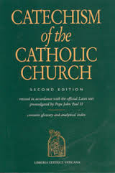
Catholic Definition of “Mercy”
CCC Glossary:
  MERCY: The loving kindness,
  compassion, or forbearance
  shown to one who offends
  (e.g., the mercy of God to us
  sinners; 1422, 1829).
  WORKS OF MERCY: Charitable actions
  by which we come to the aid of our neighbors in their bodily and spiritual needs (2447).

Slide 56
Catholic Practice of “Mercy”
Two Main Aspects:
  Forgive those who have done wrong
    Instead of punishment, retribution, revenge
  Help those in need (out of “com-passion”)
    Golden Rule: “Do unto others
    as you would have them do unto you.”
Two Main Directions:
  RECEIVING and GIVING

Slide 57
Biblical Vocabulary: OT Hebrew
Hebrew: HESED
  Used 255 times in 245 verses
  (128 in Psalms!)
  Variously translated as goodness, kindness, mercy, tender mercy, compassion, love, loving kindness…
  Often grouped with other divine attributes: esp. hesed ve-emet = “kindness and fidelity”

Slide 58
Biblical Vocabulary: NT Greek
Main Word Group:
  Verb ele-eo = “to have mercy, be merciful”
  Noun ele-os = “mercy, compassion”
  Adj ele-emon = “merciful, compassionate”
  Cf. noun ele-emosyne = “alms”
  Cf. Kyrie Eleison = “Lord, have mercy!”
Related Words:
  Also oiktirmos/oiktirmon = “merciful, to show mercy”
  Also splanchnon/splanchnizomai = “guts, innards”

Slide 59
Other Languages
Latin:
  miseri-cordia = “suffering” & “heart”
  miserere nobis = “have mercy on us”
Spanish:
  misericordia; compasión
German:
  Barmherzigkeit = “tender-heartedness”
YOUR Language?
  What words are used for “mercy”?

Slide 60
Biblical Texts Related to Mercy, Justice, Sin, Forgiveness
Many biblical texts talk about God’s justice, wrath, punishment of sinners, etc.
Many others stress mercy, love, forgiveness…
Both OLD Testament and NEW Testament

Slide 61
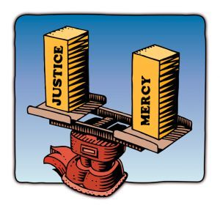
Conceptions of GOD:
Popular MIS-Conception:
  OT: God of Judgment, Punishment; Violence & War
  NT: Loving, merciful, forgiving Father of Jesus
Actual Biblical Evidence:
  OT: Both Justice & Mercy,
  Punishment & Forgiveness
  NT: Both Justice & Mercy,
  Punishment & Forgiveness

Slide 62
Psalms of Violence
Some Psalms stress justice, punishment, vengeance:
Entire Psalms omitted from Liturgy of the Hours:
  Ps 58:1-12
  Ps 83:1-19
  Ps 109:1-31
Verses of other Psalms omitted from LoH:
  See http://catholic-resources.org/LoH/Psalter-Omissions.html

Slide 63
  Ps 58:1-12
¹ For the leader. Do not destroy. A miktam of David.
² Do you indeed pronounce justice, O gods;
do you judge fairly you children of Adam?
³ No, you freely engage in crime;
your hands dispense violence to the earth.
⁴ The wicked have been corrupt since birth;
liars from the womb, they have gone astray.
⁵ Their venom is like the venom of a snake,
like that of a serpent stopping its ears,
⁶ So as not to hear the voice of the charmer
or the enchanter with cunning spells.

Slide 64
  Ps 58:1-12 (cont.)
⁷ O God, smash the teeth in their mouths;
break the fangs of these lions, LORD!
⁸ Make them vanish like water flowing away;
trodden down, let them wither like grass.
⁹ Let them dissolve like a snail that oozes away,
like an untimely birth that never sees the sun.
¹⁰ Suddenly, like brambles or thistles,
have the whirlwind snatch them away.
¹¹ Then the just shall rejoice to see the vengeance
and bathe their feet in the blood of the wicked. (!?!)
¹² Then people will say:
"Truly there is a reward for the just;
there is a God who is judge on earth!" (NAB)

Slide 65
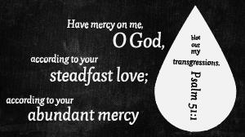
Psalms of Mercy
MANY stress mercy, compassion, and forgiveness, especially:
  Ps 51 →
  Ps 25; Ps 30
  Ps 86; Ps 89
  Ps 103; Ps 107
  Ps 123; Ps 136
  Ps 145; Ps 146; Ps 147

Slide 66
Psalm 145:8-21
⁸ The LORD is gracious and merciful,
slow to anger and abounding in mercy.
⁹ The LORD is good to all,
compassionate toward all your works.
¹⁰ All your works give you thanks,
LORD and your faithful bless you.
¹¹ They speak of the glory of your reign
and tell of your mighty works,
¹² Making known to the sons of men your mighty acts,
the majestic glory of your rule.
¹³ Your reign is a reign for all ages, your dominion for all generations.
The LORD is trustworthy in all his words, and loving in all his works.
¹⁴ The LORD supports all who are falling
and raises up all who are bowed down.

Slide 67
Psalm 145:8-21 (cont.)
¹⁵ The eyes of all look hopefully to you;
you give them their food in due season.
¹⁶ You open wide your hand
and satisfy the desire of every living thing.
¹⁷ The LORD is just in all his ways,
merciful in all his works.
¹⁸ The LORD is near to all who call upon him,
to all who call upon him in truth.
¹⁹ He fulfills the desire of those who fear him;
he hears their cry and saves them.
²⁰ The LORD watches over all who love him,
but all the wicked he destroys.
²¹ My mouth will speak the praises of the LORD;
all flesh will bless his holy name forever and ever.

Slide 68
Justice and Mercy in OT
OT promises BOTH punishment AND love/mercy. But in what proportion?
Exod 20:4-6 – [Re. idols]: “…For I, the LORD, your God, am a jealous God, inflicting punishment for their ancestors’ wickedness on the children of those who hate me, down to the third and fourth generation;
but showing love down to the thousandth generation of those who love me and keep my commandments.”
Cf. Deut 5:9-10; Deut 7:9-10; Exod 34:6-7; Num 14:18

Slide 69
Punishment VS. Mercy
Exod 34:6-7 – So the LORD passed before him [Moses] and proclaimed: The LORD, the LORD,
a God gracious and merciful, slow to anger and abounding in love and fidelity, / continuing his love for a thousand generations, and forgiving wickedness, rebellion, and sin; yet not declaring the guilty guiltless, but bringing punishment for their parents' wickedness on children and children's children to the third and fourth generation!

Slide 70
Justice & Mercy in OT
Jer 32:18 – You continue your kindness through a thousand generations; but you repay the ancestors' guilt upon their children who follow them. Great and mighty God, whose name is LORD of hosts,
Joel 2:13 – “Rend your hearts, not your garments, and return to the LORD, your God, For he is gracious and merciful, slow to anger, abounding in steadfast love, and relenting in punishment.”
(Ash Wednesday reading)
Similar also Isaiah 54:7-10; 58:6-11; 61:1-2; Micah 6:8; 7:18-19; Hosea 6:6; 11:5-9; etc.

Slide 71
Forgiveness & Punishment in NT
NT not only stresses mercy and forgiveness,
but also threatens punishment:
Conditional Forgiveness in the Lord’s Prayer: “…and forgive us our debts, as we forgive our debtors; and do not subject us to the final test, but deliver us from the evil one. If you forgive others their transgressions, your heavenly Father will forgive you. But if you do not forgive others, neither will your Father forgive your transgressions.” (Matt 6:12-15)

Slide 72
Forgiveness & Punishment in NT
“Fires of Gehenna” – Mark 9:42-48 (par. Matt 18:6-9); Matt 5:22, 29-30; Matt 10:28 (par. Luke 12:5)
“Weeping and grinding/gnashing of teeth” –
Matt 8:12; 13:42, 50; 22:13; 24:51; 25:30; Luke 13:28
“Woe to you, scribes & Pharisees…” –
Matt 23:1-39; cf. four “woes” in Luke 6:24-26;
also Matt 11:20-24; Luke 10:10-16
Cf. James 2:13 – “For judgment will be without mercy to anyone who has shown no mercy;
mercy triumphs over judgment.”

Slide 73
Key: FREE WILL & REPENTANCE!
Both in OT and NT:
God gives people choices:
  Good / Evil; Life / Death
  We have the ability, right, freedom to choose!
But there are Consequences:
  Live / Perish; Rewards / Punishments
God WANTS us all to live!
  Prophets call people to REPENTANCE:
  Return to the Lord! Obey God’s Commands!

Slide 74
Deuteronomy 30:15-20
¹⁵ See, I have today set before you life and good, death and evil.
¹⁶ IF you obey the commandments of the LORD, your God, which I am giving you today, loving the LORD, your God, and walking in his ways, and keeping his commandments, statutes and ordinances, you will live and grow numerous, and the LORD, your God, will bless you in the land you are entering to possess.
¹⁷ IF, however, your heart turns away and you do not obey, but are led astray and bow down to other gods and serve them, ¹⁸ I tell you today that you will certainly perish; you will not have a long life on the land which you are crossing the Jordan to enter and possess.
¹⁹ I call heaven and earth today to witness against you: I have set before you life and death, the blessing and the curse. Choose life, then, that you and your descendants may live, ²⁰ by loving the LORD, your God, obeying his voice, and holding fast to him. For that will mean life for you, a long life for you to live on the land which the LORD swore to your ancestors, to Abraham, Isaac, and Jacob, to give to them.

Slide 75
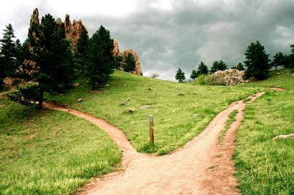
Ezekiel 18
Everyone is liable for their OWN sins!
  Parents are NOT punished for their children’s sins
  Children are NOT punished for their parent’s sins
Anyone can change!
  If good people
  turn to evil,
  they are punished!
  If evil people
  turn to good,
  they are forgiven!
  (Ezek 18:21-28 used on Friday, First Week of Lent)

Slide 76
NT: FREE WILL & REPENTANCE!
Both John Baptist & Jesus preach repentance
(Mark 1:4, 15; Matt 3:1-12; 4:17; Luke 3:1-18)
Jesus Warns: IF we do NOT repent…!
“If you do not repent, you will all perish as they did!" (two brief stories in Luke 13:1-5) – not on handout; Lent 3C
Need to admonish sinners:
“If your brother sins, rebuke him;
and if he repents, forgive him.” (Luke 17:3-4)
Apostles preach repentance for forgiveness:
(Luke 24:47; Acts 2:38; 3:19; 5:31; 8:22; 11:18; 13:24; 17:30; 19:4; 20:21; 26:20)

Slide 77
Forgiveness/Salvation FOR ALL?
Need to Distinguish:
OFFER of Forgiveness / INVITATION to Salvation
is available to ALL PEOPLE
BUT! God does not take away Human Free Will;
we still need to RESPOND, to ACCEPT the gift!
God will not drag us kicking and screaming, against our will, into Heaven!
We must CHOOSE to accept the invitation!

Slide 78
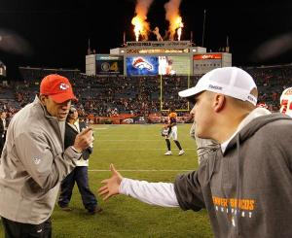
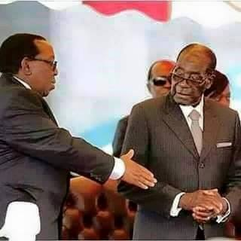
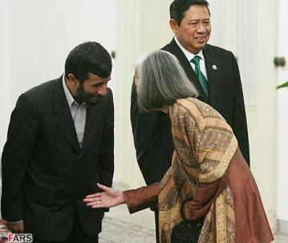
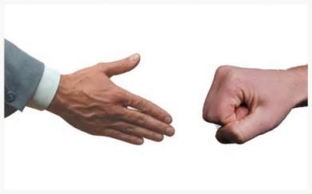
Refusal to Accept…?

Slide 79

Forgiveness → Reconciliation

Slide 80
Is God’s Mercy “Boundless”?
From GOD’s Perspective:
  YES! Unlimited OFFER of Salvation, Mercy, Forgiveness, Love for ALL People
But from OUR Perspective:
  We need to Respond: Accept, Live, Share
  “You can lead a horse to water,
  but you can’t force him to drink!”

Slide 81
Nothing Can Separate Us from God?
Paul: Romans 8:38-39 – “For I am convinced that neither death, nor life, nor angels, nor principalities, nor present things, nor future things, nor powers, / nor height, nor depth, nor any other creature will be able to separate us from the love of God in Christ Jesus our Lord.”
What’s missing from this list?
  US! Only WE can separate OURSELVES from God!
  Free Will ! We can choose for or against God!

Slide 82
How Can I Learn More?
http://catholic-resources.org
Fr. Felix Just's Biblical/Theological Website
(if you forget the URL, just Google my name!)
Catholic Bible Institute(s)
  Archdiocese of Los Angeles
  Diocese of Orange
  Diocese of San Bernardino
  Diocese of Tucson

Slide 83
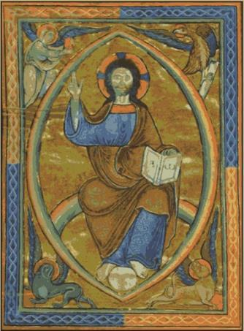
Audio CD Programs by Fr. Felix
The New Testament: A Guided Tour
The Lectionary: A Treasure for Liturgy & Prayer
What Is Faith? Gift, Mystery, Life!
A Retreat with the Gospel of Matthew
A Retreat with the Gospel of Mark
A Retreat with the Gospel of Luke
A Retreat with the Gospel of John
Available from Fr. Felix or
“Learn 25 / Now You Know Media”

Slide 84
Pilgrimages: In the Footsteps of
St. Paul in Turkey and Greece
May 2021:
Pauline Turkey
May 2022: Holy Land
May 2023:
Pauline Greece
If interested, Email me:
fjust@jesuits.org

Slide 85
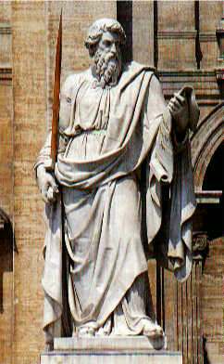
Concluding Blessing
Phil 4:8-9 – “Finally, brothers and sisters,
whatever is true, whatever is honorable,
whatever is just, whatever is pure,
whatever is lovely, whatever is gracious,
if there is any excellence
and if there is anything worthy of praise,
think about these things.
Keep on doing what you have learned
and received and heard and seen in me.
Then the God of peace will be with you.”

Slide 86

    Questions? Comments?
    THANK YOU for Attending Congress!
May You be Holy, be Merciful, be Kind,
be Loving, be Forgiving… JUST LIKE GOD!

