Slide 1
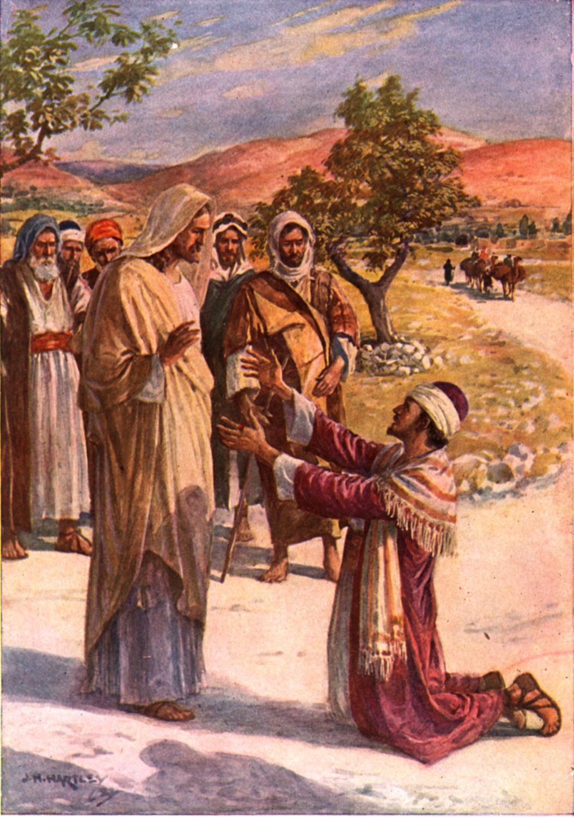
Did JESUS have
Pity, Compassion, or Mercy on people?
L.A. Religious Education Congress
“Called to Compassion”
Feb. 23, 2025 – Session 7.04
Fr. Felix Just, SJ, PhD
https://catholic-resources.org

Slide 2
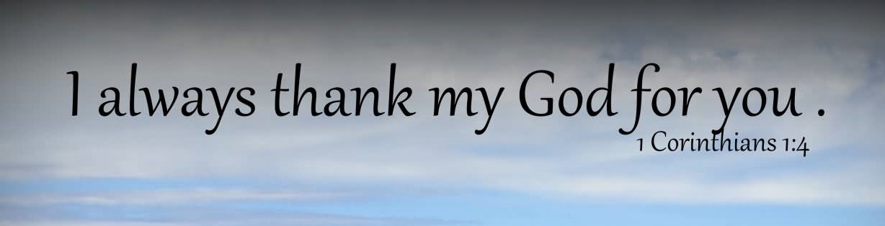
T H A N K Y O U !
For participating in R.E. Congress!
For sharing our faith as catechists!
For helping in many other ministries!
For being a disciple of Jesus Christ!

Slide 3
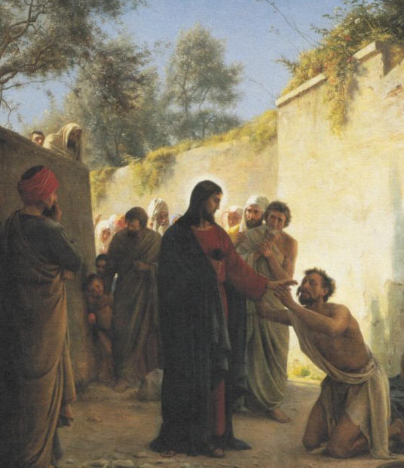
Handout for this Workshop (7.04)
“JESUS’ Teachings about
Mercy / Compassion / Pity”
  PDF file: two pages
  Biblical Vocabulary
  & Gospel Texts
On RE Congress Website:
  https://recongress.org/adult-days-workshops-1

Slide 4
What’s in a Word?
NOUNS
Compassion
Empathy/Sympathy
Kindness
Mercy
Forgiveness
Charity
PITY

Slide 5
What’s in a Word?
NOUNS | Adjectives
Compassion | Compassionate
Empathy/Sympathy | Empathetic/Sympathetic
Kindness | Kind
Mercy | Merciful
Forgiveness | Forgiving
Charity | Charitable
PITY | Pitiful? Pitiable?

Slide 6
What’s in a Word?
NOUNS | Adjectives | Verbs
Compassion | Compassionate | To Compassion???
Empathy/Sympathy | Empathetic/Sympathetic | To Empathy???
Kindness | Kind | To Kind???
Mercy | Merciful | To Mercy???
Forgiveness | Forgiving | To Forgive
Charity | Charitable | To Charity???
PITY | Pitiful? Pitiable? | To PITY !

Slide 7
Defs. of Compassion, MERCY, Pity…
FEELINGS ?
ACTIONS ?
Both ?

Slide 8
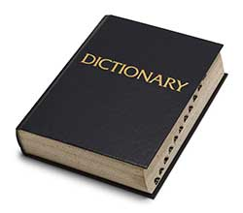
Def. of “Compassion” (dictionary.com)
Noun
a feeling of deep sympathy and sorrow for another who is stricken by misfortune, accompanied by a strong desire to alleviate the suffering.
  Synonyms: tenderness, commiseration, clemency, heart, mercy
  Antonyms: mercilessness, indifference

Slide 9
Def. of “Pity” (dictionary.com)
Noun
sympathetic or kindly sorrow evoked by the suffering, distress, or misfortune of another, often leading one to give relief or aid or to show mercy:
  to feel pity for a starving child.
a cause or reason for pity, sorrow, or regret:
  What a pity you could not go!
Verb
to feel pity or compassion for; be sorry for; commiserate with.
Adjective
motivated by a sense of pity or sympathy for others or for oneself:
  It seems he got the pity vote because of his personality, but his singing just wasn’t that great.

Slide 10
Def. of “Mercy” (dictionary.com)
compassionate or kindly forbearance shown toward an offender, an enemy, or other person in one's power; compassion, pity, or benevolence:
  Have mercy on the poor sinner.
  Synonyms: tenderness, mildness, lenity, leniency, clemency, indulgence, forgiveness
the disposition to be compassionate or forbearing:
  An adversary wholly without mercy.
the discretionary power of a judge to pardon someone or to mitigate punishment, esp. to send to prison rather than invoke the death penalty.
an act of kindness, compassion, or favor:
  She has performed countless small mercies for her friends & neighbors.
something that gives evidence of divine favor; blessing:
  It was just a mercy we had our seat belts on when it happened.
Idiom: at the mercy of, entirely in the power of; subject to:
  They were at the mercy of their captors.

Slide 11
What’s in a Word?
NOUNS | Adjectives | Verbs
Compassion | Compassionate | To Have Compassion
Empathy/Sympathy | Empathetic/Sympathetic | To Feel Em-/Sympathy
Kindness | Kind | To Be Kind
Mercy | Merciful | To Have Mercy To Be Merciful
Forgiveness | Forgiving | To Forgive
Charity | Charitable | To Be Charitable To Act Charitably
PITY | Pitiful? Pitiable? | TO PITY !

Slide 12

Pope Francis: Year of Mercy
“Jubilee Year of Mercy” was Dec. 8, 2015 – Nov. 20, 2016
Theme of 2016 RE Congress: “Boundless Mercy”
“Jesus Christ is the face of the Father’s mercy.
These words might well sum up the mystery of the Christian faith.
Mercy has become living and visible in Jesus of Nazareth, reaching its culmination in him. The Father, “rich in mercy” (Eph 2:4), after having revealed his name to Moses as “a God merciful and gracious, slow to anger, and abounding in steadfast love and faithfulness” (Exod 34:6), has never ceased to show, in various ways throughout history, his divine nature…. Jesus of Nazareth, by his words, his actions, and his entire person reveals the mercy of God.” (Misericordiae Vultus, §1; April 11, 2015)

Slide 13

Catholic Definition of “Mercy”
CCC Glossary:
  MERCY: The loving kindness, compassion,
  or forbearance shown to one who offends
  (e.g., the mercy of God to us sinners; 1422, 1829).
  WORKS OF MERCY: Charitable actions
  by which we come to the aid of our neighbors
  in their bodily and spiritual needs (2447).
Note: The CCC glossary has no entries for “compassion” or “pity.”
The CCC text has mercy (81x), merciful (27x), mercies (6x), merciless (1x), compassion (13x), compassionate (1x), pity (0x).

Slide 14
Catholic Practice of “Mercy”
Two Main Aspects:
  Forgive those who have done wrong
    Instead of punishment, retribution, revenge
  Help those in need (out of “com-passion”)
    Golden Rule: “Do unto others
    as you would have them do unto you.”
Two Main Directions:
  RECEIVING and GIVING

Slide 15
Mass: “Penitential Rite”
Lord, have mercy.
Christ, have mercy.
Lord, have mercy.
Señor, ten piedad.
Cristo, ten piedad.
Señor, ten piedad.
Seigneur, prends pitié.
O Christ, prends pitié.
Seigneur, prends pitié.
Kyrie, eleison.
Christe, eleison.
Kyrie, eleison.
Signore, pietà.
Cristo, pietà.
Signore, pietà.
Herr, erbarme dich!
Christus, erbarme dich!
Herr, erbarme dich!

Slide 16
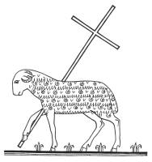
Mass: “Fraction Rite”
Lamb of God, you take away the sins of the world:
have mercy on us.
  John 1:29 – “Behold, the Lamb of God,
  who takes away the sin of the world.”
Cordero de Dios, que quitas el pecado del mundo,
ten piedad de nosotros.
Agnus Dei, qui tollis pecata mundi,
miserere nobis.

Slide 17
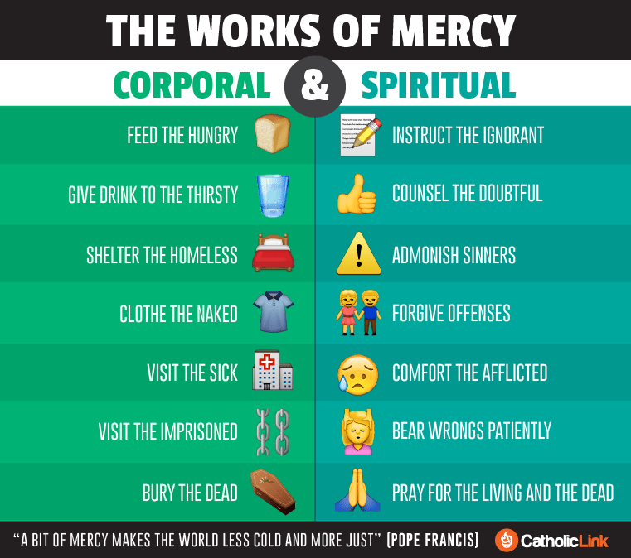
https://catholic-link.org/images/infographic-the-works-of-mercy/

Slide 18
Biblical Vocabulary: OT Hebrew
HESED
  Used 255 times in 245 verses (half in the Psalms!)
  Variously translated as goodness, kindness, mercy, tender mercy, compassion, love, loving kindness, graciousness, …
  Usually refers to GOD; often grouped with other divine attributes:
  esp. hesed ve-emet = “kindness and fidelity”
RECHEM / RACHAM
  Used 85 times in 75 verses (esp. in the Prophets)
  Literally: inner organs, esp. a woman’s womb
  Figuratively: love; compassion

Slide 19
Biblical Vocabulary: NT Greek
Main Word Group:
  verb ele-ein = “to have mercy, be merciful” (15x Gosp; 29x NT)
  noun ele-os = “mercy, compassion” (9x Gosp; 27x NT)
  noun ele-ēmosynē = “alms” (5x Gosp; 13x NT)
  adj. ele-ēmon = “merciful, compassionate” (2x: Matt 5:7; Heb 2:17)
  adj. ele-einos = “pitiable, miserable” (2x: 1 Cor 15:19; Rev 3:17)
  adj. anele-os = “merciless, unmerciful” (1x: James 2:13)
  adj. anele-ēmōn = “unmerciful” (1x: Rom 1:31)
Derived Words:
  verb hilaskomai = “to show kindness; appease” (2x: Luke 18:13; Heb 2:17)
  adj. hileōs = “gracious, merciful” (2x: Matt 16:22, in idiom “God forbid”; Heb 8:12)

Slide 20
More Biblical Vocabulary: NT Greek
splanchnizomai = “to be inwardly moved, have compassion”
(12x Gosp = 12x NT)
  Noun: splanchnon (11x) = “guts, bowels, inner organs” (Luke 1:78)
  Adj: poly-splanchnos (1x) = “very merciful; full of pity” (James 5:11)
oiktirō = “to pity, show mercy” (2x: Rom 9:15)
  Noun: oiktirmos (5x) = “sympathy, mercy” (4x Paul; + Heb 10:28)
  Adj: oiktírmōn (3x) – “merciful” (Luke 6:36 bis; James 5:11)
sym-patheō (2x) – “to sympathize, feel sympathy for” (Heb 4:15; 10:34)
  literally “to feel/suffer with” (just like Latin com-passio)
  Adj: sympathēs (1x) – “sympathetic” (1 Pet 3:8)

Slide 21
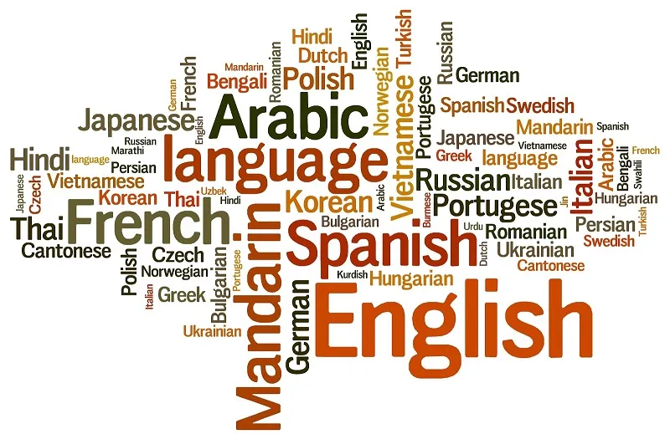
Other Languages
Latin:
  miseri-cordia = “suffering” & “heart”
Spanish:
  misericordia; compasión
German:
  Mitgefühl = “feeling together with”
  Barmherzigkeit = “tender-heartedness”
YOUR Language?
  What words are used for “mercy” and/or “compassion”?

Slide 22
Biblical Core: “Be Just Like God!”
Luke 6:36 - “Be merciful, just as your Father is merciful” (oiktirmon).
Matt 5:48 - “Be perfect, as your heavenly Father is perfect” (teleios).
Lev 19:2b - “You shall be holy, for I the Lord your God am holy.”(hagios)
(cf. Lev 11:44-45; 20:26; 21:28)
1 Peter 1:16 – for it is written, “You shall be holy, for I am holy.”
Eph 5:1-2 - “So be imitators of God, as beloved children,
² and live in love, as Christ loved us…”

Slide 23
Jesus’ Practice of Compassion & Mercy
Handout:
  https://recongress.org/
  adult-days-workshops-1
  Biblical Greek Vocabulary
  Mark, Matthew, Luke
  Why no texts from John?
This PPT:
  Healing the Sick
  Feeding the Hungry
  Forgiving Sinners
  Teaching Disciples
  Telling Parables

Slide 24
Jesus: Healing
Blind Man (Bartimaeus) at Jericho (Mark 10:46-52; par. Matt 9:27-31; Matt 20:29-34; Luke 18:35-43)
  Mark 10:47-48 – When he heard that it was Jesus of Nazareth, he began to shout out and say, “Jesus, Son of David, have mercy on me!” / Many sternly ordered him to be quiet, but he cried out even more loudly, “Son of David, have mercy on me!”
  Matt 9:27 – As Jesus went on from there, two blind men followed him, crying loudly, “Have mercy on us, Son of David!”
  Matt 20:30-31, 34 – There were two blind men sitting by the roadside. When they heard that Jesus was passing by, they shouted, “Lord, have mercy on us, Son of David!” / The crowd sternly ordered them to be quiet; but they shouted even more loudly, “Have mercy on us, Lord, Son of David!” /…/ Moved with compassion, Jesus touched their eyes. Immediately they regained their sight and followed him.
  Luke 18:38-39 – Then he shouted, “Jesus, Son of David, have mercy on me!” / Those who were in front sternly ordered him to be quiet; but he shouted even more loudly, “Son of David, have mercy on me!”
NOTE: “Lord, have mercy” also used 20+ times in the Old Testament, esp. in Psalms!

Slide 25
Blind Bartimaeus (Mark 10:46-52)
⁴⁶ They came to Jericho. And as he was leaving Jericho with his disciples and a sizable crowd, Bartimaeus, a blind man, the son of Timaeus, sat by the roadside begging. ⁴⁷ On hearing that it was Jesus of Nazareth, he began to cry out and say, “Jesus, son of David, have mercy on me.”
⁴⁸ And many rebuked him, telling him to be silent. But he kept calling out all the more, “Son of David, have mercy on me.” ⁴⁹ Jesus stopped and said, “Call him.” So they called the blind man, saying to him, “Take courage; get up, he is calling you.” ⁵⁰ He threw aside his cloak, sprang up, and came to Jesus. ⁵¹ Jesus said to him in reply, “What do you want me to do for you?” The blind man replied to him, “Master, I want to see.”
⁵² Jesus told him, “Go your way; your faith has saved you.”
Immediately he received his sight and followed him on the way.

Slide 26
Jesus: More Healing
Canaanite woman’s daughter (Matt 15:21-28)
  Matt 15:22 – Just then a Canaanite woman from that region came out and started shouting, “Have mercy on me, Lord, Son of David; my daughter is tormented by a demon.”
Gerasene Demoniac (Mark 5:1-20)
  Mark 5:19 – But Jesus refused, and said to him, “Go home to your friends, and tell them how much the Lord has done for you, and what mercy he has shown you.”
Epileptic Demoniac (Mark 9:14-29; Matt 17:14-21)
  Mark 9:22 – “It has often cast him into the fire and into the water, to destroy him;
  but if you are able to do anything, have pity on us and help us.” [vocab exception!]
  Matt 17:15 – “Lord, have mercy on my son, for he is an epileptic and he suffers terribly;
  he often falls into the fire and often into the water.”

Slide 27
Jesus: Even More Healing
Restoring a Leper (Mark 1:40-45)
  Mark 1:41 – Moved with pity, Jesus stretched out his hand and touched him,
  and said to him, “I do choose. Be made clean!”
Harvest is Plenty, Laborers are Few (Matt 9:35-38)
  Matt 9:36 – When he saw the crowds, he had compassion for them, because they were harassed and helpless, like sheep without a shepherd.
Raising a Widow’s Son at Nain (Luke 7:11-17)
  Luke 7:13 – When the Lord saw her, he had compassion for her and said to her, “Do not weep.”
Cleansing of Ten Lepers (Luke 17:11-19)
  Luke 17:13 – they called out, saying, “Jesus, Master, have mercy on us!”

Slide 28
Jesus: Feeding
Feeding the 5000 (Mark 6:30-44; Matt 14:13-21; cf. Luke 9:10-17)
  Mark 6:34 – As he went ashore, he saw a great crowd; and he had compassion for them, because they were like sheep without a shepherd; and he began to teach them many things.
  Matt 14:14 – When he went ashore, he saw a great crowd; and he had compassion for them and cured their sick. [Luke 9:11 says “he welcomed them”]
Feeding the 4000 (Mark 8:1-10; Matt 15:32-39; story not in Luke)
  Mark 8:2 – “I have compassion for the crowd, because they have been with me now for three days and have nothing to eat.”
  Matt 15:32 – Then Jesus called his disciples to him and said, “I have compassion for the crowd, because they have been with me now for three days and have nothing to eat; and I do not want to send them away hungry, for they might faint on the way.”

Slide 29
Jesus’ Teaching: Sermon on the…
Sermon on the Mount: Beatitudes (Matt 5:1-12)
  Matt 5:7 – “Blessed are the merciful, for they will receive mercy.”
Jesus’ Sermon on the Plain (Luke 6:17-49)
  Luke 6:36-37 – “Be merciful, just as your Father is merciful (oiktirmōn).
  / Do not judge, and you will not be judged…”
James 5:10-11 –
“As an example of suffering and patience, beloved, take the prophets who spoke
in the name of the Lord. ¹¹ Indeed we call blessed those who showed endurance.
You have heard of the endurance of Job, and you have seen the purpose of the Lord,
how the Lord is compassionate and merciful.
polysplanchnos + oiktirmōn

Slide 30
Jesus’ Teaching on Almsgiving
“Alms” (Greek eleēmosynē) =
literally “mercies” or “acts of mercy” or “signs of compassion”
  Matt 6:2-4 – “When you give alms, do not blow a trumpet before you, as the hypocrites do in the synagogues and in the streets to win the praise of others. Amen, I say to you, they have received their reward. / But when you give alms, do not let your left hand know what your right is doing, / so that your almsgiving may be secret. And your Father who sees in secret will repay you.”
  Luke 11:41 – “But as to what is within, give alms, and behold, everything will be clean for you.”
  Luke 12:33 – “Sell your belongings and give alms. Provide money bags for yourselves that do not wear out, an inexhaustible treasure in heaven that no thief can reach nor moth destroy.”

Slide 31
Jesus: Challenging Opponents
Dining at Tax Collector Matthew’s house (Matt 9:9-13; cf. Hosea 6:6 – Hesed )
  Matt 9:11-13 – The Pharisees saw this and said to his disciples, “Why does your teacher eat with tax collectors and sinners?” ¹² He heard this and said, “Those who are well do not need a physician, but the sick do.” ¹³ “Go and learn what this means, ‘I desire mercy, not sacrifice.’
  For I have come to call not the righteous but sinners.”
Plucking grain on a Sabbath (Matt 12:1-8)
  Matt 12:7-8 – “If you had known what this means, ‘I desire mercy and not sacrifice,’
  you would not have condemned the guiltless. / For the Son of Man is Lord of the sabbath.”
Woes to Scribes and Pharisees (Matt 23:1-36)
  Matt 23:23 – “Woe to you, scribes and Pharisees, hypocrites! For you tithe mint, dill, and cummin, and have neglected the weightier matters of the law: justice and mercy and faith.
  It is these you ought to have practiced without neglecting the others.”

Slide 32
Jesus’ Parables in Matthew’s Gospel
The Unforgiving/Unmerciful Servant (Matt 18:23-35)
  Matt 18:27 – And out of pity for him, the lord of that slave released him and forgave him the debt.
  Matt 18:33 – “‘Should you not have had mercy on your fellow slave, as I had mercy on you?’”
The Last Judgment / Sheep & Goats (Matt 25:31-46)
  Matt 25:40 – “Amen, I say to you, whatever you did for one of these least brothers of mine, you did for me.”
  Doesn’t use words “mercy” or “compassion,” but is clearly about “Corporal Works of Mercy”

Slide 33
Jesus’ Parables in Luke’s Gospel
Good Samaritan (Luke 10:29-37)
  10:33b – “…when he [the Samaritan] saw him, he was moved with pity.”
  10:37 – He said, “The one who showed him mercy.” Jesus said to him, “Go and do likewise.”
Prodigal Son (Luke 15:11-32)
  15:20 – “So he set off and went to his father. But while he was still far off, his father saw him and was filled with compassion; he ran and put his arms around him and kissed him.”
Rich Man & Lazarus (Luke 16:19-31)
  16:24 – “He called out, ‘Father Abraham, have mercy on me, and send Lazarus to dip the tip of his finger in water and cool my tongue; for I am in agony in these flames.’ ”
Pharisee & Publican (Luke 18:9-14)
  18:13 – “But the tax collector, standing far off, would not even look up to heaven,
  but was beating his breast and saying, ‘God, be merciful (hilasthēti) to me, a sinner!’ ”

Slide 34
Hymns in Luke’s Gospel
Mary’s Song of Praise: Magnificat (Luke 1:46-55)
  1:50 – “His mercy is for those who fear him from generation to generation.”
  1:54 – “He has helped his servant Israel, in remembrance of his mercy,”
Birth of John the Baptist & Zechariah’s Song of Praise:
Benedictus (Luke 1:57-80)
  1:58 – Her neighbors and relatives heard that the Lord had shown his great mercy to her,
  and they rejoiced with her.
  1:72 – “Thus he has shown the mercy promised to our ancestors,
  and has remembered his holy covenant,”
  1:78 – “By the tender mercy of our God, the dawn from on high will break upon us.”
  Note: This is the only biblical verse that combines splangchna & eleos

Slide 35
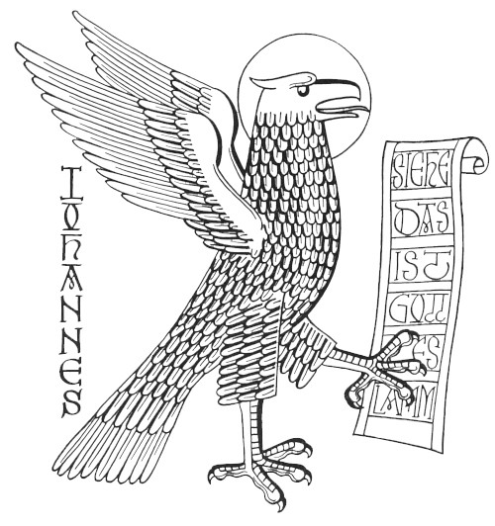
What about JOHN’s Gospel?
“Mercy” vocabulary never used! Surprised?
But… Related vocabulary?
  “LOVE One Another” (Jn 13-14)
  “Remain / Abide / Dwell / Live” (Jn 15)
  “Bear Much Fruit”; “Become Children of God”
Johannine stories of mercy in action?
  John 8: Woman caught in adultery?
  John 20: Resurrection: “Peace be with you!”
  Others?

Slide 36
Matthew 18: Community Discourse
18:1-5 – True Greatness in God’s Kingdom
18:6-9 – Warnings about causing others to sin
18:10-14 – Parable of the Lost Sheep
18:15-18 – Correction of believers who sin
18:19-20 – "Where 2 or 3 are gathered"
18:21-22 – Peter asks about forgiveness
18:23-35 – Parable of Unforgiving Servant

Slide 37
Parable of Unmerciful Servant
²³ "For this reason the kingdom of heaven may be compared to a king who wished to settle accounts with his slaves. ²⁴ When he began the reckoning, one who owed him ten thousand talents was brought to him; ²⁵ and, as he could not pay, his lord ordered him to be sold, together with his wife and children and all his possessions, and payment to be made.
²⁶ So the slave fell on his knees before him, saying, 'Have patience with me, and I will pay you everything.'
²⁷ And out of pity (splanchnistheis) for him, the lord of that slave released him and forgave him the debt.

Slide 38
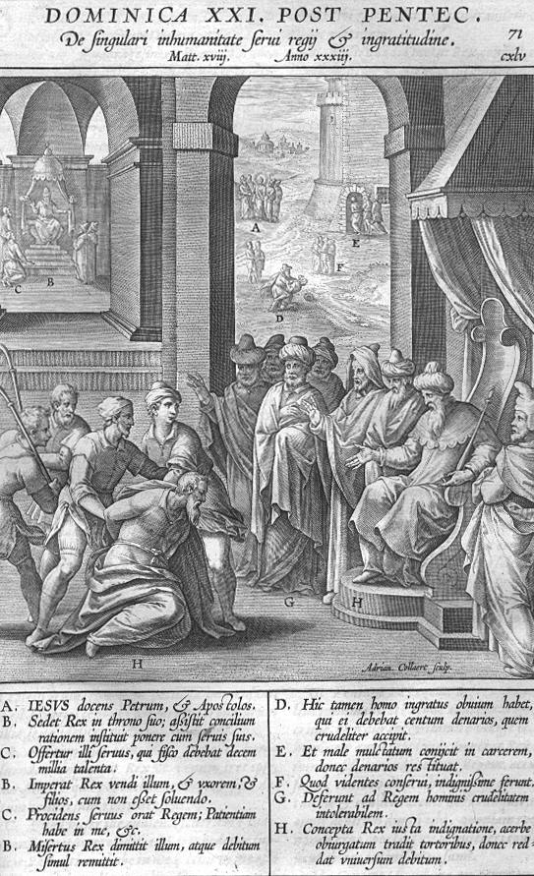

Slide 39
Par. Unmerciful Servant (cont.)
²⁸ But that same slave, as he went out, came upon one of his fellow slaves who owed him a hundred denarii; and seizing him by the throat, he said, 'Pay what you owe.'
²⁹ Then his fellow slave fell down and pleaded with him,
'Have patience with me, and I will pay you.'
³⁰ But he refused; then he went and threw him into prison
until he would pay the debt.
³¹ When his fellow slaves saw what had happened,
they were greatly distressed, and they went
and reported to their lord all that had taken place.

Slide 40
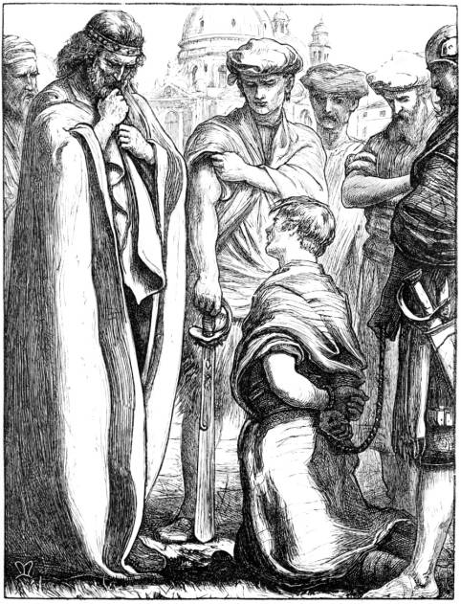

Slide 41
Par. Unmerciful Servant (cont.)
³² Then his lord summoned him and said to him,
'You wicked slave! I forgave you all that debt because you pleaded with me. ³³ Should you not have had MERCY on your fellow slave, as I had MERCY on you? '
³⁴ And in anger his lord handed him over to be tortured until he would pay his entire debt.
³⁵ So my heavenly Father will also do to every one of you,
if you do not forgive your brother or sister from your heart."
(Matt 18:23-35 NRSV)

Slide 42
Questions for Reflection:
How “compassionate” am I? (in terms of forgiveness)
WHOM do I need to forgive?
Of whom do I need to ask forgiveness?
How willing am I to forgive others?
How ready am I to ask for forgiveness?

Slide 43
PARABLE of the Last Judgment (Matt 25:31-46)
³¹ "When the Son of Man comes in his glory, and all the angels with him, then he will sit on the throne of his glory.
³² All the nations will be gathered before him, and he will separate people one from another as a shepherd separates the sheep from the goats, ³³ and he will put the sheep at his right hand and the goats at the left.
³⁴ Then the king will say to those at his right hand, 'Come, you that are blessed by my Father, inherit the kingdom prepared for you from the foundation of the world; ³⁵ for I was hungry and you gave me food, I was thirsty and you gave me something to drink, I was a stranger and you welcomed me, ³⁶ I was naked and you gave me clothing, I was sick and you took care of me, I was in prison and you visited me.'
³⁷ Then the righteous will answer him, 'Lord, when was it that we saw you hungry and gave you food, or thirsty and gave you something to drink? ³⁸ And when was it that we saw you a stranger and welcomed you, or naked and gave you clothing? ³⁹ And when was it that we saw you sick or in prison and visited you?'
⁴⁰ And the king will answer them, 'Truly I tell you, just as you did it to one of the least of these who are members of my family, you did it to me.'

Slide 44
PARABLE of the Last Judgment (Matt 25:31-46)
⁴¹ Then he will say to those at his left hand, 'You that are accursed, depart from me into the eternal fire prepared for the devil and his angels; ⁴² for I was hungry and you gave me no food, I was thirsty and you gave me nothing to drink, ⁴³ I was a stranger and you did not welcome me, naked and you did not give me clothing, sick and in prison and you did not visit me.'
⁴⁴ Then they also will answer, 'Lord, when was it that we saw you hungry or thirsty or a stranger or naked or sick or in prison, and did not take care of you?'
⁴⁵ Then he will answer them, 'Truly I tell you, just as you did not do it to one of the least of these, you did not do it to me.'
⁴⁶ And these will go away into eternal punishment, but the righteous into eternal life."

Slide 45
James 2
⁸ You do well if you really fulfill the royal law according to the scripture,
"You shall love your neighbor as yourself." …
¹³ For judgment will be without mercy to anyone who has shown no mercy;
mercy triumphs over judgment.
¹⁴ What good is it, my brothers and sisters, if you say you have faith but do not have works? Can faith save you? ¹⁵ If a brother or sister is naked and lacks daily food, ¹⁶ and one of you says to them, "Go in peace; keep warm and eat your fill," and yet you do not supply their bodily needs, what is the good of that?
¹⁷ So faith by itself, if it has no works, is dead.
²⁴ You see that a person is justified by works and not by faith alone.
²⁶ For just as the body without the spirit is dead, so faith without works is also dead.

Slide 46
Questions for Reflection:
How “compassionate” am I? (in terms of charitable action)
Whom does God want me to help in their needs?
Do I “suffer with them”? Do my feelings lead to actions?
How willing am I to help or assist those in need?
How often do I share the gifts God has given me?

Slide 47
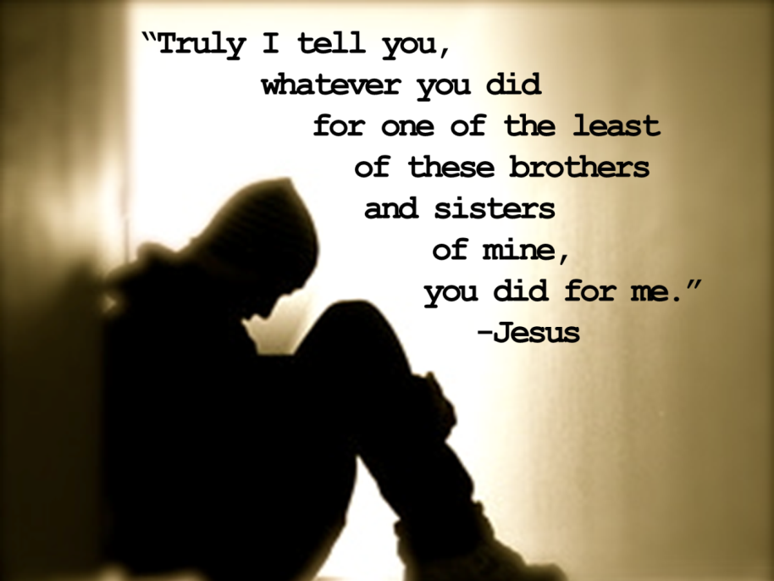
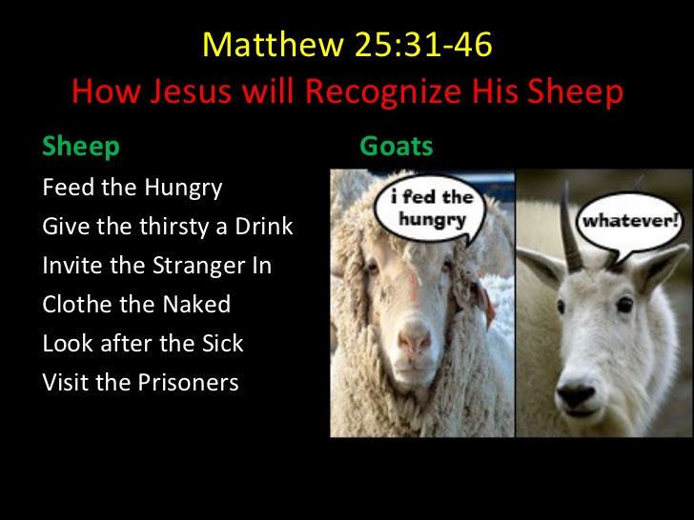

Slide 48
Jesus’ Parables in Luke’s Gospel
Good Samaritan (Luke 10:29-37)
  10:33b – “…when he [the Samaritan] saw him, he was moved with pity.”
  10:37 – He said, “The one who showed him mercy.” Jesus said to him, “Go and do likewise.”
Prodigal Son (Luke 15:11-32)
  15:20 – “So he set off and went to his father. But while he was still far off, his father saw him and was filled with compassion; he ran and put his arms around him and kissed him.”
Rich Man & Lazarus (Luke 16:19-31)
  16:24 – “He called out, ‘Father Abraham, have mercy on me, and send Lazarus to dip the tip of his finger in water and cool my tongue; for I am in agony in these flames.’ ”
Pharisee & Publican (Luke 18:9-14)
  18:13 – “But the tax collector, standing far off, would not even look up to heaven,
  but was beating his breast and saying, ‘God, be merciful (hilasthēti) to me, a sinner!’ ”

Slide 49
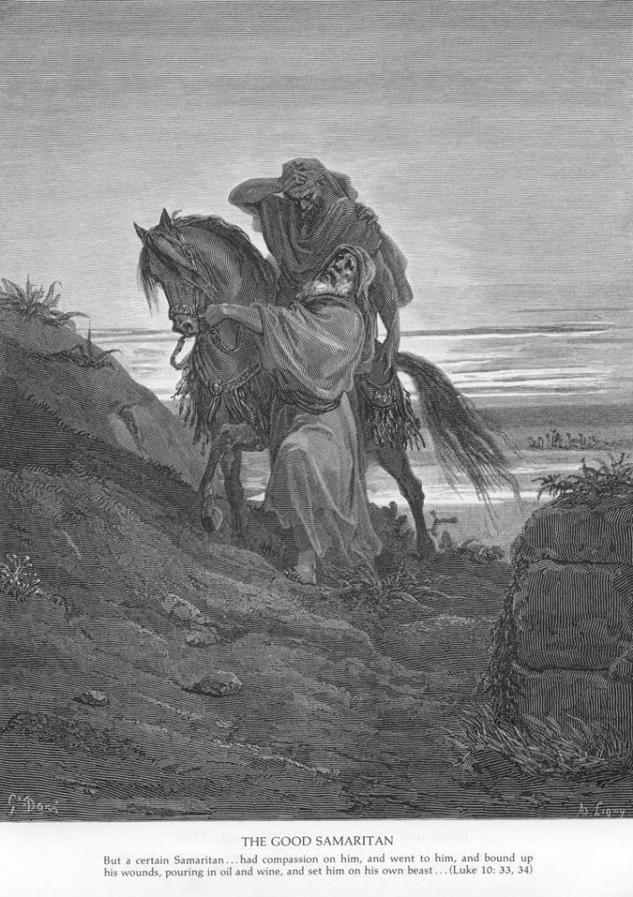
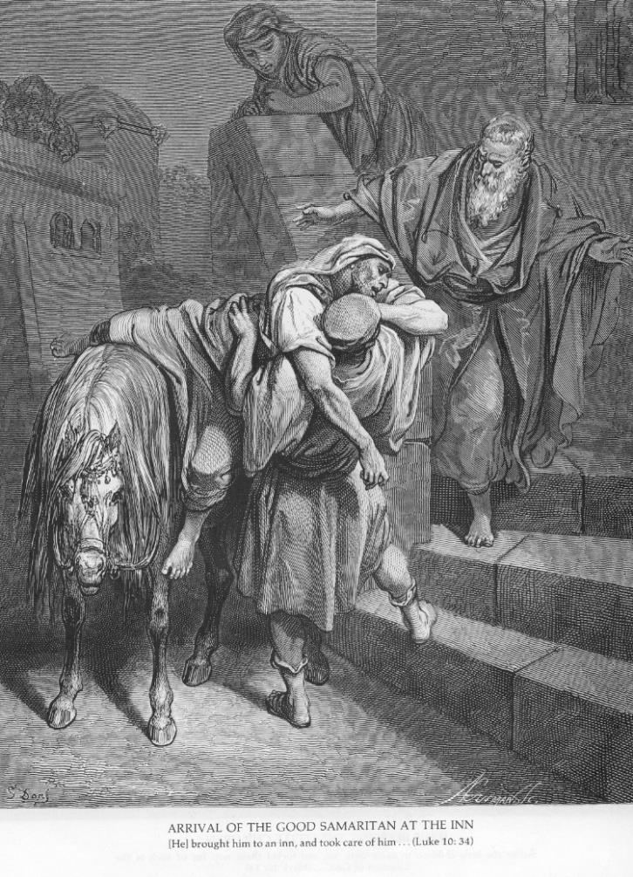
Good Samaritan (Luke 10:29-37)

Slide 50
Good Samaritan (Luke 10:29-37)
²⁵ Just then a lawyer stood up to test Jesus.
"Teacher," he said, "what must I do to inherit eternal life?"
²⁶ He said to him, "What is written in the law? What do you read there?"
²⁷ He answered, "You shall love the Lord your God with all your heart,
and with all your soul, and with all your strength, and with all your mind;
and your neighbor as yourself." [cf. Deut 6:5 & Lev 19:18]
²⁸ And he said to him,
"You have given the right answer; do this, and you will live."
²⁹ But wanting to justify himself, he asked Jesus,
"And who is my neighbor?"

Slide 51
Good Samaritan (Luke 10:29-37)
³⁰ Jesus replied, "A man was going down from Jerusalem to Jericho, and fell into the hands of robbers, who stripped him, beat him, and went away, leaving him half dead.
³¹ Now by chance a priest was going down that road; and when he saw him, he passed by on the other side. ³² So likewise a Levite, when he came to the place and saw him, passed by on the other side. ³³ But a Samaritan while traveling came near him; and when he saw him, he was moved with pity. ³⁴ He went to him and bandaged his wounds, having poured oil and wine on them. Then he put him on his own animal, brought him to an inn, and took care of him. ³⁵ The next day he took out two denarii, gave them to the innkeeper, and said, 'Take care of him; and when I come back, I will repay you whatever more you spend.'
³⁶ Which of these three, do you think, was a neighbor to the man who fell into the hands of the robbers?"
³⁷ He said, "The one who showed him mercy."
Jesus said to him, "Go and do likewise."

Slide 52
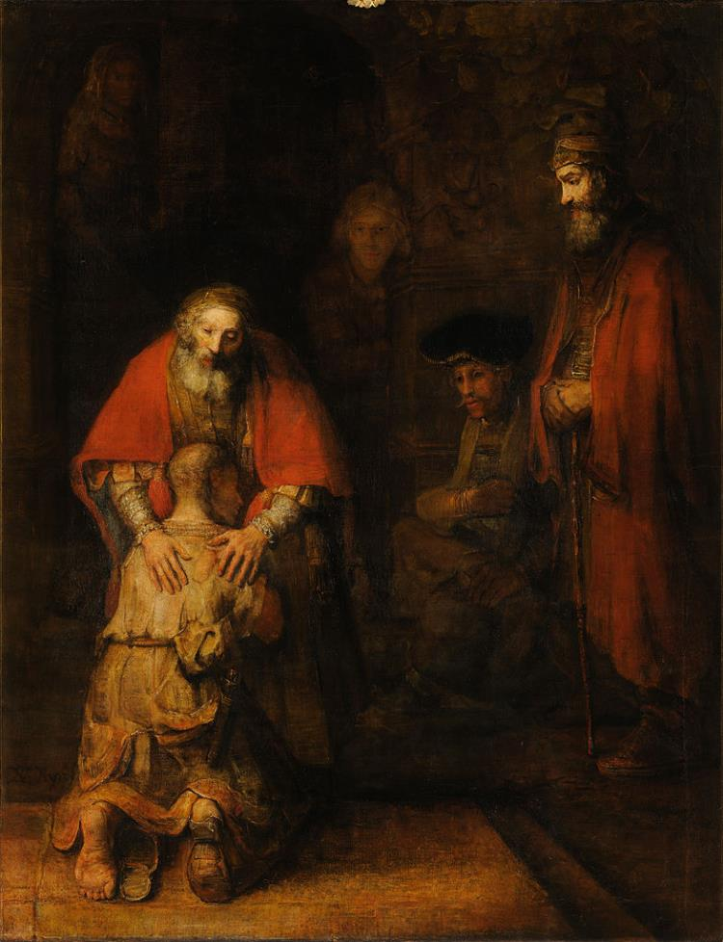
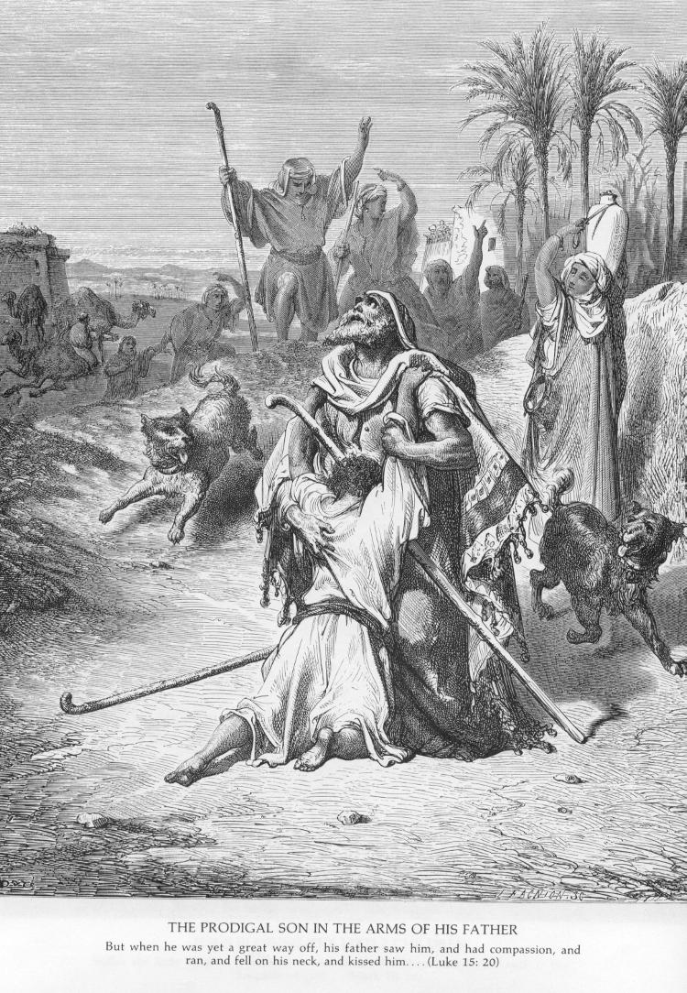
Lost SON (“Prodigal”; Luke 15:11-32)

Slide 53
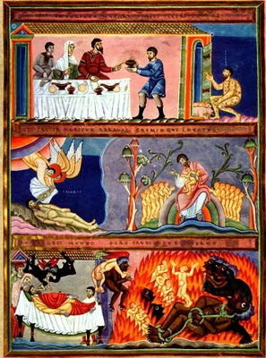
Rich Man
& Lazarus
(Luke 16:19-31)

Slide 54
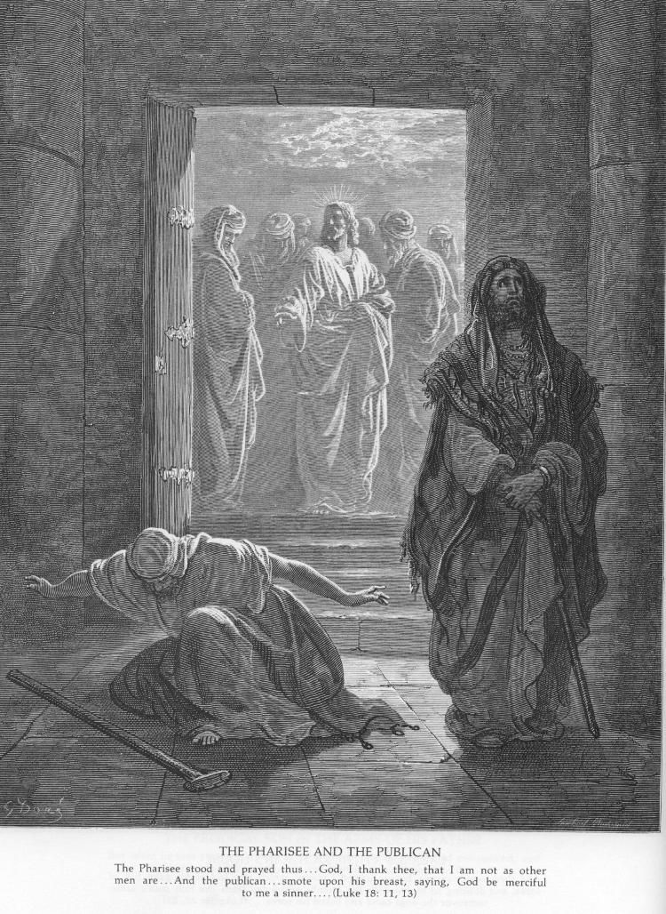
Pharisee & Publican (Luke 18:9-14)

Slide 55
Luke 18:9-14
⁹ He then addressed this parable to those who were convinced of their own righteousness and despised everyone else.
¹⁰ "Two people went up to the temple area to pray; one was a Pharisee and the other was a tax collector.
¹¹ The Pharisee took up his position and spoke this prayer to himself, 'O God, I thank you that I am not like the rest of humanity-- greedy, dishonest, adulterous-- or even like this tax collector. ¹² I fast twice a week, and I pay tithes on my whole income.'
¹³ But the tax collector stood off at a distance and would not even raise his eyes to heaven but beat his breast and prayed, 'O God, be merciful to me a sinner.'
¹⁴ I tell you, the latter went home justified, not the former; for everyone who exalts himself will be humbled, and the one who humbles himself will be exalted."

Slide 56
Summary: Jesus on Compassion & Mercy
Includes both FEELINGS and ACTIONS.
  We must both RECEIVE and GIVE…
WHO shows Compassion & Mercy?
  GOD offers mercy to US and ALL people.
  JESUS shows mercy to those in need.
  WE are invited to receive God’s mercy for us.
  We are required to show mercy to all others.

Slide 57
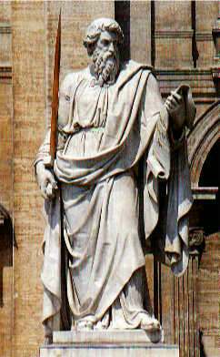
Concluding Blessings
Phil 2:1-2 – “If then there is any encouragement in Christ,
any consolation from love, any sharing in the Spirit,
any compassion and sympathy, make my joy complete:
be of the same mind, having the same love,
being in full accord and of one mind.”
Col 3:12-14 – “Put on then, as God's chosen ones,
holy and beloved, heartfelt compassion, kindness, humility, gentleness, and patience, ¹³ bearing with one another and
forgiving one another, if one has a grievance against another;
as the Lord has forgiven you, so must you also do.
¹⁴ And over all these put on love, that is, the bond of perfection.”

Slide 58
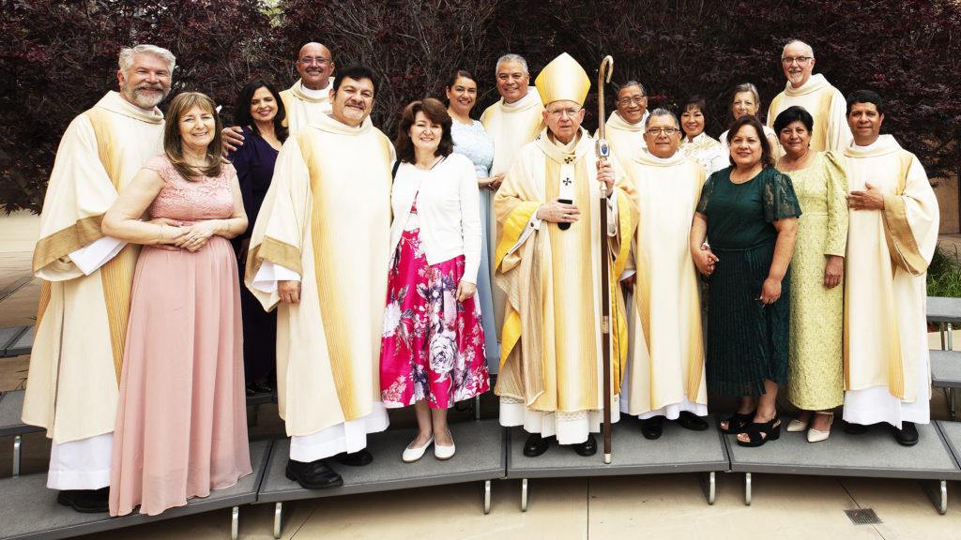
Diaconate Formation in ADLA
Is God possible calling you to serve as a Deacon in the Church?
Diaconal Ministries:
  Service at the Altar
  Service of the Word
  Service of Charity
Come to Exhibit Hall, Booth 422
Email me: fjust2000@yahoo.com

Slide 59
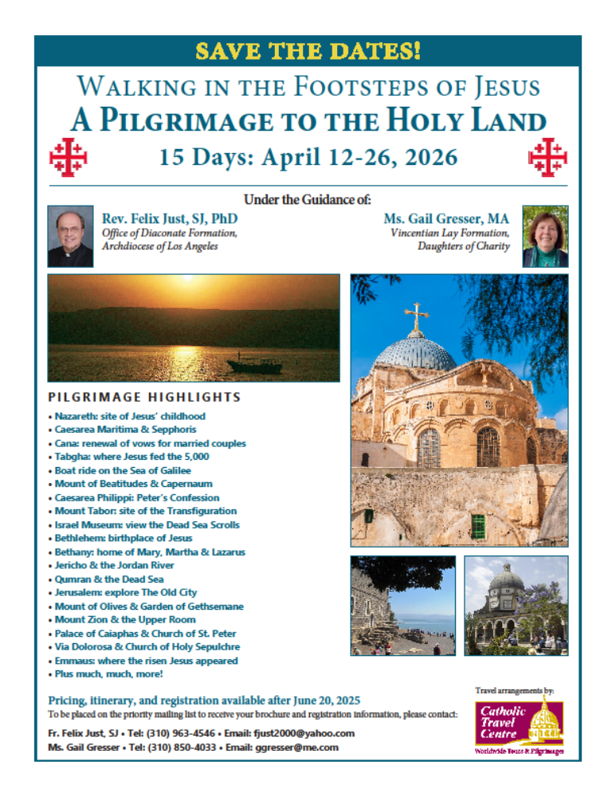
Biblical Pilgrimages
April 2025: Pauline Greece
April 2026: HOLY LAND – we hope!
Future:
  July 2026: Ireland
  ? 2027: Rome & Italy (& Malta?)
  ? 2028: Pauline Turkey
Email me: fjust2000@yahoo.com

Slide 60
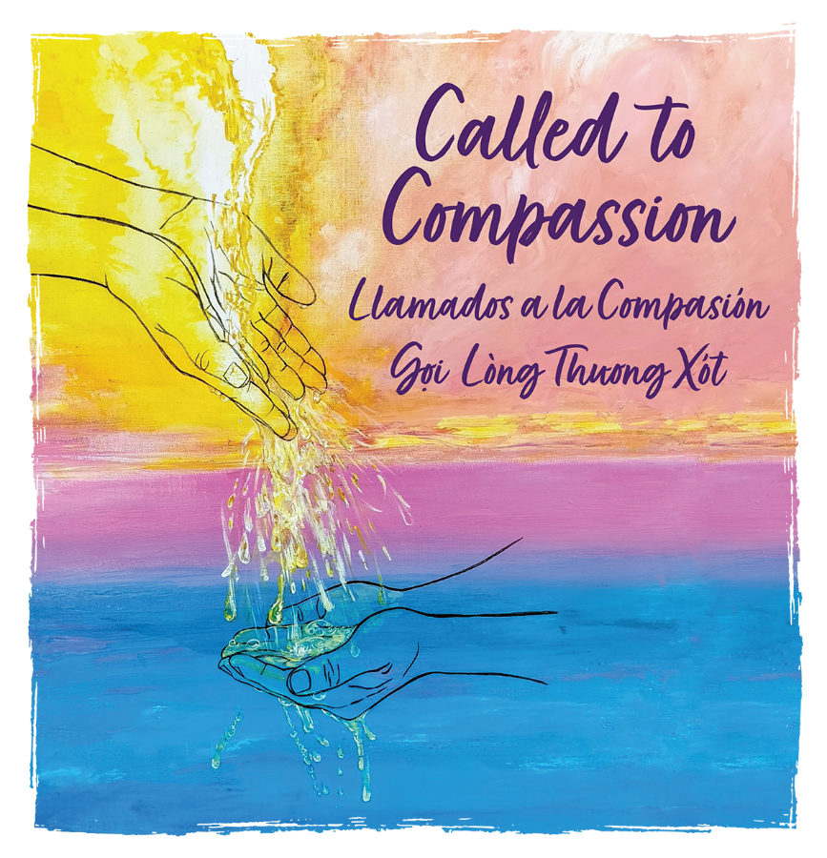
    Questions? Comments?
    THANK YOU for Attending Congress!
May You be Holy, Compassionate, Merciful, Kind, Loving, Forgiving… JUST LIKE GOD!

Slide 62
Forgiveness & Punishment in NT
NT not only stresses mercy and forgiveness,
but also threatens punishment:
Conditional Forgiveness in the Lord’s Prayer: “…and forgive us our debts, as we forgive our debtors; and do not subject us to the final test, but deliver us from the evil one. If you forgive others their transgressions, your heavenly Father will forgive you. But if you do not forgive others, neither will your Father forgive your transgressions.” (Matt 6:12-15)

Slide 63
Forgiveness & Punishment in NT
“Fires of Gehenna” – Mark 9:42-48 (par. Matt 18:6-9); Matt 5:22, 29-30; Matt 10:28 (par. Luke 12:5)
“Weeping and grinding/gnashing of teeth” –
Matt 8:12; 13:42, 50; 22:13; 24:51; 25:30; Luke 13:28
“Woe to you, scribes & Pharisees…” –
Matt 23:1-39; cf. four “woes” in Luke 6:24-26;
also Matt 11:20-24; Luke 10:10-16
Cf. James 2:13 – “For judgment will be without mercy to anyone who has shown no mercy;
mercy triumphs over judgment.”

Slide 64
Key: FREE WILL & REPENTANCE!
Both in OT and NT:
God gives people choices:
  Good / Evil; Life / Death
  We have the ability, right, freedom to choose!
But there are Consequences:
  Live / Perish; Rewards / Punishments
God WANTS us all to live!
  Prophets call people to REPENTANCE:
  Return to the Lord! Obey God’s Commands!

Slide 65
NT: FREE WILL & REPENTANCE!
Both John Baptist & Jesus preach repentance
(Mark 1:4, 15; Matt 3:1-12; 4:17; Luke 3:1-18)
Jesus Warns: IF we do NOT repent…!
“If you do not repent, you will all perish as they did!"
(two brief stories in Luke 13:1-5) – Lent 3C
Need to admonish sinners:
“If your brother sins, rebuke him;
and if he repents, forgive him.” (Luke 17:3-4)
Apostles preach repentance for forgiveness:
(Luke 24:47; Acts 2:38; 3:19; 5:31; 8:22; 11:18; 13:24; 17:30; 19:4; 20:21; 26:20)

Slide 66
Forgiveness/Salvation FOR ALL?
Need to Distinguish:
OFFER of Forgiveness / INVITATION to Salvation
is available to ALL PEOPLE
BUT! God does not take away Human Free Will;
we still need to RESPOND, to ACCEPT the gift!
God will not drag us kicking and screaming, against our will, into Heaven!
We must CHOOSE to accept the invitation!

Slide 67
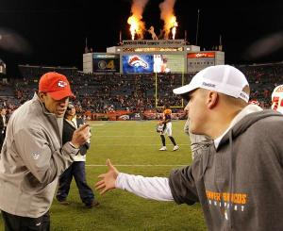
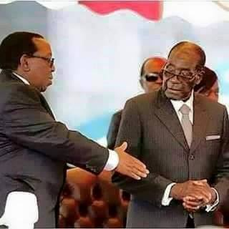
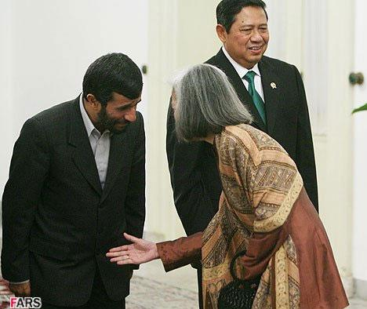
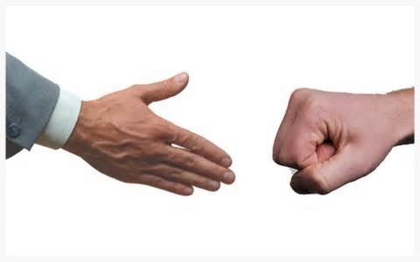
Refusal to Accept…?

Slide 68

Forgiveness → Reconciliation

