Slide 1
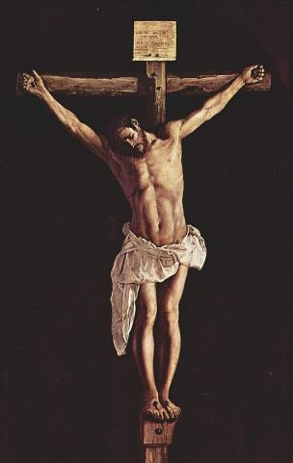
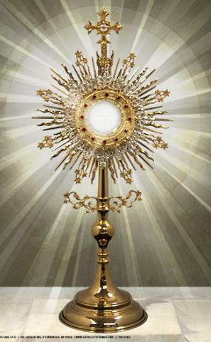
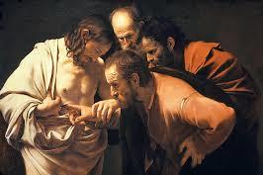
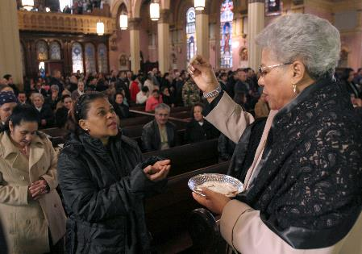
What does
“The Body of Christ” mean in the Bible?
L.A. Religious Education Congress
February 26, 2023: Session 7-07
Fr. Felix Just, S.J., Ph.D.
https://catholic-resources.org

Slide 2

T H A N K Y O U !
For participating in R.E. Congress 2023!
For sharing our faith as catechists!
For helping in many other ministries!
For “embracing grace” as disciples of Jesus!

Slide 3
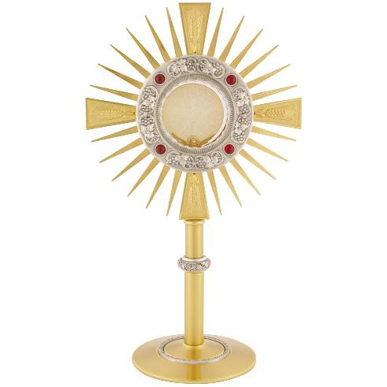
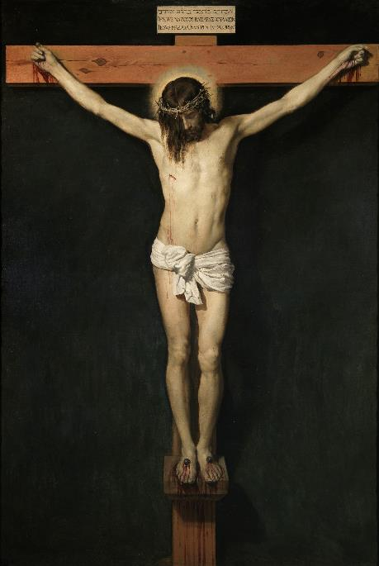
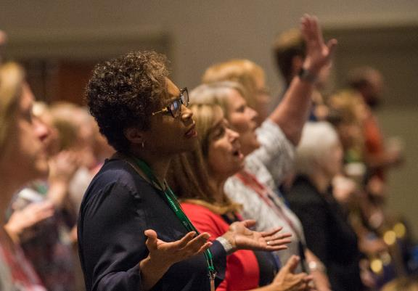
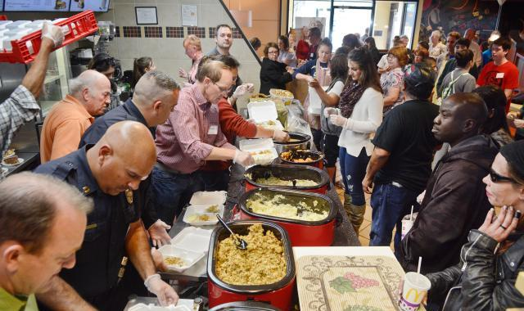
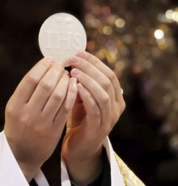
What Is the “Body of Christ”?

Slide 4
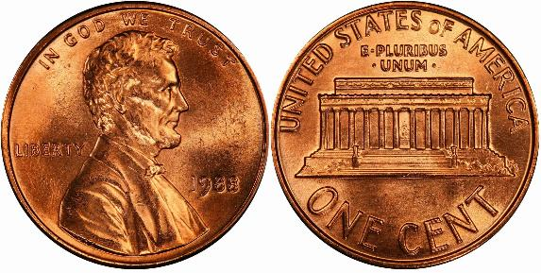
BOTH / AND Approach in Catholicism
Proper Catholic Answer to ALL Theological Questions:
  Both A and B (and C and D…)
  Not only A, but also B (and C and D…)
Avoid One-Sided Over-emphases:
  Only A, not B – or – Only B, not A
  Either extreme is wrong (leads to “heresies”!)
  “Half-truths” are misleading / wrong!

Slide 5
What is the “Body of Christ” in the Bible?
PDF Handout on RECongress website
Incarnation
  Physical/Mortal Body of the Human Jesus
Resurrection
  Glorified/Eternal Body of the Resurrected Christ
Sacrament
  Real/Present Body of Christ: The Eucharist
Church
  Mystical/Ecclesial Body of Christ: The Church
Our Spiritual Life
  Spirit of Christ Dwells in our Mortal Bodies

Slide 6
Catechism of the Catholic Church, Glossary (USCCB, 2000)
BODY OF CHRIST:
The human body which the Son of God assumed through his conception in the womb of Mary and which is now glorified in heaven (467, 476, 645).
This same Body and Blood, together with the soul and divinity, of our Lord Jesus Christ are sacramentally present in the Eucharist under the appearances of bread and wine (1374).
The Church is called the (mystical) Body of Christ because of the intimate communion which Jesus shares with his disciples; the metaphor of a body, whose head is Christ and whose members are the faithful, provides an image which keeps in focus both the unity and the diversity of the Church (787, 790, 1396).

Slide 7
Handout, A) “The Body of Christ” – INCARNATION
Physical Body of the Human Jesus:
Essential Pre-requisite for Jesus’ Public Ministry, Passion & Death, Resurrection
Gal 4:4-5 – “But when the fullness of time had come, God sent his Son, born of a woman, born under the law, / to ransom those under the law, so that we might receive adoption.”
Matt 1–2; Luke 1–2 – Infancy Narratives
John 1:14a – Incarnation: “And the Word became flesh and made his dwelling among us…”
Phil 2:6-8 – “[Jesus], though he was in the form of God, did not regard equality with God something to be grasped. / Rather, he emptied himself, taking the form of a slave, coming in human likeness; and found human in appearance, / he humbled himself, becoming obedient to death, even death on a cross.” (NAB)
Caution: This is not “Docetism” – merely “appearing” in a body, but not really fully human!

Slide 8
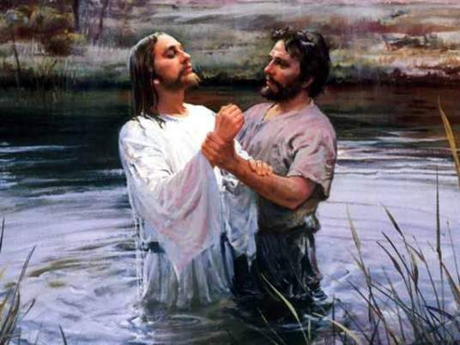
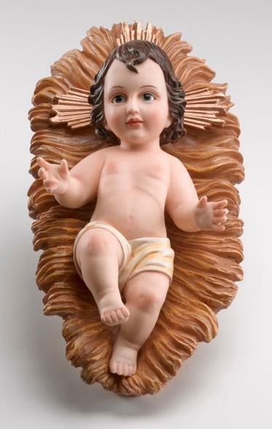
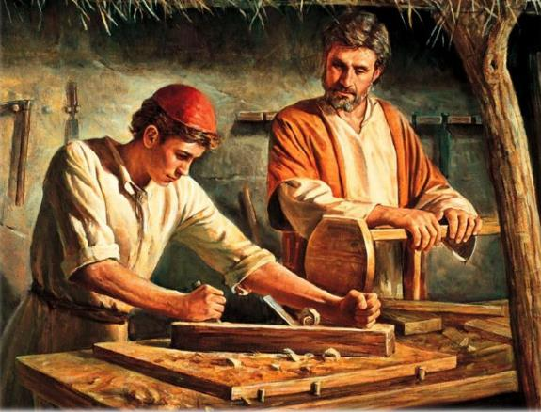
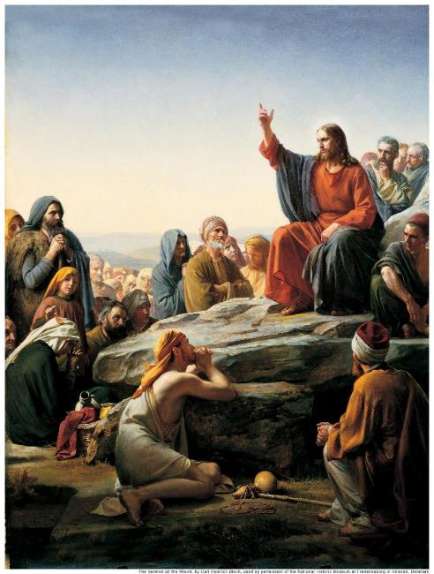
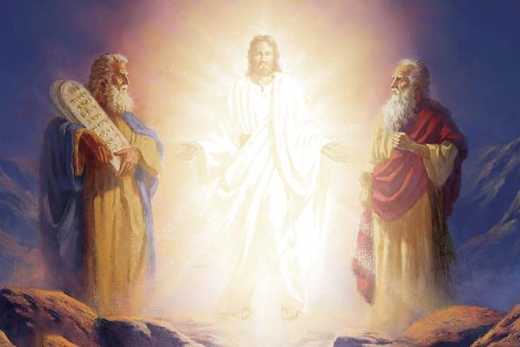
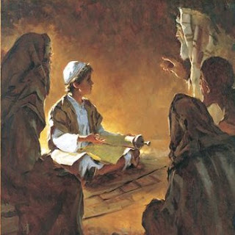
Imagining the “Body of Christ”

Slide 9
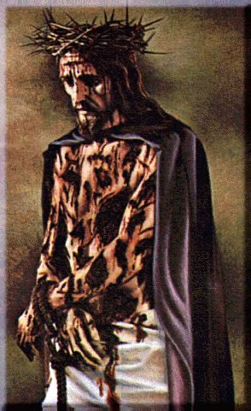
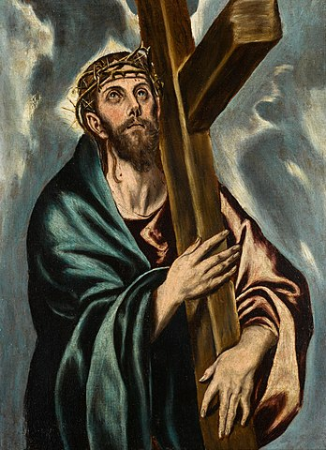
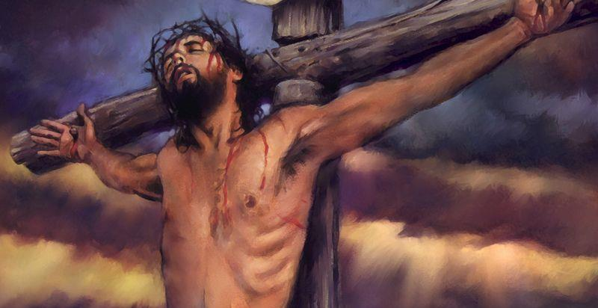
A) The Mortal Body of the Human Jesus:
Jesus really DIED on the Cross, and his body was buried in a tomb!
Mark 14:8b – Anointing at Bethany: “She has anticipated anointing my body for burial.” (cf. Mt 26:12)
Mark 15:43-44 – Joseph Arimathea asks Pilate for “the body of Jesus” (cf. Mt 27:58-59; Lk 23:52-55; Jn 19:38-42)
Luke 24:1-3 – On Easter morning, the women do not find “the body of the Lord Jesus” in the tomb. (cf. Lk 24:23)

Slide 10
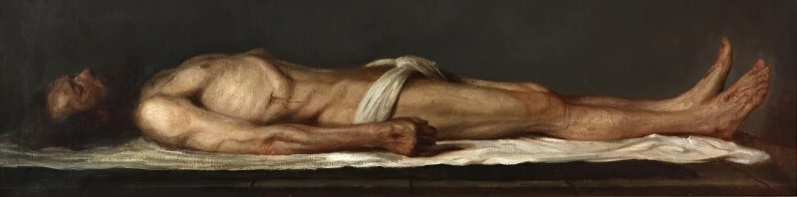
The Mortal Body of the Human Jesus (cont.)
Our Salvation comes through the Death of Jesus in his Mortal Human Body:
Rom 7:4 – “In the same way, my brothers, you also were put to death to the law through the body of Christ, so that you might belong to another, to the one who was raised from the dead in order that we might bear fruit for God.”
Col 1:21-22 – “And you who once were alienated and hostile in mind because of evil deeds / he has now reconciled in his fleshly body through his death, to present you holy, without blemish, and irreproachable before him…”
Heb 10:5, 10 – “When he came into the world, he said: ‘Sacrifice and offering you did not desire, but a body you prepared for me;’ /…/ ¹⁰ By this ‘will,’ we have been consecrated through the offering of the body of Jesus Christ once for all.”
1 Pet 2:24 – “He himself bore our sins in his body upon the cross, so that, free from sin, we might live for righteousness. By his wounds you have been healed.”

Slide 11
CCC, Part One, Section Two, Chapter Two, Article 3:
"HE WAS CONCEIVED BY THE POWER OF THE HOLY SPIRIT, AND WAS BORN OF THE VIRGIN MARY"
Paragraph 1. THE SON OF GOD BECAME MAN (456-483)
I. WHY DID THE WORD BECOME FLESH? (456-460)
II. THE INCARNATION (461-463)
III. TRUE GOD AND TRUE MAN (464-469)
IV. HOW IS THE SON OF GOD MAN? (470-478)
In Brief:
479 – At the time appointed by God, the only Son of the Father, the eternal Word, that is, the Word and substantial Image of the Father, became incarnate; without losing his divine nature he has assumed human nature.
480 – Jesus Christ is true God and true man, in the unity of his divine person; for this reason he is the one and only mediator between God and [human beings].
481 – Jesus Christ possesses two natures, one divine and the other human, not confused, but united in the one person of God's Son.
482 – Christ, being true God and true man, has a human intellect and will, perfectly attuned and subject to his divine intellect and divine will, which he has in common with the Father and the Holy Spirit.
483 – The Incarnation is therefore the mystery of the wonderful union of the divine and human natures in the one person of the Word.

Slide 12
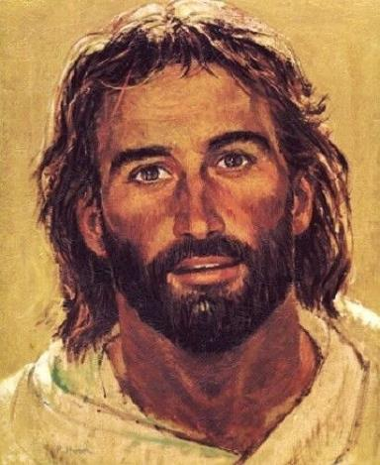
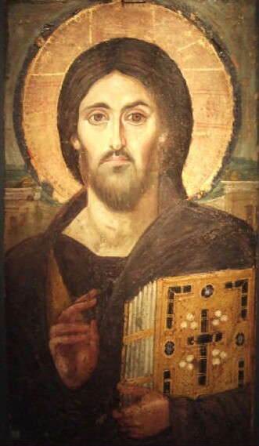
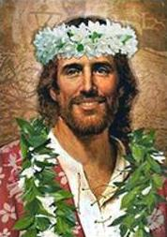
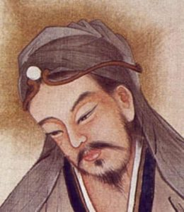
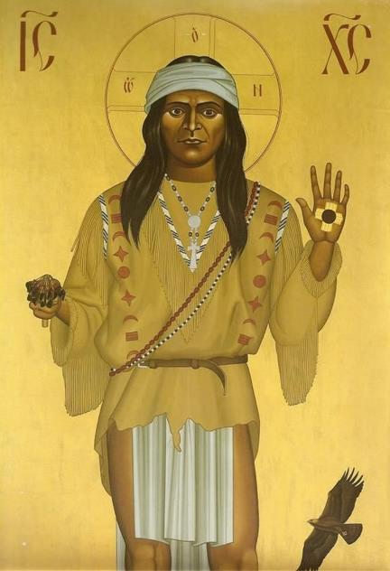
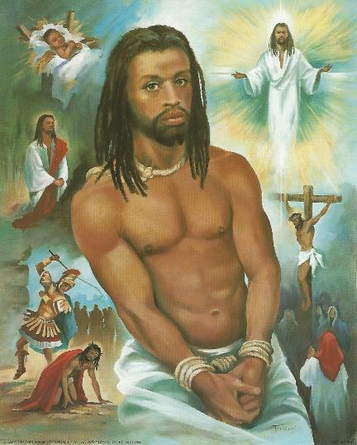
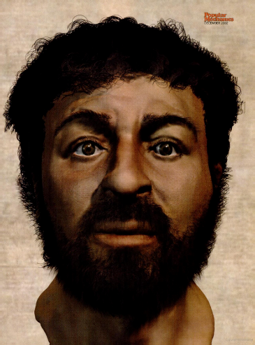
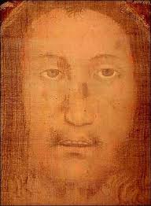
Whose Christ?

Slide 13
B) “The Body of Christ” – RESURRECTION
Glorified/Eternal Body of the Resurrected Christ
Jesus died in the flesh; He also rose in the flesh (not as a disembodied spirit or ghost)
Matt 28:9b – [Women meet the risen Lord]: “They approached, embraced his feet, and did him homage.”
Luke 24:39-40 – “Look at my hands and my feet, that it is I myself. Touch me and see, because a ghost does not have flesh and bones as you can see I have.” / And as he said this, he showed them his hands and his feet.
John 2:19b-22 – [Jesus]: "Destroy this temple and in three days I will raise it up." ²⁰ The Jews said, "This temple has been under construction for forty-six years, and you will raise it up in three days?" ²¹ But he was speaking about the temple of his body. ²² Therefore, when he was raised from the dead, his disciples remembered that he had said this, and they came to believe the scripture and the word Jesus had spoken.
John 20:20, 25b-28 – “[Jesus] showed them his hands and his side. The disciples rejoiced when they saw the Lord.” /…/ ^{25b} [Thomas]: “Unless I see the mark of the nails in his hands and put my finger into the nailmarks and put my hand into his side, I will not believe." ²⁶ Now a week later his disciples were again inside and Thomas was with them. Jesus came, although the doors were locked, and stood in their midst and said, "Peace be with you." ²⁷ Then he said to Thomas, "Put your finger here and see my hands, and bring your hand and put it into my side, and do not be unbelieving, but believe." ²⁸ Thomas answered and said to him, "My Lord and my God!"

Slide 14
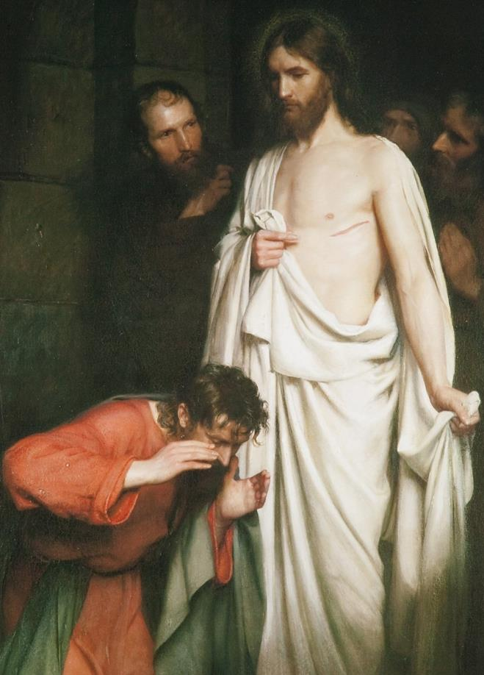
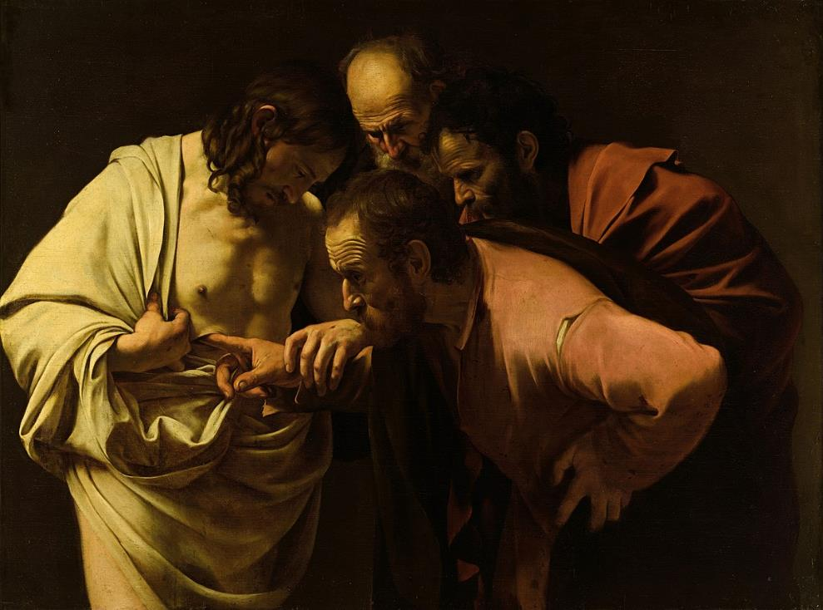
The Risen Jesus and Thomas

Slide 15
Resurrection: Intro & Definitions
English noun “resurrection” is derived from Latin resurgere
  verb = “to rise again”; past participle = “risen”
NT Greek noun: ἀνάστασις (anastasis; “arising; raising up”)
  Related verbs: ἀνίστημι (anistēmi; “to raise up”; “to rise, arise”)
  and ἐγείρω (egeirō; “to raise up”).
  Common words w/ ordinary meanings: standing up, lifting objects up
  But applied theologically to “life after death” – for Jesus and for us.
“Resurrection of the Body” = Transformation or transition
from mortal life, through physical death,
to a NEW and radically different form of life!
  Related: “Eternal Life” = life with God, existence without limitations
  Meaning even more than "eternal rest" or "heavenly reward"
  or "beatific vision" or "living forever" or “life without end"

Slide 16
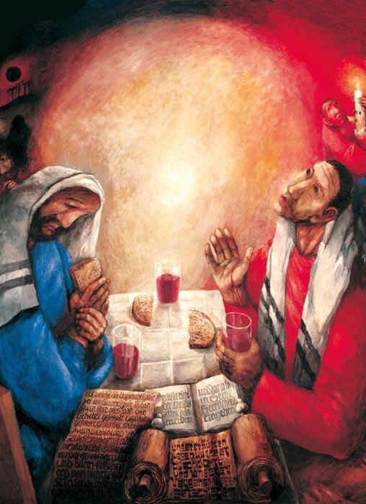
Koeder - Emmaus
Jesus
and two disciples
at Emmaus
Lk 24:28-32
by Sieger Köder

Slide 17
Resurrection: Intro & Definitions
What “Resurrection” Is NOT:
Resuscitation = reviving a person from unconsciousness, coma, or apparent death, back to the same earthly life.
Reanimation = rejoining of an earthly body with the same soul
(or maybe a new soul) after a temporary separation.
Reincarnation = rebirth of a soul into a new/different but still physical/mortal body (common idea in Eastern religions).
Immortality = inability to die; life continuing forever
(esp. a soul after its separation from a dead body).

Slide 18
What is a “Resurrected Body”? (for Jesus? for us?)
NOT: resuscitation, nor reanimation, nor reincarnation, nor immortality of the soul!
Rather: a transformed, incorruptible, immortal, gloried “Body”!
1 Cor 15:1-58 –
¹² But if Christ is preached as raised from the dead, how can some among you say there is no resurrection of the dead? ¹³ If there is no resurrection of the dead, then neither has Christ been raised.
²⁰ But now Christ has been raised from the dead, the firstfruits of those who have fallen asleep. ²¹ For since death came through a human being, the resurrection of the dead came also through a human being.
³⁵ But someone may say, "How are the dead raised? With what kind of body will they come back?"
³⁶ You fool! What you sow is not brought to life unless it dies. ³⁷ And what you sow is not the body that is to be but a bare kernel of wheat, perhaps, or of some other kind; ³⁸ but God gives it a body as he chooses, and to each of the seeds its own body. ³⁹ Not all flesh is the same, but there is one kind for human beings, another kind of flesh for animals, another kind of flesh for birds, and another for fish.

Slide 19
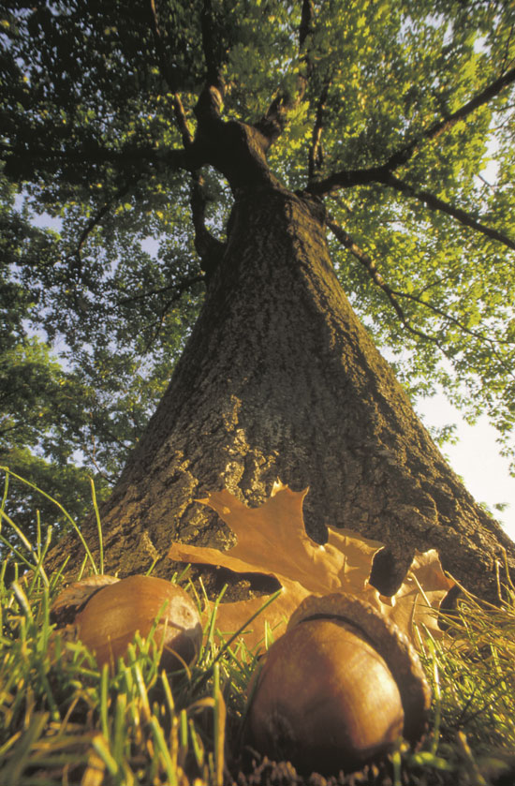


Slide 20

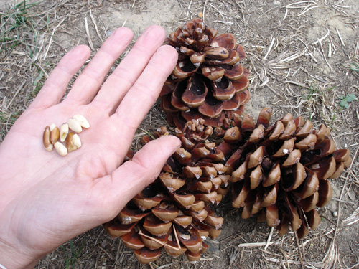

Slide 21
Resurrection in 1 Cor 15
⁴⁰ There are both heavenly bodies and earthly bodies, but the brightness of the heavenly is one kind and that of the earthly another. ⁴¹ The brightness of the sun is one kind, the brightness of the moon another, and the brightness of the stars another. For star differs from star in brightness.
⁴² So also is the resurrection of the dead. It is sown corruptible; it is raised incorruptible.
⁴³ It is sown dishonorable; it is raised glorious. It is sown weak; it is raised powerful.
⁴⁴ It is sown a natural body; it is raised a spiritual body.
If there is a natural body, there is also a spiritual one.
⁴⁵ So, too, it is written, "The first man, Adam, became a living being," the last Adam a life-giving spirit. ⁴⁶ But the spiritual was not first; rather the natural and then the spiritual.
⁴⁷ The first man was from the earth, earthly; the second man, from heaven.
⁴⁸ As was the earthly one, so also are the earthly, and as is the heavenly one, so also are the heavenly. ⁴⁹ Just as we have borne the image of the earthly one, we shall also bear the image of the heavenly one.

Slide 22
Resurrection in 1 Cor 15
⁵⁰ This I declare, brothers: flesh and blood cannot inherit the kingdom of God, nor does corruption inherit incorruption. ⁵¹ Behold, I tell you a mystery. We shall not all fall asleep, but we will all be changed, ⁵² in an instant, in the blink of an eye, at the last trumpet. For the trumpet will sound, the dead will be raised incorruptible, and we shall be changed.
⁵³ For that which is corruptible must clothe itself with incorruptibility, and that which is mortal must clothe itself with immortality. ⁵⁴ And when this which is corruptible clothes itself with incorruptibility and this which is mortal clothes itself with immortality, then the word that is written shall come about: "Death is swallowed up in victory. ⁵⁵ Where, O death, is your victory? Where, O death, is your sting?" (Hos 14:13) ⁵⁶ The sting of death is sin, and the power of sin is the law. ⁵⁷ But thanks be to God who gives us the victory through our Lord Jesus Christ.
⁵⁸ Therefore, my beloved brothers, be firm, steadfast, always fully devoted to the work of the Lord, knowing that in the Lord your labor is not in vain.

Slide 23
Resurrection Body: What Kind?
Both essentially similar and radically different:
  Our future life has continuity with our present life:
    Will we still be individuals, “some-bodies”!
    You will still be you; and I will still be me.
  Yet we’ll be radically changed, unlike we are now:
    “spiritual”? “glorified”? “immortal”? “incorruptible”?
Will resurrected body be “material/physical”?
  Maybe, but not limited by the ordinary space-time “physics” of our present world.
  If “physical,” then somehow “beyond” limitations of our space & time,
  in ways we can’t understand yet.

Slide 24
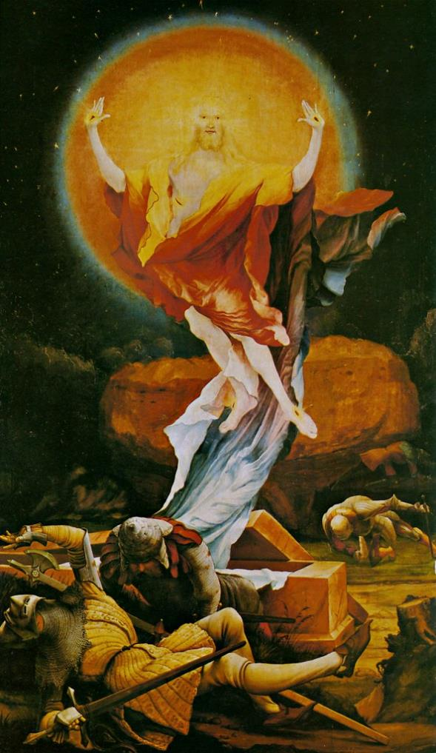
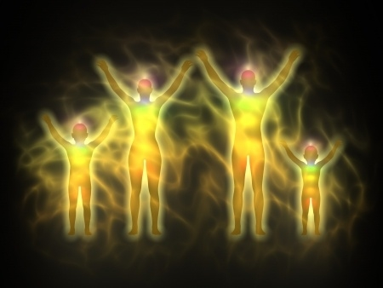

Slide 25
CCC: “The condition of Christ's risen humanity”
645 – By means of touch and the sharing of a meal, the risen Jesus establishes direct contact with his disciples. He invites them in this way to recognize that he is not a ghost and above all to verify that the risen body in which he appears to them is the same body that had been tortured and crucified, for it still bears the traces of his Passion.⁵⁰⁸ Yet at the same time this authentic, real body possesses the new properties of a glorious body: not limited by space and time but able to be present how and when he wills; for Christ's humanity can no longer be confined to earth, and belongs henceforth only to the Father's divine realm.⁵⁰⁹ For this reason too the risen Jesus enjoys the sovereign freedom of appearing as he wishes: in the guise of a gardener or in other forms familiar to his disciples, precisely to awaken their faith.⁵¹⁰
646 – Christ's Resurrection was not a return to earthly life, as was the case with the raisings from the dead that he had performed before Easter: Jairus' daughter, the young man of Naim, Lazarus. These actions were miraculous events, but the persons miraculously raised returned by Jesus' power to ordinary earthly life. At some particular moment they would die again. Christ's Resurrection is essentially different. In his risen body he passes from the state of death to another life beyond time and space. At Jesus' Resurrection his body is filled with the power of the Holy Spirit: he shares the divine life in his glorious state, so that St. Paul can say that Christ is "the man of heaven".⁵¹¹

Slide 26
RESURRECTION in CCC “In Brief”
656 Faith in the Resurrection has as its object an event which is historically attested to by the disciples, who really encountered the Risen One. At the same time, this event is mysteriously transcendent insofar as it is the entry of Christ's humanity into the glory of God.
657 The empty tomb and the linen cloths lying there signify in themselves that by God's power Christ's body had escaped the bonds of death and corruption. They prepared the disciples to encounter the Risen Lord.
658 Christ, "the first-born from the dead" (Col 1:18), is the principle of our own resurrection, even now by the justification of our souls (cf. Rom 6:4),
and one day by the new life he will impart to our bodies (cf. Rom 8:11).

Slide 27
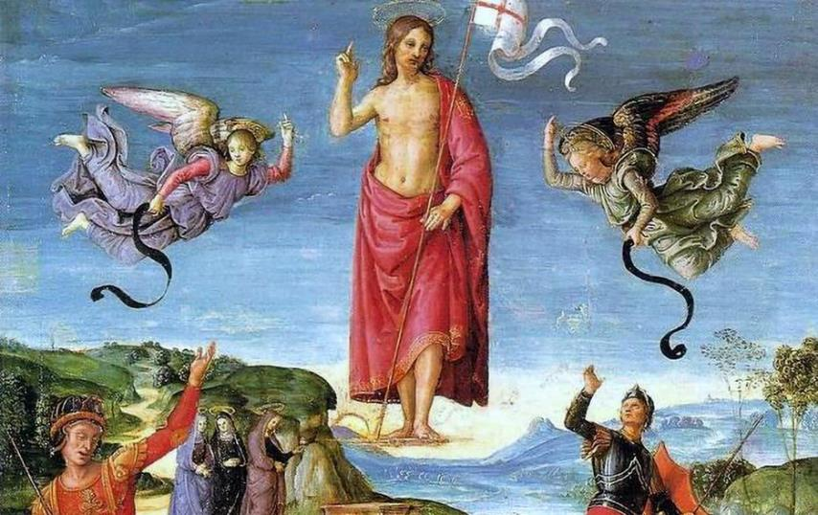
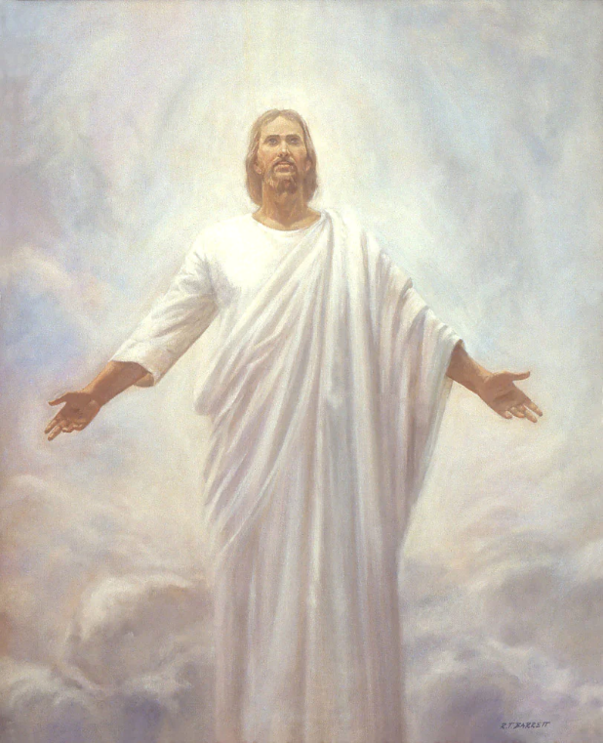
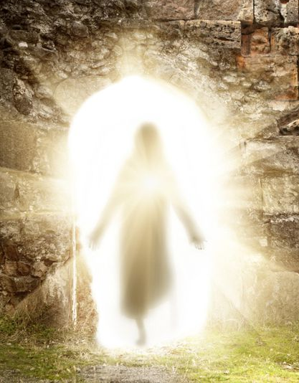
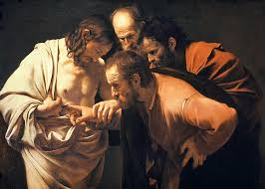
The Risen Lord

Slide 28
C) “The Body of Christ” – SACRAMENT
Sacramental/Eucharistic Body of Christ:
Gen 14:18-19a – [When Abram returned from a victory…] “Melchizedek, king of Salem, brought out bread and wine. He was a priest of God Most High. ¹⁹ He blessed Abram with these words…”
Mark 6:32-44 – Feeding the Multitudes (cf. Mt 14:13-21; Lk 9:10-17; Jn 6:1-15; also Mk 8:1-10; Mt 15:32-39)
[ Take / Bless / Break / Give ] – see https://catholic-resources.org/Bible/Eucharist.htm
Mark 14:22-25 – [Last Supper]: While they were eating, he took bread, said the blessing, broke it, and gave it to them, and said, "Take it; this is my body." ²³ Then he took a cup, gave thanks, and gave it to them, and they all drank from it. ²⁴ He said to them, "This is my blood of the covenant, which will be shed for many. ²⁵ Amen, I say to you, I shall not drink again the fruit of the vine until the day when I drink it new in the kingdom of God." (cf. Mt 26:26; Lk 22:19; 1 Cor 11:23-25)
Luke 24:30-35 – [Emmaus]: And it happened that, while he was with them at table, he took bread, said the blessing, broke it, and gave it to them. ³¹ With that their eyes were opened and they recognized him, but he vanished from their sight. ³² Then they said to each other, "Were not our hearts burning within us while he spoke to us on the way and opened the scriptures to us?" ³³ So they set out at once and returned to Jerusalem… /…/ ³⁵ Then the two recounted what had taken place on the way and how he was made known to them in the breaking of the bread.

Slide 29
C) “The Body of Christ” – SACRAMENT
John 6:48-58 – “I am the bread of life. ⁴⁹ Your ancestors ate the manna in the desert, but they died;
⁵⁰ this is the bread that comes down from heaven so that one may eat it and not die. ⁵¹ I am the living bread that came down from heaven; whoever eats this bread will live forever; and the bread that I will give is my flesh for the life of the world." ⁵² The Jews quarreled among themselves, saying, "How can this man give us his flesh to eat?" ⁵³ Jesus said to them, "Amen, amen, I say to you, unless you eat the flesh of the Son of Man and drink his blood, you do not have life within you. ⁵⁴ Whoever eats my flesh and drinks my blood has eternal life, and I will raise him on the last day. ⁵⁵ For my flesh is true food, and my blood is true drink. ⁵⁶ Whoever eats my flesh and drinks my blood remains in me and I in him.
⁵⁷ Just as the living Father sent me and I have life because of the Father, so also the one who feeds on me will have life because of me. ⁵⁸ This is the bread that came down from heaven. Unlike your ancestors who ate and still died, whoever eats this bread will live forever."
1 Cor 10:16-17 – “The cup of blessing that we bless, is it not a participation in the blood of Christ? The bread that we break, is it not a participation in the body of Christ? ¹⁷ Because the loaf of bread is one, we, though many, are one body, for we all partake of the one loaf.”

Slide 30
C) “The Body of Christ” – SACRAMENT
1 Cor 11:17-34a – “In giving this instruction, I do not praise the fact that your meetings are doing more harm than good. ¹⁸ First of all, I hear that when you meet as a church there are divisions among you, and to a degree I believe it; ¹⁹ there have to be factions among you in order that also those who are approved among you may become known. ²⁰ When you meet in one place, then, it is not to eat the Lord's supper, ²¹ for in eating, each one goes ahead with his own supper, and one goes hungry while another gets drunk. ²² Do you not have houses in which you can eat and drink? Or do you show contempt for the church of God and make those who have nothing feel ashamed? What can I say to you? Shall I praise you? In this matter I do not praise you.
²³ For I received from the Lord what I also handed on to you, that the Lord Jesus, on the night he was handed over, took bread, ²⁴ and, after he had given thanks, broke it and said, "This is my body that is for you. Do this in remembrance of me." ²⁵ In the same way also the cup, after supper, saying, "This cup is the new covenant in my blood. Do this, as often as you drink it, in remembrance of me."
²⁶ For as often as you eat this bread and drink the cup, you proclaim the death of the Lord until he comes.
²⁷ Therefore whoever eats the bread or drinks the cup of the Lord unworthily will have to answer for the body and blood of the Lord. ²⁸ A person should examine himself, and so eat the bread and drink the cup. ²⁹ For anyone who eats and drinks without discerning the body, eats and drinks judgment on himself. ³⁰ That is why many among you are ill and infirm, and a considerable number are dying. ³¹ If we discerned ourselves, we would not be under judgment; ³² but since we are judged by the Lord, we are being disciplined so that we may not be condemned along with the world. ³³ Therefore, my brothers, when you come together to eat, wait for one another. ³⁴ If anyone is hungry, he should eat at home, so that your meetings may not result in judgment….”

Slide 31
CCC - “The presence of Christ by the power of his word and the Holy Spirit”
1373 "Christ Jesus, who died, yes, who was raised from the dead, who is at the right hand of God, who indeed intercedes for us," is present in many ways to his Church:¹⁹⁵ in his word, in his Church's prayer, "where two or three are gathered in my name,"¹⁹⁶ in the poor, the sick, and the imprisoned,¹⁹⁷ in the sacraments of which he is the author, in the sacrifice of the Mass, and in the person of the minister. But "he is present . . . most especially in the Eucharistic species."¹⁹⁸
1374 The mode of Christ's presence under the Eucharistic species is unique. It raises the Eucharist above all the sacraments as "the perfection of the spiritual life and the end to which all the sacraments tend."¹⁹⁹ In the most blessed sacrament of the Eucharist "the body and blood, together with the soul and divinity, of our Lord Jesus Christ and, therefore, the whole Christ is truly, really, and substantially contained."²⁰⁰ "This presence is called 'real' - by which is not intended to exclude the other types of presence as if they could not be 'real' too, but because it is presence in the fullest sense: that is to say, it is a substantial presence by which Christ, God and man, makes himself wholly and entirely present."²⁰¹
1375 It is by the conversion of the bread and wine into Christ's body and blood that Christ becomes present in this sacrament. the Church Fathers strongly affirmed the faith of the Church in the efficacy of the Word of Christ and of the action of the Holy Spirit to bring about this conversion…
1376 The Council of Trent summarizes the Catholic faith by declaring: "Because Christ our Redeemer said that it was truly his body that he was offering under the species of bread, it has always been the conviction of the Church of God, and this holy Council now declares again, that by the consecration of the bread and wine there takes place a change of the whole substance of the bread into the substance of the body of Christ our Lord and of the whole substance of the wine into the substance of his blood. This change the holy Catholic Church has fittingly and properly called transubstantiation."²⁰⁴

Slide 32
Real Presence of Christ?
Pew Survey 2019 – claimed that only about 1/3 of Catholics believe
Was this survey accurate? Has belief declined so much?
Be careful with imprecise/sloppy language, esp. in theology!
Distinguish between faith and theology!
  FAITH: Real Presence (belief that Christ is truly present, body & blood, soul & divinity)
  THEOLOGY: Transubstantiation (explains why it still appears as ordinary bread & wine)
    Only CCC 1376 (and “In Brief, 1413”)

Slide 33
Pew Research Surveys: 2011 vs. 2019
2011: more precise theological language:
Which of the following statements best describes the Catholic teaching about the bread and wine used for communion?
1. The bread and wine really become the body and blood of Jesus Christ.
2. The bread and wine are only symbols of the body and blood of Jesus Christ.
Do you believe that at the Consecration during a Catholic Mass, the bread and wine really become the body and blood of Jesus Christ?
1. Yes, believe.
2. No, don't believe.
2019: formulated the two questions differently:
Which of the following best describes Catholic teaching about the bread and wine used for Communion?
The bread and wine…
1. Actually become the body and blood of Jesus Christ
2. Are symbols of the body and blood of Jesus Christ
3. Not sure.
Regardless of the official teaching of the Catholic Church, what do you personally believe about the bread and wine used for Communion? During Catholic Mass, the bread and wine…
1. Actually become the body and blood of Jesus Christ.
2. Are symbols of the body and blood of Jesus Christ.

Slide 34
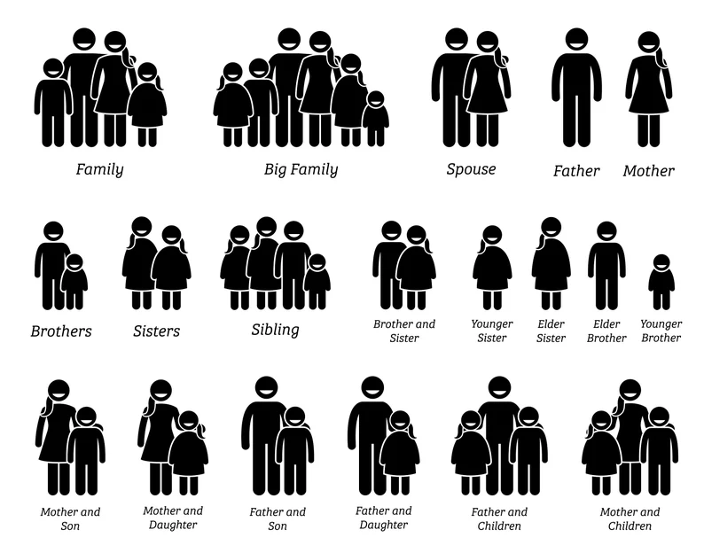
“REAL” vs. “Actual”?
Physical?
Biological?
Chemical?
Genetic?
Historical?
Legal?
Spiritual?
Conventional?

Slide 35
SYMBOL?
Flannery O’Connor (letter, Dec. 1955):
“Well, toward morning the conversation turned on the Eucharist, which I, being the Catholic, was obviously supposed to defend. Mrs. Broadwater said when she was a child and received the Host, she thought of it as the Holy Ghost, He being the ‘most portable’ person of the Trinity; now she thought of it as a symbol and implied that it was a pretty good one. I then said, in a very shaky voice, ‘Well, if it’s a symbol, to hell with it.’ That was all the defense I was capable of but I realize now that this is all I will ever be able to say about it, outside of a story, except that it is the center of existence for me; all the rest of life is expendable.”
“If it’s a mere symbol.” / “If it’s only a symbol…” / “If it’s nothing but a symbol…”
But could it be a “Real Symbol”?

Slide 36

Mere Symbol vs. Real Symbol?

Slide 37
D) “The Body of Christ” – CHURCH
Spiritual/Mystical Body of Christ: The One United Church
Romans 12:4-5 – “For as in one body we have many parts, and all the parts do not have the same function, ⁵ so we, though many, are one body in Christ and individually parts of one another.”
Galatians 3:26-28 – “For through faith you are all children of God in Christ Jesus. ²⁷ For all of you who were baptized into Christ have clothed yourselves with Christ. ²⁸ There is neither Jew nor Greek, there is neither slave nor free person, there is not male and female; for you are all one in Christ Jesus.”

Slide 38
D) “The Body of Christ” – CHURCH (in 1 Cor)
1 Cor 12:12-27 – “As a body is one though it has many parts, and all the parts of the body, though many, are one body, so also Christ. ¹³ For in one Spirit we were all baptized into one body, whether Jews or Greeks, slaves or free persons, and we were all given to drink of one Spirit. ¹⁴ Now the body is not a single part, but many.
¹⁵ If a foot should say, ‘Because I am not a hand I do not belong to the body,’ it does not for this reason belong any less to the body. ¹⁶ Or if an ear should say, ‘Because I am not an eye I do not belong to the body,’ it does not for this reason belong any less to the body. ¹⁷ If the whole body were an eye, where would the hearing be? If the whole body were hearing, where would the sense of smell be? ¹⁸ But as it is, God placed the parts, each one of them, in the body as he intended. ¹⁹ If they were all one part, where would the body be?
²⁰ But as it is, there are many parts, yet one body. ²¹ The eye cannot say to the hand, ‘I do not need you,’ nor again the head to the feet, ‘I do not need you.’ ²² Indeed, the parts of the body that seem to be weaker are all the more necessary, ²³ and those parts of the body that we consider less honorable we surround with greater honor, and our less presentable parts are treated with greater propriety, ²⁴ whereas our more presentable parts do not need this. But God has so constructed the body as to give greater honor to a part that is without it, ²⁵ so that there may be no division in the body, but that the parts may have the same concern for one another.
²⁶ If one part suffers, all the parts suffer with it; if one part is honored, all the parts share its joy.
²⁷ Now you are Christ's body, and individually parts of it.”

Slide 39
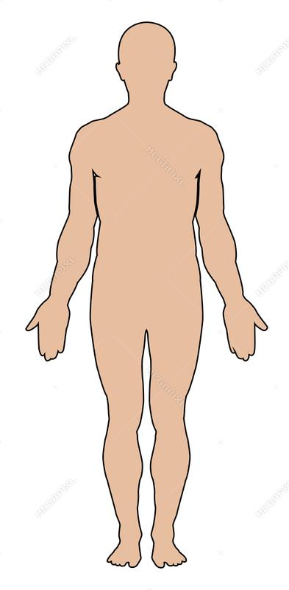
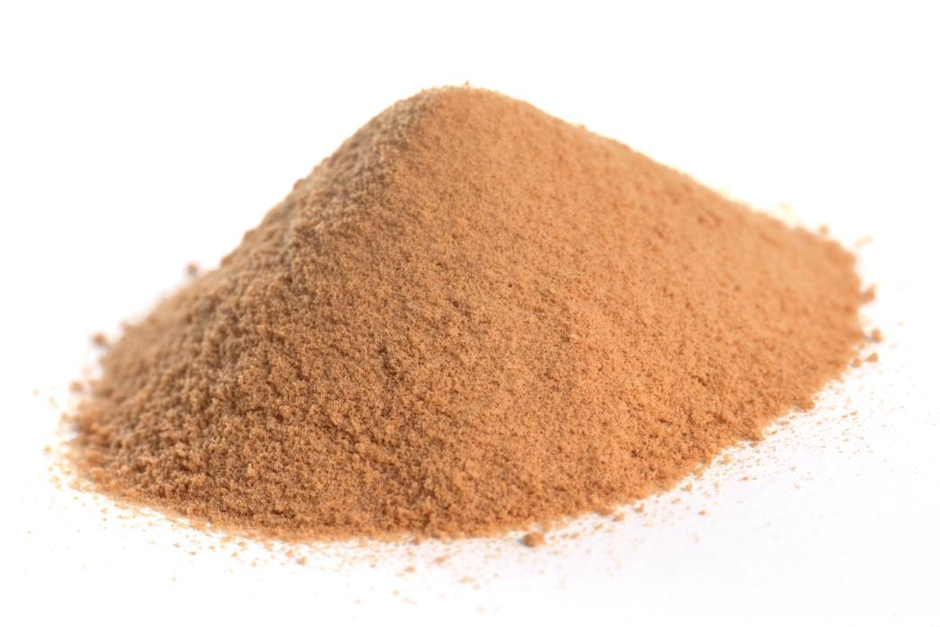
Unity vs. Uniformity?

Slide 40
D) “The Body of Christ” – CHURCH (in Colossians)
Col 1:18, 24 – “He is the head of the body, the church. He is the beginning, the firstborn from the dead… // ²⁴ Now I rejoice in my sufferings for your sake, and in my flesh I am filling up what is lacking in the afflictions of Christ on behalf of his body, which is the church…”
Col 2:9-10 – “For in him dwells the whole fullness of the deity bodily, ¹⁰ and you share in this fullness in him, who is the head of every principality and power.”
Col 2:18-19 – “Let no one disqualify you, delighting in self-abasement and worship of angels, taking his stand on visions, inflated without reason by his fleshly mind, ¹⁹ and not holding closely to the head, from whom the whole body, supported and held together by its ligaments and bonds, achieves the growth that comes from God.”
Col 3:15 – “And let the peace of Christ control your hearts, the peace into which you were also called in one body…”

Slide 41
D) “The Body of Christ” – CHURCH
Eph 1:22-23 – “He [God] put all things beneath his [Jesus’] feet and gave him as head over all things to the church,
²³ which is his body, the fullness of the one who fills all things in every way.”
Eph 2:13-22 – But now in Christ Jesus you [Gentiles] who once were far off have become near by the blood of Christ. ¹⁴ For he is our peace, he who made both one and broke down the dividing wall of enmity, through his flesh, ¹⁵ abolishing the law with its commandments and legal claims, that he might create in himself one new person in place of the two, thus establishing peace, ¹⁶ and might reconcile both with God, in one body, through the cross, putting that enmity to death by it. ¹⁷ He came and preached peace to you who were far off and peace to those who were near, ¹⁸ for through him we both have access in one Spirit to the Father. ¹⁹ So then you are no longer strangers and sojourners, but you are fellow citizens with the holy ones and members of the household of God, ²⁰ built upon the foundation of the apostles and prophets, with Christ Jesus himself as the capstone. ²¹ Through him the whole structure is held together and grows into a temple sacred in the Lord; ²² in him you also are being built together into a dwelling place of God in the Spirit.”
Eph 3:6 – “…that the Gentiles are coheirs, members of the same body, and copartners in the promise in Christ Jesus through the gospel.”
Eph 4:1-6 – “I, then, a prisoner for the Lord, urge you to live in a manner worthy of the call you have received, ² with all humility and gentleness, with patience, bearing with one another through love, ³ striving to preserve the unity of the spirit through the bond of peace: ⁴ one body and one Spirit, as you were also called to the one hope of your call; ⁵ one Lord, one faith, one baptism; ⁶ one God and Father of all, who is over all and through all and in all.”

Slide 42
D) “The Body of Christ” – CHURCH
Eph 5:21-33 (NRSV) – “Be subject to one another out of reverence for Christ. ²² Wives, be subject to your husbands as you are to the Lord. ²³ For the husband is the head of the wife just as Christ is the head of the church, the body of which he is the Savior. ²⁴ Just as the church is subject to Christ, so also wives ought to be, in everything, to their husbands. ²⁵ Husbands, love your wives, just as Christ loved the church and gave himself up for her, ²⁶ in order to make her holy by cleansing her with the washing of water by the word, ²⁷ so as to present the church to himself in splendor, without a spot or wrinkle or anything of the kind-- yes, so that she may be holy and without blemish. ²⁸ In the same way, husbands should love their wives as they do their own bodies. He who loves his wife loves himself. ²⁹ For no one ever hates his own body, but he nourishes and tenderly cares for it, just as Christ does for the church, ³⁰ because we are members of his body. ³¹ "For this reason a man will leave his father and mother and be joined to his wife, and the two will become one flesh." ³² This is a great mystery, and I am applying it to Christ and the church. ³³ Each of you, however, should love his wife as himself, and a wife should respect her husband.”

Slide 43
D) Church = “The Body of Christ” in CCC
777 – The word "Church" means "convocation." It designates the assembly of those whom God's Word "convokes," i.e., gathers together to form the People of God, and who themselves, nourished with the Body of Christ, become the Body of Christ.
779 – The Church is both visible and spiritual, a hierarchical society and the Mystical Body of Christ. She is one, yet formed of two components, human and divine. That is her mystery, which only faith can accept.
780 – The Church in this world is the sacrament of salvation, the sign and the instrument of the communion of God and [human beings].

Slide 44
CCC “In Brief” (§§802-810)
The Church is the Body of Christ. Through the Spirit and his action in the sacraments, above all the Eucharist, Christ, who once was dead and is now risen, establishes the community of believers as his own Body.
In the unity of this Body, there is a diversity of members and functions. All members are linked to one another, especially to those who are suffering, to the poor and persecuted.
The Church is this Body of which Christ is the head: she lives from him, in him, and for him; he lives with her and in her.
The Church is the Bride of Christ: he loved her and handed himself over for her. He has purified her by his blood and made her the fruitful mother of all God's children.
The Church is the Temple of the Holy Spirit. The Spirit is the soul, as it were, of the Mystical Body, the source of its life, of its unity in diversity, and of the riches of its gifts and charisms.

Slide 45
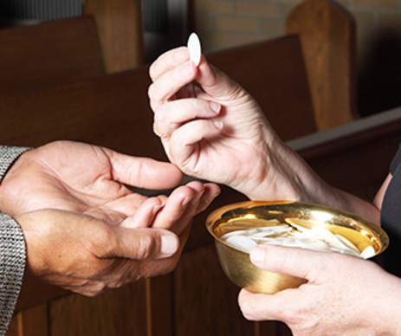
Words at Communion: “The Body of Christ”

Slide 46
Four-fold “Presence” of Christ in the Liturgy
Vatican II: Sacrosanctum Concilium §7
To accomplish so great a work, Christ is always present in his Church, especially in her liturgical celebrations. He is present in the sacrifice of the Mass, not only in the person of his minister, “the same now offering, through the ministry of priests, who formerly offered himself on the cross,” but especially under the Eucharistic species. By his power he is present in the sacraments, so that when someone baptizes it is really Christ himself who baptizes. He is present in his word, since it is he himself who speaks when the holy scriptures are read in the Church. He is present, lastly, when the Church prays and sings, for he promised: “Where two or three are gathered together in my name, there am I in the midst of them” (Matt 18:20)
Role of the Tabernacle during Mass?
Genuflect only at beginning and end of Mass.

Slide 47
E) “The Body of Christ” – OUR SPIRITUAL LIFE
  Spirit of Christ Dwells in our Mortal Bodies
1 Cor 6:12-20 – "Everything is lawful for me," but not everything is beneficial. "Everything is lawful for me," but I will not let myself be dominated by anything. ¹³ "Food for the stomach and the stomach for food," but God will do away with both the one and the other. The body, however, is not for immorality, but for the Lord, and the Lord is for the body; ¹⁴ God raised the Lord and will also raise us by his power. ¹⁵ Do you not know that your bodies are members of Christ? Shall I then take Christ's members and make them the members of a prostitute? Of course not! ¹⁶ Or do you not know that anyone who joins himself to a prostitute becomes one body with her? For "the two," it says, "will become one flesh." ¹⁷ But whoever is joined to the Lord becomes one spirit with him. ¹⁸ Avoid immorality. Every other sin a person commits is outside the body, but the immoral person sins against his own body. ¹⁹ Do you not know that your body is a temple of the holy Spirit within you, whom you have from God, and that you are not your own? ²⁰ For you have been purchased at a price. Therefore, glorify God in your body.”

Slide 48
E) “The Body of Christ” – OUR SPIRITUAL LIFE
Romans 8:9-17 – But you are not in the flesh; on the contrary, you are in the spirit, if only the Spirit of God dwells in you. Whoever does not have the Spirit of Christ does not belong to him. ¹⁰ But if Christ is in you, although the body is dead because of sin, the spirit is alive because of righteousness. ¹¹ If the Spirit of the one who raised Jesus from the dead dwells in you, the one who raised Christ from the dead will give life to your mortal bodies also, through his Spirit that dwells in you.
¹² Consequently, brothers, we are not debtors to the flesh, to live according to the flesh. ¹³ For if you live according to the flesh, you will die, but if by the spirit you put to death the deeds of the body, you will live. ¹⁴ For those who are led by the Spirit of God are children of God. ¹⁵ For you did not receive a spirit of slavery to fall back into fear, but you received a spirit of adoption, through which we cry, "Abba, Father!" ¹⁶ The Spirit itself bears witness with our spirit that we are children of God, ¹⁷ and if children, then heirs, heirs of God and joint heirs with Christ, if only we suffer with him so that we may also be glorified with him.”

Slide 49
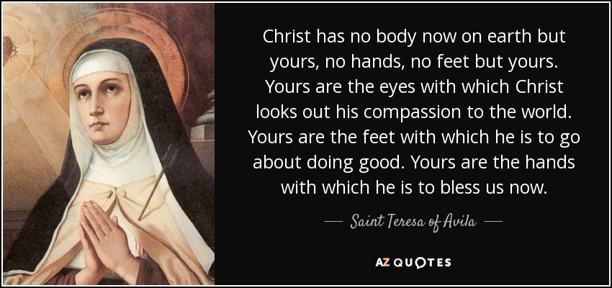

Slide 50
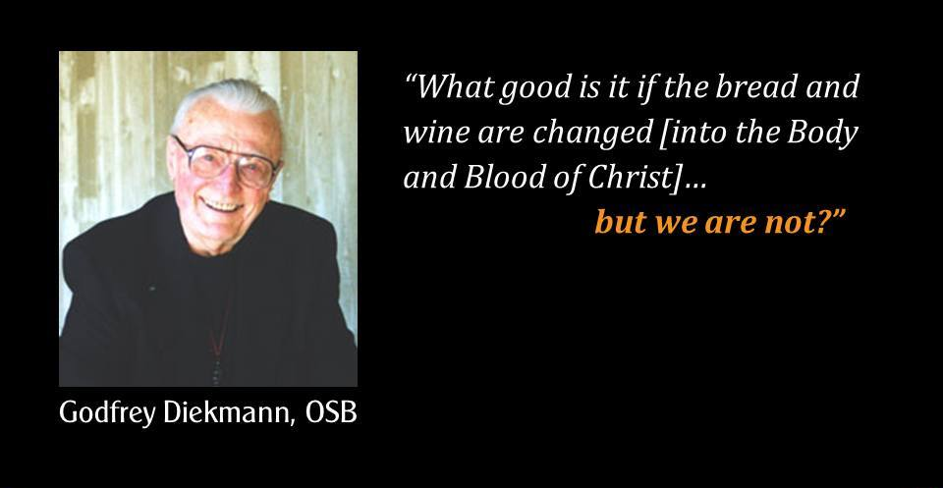

Slide 51
Recap: What is the “Body of Christ”?
Incarnation
  Physical/Mortal Body of the Human Jesus
Resurrection
  Glorified/Eternal Body of the Resurrected Christ
Sacrament
  Real/Present Body of Christ: The Eucharist
Church
  Mystical/Ecclesial Body of Christ: The Church
Spiritual Life
  Spirit of Christ Dwells in our Mortal Bodies

Slide 52
How Can I Learn More?
http://catholic-resources.org
Fr. Felix Just's Biblical/Theological Website
(if you forget the URL, just Google my name!)
Read & Pray the Bible Daily (esp. the Gospels)
Participate in LA’s “Catholic Bible Institute”

Slide 53
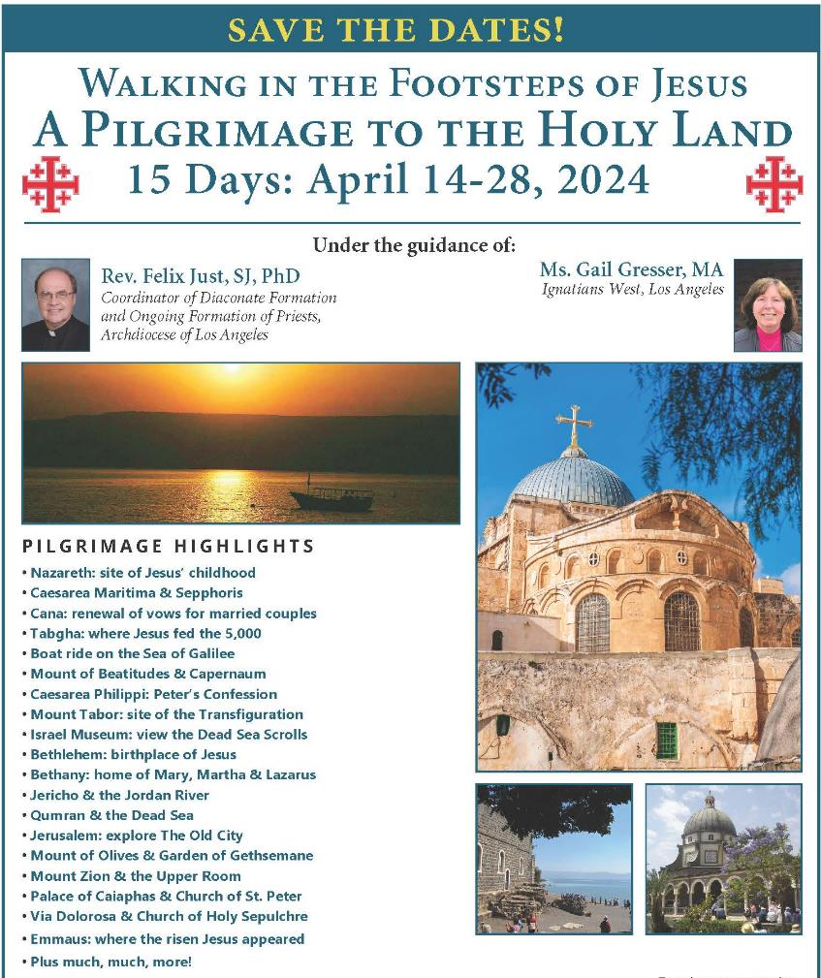
Holy Land
Pilgrimage
April 14-28, 2024 https://catholic-resources.org

Slide 54
Concluding Prayer: Pope Francis (9/25/22)
Brothers and sisters, let us dream.
Let us dream of such a Church: a Eucharistic Church.
Made up of women and men who break like bread for all those who chew on loneliness and poverty, for those who hunger for tenderness and compassion, for those whose lives are crumbling because the good leaven of hope is lacking. A Church that kneels before the Eucharist and worships with awe the Lord present in the bread; but that also knows how to bend with compassion and tenderness before the wounds of those who suffer, lifting up the poor, wiping away the tears of those who suffer, making herself the bread of hope and joy for all. Because there is no true Eucharistic worship without compassion for the many “Lazaruses” who even today walk beside us.

Slide 55
Conclusion
https://catholic-resources.org
Comments? Questions?
Thank You for Participating in RE Congress!

