Slide 1
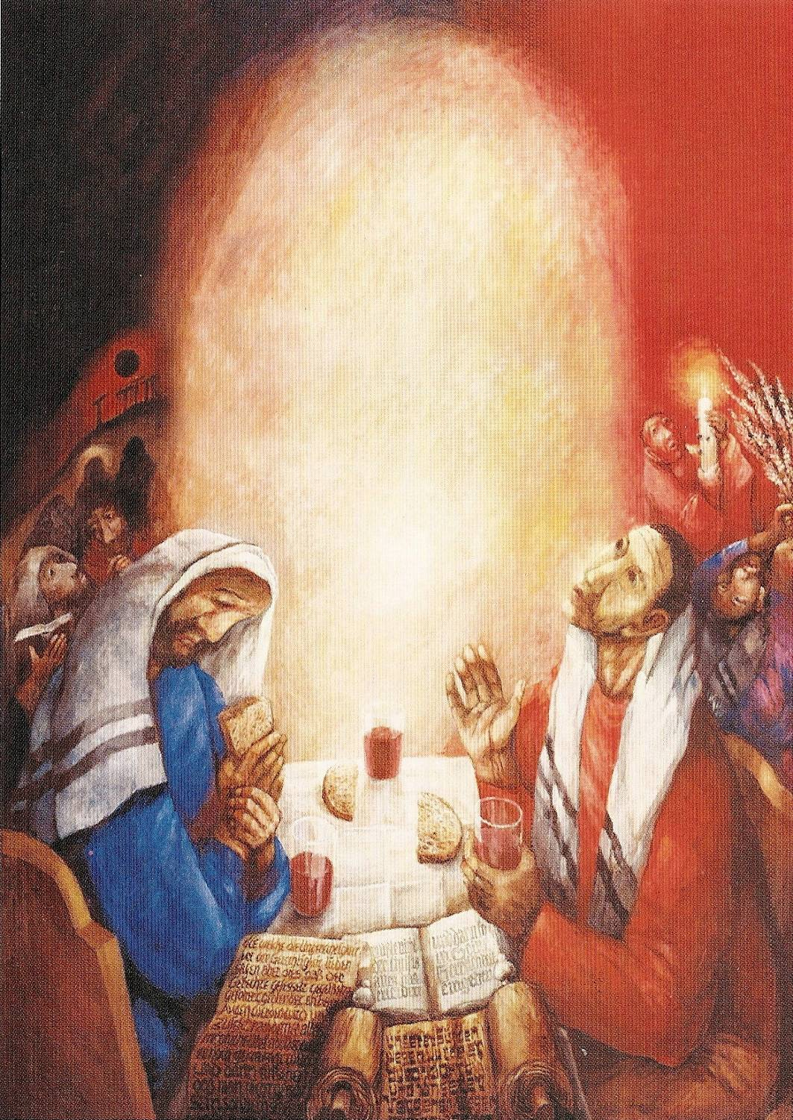
On the Road to Emmaus:
How Can Luke's Gospel Help Us
Be Better Disciples of Jesus?
L.A. Religious Education Congress
March 19, 2022: Session 4-06
Fr. Felix Just, S.J., Ph.D.
https://catholic-resources.org
Sieger Köder

Slide 2
RE Congress Theme: “Living Waters of HOPE”
Based on JOHN 4 – Jesus Encounters the Samaritan Woman at the Well
  3rd Sunday of Lent, Year A (for RCIA Scrutinies)
  One of my RE Congress Talks in 2018
This Talk: Luke 24 – EMMAUS Narrative
  Image of “Journeying Together” in our Christian Discipleship
  Basis of Pope Francis’ Letter, Aperuit Illis – “Sunday of the Word of God”
  Synod (“Journeying Together”): Communion, Participation, Mission
  Sunday Lectionary: 2022 is Year C – focus on LUKE’s Gospel

Slide 3
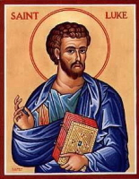
Structural Outline of LUKE’s Gospel
A) Literary Preface & Infancy Narrative: 1:1 – 2:52
B) Preparatory Events: 3:1 – 4:13
C) Jesus’ Ministry in Galilee: 4:14 – 9:50
D) Jesus’ Journey to Jerusalem: 9:51 – 19:27
C') Jesus’ Ministry in Jerusalem: 19:28 – 21:38
B') Passion Narrative: 22:1 – 23:56
A') Resurrection Appearances & Ascension: 24:1-53

Slide 4
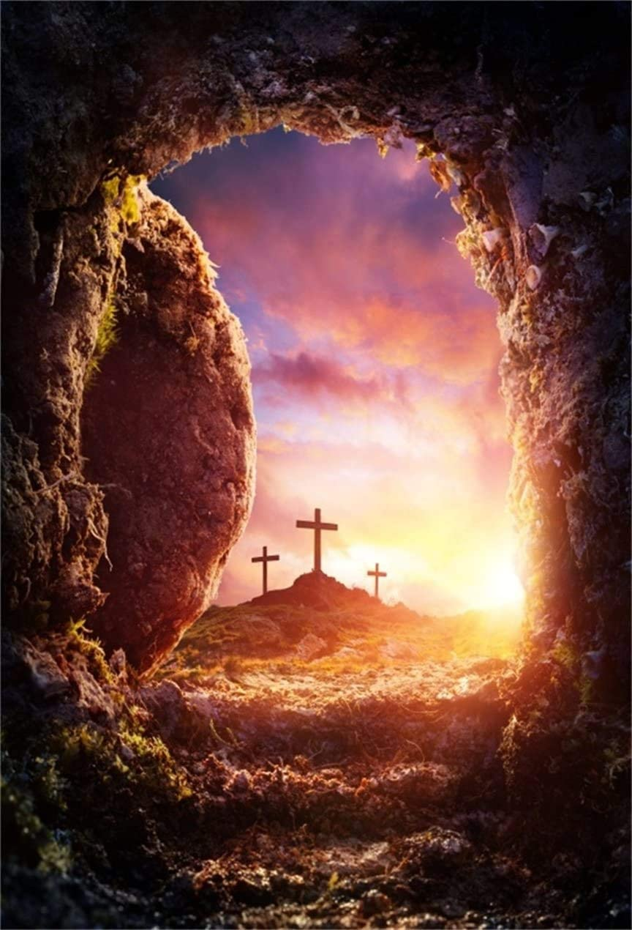
Resurrection in Luke’s Gospel
Overview of Luke 24:
24:1-11 – Some Women Disciples Find Jesus’ Tomb Empty
24:12 – Peter Runs to the Tomb (but doesn’t himself see Jesus)
24:13-35 – Jesus Appears to Two Disciples on the Way to Emmaus
24:36-43 – Jesus Appears to Disciples in Jerusalem that Sunday Evening
24:44-53 – Jesus’ Last Words and His Ascension to Heaven

Slide 5
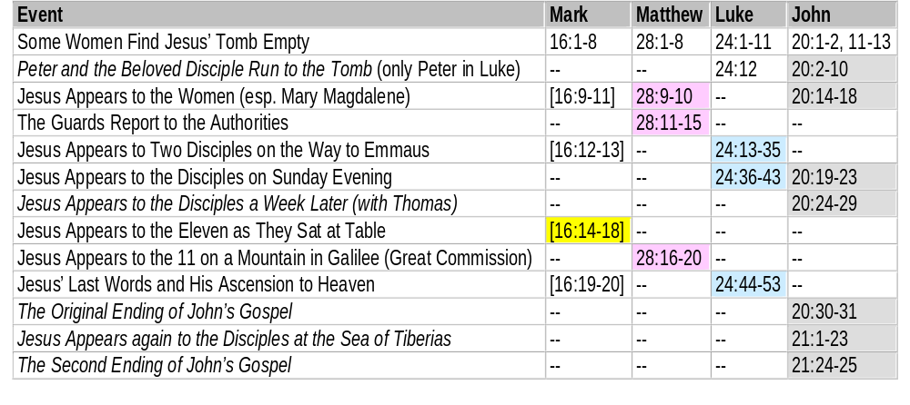
Appearances of the Risen Jesus in the Four Gospels
https://catholic-resources.org/Bible

Slide 6
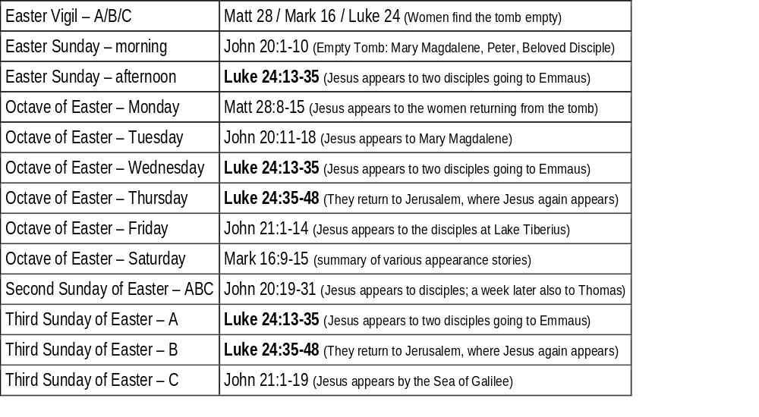
Resurrection Accounts in the Lectionary for Mass
https://catholic-resources.org/Lectionary

Slide 7
The Burial of Jesus (Luke 23:50-56)
⁵⁰ Now there was a virtuous and righteous man named Joseph
who, though he was a member of the council,
⁵¹ had not consented to their plan of action.
He came from the Jewish town of Arimathea and was awaiting the kingdom of God.
⁵² He went to Pilate and asked for the body of Jesus.
⁵³ After he had taken the body down, he wrapped it in a linen cloth
and laid him in a rock-hewn tomb in which no one had yet been buried.
⁵⁴ It was the day of preparation, and the sabbath was about to begin.
⁵⁵ The women who had come from Galilee with him followed behind,
and when they had seen the tomb and the way in which his body was laid in it,
⁵⁶ they returned and prepared spices and perfumed oils.
Then they rested on the sabbath according to the commandment.

Slide 8
The Empty Tomb Narrative (Luke 24:1-12)
¹ But at daybreak on the first day of the week they took the spices they had prepared and went to the tomb.
² They found the stone rolled away from the tomb;
³ but when they entered, they did not find the body of the Lord Jesus.
⁴ While they were puzzling over this, behold, two men in dazzling garments appeared to them.
⁵ They were terrified and bowed their faces to the ground.
They said to them, "Why do you seek the living one among the dead?
⁶ He is not here, but he has been raised. Remember what he said to you while he was still in Galilee,
⁷ that the Son of Man must be handed over to sinners and be crucified, and rise on the third day."
⁸ And they remembered his words.
⁹ Then they returned from the tomb and announced all these things to the eleven and to all the others.
¹⁰ The women were Mary Magdalene, Joanna, and Mary the mother of James;
the others who accompanied them also told this to the apostles,
¹¹ but their story seemed like nonsense and they did not believe them.
¹² But Peter got up and ran to the tomb, bent down, and saw the burial cloths alone;
then he went home amazed at what had happened.

Slide 9
The Empty Tomb Narrative (Luke 24:1-12)
Differences / Emphases in LUKE’s account:
  More women go to the tomb
  Two men in bright garments (heavenly messengers; cf. Acts 1:10)
  “Remember how he told you…” (cf. Passion Predictions)
  Women then transmit the message,
  but the eleven and other disciples don’t believe!
  Peter runs to tomb (alone? cf. Lk 24:24; Jn 20:2-10),
  sees the burial cloths, returns home “amazed.”

Slide 10
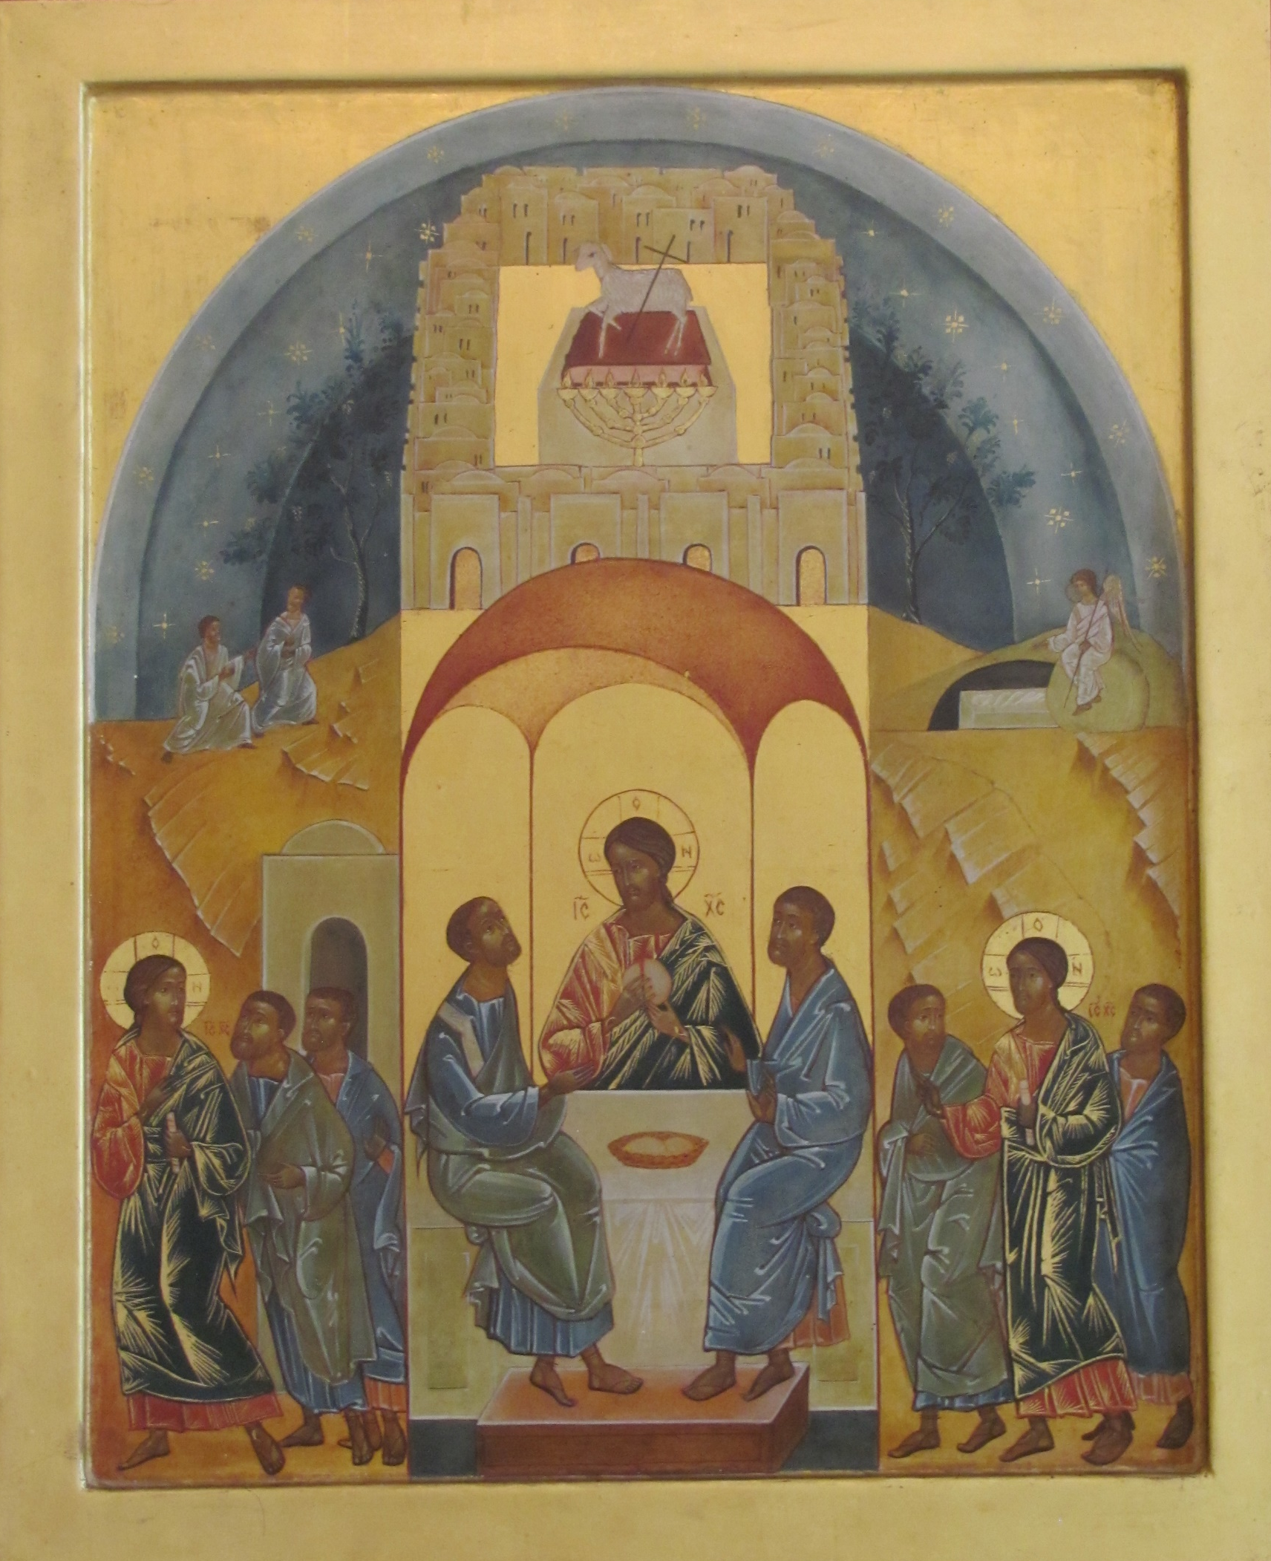
Jesus Appears on Road to Emmaus (Luke 24:13-35)
“First Reading” – Read & Notice:
  WHEN?
  WHO?
  WHERE?
  WHAT?
  ROLE of SCRIPTURES?
  ROLE of SACRAMENT?
“Second Reading” – Closer Analysis

Slide 11
The Emmaus Narrative (Luke 24:13-35)
¹³ That very day [, the first day of the week], two of them [two of Jesus’ disciples]
were going to a village seven miles from Jerusalem called Emmaus,
¹⁴ and they were conversing about all the things that had occurred.
¹⁵ And it happened that while they were conversing and debating,
Jesus himself drew near and walked with them,
¹⁶ but their eyes were prevented from recognizing him.
¹⁷ He asked them, "What are you discussing as you walk along?”
They stopped, looking downcast.
¹⁸ One of them, named Cleopas, said to him in reply,
"Are you the only visitor to Jerusalem who does not know
of the things that have taken place there in these days?"

Slide 12
Luke 24:13-35 (cont.)
¹⁹ And he replied to them, "What sort of things?"
They said to him, "The things that happened to Jesus the Nazarene,
who was a prophet mighty in deed and word before God and all the people,
²⁰ how our chief priests and rulers both handed him over to a sentence of death
and crucified him.
²¹ But we were hoping that he would be the one to redeem Israel;
and besides all this, it is now the third day since this took place.
²² Some women from our group, however, have astounded us:
they were at the tomb early in the morning ²³ and did not find his Body;
they came back and reported that they had indeed seen a vision of angels
who announced that he was alive.
²⁴ Then some of those with us went to the tomb
and found things just as the women had described, but him they did not see."

Slide 13
Luke 24:13-35 (cont.)
²⁵ And he said to them, "Oh, how foolish you are!
How slow of heart to believe all that the prophets spoke!
²⁶ Was it not necessary that the Christ should suffer these things
and enter into his glory?"
²⁷ Then beginning with Moses and all the prophets,
he interpreted to them what referred to him in all the Scriptures.
²⁸ As they approached the village to which they were going,
he gave the impression that he was going on farther.
²⁹ But they urged him, "Stay with us, for it is nearly evening and the day is almost over."
So he went in to stay with them.

Slide 14
Luke 24:13-35 (cont.)
³⁰ And it happened that, while he was with them at table,
he took bread, said the blessing, broke it, and gave it to them.
³¹ With that their eyes were opened and they recognized him,
but he vanished from their sight.
³² Then they said to each other, "Were not our hearts burning within us
while he spoke to us on the way and opened the Scriptures to us?"
³³ So they set out at once and returned to Jerusalem
where they found gathered together the Eleven and those with them
³⁴ who were saying, "The Lord has truly been raised and has appeared to Simon!"
³⁵ Then the two recounted what had taken place on the way
and how he was made known to them in the breaking of the bread.

Slide 15
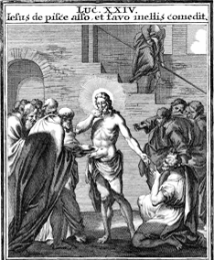
Luke 24:36-43
³⁶ While they were still speaking about this,
he stood in their midst and said to them, "Peace be with you."
³⁷ But they were startled and terrified
and thought that they were seeing a ghost.
³⁸ Then he said to them, "Why are you troubled?
And why do questions arise in your hearts?
³⁹ Look at my hands and my feet, that it is I myself.
Touch me and see, because a ghost does not have
flesh and bones as you can see I have."
⁴⁰ And as he said this, he showed them his hands and his feet.
⁴¹ While they were still incredulous for joy and were amazed,
he asked them, "Have you anything here to eat?"
⁴² They gave him a piece of baked fish; ⁴³ he took it and ate it in front of them.
Johann Weigel, 1695

Slide 16
Luke 24:44-53
⁴⁴ He said to them, "These are my words that I spoke to you while I was still with you,
that everything written about me in the law of Moses and in the prophets and psalms
must be fulfilled."
⁴⁵ Then he opened their minds to understand the scriptures. ⁴⁶ And he said to them,
"Thus it is written that the Messiah would suffer and rise from the dead on the third day
⁴⁷ and that repentance, for the forgiveness of sins, would be preached in his name
to all the nations, beginning from Jerusalem. ⁴⁸ You are witnesses of these things.
⁴⁹ And behold I am sending the promise of my Father upon you; but stay in the city
until you are clothed with power from on high."
⁵⁰ Then he led them out as far as Bethany, raised his hands, and blessed them.
⁵¹ As he blessed them he parted from them and was taken up to heaven.
⁵² They did him homage and then returned to Jerusalem with great joy,
⁵³ and they were continually in the temple praising God.

Slide 17
Icon from the Chapel at Emmaus-Nicopolis

Slide 18
On the Road to Emmaus (Luke 24:13-35)
“Second Reading” – Closer Analysis
  WHEN?
  WHO?
  WHERE?
  WHAT?
  ROLE of SCRIPTURES?
  ROLE of SACRAMENT?

Slide 19
WHEN?
Easter Sunday: “That very day, [the first day of the week]” (24:13, cf. 24:1)
  Disciples here: “it is now the third day since this [crucifixion] took place.” (24:21)
  Jesus, earlier: “…be killed, and on the third day be raised” (9:22; cf. 18:33; 24:7)
Note: Luke 24 is written as if it were all in one day:
  “At Daybreak”: Women find the tomb empty; Peter runs to the tomb
  “That same day” (afternoon?): Jesus appears on the Road to Emmaus
  “Towards evening”: Jesus and the two disciples dine at Emmaus
  “That very hour”: The two disciples return to Jerusalem
  “As they were speaking”: Jesus appears to the disciples gathered in Jerusalem
  “Then”: Jesus leads the disciples to Bethany, and he ascends to heaven
  “And”: The disciples return to the Jerusalem
Contrast: ACTS 1 says that Jesus appeared for 40 days until his Ascension

Slide 20
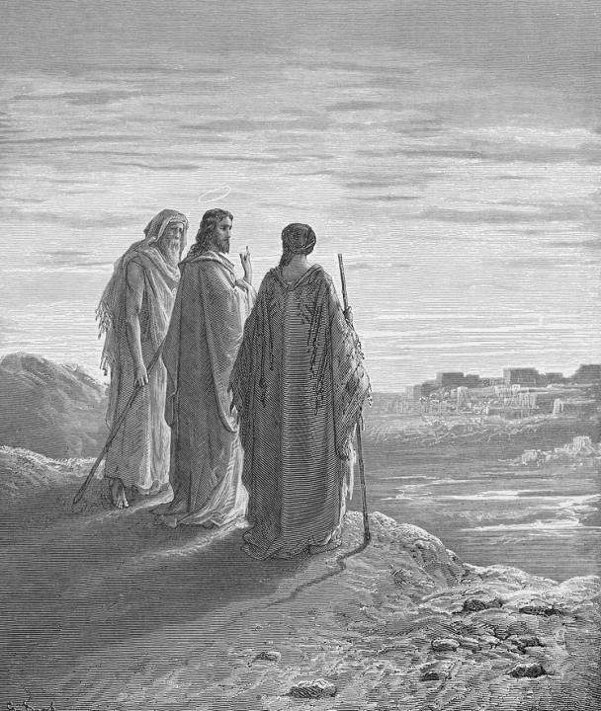
WHO?
Cleopas and…? (anonymous)
Two Men?
  Assumption of Christian Tradition
  Woodcut by Gustave Doré (1865)
Maybe a Man and a Woman?
  Cleopas & his Sister?
  Cleopas & his Wife?

Slide 21
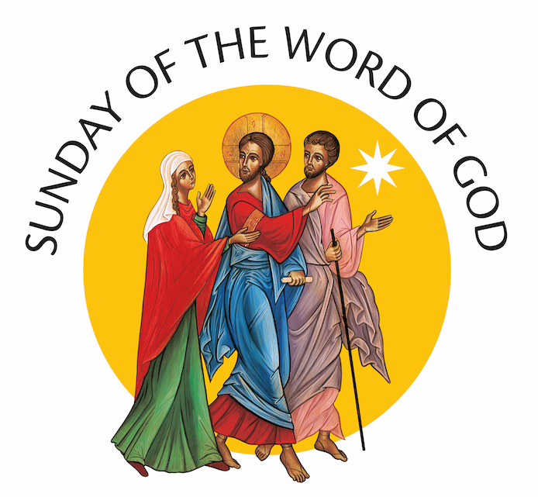

Slide 22
Official Logo for the “Sunday of the Word of God”
Vatican City (CNS, 1/24/2020) — An icon of the encounter with Jesus on the road to Emmaus was chosen as the official logo for the worldwide celebration of the Sunday of the Word of God.
The colorful logo is based on an icon written by the late-Benedictine Sister Marie-Paul Farran, a member of the Our Lady of Calvary Congregation, who lived and worked at its monastery on the Mount of Olives in Jerusalem. The logo was presented to the press at a
Vatican news conference Jan. 17, ahead of the newly established Sunday of the Word of God, which is being celebrated Jan. 26 this year.
Pope Francis has asked that the Third Sunday in Ordinary Time each year be observed as a special day devoted to the celebration, study and dissemination of the word of God. The logo shows the resurrected Christ holding in his left hand a scroll, which is "the sacred Scripture that found its fulfillment in his person," Archbishop Rino Fisichella, president of the Pontifical Council for Promoting New Evangelization, told reporters.
By his side are two disciples: Clopas and his wife, Mary. They both fix their gaze on Christ while Clopas holds a stick to indicate "a pilgrimage," the archbishop said. Mary is holding one hand upward and with her other hand seems to be touching the Lord, reaffirming that he has fulfilled the ancient promises and is the living Word that must be proclaimed to the world, he said. Holding the stick in one hand, Clopas’ free hand is pointing the road ahead, which all disciples are called to take in order to bring the Good News to everyone, Archbishop Fisichella said.
There is a star overhead symbolizing evangelization and the "permanent light" that guides their journey and shows them the way, he added. It is also important, he said, to notice the feet of all three are depicted as being in motion, representing that the proclamation of the Risen Christ cannot be accomplished by "tired or lazy disciples" but only by those who are "dynamic" and ready to find new ways to speak so that sacred Scripture may become the living guide of the life of the church and its people.
From https://www.osvnews.com/amp/2020/01/24/official-logo-for-the-sunday-of-the-word-of-god-unveiled-at-vatican/

Slide 23
CLEOPAS / CLOPAS and MARY ?
Cleopas: only in Luke 24:18
“One of them, named Cleopas, said to him in reply,”
Clopas: only in John 19:25
  “Standing by the cross of Jesus were his mother and his mother's sister, Mary [the wife] of Clopas, and Mary Magdalene.”
Women at the Cross and the Tomb:
  Mark 15:40-41 – “There were also women looking on from a distance. Among them were Mary Magdalene, Mary the mother of the younger James and of Joses, and Salome. / These women had followed him when he was in Galilee and ministered to him. There were also many other women who had come up with him to Jerusalem.”
  Mark 15:47 & 16:1 – “Mary Magdalene and Mary the mother of Joses watched where he was laid. /
  When the sabbath was over, Mary Magdalene, Mary, the mother of James, and Salome bought spices so that they might go and anoint him.”
  Matt 27:55-56, 61 – “There were many women there, looking on from a distance, who had followed Jesus from Galilee, ministering to him. /
  Among them were Mary Magdalene and Mary the mother of James and Joseph, and the mother of the sons of Zebedee… /
  But Mary Magdalene and the other Mary remained sitting there, facing the tomb.”
  Matt 28:1 – “After the sabbath, as the first day of the week was dawning, Mary Magdalene and the other Mary came to see the tomb.”
  Luke 24:10 – “The women were Mary Magdalene, Joanna, and Mary the mother of James; the others who accompanied them also told this to the apostles.”
Extended Family of Jesus:
  Mark 6:3 – “Isn’t he the carpenter, the son of Mary, and the brother of James and Joses and Judas and Simon? And aren’t his sisters here with us?”
  Matt 13:55-56a – “Isn’t he the carpenter's son? Isn’t his mother named Mary and his brothers James, Joseph, Simon, and Judas? / Aren’t his sisters all with us?”
  Luke 4:22 – “Isn’t this Joseph’s son?” (no mention of “brothers & sisters”)

Slide 24
CLEOPAS / CLOPAS and MARY ?
Cleopas: only in Luke 24:18
“One of them, named Cleopas, said to him in reply,”
Clopas: only in John 19:25
  “Standing by the cross of Jesus were his mother and his mother's sister, Mary [the wife] of Clopas, and Mary Magdalene.”
Women at the Cross and the Tomb:
  Mark 15:40-41 – “There were also women looking on from a distance. Among them were Mary Magdalene, Mary the mother of the younger James and of Joses, and Salome. / These women had followed him when he was in Galilee and ministered to him. There were also many other women who had come up with him to Jerusalem.”
  Mark 15:47 & 16:1 – “Mary Magdalene and Mary the mother of Joses watched where he was laid. /
  When the sabbath was over, Mary Magdalene, Mary, the mother of James, and Salome bought spices so that they might go and anoint him.”
  Matt 27:55-56, 61 – “There were many women there, looking on from a distance, who had followed Jesus from Galilee, ministering to him. /
  Among them were Mary Magdalene and Mary the mother of James and Joseph, and the mother of the sons of Zebedee… /
  But Mary Magdalene and the other Mary remained sitting there, facing the tomb.”
  Matt 28:1 – “After the sabbath, as the first day of the week was dawning, Mary Magdalene and the other Mary came to see the tomb.”
  Luke 24:10 – “The women were Mary Magdalene, Joanna, and Mary the mother of James; the others who accompanied them also told this to the apostles.”
Extended Family of Jesus:
  Mark 6:3 – “Isn’t he the carpenter, the son of Mary, and the brother of James and Joses and Judas and Simon? And aren’t his sisters here with us?”
  Matt 13:55-56a – “Isn’t he the carpenter's son? Isn’t his mother named Mary and his brothers James, Joseph, Simon, and Judas? / Aren’t his sisters all with us?”
  Luke 4:22 – “Isn’t this Joseph’s son?” (no mention of “brothers & sisters”)

Slide 25
On the Other Hand…?
These two people talk about the women in the grammatical third person (vv. 22-24):
²² Some women from our group, however, have astounded us:
they were at the tomb early in the morning ²³ and did not find his Body;
they came back and reported that they had indeed seen a vision of angels
who announced that he was alive.
²⁴ Then some of those with us went to the tomb
and found things just as the women had described, but him they did not see.“
Would they be talking in quite this way, if Cleopas and Mary are together here?
Or if Mary (of Clopas) herself was one of the women at the tomb that morning?

Slide 26
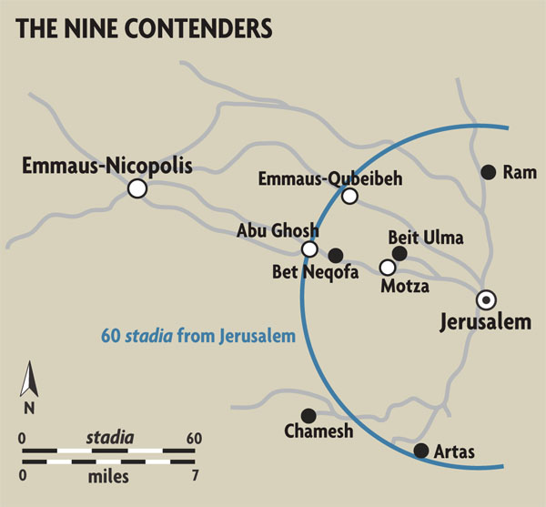
WHERE?
“a village called Emmaus, about seven miles
from Jerusalem” (Lk 24:13)
Greek NT: “sixty stadia”
  One stadios ~ 607 feet
  36,420 feet ~ 6.9 miles
Greek NT textual variant:
  “160 stadia” ~18 miles
Exact location uncertain
  Four main “contenders”

Slide 27
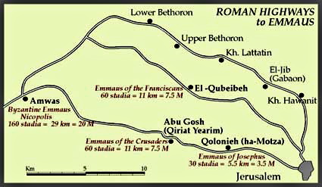
Which EMMAUS?
https://www.seetheholyland.net/emmaus/

Slide 28
WHAT is happening?
Going down, Walking along, Journeying together (vv. 13, 15, 28);
on the road, along the way (vv. 17, 32, 35)
  Note: They are leaving Jerusalem: fleeing? hiding? going home?
Conversing, Debating, Discussing
  “all the things that had occurred…” (v. 14)
  “the things that have taken place (in Jerusalem) these days” (v. 18)
  “The things that happened to Jesus the Nazarene, who was a prophet mighty in deed and word before God and all the people” (v. 19)
  Jesus’ rejection by authorities: his arrest, condemnation, crucifixion, death, burial (v. 20)
Disappointment / HOPES DASHED
  “Looking downcast” (v. 17)
  “We were hoping that he would be the one to redeem Israel” (v. 21)
  Didn’t understand the report of the women who had gone to the tomb (vv. 22-24)

Slide 29
Jesus Explains the SCRIPTURES
Luke 24:25-27 (at Emmaus)
²⁵ And he said to them, "Oh, how foolish you are! How slow of heart to believe all that the prophets spoke!
²⁶ Was it not necessary that the Messiah/Christ should suffer these things and enter into his glory?"
²⁷ Then beginning with Moses and all the prophets, he interpreted to them what referred to him in all the scriptures.
Luke 24:44-47 (back in Jerusalem)
⁴⁴ He said to them, "These are my words that I spoke to you while I was still with you,
that everything written about me in the law of Moses and in the prophets and psalms must be fulfilled."
⁴⁵ Then he opened their minds to understand the scriptures.
⁴⁶ And he said to them, "Thus it is written that the Messiah would suffer and rise from the dead on the third day
⁴⁷ and that repentance, for the forgiveness of sins, would be preached in his name to all the nations,
beginning from Jerusalem.

Slide 30
Jesus’ Prior Words about His Suffering
“Passion Predictions” in Luke’s Gospel (more than three times!)
9:22 – “The Son of Man must suffer greatly and be rejected by the elders, the chief priests, and the scribes, and be killed and on the third day be raised.” (cf. Mark 8:31)
9:44 – “Pay attention to what I am telling you. The Son of Man is to be handed over to men.” (cf. Mark 9:31)
17:25 – “But first [before the Son of Man returns] he must suffer greatly and be rejected by this generation.”
18:31b-33 – “Behold, we are going up to Jerusalem and everything written by the prophets about the Son of Man will be fulfilled. / He will be handed over to the Gentiles and he will be mocked and insulted and spat upon; / and after they have scourged him they will kill him, but on the third day he will rise.” (cf. Mark 10:32-34)
20:9-16 – Parable of the Vineyard (cf. Mark 12:1-9; Matt 21:33-41)
20:17 – “The stone which the builders rejected has become the cornerstone/keystone”
(cf. Mark 12:10; Matt 21:42; Acts 4:11; 1 Pet 2:7)
22:15 [at Last Supper] – "I have eagerly desired to eat this Passover with you before I suffer,”

Slide 31
Apostles Later Preach about Jesus’ Suffering
Acts of the Apostles:
3:18 [Peter in Jerusalem] – “but God has thus brought to fulfillment what he had announced beforehand through the mouth of all the prophets, that his Messiah would suffer.”
17:2-3 [Paul in Thessalonica] – Following his usual custom, Paul joined them, and for three sabbaths he entered into discussions with them from the scriptures, / expounding and demonstrating that the Messiah had to suffer and rise from the dead, and that "This is the Messiah, Jesus, whom I proclaim to you."
26:22-23 [Paul to King Agrippa] – “But I have enjoyed God's help to this very day, and so I stand here testifying to small and great alike, saying nothing different from what the prophets and Moses foretold, / that the Messiah must suffer and that, as the first to rise from the dead, he would proclaim light both to our people and to the Gentiles."

Slide 32
“Messiah” in Old Testament
“Messiah” = “Anointed One” (from Hebrew verb mashah = “to anoint with oil”)
  “Christ” < Greek verb chriō (“to anoint”) and noun christos (“anointed one”)
Used 40+ times in HB / LXX:
  Usually Singular: ref. to priests, prophets, later esp. kings
    Plural in Ps 105:15 - "Do not touch my anointed ones, to my prophets do no harm."
Expectation: “The Lord’s Anointed One” is protected/saved by God
  Especially 1 Sam 24–26
  David repeatedly says he will not harm the “anointed” King Saul
  Exception? 2 Sam 1:1-16
  An Amalekite killed Saul, “the Lord’s anointed”; for which he himself is killed

Slide 33
Rabbinic Jewish Concept of “Messiah”
“Messiah” ushers in the “Messianic Age”
  Leader “Anointed” by God: King? Priest? Prophet? Combo?
  Age of peace, justice, harmony, love, mercy, forgiveness, restoration, etc.
  No more war, tragedy, disease, illness, violence; No more death!
Therefore: “The Messiah doesn’t (or can’t) die!”
  Corollary: Anyone who dies, can’t have been the Messiah!
  Not Jesus (~33), not Bar Kochba (~135)
  Not Rabbi Manachem Schneerson (1902–1994)
Christians Claim: Jesus IS the Messiah / The Messiah IS Jesus!
  HOW is that possible? How can we explain that?

Slide 34
“What Referred to Him in ALL the Scriptures”?
Which Texts? – of “Moses, the Prophets, and the Psalms”?
MOSES:
  Deut 18:15 (Moses to the people) – “A prophet like me will the LORD, your God, raise up for you
  from among your own kindred; that is the one to whom you shall listen.” (also quoted in Acts 3:22)
  Deut 18:18 (God replies to Moses) - “I will raise up for them a prophet like you from among their kindred, and will put my words into the mouth of the prophet; the prophet shall tell them all that I command.”
Other Texts from “Moses”: Genesis, Exodus, Leviticus, Numbers, Deuteronomy?
  John 1:45 [Philip to Nathanael] – “We have found the one about whom Moses wrote in the law, and also the prophets, Jesus, son of Joseph, from Nazareth.”
  John 5:46 [Jesus to Jews] – “For if you believed Moses, you would believe me; for he wrote of me.”

Slide 35
“What Referred to Him in the PROPHETS”?
Four “Suffering Servant Songs” in ISAIAH (used during Holy Week)
  Isaiah 42:1-7
    ¹ Here is my servant whom I uphold, my chosen one with whom I am pleased.
    Upon him I have put my spirit; he shall bring forth justice to the nations.
    ² He will not cry out, nor shout, nor make his voice heard in the street.
    ³ A bruised reed he will not break, and a dimly burning wick he will not quench. He will faithfully bring forth justice.
    ⁴ He will not grow dim or be bruised until he establishes justice on the earth; the coastlands will wait for his teaching.
    ⁵ Thus says God, the LORD, who created the heavens and stretched them out,
    who spread out the earth and its produce, Who gives breath to its people and spirit to those who walk on it:
    ⁶ I, the LORD, have called you for justice, I have grasped you by the hand;
    I formed you, and set you as a covenant for the people, a light for the nations,
    ⁷ To open the eyes of the blind, to bring out prisoners from confinement,
    and from the dungeon, those who live in darkness. (cf. Isa 61:1-2; quoted by Jesus in Luke 4:18-19)
  Isaiah 49:1-6
  Isaiah 50:4-9a
  Isaiah 52:13—53:12

Slide 36
“What Referred to Him in Other PROPHETS”?
Lam 4:20 – “The LORD's anointed -- our very lifebreath! -- was caught in their snares,
He in whose shade we thought to live among the nations.”
Dan 9:25-26 –
“Know and understand: From the utterance of the word that Jerusalem was to be rebuilt
Until there is an anointed ruler, there shall be seven weeks.
In the course of sixty-two weeks it shall be rebuilt,
With squares and trenches, in time of affliction. /
After the sixty-two weeks an anointed one shall be cut down with no one to help him.
And the people of a leader who will come shall destroy the city and the sanctuary.
His end shall come in a flood; until the end of the war, which is decreed, there will be desolation.”
Hab 3:13 – “You came forth to save your people, to save your anointed one.”

Slide 37
“What Referred to Him in the PSALMS”?
Psalm 2
  ¹ Why do the nations protest and the peoples conspire in vain?
  ² Kings on earth rise up and princes plot together against the LORD and against his anointed one:
  ⁷ I will proclaim the decree of the LORD, he said to me, “You are my son; today I have begotten you.”
Psalm 22
  ² “My God, my God, why have you abandoned me?”
  ³¹ “And I will live for the LORD; my descendants will serve you.
  ³² The generation to come will be told of the Lord,
  that they may proclaim to a people yet unborn the deliverance you have brought.”
Psalm 31
  ² “In you, LORD, I take refuge; let me never be put to shame.”
  ⁶ “Into your hands I commend my spirit; you will redeem me, LORD, God of truth.”

Slide 38
Word & SACRAMENT
The Supper at Emmaus – only in Luke 24
  ³⁰ "When he was at table with them, he took bread,
  blessed it, and broke it, and gave it to them.
  ³¹ Then their eyes were opened, and they recognized him;
  and he vanished from their sight...
  ³³ That same hour they got up and returned to Jerusalem;
  and they found the eleven and their companions gathered together...
  ³⁵ Then they told what had happened on the road,
  and how he had been made known to them
  in the breaking of the bread.“
Feeding of 5000 – Luke 9:16 (cf. Mark 6:41; 8:6; Matt 14:19; 15:36)
Last Supper – Luke 22:19 (cf. Mark 14:22; Matt 26:26)

Slide 39
“Breaking of the Bread” (a.k.a. Lord's Supper or Eucharist)
1 Cor 10:16-17 - "The cup of blessing that we bless, is it not a sharing in the BLOOD of Christ?
The bread that we break, is it not a sharing in the BODY of Christ?
Because there is one bread, we who are many are one body, for we all partake of the one bread."
1 Cor 11:17-21 (Paul scolding the early Christians in Corinth for not conducting the Lord's Supper properly) -
"...when you come together it is not for the better but for the worse. For, to begin with,
when you come together as a church, I hear that there are divisions among you...
When you come together, it is not really to eat the Lord's supper.
For when the time comes to eat, each of you goes ahead with your own supper,
and one goes hungry and another becomes drunk." (see also 11:23-34)
Acts 2:42, 46 - "They (the community of believers in Jerusalem) devoted themselves to the apostles' teaching and fellowship,
to the breaking of bread and the prayers... Day by day, as they spent much time together in the temple,
they broke bread at home and ate their food with glad and generous hearts..."
Acts 20:7, 11 - "On the first day of the week, when we met to break bread,
Paul was holding a discussion with them; since he intended to leave the next day, he continued speaking until midnight...
Then Paul went upstairs, and after he had broken bread and eaten, he continued to converse with them until dawn; then he left."
Acts 27:35 (Paul speaks to everyone on a ship after fourteen days of riding out a storm at sea) -
"After he had said this, he took bread; and giving thanks to God in the presence of all, he broke it and began to eat."

Slide 40
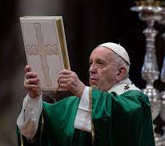
Pope Francis, Aperuit Illis
“Instituting the Sunday of the Word of God”
  Apostolic Letter, issued Sept. 30, 2019
  Memorial of St. Jerome (1600th Anniv. of Jerome’s Death)
Largely Based on Emmaus Narrative:
  Par. 1 – Begins by quoting Luke 24:45
    “He opened their minds to understand the Scriptures”
  Par. 2-3 – Declaring the 3rd Sunday in Ordinary Time
  Par. 4-5 – Connection of Bible & Faith for all people (ancient & today)
  Par. 6-8 – Emmaus: role of Scripture and of Eucharist
  Par. 9-15 – Other aspects of Scripture pertinent for us today

Slide 41
Aperuit Illis – Instituting the Sunday of the Word of God
1. "He opened their minds to understand the Scriptures" (Lk 24:45). This was one of the final acts of the risen Lord before his Ascension. Jesus appeared to the assembled disciples, broke bread with them and opened their minds to the understanding of the sacred Scriptures. To them, amid their fear and bewilderment, he unveiled the meaning of the paschal mystery: that in accordance with the Father’s eternal plan he had to suffer and rise from the dead, in order to bring repentance and the forgiveness of sins (cf. Lk 24:26, 46-47). He then promised to send the Holy Spirit, who would give them strength to be witnesses of this saving mystery (cf. Lk 24:49).
The relationship between the Risen Lord, the community of believers and sacred Scripture is essential to our identity as Christians. Without the Lord who opens our minds to them, it is impossible to understand the Scriptures in depth. Yet the contrary is equally true: without the Scriptures, the events of the mission of Jesus and of his Church in this world would remain incomprehensible. Hence, Saint Jerome could rightly claim: "Ignorance of the Scriptures is ignorance of Christ" (Commentary on Isaiah, Prologue: PL 24,17B).

Slide 42
Aperuit Illis – Instituting the Sunday of the Word of God
6. Before encountering his disciples, gathered behind closed doors, and opening their minds to the understanding of the Scriptures (cf. Lk 24:44-45), the risen Lord appeared to two of them on the road to Emmaus from Jerusalem (cf. Lk 24:13-35). Saint Luke’s account notes that this happened on the very day of his resurrection, a Sunday. The two disciples were discussing the recent events concerning Jesus’ passion and death. Their journey was marked by sorrow and disappointment at his tragic death. They had hoped that he would be the Messiah who would set them free, but they found themselves instead confronted with the scandal of the cross. The risen Lord himself gently draws near and walks with them, yet they do not recognize him (cf. v. 16). Along the way, he questions them, and, seeing that they have not grasped the meaning of his passion and death, he exclaims: "O foolish men, and slow of heart" (v. 25). Then, "beginning with Moses and all the prophets, he interpreted to them the things about himself in all the Scriptures" (v.27). Christ is the first exegete! Not only did the Old Testament foretell what he would accomplish, but he himself wished to be faithful to its words, in order to make manifest the one history of salvation whose fulfilment is found in Christ.

Slide 43
Aperuit Illis – Instituting the Sunday of the Word of God
7. The Bible, as sacred Scripture, thus speaks of Christ and proclaims him as the one who had to endure suffering and then enter into his glory (cf. v. 26). Not simply a part, but the whole of Scripture speaks of Christ. Apart from the Scriptures, his death and resurrection cannot be rightly understood. That is why one of the most ancient confessions of faith stressed that "Christ died for our sins in accordance with the Scriptures, that he was buried, that he was raised on the third day in accordance with the Scriptures, and that he appeared to Cephas" (1Cor15:3-5). Since the Scriptures everywhere speak of Christ, they enable us to believe that his death and resurrection are not myth but history, and are central to the faith of his disciples.
A profound bond links sacred Scripture and the faith of believers. Since faith comes from hearing, and what is heard is based on the word of Christ (cf. Rom 10:17), believers are bound to listen attentively to the word of the Lord, both in the celebration of the liturgy and in their personal prayer and reflection.

Slide 44
Aperuit Illis – Instituting the Sunday of the Word of God
8. The journey that the Risen Lord makes with the disciples of Emmaus ended with a meal. The mysterious wayfarer accepts their insistent request: "Stay with us, for it is almost evening and the day is now far spent" (Lk 24:29). They sit down at table, and Jesus takes the bread, blesses it, breaks it and offers it to them. At that moment, their eyes are opened, and they recognize him (cf. v. 31).
This scene clearly demonstrates the unbreakable bond between sacred Scripture and the Eucharist. As the Second Vatican Council teaches, "the Church has always venerated the divine Scriptures as she has venerated the Lord’s body, in that she never ceases, above all in the sacred liturgy, to partake of the bread of life and to offer it to the faithful from the one table of the word of God and the body of Christ" (Dei Verbum, 21).

Slide 45
Aperuit Illis – Instituting the Sunday of the Word of God
8 (cont.) Regular reading of sacred Scripture and the celebration of the Eucharist make it possible for us to see ourselves as part of one another. As Christians, we are a single people, making our pilgrim way through history, sustained by the Lord, present in our midst, who speaks to us and nourishes us. A day devoted to the Bible should not be seen as a yearly event but rather a year-long event, for we urgently need to grow in our knowledge and love of the Scriptures and of the risen Lord, who continues to speak his word and to break bread in the community of believers. For this reason, we need to develop a closer relationship with sacred Scripture; otherwise, our hearts will remain cold and our eyes shut, struck as we are by so many forms of blindness.
Sacred Scripture and the sacraments are thus inseparable. When the sacraments are introduced and illumined by God’s word, they become ever more clearly the goal of a process whereby Christ opens our minds and hearts to acknowledge his saving work. We should always keep in mind the teaching found in the Book of Revelation: the Lord is standing at the door and knocking. If anyone should hear his voice and open for him, he will come in and eat with them (cf. 3:20). Christ Jesus is knocking at our door in the words of sacred Scripture. If we hear his voice and open the doors of our minds and hearts, then he will enter our lives and remain ever with us.

Slide 46


Slide 47
INTERNATIONAL THEOLOGICAL COMMISSION:
“Synodality in the Life and Mission of the Church”
16. Jesus is the pilgrim who proclaims the good news of the Kingdom of God (cf. Luke 4:14-15; 8:1; 9:57; 13:22; 19:11), teaches "the way of God" (cf. Luke 20:21) and points the way to it (Luke 9:51–19:28). In fact, He Himself is "the way" (cf. John 14:6) that leads to the Father; in the Holy Spirit (cf. John 16:13) He shares with everyone the truth and love of communion with God and our sisters and brothers. Living communion according to the standard of Jesus’ new commandment means walking together in history as the People of God of the new covenant, in a way that fits the gift received (cf. John 15:12-15).
In his account of the disciples at Emmaus, Luke gives us a living icon of the Church as People of God, guided on its way by the risen Lord, who lights it up by His Word and feeds it with the Bread of Life (cf. Luke 24:13-35).

Slide 48
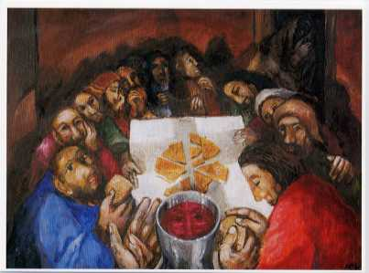

Slide 49
OTHER Themes of Luke’s Gospel (HO for 4-06)
A) Christology & Discipleship:
  Savior & Lord of All (1:68-79; 2:11, 29-32)
  Christ/Messiah & Prophet (4:16-30; 13:33-34)
  “Love your enemies” (6:27, 35); “be merciful” (6:36)
  Be sent on “mission” (9:1-6; 10:1-20)
B) Theological Geography & Contextualized History
  Gospel begins & ends in Temple of Jerusalem
  Jesus’ journey to Jerusalem is central
  Historical markers: 1:5 (days of Herod); 2:1-3 (census of Augustus);
  3:1-2 (15th year of Tiberius)

Slide 50
Other Themes & Emphases in Luke
C) Prominence of the Holy Spirit
  Drives all the action throughout Luke’s Gospel (and Acts)
  “Inspires” Zechariah, Elizabeth, John the Baptist, Mary, Jesus, esp. at the beginning
D) Prayer and Praise, Thanksgiving and Joy, Mercy and Salvation:
  Hymns of praise
  Prayers of Jesus & of other characters
  Jesus’ teachings about prayer

Slide 51
Other Themes & Emphases in Luke
E) More Parables than in any other Gospel:
  Focus on repentance/forgiveness (esp. Luke 15)
  Use of wealth/possessions (esp. Luke 16)
F) Prominence of Food & Meals
  Stresses importance of hospitality, community and sharing
  “Eating your way through Luke’s Gospel”
  “Breaking of the Bread” (esp. Luke 24)

Slide 52
Other Themes & Emphases in Luke
G) Prominence of Women
  reflects Luke’s original readers; women leaders in Pauline churches
  Luke often pairs stories with men and stories with women (real or fictional)
H) More attention to Poor & Lowly, Sick & Sinners, Samaritans & Gentiles
  Prominence of Women, both real and fictional characters (often in story pairs)
  Samaritan Villagers; Parable of Good Samaritan; Healing of 10 Lepers (one Sam.)
I) Theme of Reversal:
  poor/rich, hungry/satisfied, weak/strong, lowly/proud, etc.
  Mary’s “Magnificat” (Luke 1:46-55);
  Beatitudes & Woes (Luke 6:20-26; contrast Matt 5:3-12)

Slide 53
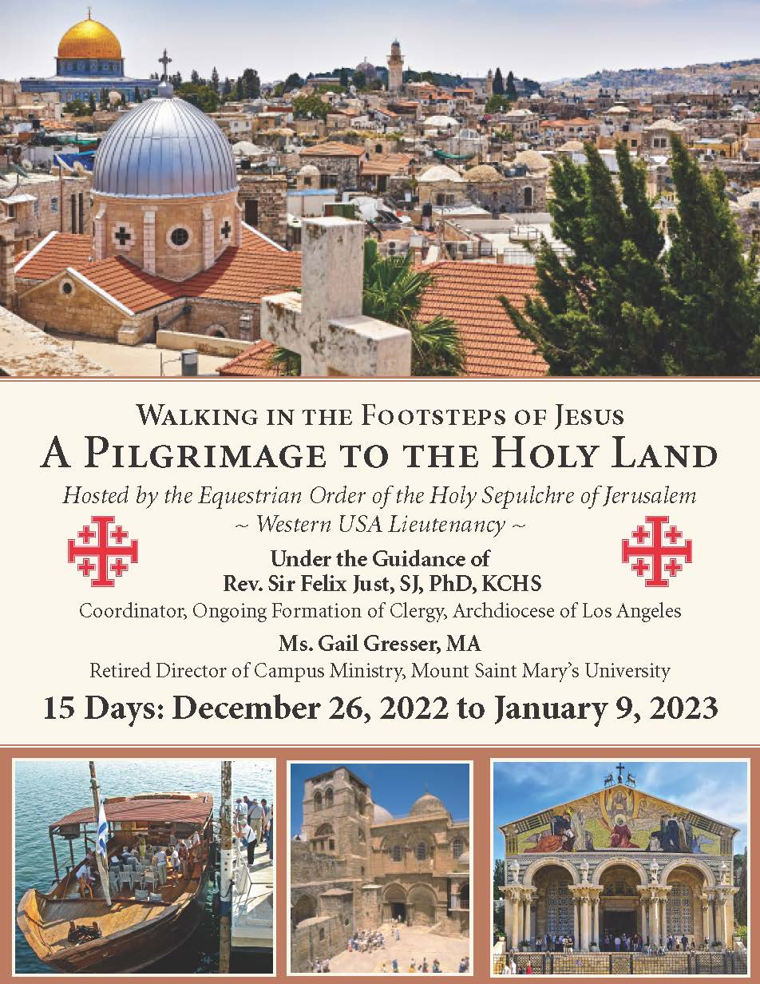
Holy Land
Pilgrimage
Dec. 26, 2022 to Jan. 9, 2023 https://catholic-resources.org

Slide 54
Conclusion
https://catholic-resources.org
Comments? Questions?
Thanks for Participating in RE Congress!

