Slide 1
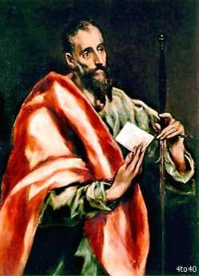
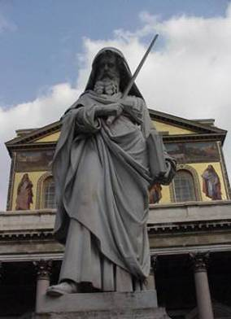
Saint Paul (with us/others) in Greece
Fr. Felix Just, S.J.
Loyola Marymount Jesuits
Los Angeles, CA
https://catholic-resources.org

Slide 2
Welcome & Introductions
Welcome!
Prayer
Brief Introductions
Introductory Webinars:
  Th, Nov. 7 (tonight) – Overview: Pilgrimage & Paul
  Th, Dec. 12 (Fr. Alexei) – Christianities E & W
  Th, Jan. 23 (Fr. Felix) – Paul’s Travels & Letters I
  Th, Feb. 6 (Fr. Felix) – Paul’s Travels & Letters II

Slide 3
PILGRIMS’ PRAYER
Lord Jesus,
You have called us as pilgrims to walk your Holy Way.
Lead and guide us as we prepare
to follow in the footsteps of your earliest followers,
and walk in the way of our fathers and mothers in faith.
May they teach us to see you afresh through their eyes,
and to come to know you more deeply.
Give us grace to see you not only in sacred places
and in the people we meet in Greece and Turkey,
but also in each other.
May our journey renew us for the work
we are called to do in your Name. Amen.

Slide 4
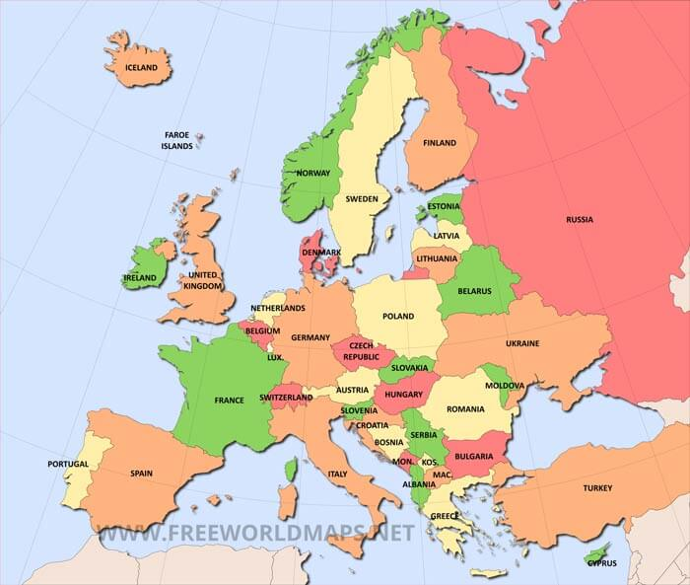
Europe

Slide 5
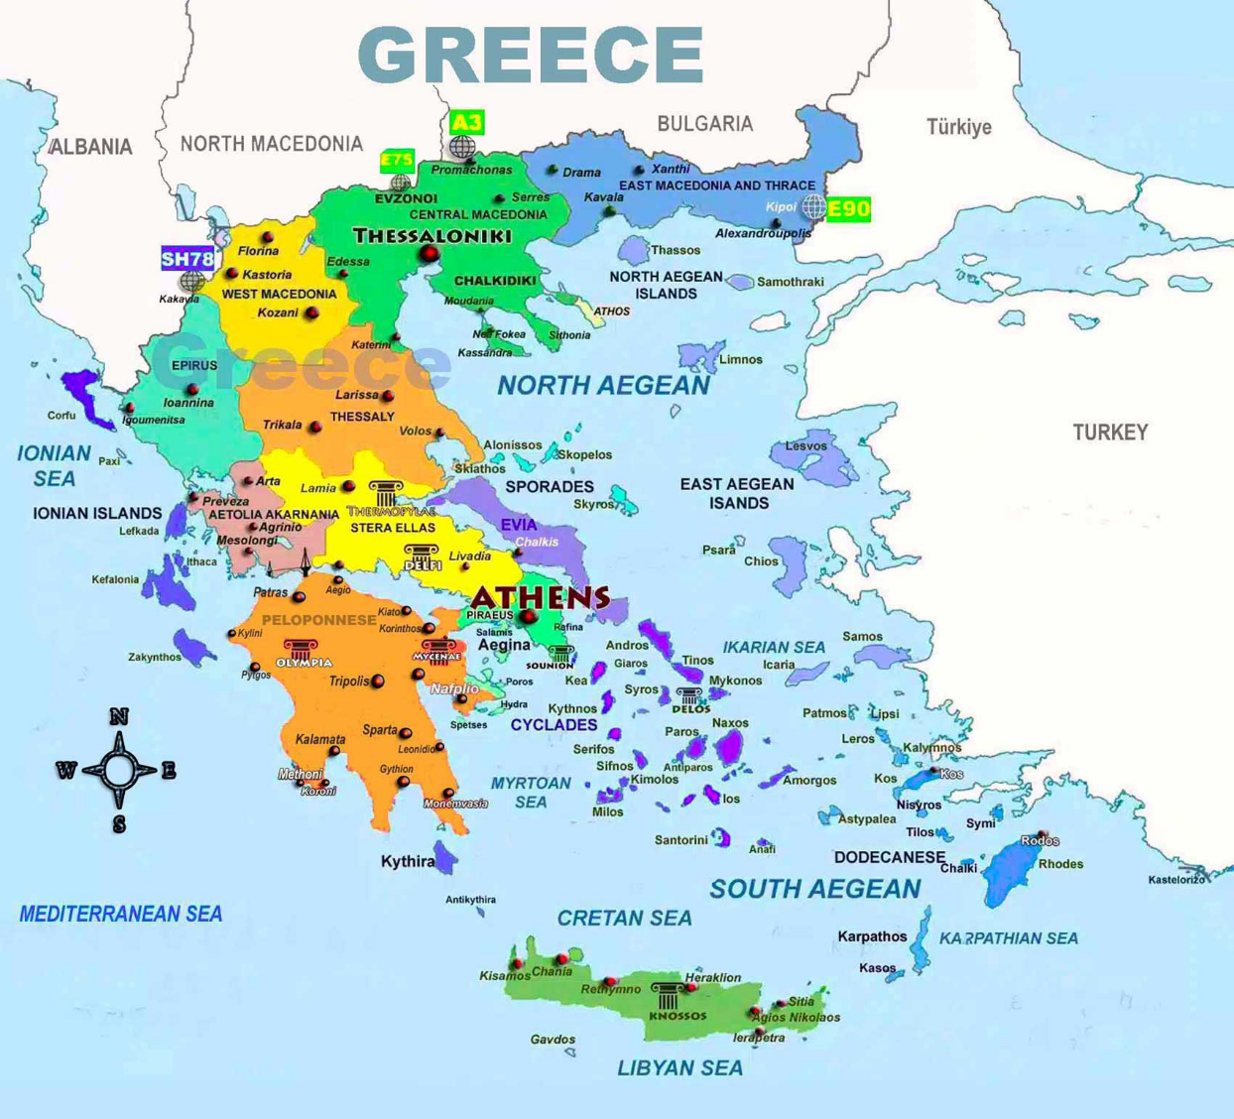

Slide 6
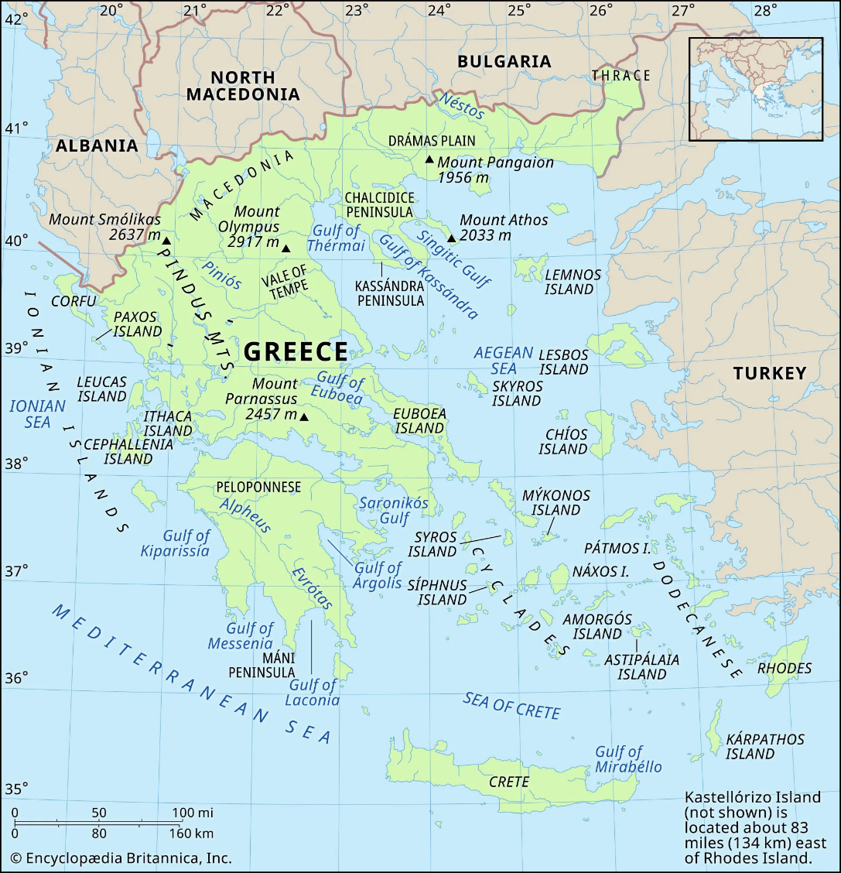

Slide 7
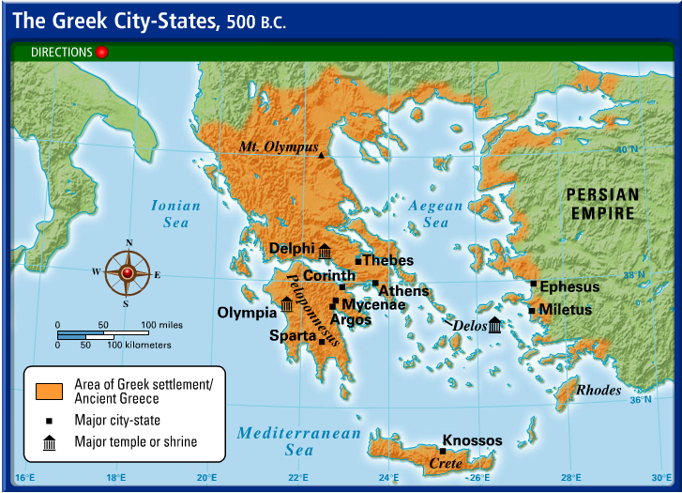

Slide 8
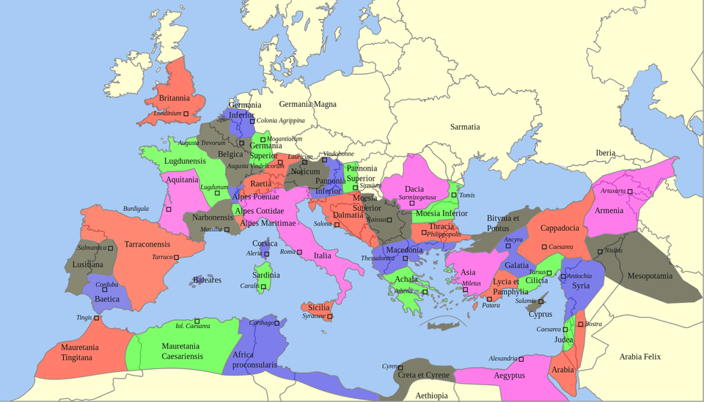
Provinces in Roman Empire

Slide 9
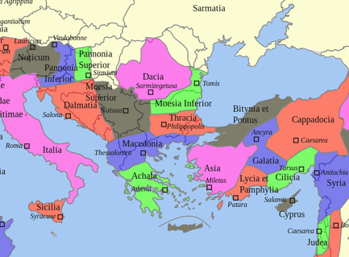
Provinces in Roman Empire

Slide 10
Pilgrimage: St. Paul in Greece
LAND: Thessaloniki, Filippoi, Kavala, Amphipolis, Veria, Vergina, Kalambaka, Meteora, Delphi, Athens, …Corinth, Cenchrea
  Days 2-4: https://maps.app.goo.gl/JeW7EMv3RP8GZ9taA
  Days 5-8: https://maps.app.goo.gl/KxRHxu2MSKhAVRYN9
  Day 14: https://maps.app.goo.gl/LZVoLGvCBdLgvEpt5
CRUISE (Days 9-12): Lavrio (port), Mykonos (island), Kusadasi/Ephesus, Patmos, Crete (Heraklion), Santorini
  FJ Map: https://maps.app.goo.gl/8DhCzFbTzuQxkGjJ6

Slide 11
Greece Pilgrimage: Days 1 – 4
THU, APRIL 3, DAY 1: DEPART the USA
  Los Angeles → Frankfurt → Thessalonki (Northern Greece)
FRI, APRIL 4, DAY 2: ARRIVE in THESSALONIKI
  Transfer from airport to hotel (dinner).
SAT, APRIL 5, DAY 3: EXCURSION to PHILIPPI and KAVALA
  Bus to Philippi, on the ancient Via Egnatia (Roman road between Rome and Byzantium, today’s Istanbul).
  Mass by river (where St. Lydia was baptized by Paul)
  Visit ruins of prison (where Paul and Silas were held), Agora (with its Theater), and a 5th century Basilica.
  Continue to nearby port of Kavala (Neapolis in Acts 16:11).
  Drive by Amphipolis on road back to Thessaloniki.
SUN, APRIL 6, DAY 4: VISIT CITY of THESSALONIKI
  Mass at Holy Cathedral of the Immaculate Conception; then explore ancient city of Thessalonica.
  Visit Greek Orthodox Church of Saint Demitrius (4th century Thessalonian Christian martyr) and
  Church of Hagia Sophia (8th century, UNESCO World Heritage Site)
  View Rotunda of Galerius (a church for 1200+ years) and Arch of Galerius (AD 298-299)

Slide 12
Greece Pilgrimage: Days 5 – 8
MON, APRIL 7, DAY 5: THESSALONIKI → VERIA → VERGINA → KALAMBAKA
  Travel to Veria (Berea), major worship site for 1st century Romans.
  Travel to Vergina (Museum of Royal Tombs; burial of Philip II of Macedon; UNESCO World Heritage Site). Continue to Kalambaka (dinner at hotel)
TUE, APRIL 8, DAY 6: VISIT METEORA MONASTERIES
  Visit two Greek Orthodox monasteries (13th - 14th centuries; UNESCO World Heritage Site)
WED, APRIL 9, DAY 7: KALAMBAKA → DELPHI → ATHENS
  Bus to Delphi (significant religious sanctuary; home of god Apollo & most famous oracle of antiquity)
  Continue to Athens (dinner at hotel)
THURS, APRIL 10, DAY 8: ATHENS: VISIT AGORA & PARTHENON; CITY TOUR
  Mass at Cathedral of St. Dionysius, patron saint of Athens (Acts 17:34)
  Tour remains of ancient Athens: Acropolis, Parthenon, Hadrian’s Arch, Temple of Zeus, Agora, Areopagus

Slide 13
Greece Pilgrimage: Days 9 – 12
FRI, APRIL 11, DAY 9: CRUISE: PORT of LAVRIO → MYKONOS → KUSADASI
  Board cruise ship at port of Lavrio. Sail to island of Mykonos.
  Continue overnight to Kasadasi (Turkey)
SAT, APRIL 12, DAY 10: CRUISE: KUSADASI (EPHESUS) → PATMOS → CRETE
  Dock at Kusadasi; bus to Ephesus; visit extensive ruins of capital of Roman Province of Asia [Minor].
  Visit ruins of Church of the Virgin Mary, site of Council of Ephesus (AD 431).
  Visit Basilica of St. John, with tomb of St. John & House of Virgin Mary.
  Return to Kusadasi; sail to Island of Patmos; visit Monastery of St. John (11th century, with grotto)
SUN, APRIL 13, DAY 11: CRUISE: CRETE → SANTORINI → Return to ATHENS
  Arrive in Crete (explore island on our own or purchase shore excursion)
  Continue to Island of Santorini.
MON, APRIL 14, DAY 12: LAVRIO → CORINTH → CENCHREA → ATHENS
  Return to port; bus to Corinth; view Acropolis (“upper city”); visit ruins of lower city: Agora (central market)
  On way back to Athens, brief stop at Cenchrea (site of Phoebe’s
TUE, APRIL 15, DAY 13: RETURN to USA
More details: https://catholic-resources.org/Events/Pilgrimages/2025_Just_Gresser_Greece_Brochure.pdf

Slide 14
Intro: Me, You, Paul, and God
Galatians 4:4-7 – “But when the fullness of time had come, God sent his Son, born of a woman, born under the law, to ransom those under the law, so that we might receive adoption. As proof that you are children, God sent the spirit of his Son into our hearts, crying out, ‘Abba, Father! ’ So you are no longer a slave but a child, and
if a child then also an heir, through God.”

Slide 15
What was the “Pauline Year”?
“Dear brothers and sisters, as in early times, today too Christ needs apostles ready to sacrifice themselves.
He needs witnesses and martyrs like St Paul.
Paul, a former violent persecutor of Christians, when he fell to the ground dazzled by the divine light on the road to Damascus, did not hesitate to change sides to the Crucified One and followed him without second thoughts. He lived and worked for Christ, for him he suffered and died. How timely his example is today!”
“And for this very reason I am pleased to announce officially that we shall be dedicating a special Jubilee Year to the Apostle Paul from 28 June 2008 to 29 June 2009, on the occasion of the bimillennium of his birth, which historians have placed between the years 7 and 10 A.D.!”
Pope Benedict XVI, 28 June 2007
First Vespers of the Solemnity of Saints Peter and Paul

Slide 16
What was the “Pauline Year”?
A year in which the Catholic Church celebrated the 2000th anniversary of the birth of St. Paul.
  The Church invites us to deepen our understanding of the teachings of this great Christian Apostle, and to imitate his life of witness and sacrifice for Jesus Christ.
Three principal liturgical celebrations:
  June 28, 2008 – Solemnity of Sts. Peter & Paul (vigil)
  Jan. 25, 2009 – Feast of the Conversion of St. Paul
  June 29, 2009 – Solemnity of Sts. Peter & Paul

Slide 17
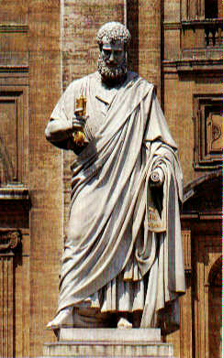
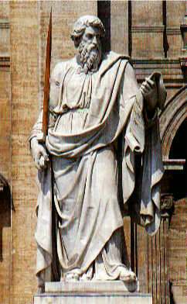
Saint Peter & Saint Paul
←
Saint Peter with keys
(Matt 16:19)
→
Saint Paul with a sword
(Eph 6:17)

Slide 18
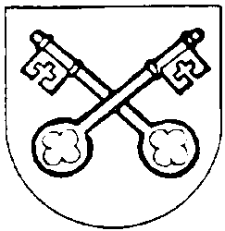
Symbol of St. Peter: Keys
Matt 16:13-20 – 13 When Jesus went into the region of Caesarea Philippi he asked his disciples, "Who do people say that the Son of Man is?" 14 They replied, "Some say John the Baptist, others Elijah, still others Jeremiah or one of the prophets." 15 He said to them, "But who do you say that I am?" 16 Simon Peter said in reply, "You are the Messiah, the Son of the living God." 17 Jesus said to him in reply, "Blessed are you, Simon son of Jonah. For flesh and blood has not revealed this to you, but my heavenly Father. 18 And so I say to you, you are Peter, and upon this rock I will build my church, and the gates of the netherworld shall not prevail against it. 19 I will give you the keys to the kingdom of heaven. Whatever you bind on earth shall be bound in heaven; and whatever you loose on earth shall be loosed in heaven."

Slide 19

Symbol of St. Paul: Sword
Eph 6:10-17 – Finally, draw your strength from the Lord and from his mighty power. 11 Put on the armor of God so that you may be able to stand firm against the tactics of the devil… 13 Therefore, put on the armor of God, that you may be able to resist on the evil day and, having done everything, to hold your ground. 14 So stand fast with your loins girded in truth, clothed with righteousness as a breastplate, 15 and your feet shod in readiness for the gospel of peace. 16 In all circumstances, hold faith as a shield, to quench all (the) flaming arrows of the evil one. 17 And take the helmet of salvation and the sword of the Spirit, which is the word of God.

Slide 20

The Importance of St. Paul
27 "books" in the New Testament:
  4 "Gospels" (Matthew, Mark, Luke, John)
  1 "Acts of the Apostles"
  21 "Letters" or "Epistles" by various apostles
  1 "Apocalypse of John"
Many of these books are related to St. Paul:
  13 of the 21 "Letters" are written by or attributed to Paul.
  More than half of "Acts of the Apostles" deals with the life, conversion, and other activities of Paul and his companions.
  Paul and his associates founded many Christian "churches" (not buildings, but communities) throughout the Eastern Mediterranean.

Slide 21
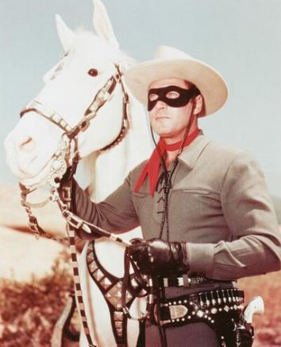
Who was Saint Paul?
NOT a "Lone Ranger"
  never worked alone; always together with
  many associates, companions, friends,…
NOT the "Founder of Christianity"
  not more important than Jesus Christ
YES, he was a great apostle, missionary, preacher
  travelled throughout the Mediterranean region
YES, he was a theologian and writer of letters
  but never wrote an autobiography nor a systematic theology
YES, he was a great Organizer and Leader
  directed a very extensive missionary operation

Slide 22
What do we know about Paul's Life?
Two main historical sources:
  Acts of the Apostles (Luke's second volume)
  Paul's own letters (a few autobiographical notes)
We do not know some basic “facts”:
  When was he born?
  What were the names of his parents?
  When did he become a Christian?
  When did he die?

Slide 23
The Life of Saint Paul
Birth in Tarsus:
  Perhaps in AD 7 – 10?
Cultural, Religious, and Political Life:
  Two languages, two cultures: Hebrew-Jewish & Greco-Roman
Christian and Missionary Life:
  “Apostle” to Gentiles; “Father” to converts; “Brother” to all
Death in Rome:
  Perhaps AD 62 or 64 or 67? – certainly during the reign of Emperor Nero (who reigned AD 54-68)
  Great Fire of Rome AD 64: Nero blamed the Christians
  (many were martyred, possibly including Peter and Paul)

Slide 24
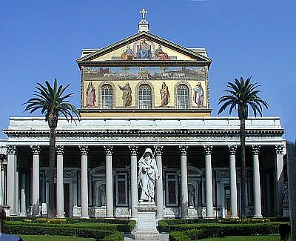
St. Paul Outside the Walls (Rome)

Slide 25
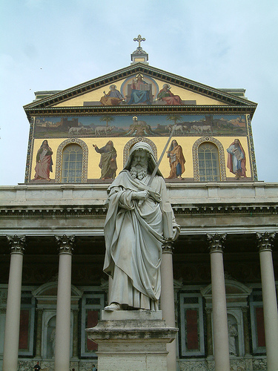
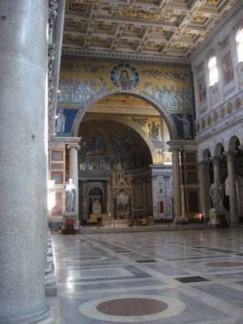
St. Paul Outside the Walls (Rome)

Slide 26
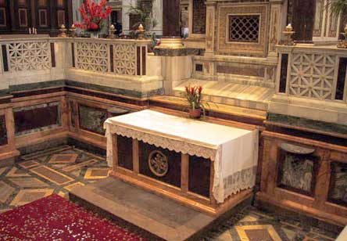
Tomb of St. Paul: Altar

Slide 27
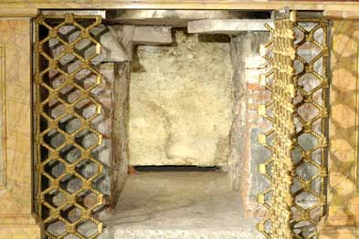
Tomb of St. Paul: Sarcophagus

Slide 28
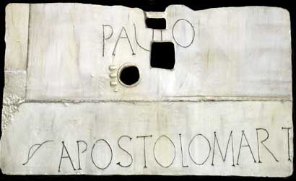
Tomb of St. Paul: Lapida

Slide 29
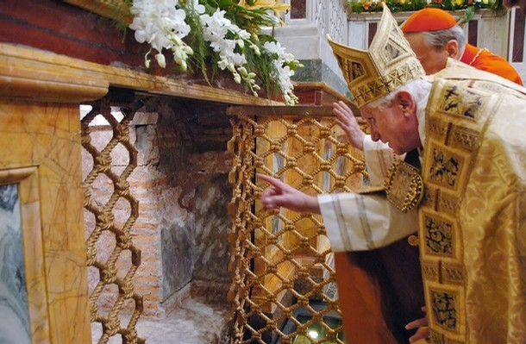
Tomb of St. Paul: Pope's Visit

Slide 30
Sources for Paul’s Life
Acts of the Apostles
  7:58–8:3 – Young Saul at Stephen’s stoning
  9:1-19 – Saul’s “conversion” on road to Damascus
  9:20-30 – Saul in Damascus, Jerusalem, Tarsus
  11:25-30 – Barnabas brings Saul to Antioch
  Chaps. 13 to 28 – Paul’s missionary journeys thru Eastern Mediterranean, and a final journey to Rome
Differences: Luke’s Acts vs. Paul’s Letters?

Slide 31
Sources for Paul’s Life (cont.)
Autobiographical asides in Paul’s letters:
  Gal 1:11–2:14 – longest autobiographical passage
  Rom 11:1 – an Israelite, of the tribe of Benjamin
  Phil 3:5-6 – Paul’s prior persecution of Christians
  1 Cor 9:1; 15:8-10 – “appearance” of Jesus to Paul
  2 Cor 2:12-13 – Paul went to Troas and Macedonia
  2 Cor 11:23-33 – Paul’s hardships and sufferings
  1 Thess 2:1–3:8 – visit of Paul, Silas, Timothy
  1 Cor 15:32; 16:8 – Paul stays in Ephesus

Slide 32
2 Cor 11:21-33 – Paul’s Sufferings
“But what anyone dares to boast of (I am speaking in foolishness) I also dare. 22 Are they Hebrews? So am I. Are they Israelites? So am I. Are they descendants of Abraham? So am I. 23 Are they ministers of Christ? (I am talking like an insane person.) I am still more, with far greater labors, far more imprisonments, far worse beatings, and numerous brushes with death. 24 Five times at the hands of the Jews I received forty lashes minus one. 25 Three times I was beaten with rods, once I was stoned, three times I was shipwrecked, I passed a night and a day on the deep; 26 on frequent journeys, in dangers from rivers, dangers from robbers, dangers from my own race, dangers from Gentiles, dangers in the city, dangers in the wilderness, dangers at sea, dangers among false brothers; [Note: We do not know WHEN or WHERE most of this happened!]

Slide 33
2 Cor 11:21-33 – Paul’s Sufferings (cont.)
27 in toil and hardship, through many sleepless nights, through hunger and thirst, through frequent fastings, through cold and exposure. 28 And apart from these things, there is the daily pressure upon me of my anxiety for all the churches.
29 Who is weak, and I am not weak? Who is led to sin, and I am not indignant? 30 If I must boast, I will boast of the things that show my weakness. 31 The God and Father of the Lord Jesus knows, he who is blessed forever, that I do not lie.
32 At Damascus, the governor under King Aretas guarded the city of Damascus, in order to seize me,
33 but I was lowered in a basket through a window in the wall and escaped his hands. -- (cf. Acts 9:23-25)

Slide 34
Sources for Paul's Life (cont.)
Notes on Paul’s travels & companions:
  1 Cor 4:17; 16:10 – Paul sent Timothy to Corinth
  1 Cor 16:1-12, 19 – Paul’s further travel plans
  Rom 15:22-32 – plans to visit Rome & Spain
  Phil 2:25; 4:18 – Epaphroditus to/from Philippi
  Col 1:7; 4:12 – Epaphras came from Colossae
  Rom 16:1-23 – many friends from Achaia, Asia, etc.
  Beginning & ending of most of his letters: recipients named & greetings exchanged

Slide 35
Paul’s Three Missionary Journeys?
Traditional (but Inaccurate) Division:
  1) Acts 13–14: Journey through Cyprus, Pamphylia, and Pisidia (today's South-Central Turkey)
  2) Acts 15:39–18:22: Journey through Macedonia and Achaia (modern Greece) and Asia Minor (Western Turkey)
  3) Acts 18:23–21:16: Another Journey through Asia Minor, Macedonia, and Achaia, ending in Jerusalem
  R) Acts 22–28: After being arrested in Jerusalem and imprisoned in Caesarea, Paul is taken by ship to Rome
  See handout

Slide 36
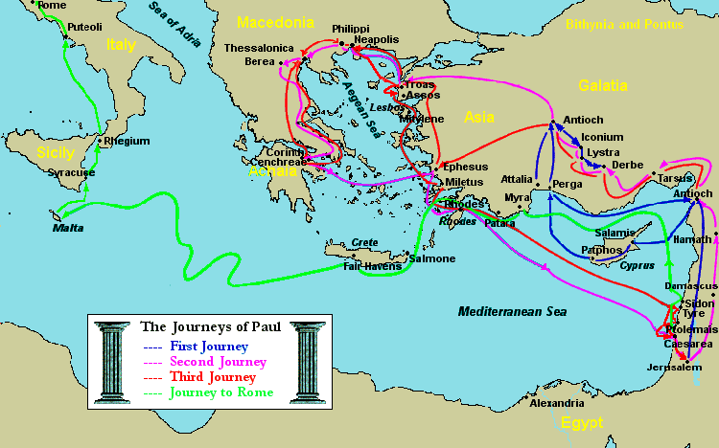
Paul's Journeys: Traditional View

Slide 37
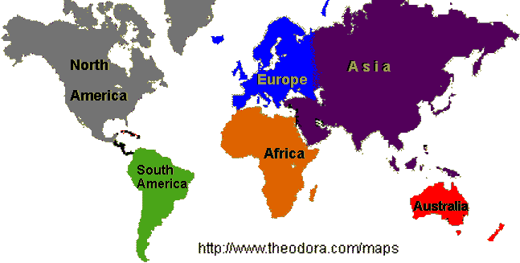
World & Continents

Slide 38
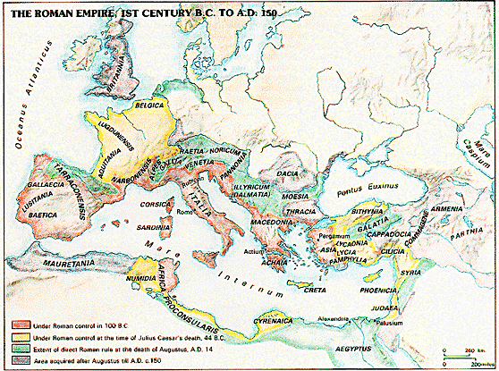
Roman Empire

Slide 39
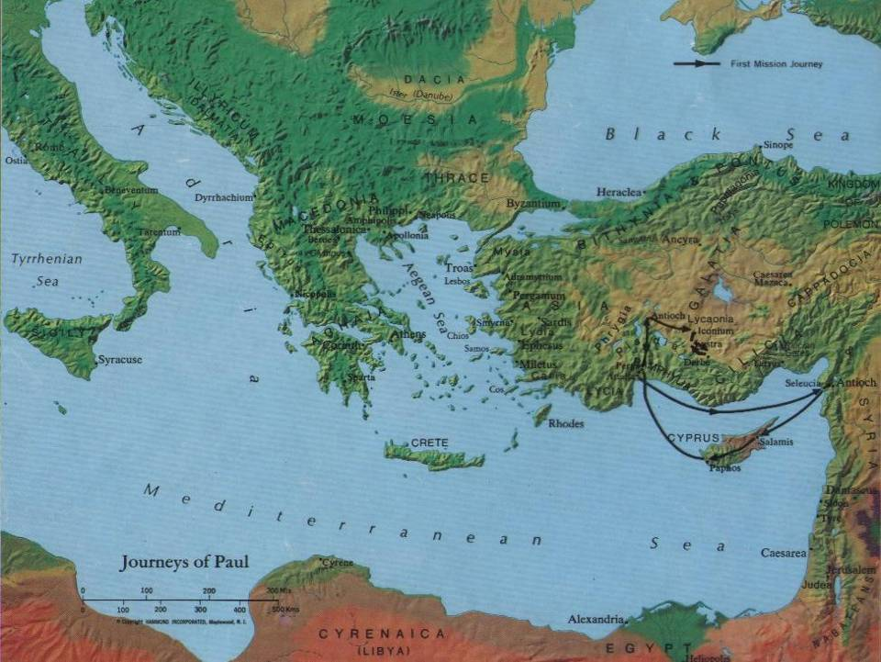
Paul's 1st Journey (Acts 13–14)?

Slide 40
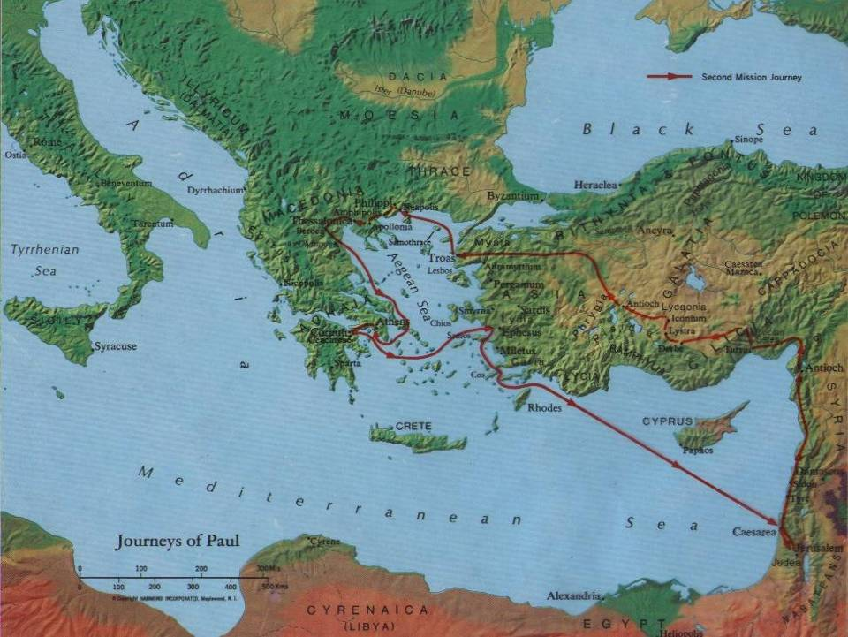
Paul's 2nd Journey (Acts 15–18)?

Slide 41
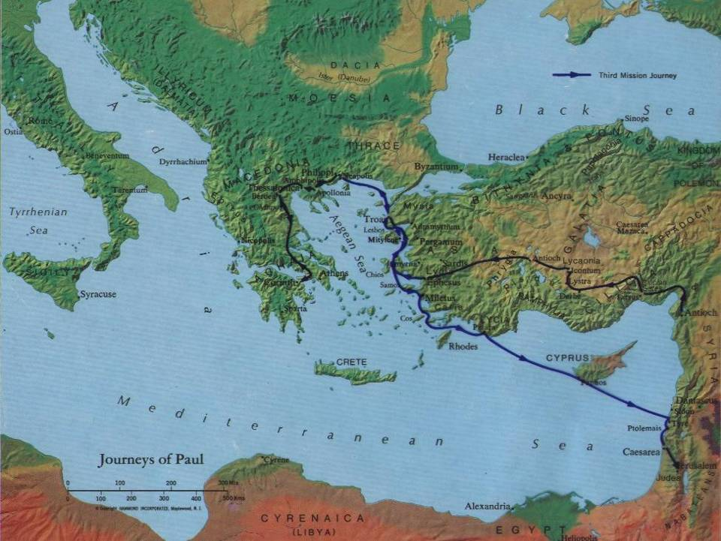
Paul's 3rd Journey (Acts 18–21)?

Slide 42
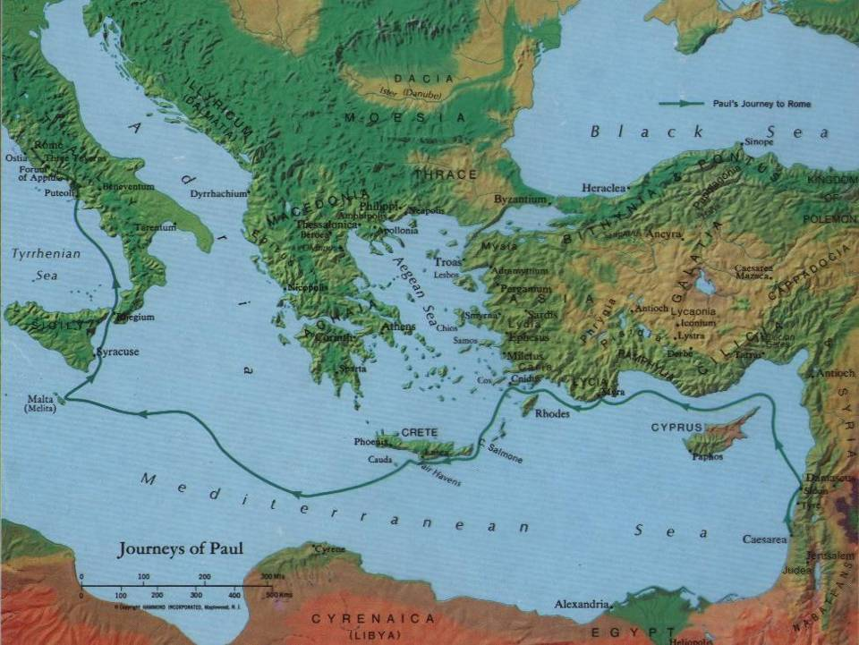
Paul's Journey to Rome (Acts 27–28)

Slide 43
Problems with the Traditional View
Paul is not in charge during the first journey:
  Barnabas is the leader; Paul is his assistant.
  Acts 9:27; 11:25-30; 13:1-3 – Barnabas has priority over Saul
  Acts 13–14 – Order of names: “Barnabas & Saul/Paul”
  Acts 14:12 – Barnabas is “Zeus”; Paul is “Hermes”
After Paul & Barnabas separate, he is never alone:
  Acts 15:39-40; 16:1-3 – travels with Silas and Timothy;
  also 1 Thess 1:1; 2 Cor 1:19 – Paul, Silvanus, Timothy
  More and more associates over time (see esp. Rom 16)
  Beginnings of Paul’s letters usually mention co-authors.
  Endings of his letters include many individual greetings.

Slide 44
Problems with “Three Journeys”
So-called 2nd and 3rd “journeys” are not circle-trips,
they do not start and end in Syrian Antioch:
  Acts 18:22-23 – “Upon landing at Caesarea, he went up and greeted the church and then went down to Antioch. After staying there some time, he left and traveled in orderly sequence through the Galatian country and Phrygia, bringing strength to all the disciples.”
Is this really the end of trip 2 and the start of trip 3?
  If Paul ever returned to Antioch, it was only for a brief visit; he is no longer commissioned by the church there.

Slide 45
Problems with “Three Journeys”
Paul make a definite break with Barnabas and the Church at Antioch. But WHY?
  Acts 15:39-40 – a dispute with Barnabas about John Mark?
  Galatians 2:11-14 – “And when Kephas came to Antioch,
  I opposed him to his face because he clearly was wrong.
  12 For, until some people came from James, he used to eat with the Gentiles; but when they came, he began to draw back and separated himself, because he was afraid of the circumcised. 13 And the rest of the Jews also acted hypocritically along with him, with the result that even Barnabas was carried away by their hypocrisy. 14 But when I saw that they were not on the right road in line with the truth of the gospel, I said to Kephas in front of all, ‘If you, though a Jew, are living like a Gentile and not like a Jew, how can you compel the Gentiles to live like Jews?’ ”

Slide 46
Corrections to the Traditional View
After leaving Antioch, Paul and some companions spend several years preaching and establishing communities of believers (churches) in Macedonia & Achaia, esp. Corinth.
A few years later, they leave Corinth and make Ephesus, the capital city of Asia Minor, the main base of their expanding missionary operations for several more years.

Slide 47
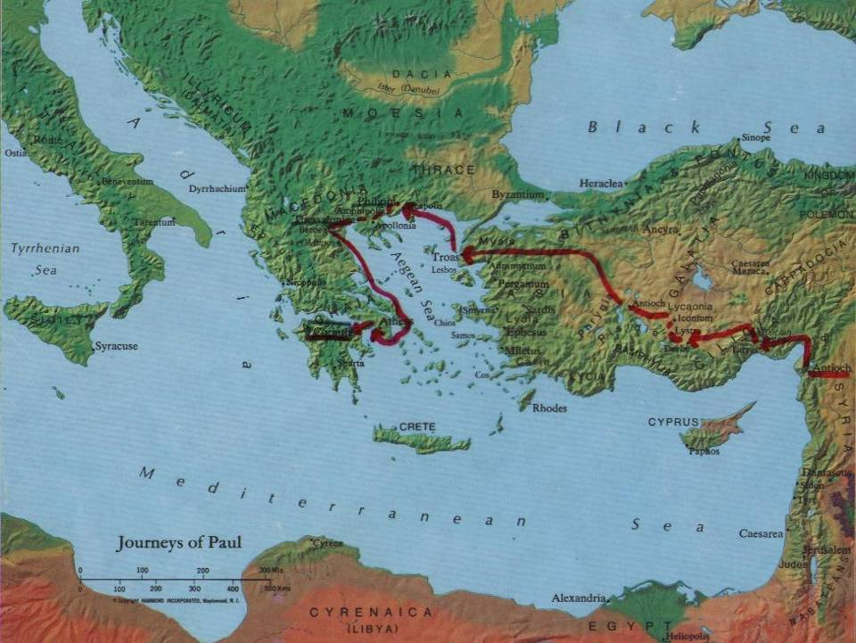
Paul leaves Antioch, settles in Corinth

Slide 48

Paul moves from Corinth to Ephesus

Slide 49

Paul prepares to visit Jerusalem

Slide 50
Five Main Phases of Paul's Life
0) Pre-Christian Phase (ca. AD 10–35)
1) Paul’s New Christian Life:
in the EAST (ca. AD 35–49)
2) Early Independent Missionary Phase:
in MACEDONIA & ACHAIA (ca. AD 50–52)
3) Mature Missionary Leadership Phase:
in ASIA (Minor) (ca. AD 53–57)
4) Final Missionary Travel Phase:
plans to go further WEST (ca. AD 58–62/64)
X) After Paul’s Death: his legacy continues
(AD 60's - 90's and beyond)

Slide 51

Main Phases of Paul's Life

Slide 52
0) Paul’s Pre-Christian Life (ca. AD 10–35)
Jew, born in Tarsus, capital of CILICIA (Acts 9:11, 30; 11:25; 21:39); possibly educated in Jerusalem (Acts 22:3).
Hebrew, born of Hebrew parents (Phil 3:5; 2 Cor 11:22);
probably also a Roman citizen (Acts 22:25-29; 23:27).
Bi-lingual (Hebrew/Aramaic & Greek) and bi-cultural (Jewish & Hellenistic/Greek); ideal “transition figure” for spread of Christianity from Palestine to rest of empire.
First named “Saul” (Acts 7:58–13:9; 22:7; 26:14; cf. Rom 11:1);
later changed to “Paul” (see Acts 13:9ff and all his Epistles).
Pharisee, very zealous for Torah & Jewish traditions (Phil 3:5; Acts 23:6-9; 26:5).
Persecutes followers of Jesus (Gal 1:13-14; Phil 3:5-6; 1 Cor 15:9; Acts 7:58; 8:1; 9:1-2; 22:3-5; 26:4-12).

Slide 53
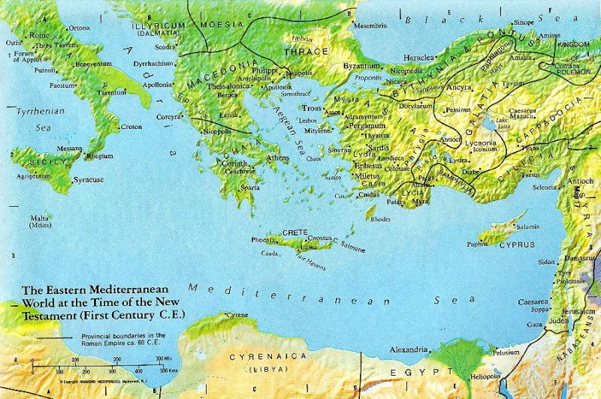
Paul’s Youth

Slide 54
0) Paul’s Pre-Christian Life (in his own words)
Phil 3:4b-6 – If anyone else thinks he can be confident in flesh, all the more can I. 5 Circumcised on the eighth day, of the race of Israel, of the tribe of Benjamin, a Hebrew of Hebrew parentage, in observance of the law a Pharisee, 6 in zeal I persecuted the church, in righteousness based on the law I was blameless.
Gal 1:13-14 – For you heard of my former way of life in Judaism, how I persecuted the church of God beyond measure and tried to destroy it, 14 and progressed in Judaism beyond many of my contemporaries among my race, since I was even more a zealot for my ancestral traditions.
1 Cor 15:9 – “For I am the least of the apostles, not fit to be called an apostle, because I persecuted the church of God.”

Slide 55
1) Paul’s New Christian Life (ca. AD 35–49)
Jesus is “revealed” to Paul (the so-called “conversion”) while Paul is on road to Damascus, in southern SYRIA
Acts 9:3-30; 22:6-21; 26:12-18 – three accounts: blinding light
1 Cor 9:1a – “Am I not free? Am I not an apostle?
Have I not seen Jesus our Lord?”
1 Cor 15:8 – “Last of all, as to one born abnormally,
he [Jesus] appeared to me.”
Gal 1:11-16 – “God was pleased to reveal his Son to me”
Cf. 2 Cor 4:6 – “For God who said, ‘Let light shine out of darkness,’
has shone in our hearts to bring to light the knowledge of the glory
of God on the face of Jesus Christ.”

Slide 56
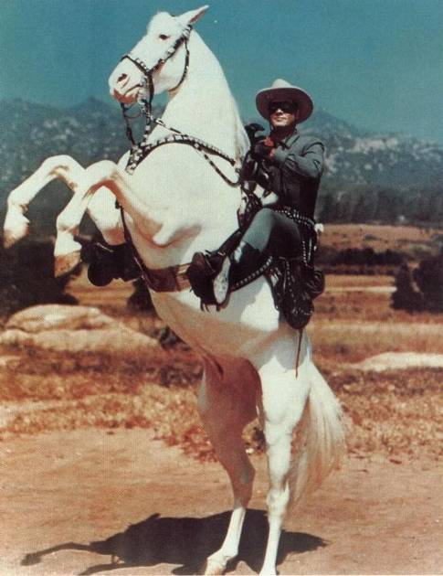
The "Conversion" of Saint Paul ?

Slide 57
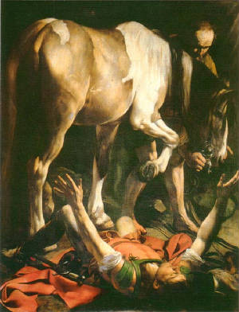
The "Conversion" of Saint Paul ?
(by Caravaggio, 1600)
Is a horse mentioned in the biblical accounts?

Slide 58
Jesus’ “Revelation” to Paul
Galatians 1:11–2:1 – “Now I want you to know, brothers, that the gospel preached by me is not of human origin. 12 For I did not receive it from a human being, nor was I taught it, but it came through a revelation of Jesus Christ. 13 For you heard of my former way of life in Judaism… 15 But when God, who from my mother’s womb had set me apart and called me through his grace, was pleased 16 to reveal his Son to me, so that I might proclaim him to the Gentiles, I did not immediately consult flesh and blood, 17 nor did I go up to Jerusalem to those who were apostles before me; rather, I went into Arabia and then returned to Damascus. 18 Then after three years I went up to Jerusalem to confer with Kephas and remained with him for fifteen days…
21 Then I went into the regions of Syria and Cilicia…
2:1 Then after fourteen years I again went up to Jerusalem with Barnabas, taking Titus along also…

Slide 59
Paul in Syria (Acts 9; Gal 1)

Slide 60
1) Paul’s New Christian Life (ca. AD 35–49)
Jesus is “revealed” to Paul.
Paul begins preaching in Arabia, Damascus, Syria, and Cilicia, with some opposition (Gal 1:17-24; 2 Cor 11:23-33).
Barnabas takes an interest in Paul, helps him, introduces him to other Christians (Acts 9:26-30; 11:25-30; 12:25).
Sent out by church of Antioch, in northern SYRIA,
Barnabas & Paul go preach in Cyprus, Pamphylia, Phrygia (Acts 13–14); Barnabas is leader, with Paul as his assistant (esp. Acts 14:12, Barnabas = “Zeus,” Paul = “Hermes”).
Barnabas & Paul participate in “Council of Jerusalem”
(ca. AD 49, possibly later; compare Gal 2:1-10 and Acts 15)

Slide 61
2) Early Missionary Phase (ca. AD 50–52)
Paul breaks with Barnabas due to “Incident at Antioch” (contrast Gal 2:11-14 with Acts 15:36-41)
Paul, Silas, Timothy cross from ASIA to MACEDONIA; start churches in Philippi & Thessalonica (Acts 16:1–17:15)

Slide 62
Paul, Silas & Timothy (Acts 16-17)

Slide 63
2) Early Missionary Phase (ca. AD 50–52)
Paul breaks with Barnabas…
Paul, Silas, Timothy go to MACEDONIA…
Kicked out of Macedonian cities, they go to ACHAIA; Paul briefly visits Athens, with little success (Acts 17:16-34)
They go to Corinth, capital of ACHAIA, for 18+ months (Acts 18:11, 18); meet Prisca & Aquila after Emperor Claudius had expelled Jews from Rome (AD 49; Acts 18:2)
Paul tried before Gallio (Acts 18:12-17), who was Proconsul of Achaia only AD 51–52; only fixed date for Paul’s life.
From Corinth, Paul & companions write 1 Thess, and probably also 2 Thess (see 1 Thess 3:1-6)

Slide 64
Paul, Silas & Timothy (Acts 17-18)

Slide 65
3) Missionary Leadership Phase (ca. AD 53–57)
Travels thru Asia to Syria (brief visits to Jerusalem & Antioch?), and back to Ephesus, capital of ASIA (Acts 18:18–19:41).
Remains in Ephesus at least 27 months, or longer (Acts 19:8, 10, 22); Ephesus becomes “missionary headquarters.”
Paul travels and sends/receives messengers & letters back & forth from Ephesus to Macedonia, Corinth, parts of Asia Minor, etc. (1 Cor 16:5-12; 2 Cor 8-9; Phil 2:19-30; 4:10-20).
Associates found other Xn communities in Asia Minor; e.g., Epaphras establishes church in Colossae (Col 1:7).
Paul encounters opposition; blamed for riot of silversmiths in Ephesus (see Acts 19:26); probably imprisoned there.
From Ephesus, Paul & his companions write 1 Cor, 2 Cor, Phil, Phlm, and probably Gal (see 1 Cor 15:32; 16:8; 16:19).

Slide 66
Paul & Companions (Acts 19-20)

Slide 67
Contacts between Pauline Churches

Slide 68
4) Final Missionary Travels (ca. AD 58–62/64)
Wants to go to Rome & Spain, but first deliver money to Jerusalem Christians (1 Cor 16:1-4; Rom 15:22-32; Acts 19:21); stays in Corinth 3 months (Acts 20:3); writes to Romans.
Paul and associates deliver this collection to Jerusalem; soon he is arrested in Temple (Acts 20–21).
Under arrest ca. 2 years in Caesarea; appeals to Caesar; taken to Rome; remains under house-arrest 2 more years (Acts 22–28); possibly writes Col from prison in Caesarea.
What’s next? Nothing else written in Acts: either tried, found guilty, and executed; or tried, found innocent and released, so maybe (?) went to preach in Spain.
Paul was executed during Nero’s reign; at end of first Roman imprisonment (AD 62), or after returning from Spain (AD 64); death not recorded in Acts of the Apostles.

Slide 69
Roman Empire

Slide 70
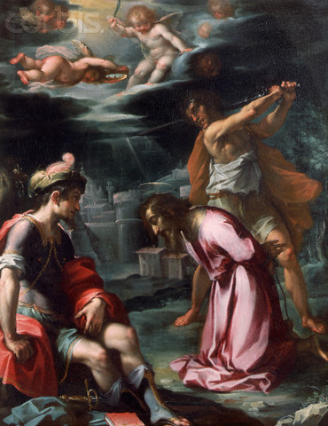
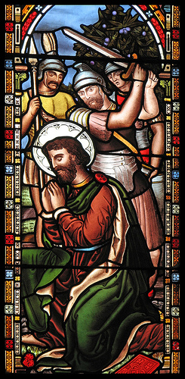
Death of St. Paul?

Slide 71
X) After Paul’s Death (AD 60’s - 90’s and on)
Paul’s associates continue to preach, gain converts, build up Christian churches, address problems, write letters, etc.
1 Tim, 2 Tim, Tit, and Eph probably pseudepigraphic (i.e., written in Paul’s name, by his followers, after his death).
Ephesus and Colossae remain strong centers of Pauline-style Christianity, possibly led by Timothy and Onesimus.
Someone begins collecting & editing Paul’s letters (cf. 2 Pet 3:15-16); by late 1st century, ca. 10 letters circulate together; Ephesians possibly functions as a “cover letter.”
Eventually, thirteen letters attributed to Paul are deemed “canonical” (sometimes also “Letter to the Hebrews”?).
Other legends about Paul develop, as found in non-canonical works (e.g., “Acts of Paul”; “Acts of Paul and Thecla”).

Slide 72
Pauline Letters in Canonical Order
Letters to Communities:
Romans (16 / 7111)
1 Corinthians (16 / 6829)
2 Corinthians(13 / 4477)
Galatians (6 / 2230)
Ephesians (6 / 2422)
Philippians (4 / 1629)
Colossians (4 / 1582)
1 Thessalonians (5 / 1481)
2 Thessalonians(3 / 823)
Letters to Individuals:
1 Timothy (6 / 1591)
2 Timothy (4 / 1238)
Titus (3 / 659)
Philemon (1 / 335)
A sermon related to,
but not written by Paul:
  Hebrews (13 / 4953)

Slide 73

Paul’s Letters in Chronological Order
~AD 50-52: 1 Thessalonians
(also 2 Thessalonians?)
~AD 53-57: 1 Corinthians, 2 Corinthians,
Philippians, Philemon, & Galatians (earlier?)
~AD 58-60: Romans (also Colossians?)
~AD 62-67? – Martyrdom of St. Paul
~AD 62-85: Ephesians, 1 Timothy, 2 Timothy & Titus
  Probably pseudepigraphic (written by followers, after his death)
  Also 2 Thessalonians & Colossians?

Slide 74
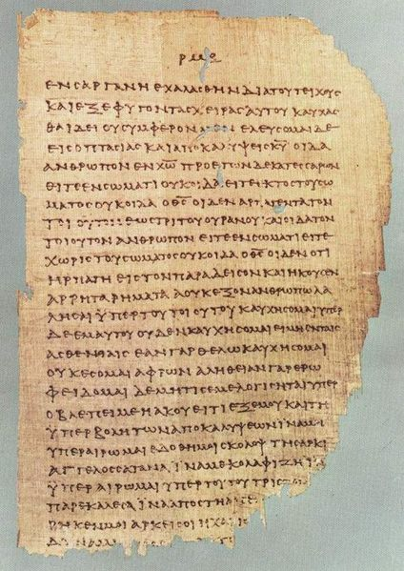
P⁴⁶
Oldest manuscript of Paul’s letters.
Originally part of the Chester Beatty Papyri
Written ca. AD 200
Total of 104 pages, but several now missing
Included at least ten of the Pauline letters
At right, the text of
2 Cor 11:33–12:9

Slide 75
Letters to Christian Communities

Slide 76
Letter(s) from Corinth to Thessalonica (50-52?)

Slide 77
Letters from Ephesus to other Churches (53-57?)

Slide 78
Paul’s Letter from Corinth to Rome (58-60?)

Slide 79
Structure of Ancient Letters
I) Letter Beginning | II) Letter Body | III) Letter Conclusion
Sender(s): From whom Recipient(s): To whom Formulaic Greeting Thanksgiving/Blessing | Initial Exhortation Thesis Statement Theological Discussions Ethical Admonitions | Practical Matters Individual Greetings Personal Postscript Doxology (or Prayer)

Slide 80
Structure of Paul’s Letters
I) Letter Beginning
  Sender/Author(s):
  From Paul and some of his companions…
  Recipient/Addressee(s):
  To the church/the saints in… (a city or region)
  Formulaic Greeting:
  Grace and Peace to you from God our Father and the Lord Jesus Christ… (Greek & Hebrew)
  Thanksgiving (or Blessing):
  I give thanks to God for your…

Slide 81
Structure of Paul’s Letters
II) Letter Body
  Initial Exhortation:
  E.g., remain firm in faith
  Thesis Statement:
  Paul’s Main Point, briefly stated
  THEOLOGICAL Discussions:
  Arguing from scripture and experience
  ETHICAL Admonitions:
  Applying to communal and individual life

Slide 82
Structure of Paul’s Letters
III) Letter Conclusion
  Practical Matters:
  planned trips, visits, bring things
  Individual Greetings:
  from & to many friends, brothers & sisters
  Personal Postscript:
  in Paul’s own handwriting (thus using a secretary)
  Doxology (praise to God)
  or Final Prayer (for the believers)

Slide 83
Ex: First Letter to Thessalonians
Beginning (1:1-10):
  1:1a – From Paul, Silvanus, and Timothy
  1:1b – to the church of Thessalonians in God Father & Lord JC
  1:1c – Grace to you and peace!
  1:2-10 – Thanks to God for love, faith, sharing, joy…
Body (2:1—5:11):
  Exhortations: 2:1-12 – follow Paul's example;
  2:17–3:13 – Paul’s relations with believers in Thessalonica
  Theology: 4:13–5:11 – death, resurrection, and the parousia
  Ethics: 4:1-12 – live according to God’s will
Conclusion (5:12-28):
  5:12-22, 25, 27 – respect church authorities, pray, etc.
  5:23-24 – “May the God of peace make you perfectly holy…”
  5:26 – “Greet all the brothers & sisters with a holy kiss.”
  5:28 – “The grace of our Lord Jesus Christ be with you.”

Slide 84
Summary & Application
Paul never worked or traveled alone
  We too need to work in teams
Paul started as a junior assistant
  We need to mentor younger ministers
Paul had more and more associates over time
  We need to recruit and train new volunteers
Paul cooperated with many other missionaries
  We need to collaborate on many levels
Paul stressed the need for unity among Christians
  We need to avoid forming cliques and factions

Slide 85
Summary & Application
Paul was both Father and Brother to his converts
  We need to combine authority and companionship
Paul stressed hard work and financial responsibility
  We need to contribute our time, talent, and treasure
Paul organized a collection for the poor
  We need to help the needy of our own day
Paul was “all things to all people”
  We need to be adaptable in different situations
Paul stressed both theology and ethics
  We need to focus on both faith and morals

Slide 86
Summary & Application
Paul both praised and scolded, as necessary
  We need to balance encouragement and challenge
Paul told people to imitate his life and actions
  We need to set a good example for others to follow
Paul both preached orally and wrote letters
  We need to supplement teaching with written materials
Paul frequently quoted and applied scriptures
  We need to read and use the Bible regularly
Paul maintained his close connection with Jesus
  We need to pray and attend liturgy regularly

Slide 87
Concluding Words
2 Cor 13:11 – “Finally, brothers and sisters, rejoice.
Mend your ways, encourage one another,
agree with one another, live in peace,
and the God of love and peace will be with you.”
Phil 4:8-9 – “Finally, brothers and sisters,
whatever is true, whatever is honorable,
whatever is just, whatever is pure,
whatever is lovely, whatever is gracious,
if there is any excellence and if there is anything
worthy of praise, think about these things.
Keep on doing what you have learned
and received and heard and seen in me.
Then the God of peace will be with you.”

Slide 88
Pauline Year: 2008 – 2009
Official Slogan of the Pauline Year:
  “It is no longer I who live,
  but Christ who lives in me.” (Gal 2:20)
Prayer of Pope Benedict XVI (6/28/2008):
  “Let us now thank the Lord for having called Paul, making him the light to the Gentiles
  and the teacher of us all, and let us pray to him:
  Give us even today witnesses of the Resurrection, struck by the impact of your love and able to bring the light of the Gospel in our time.
  St. Paul, pray for us!”

Slide 89
Prayer to the Apostle Paul for the Pauline Year
O Glorious St. Paul,
Most zealous Apostle, Martyr for the love of Christ,
Give us a deep faith, a steadfast hope,
a burning love for our Lord,
so that we can proclaim with you,
"It is no longer I who live, but Christ who lives in me."
Help us to become apostles,
serving the Church with a pure heart,
witnesses to her truth and beauty
amidst the darkness of our days.
With you we praise God our Father:
"To Him be the glory, in the Church and in Christ,
Now and for ever." Amen.

Slide 90
Questions? Comments?
Thanks for coming!
More Biblical Resources:
https://catholic-resources.org
– by Fr. Felix Just, S.J.
https://vatican.va
– from the Holy See (Vatican)
https://www.annopaolino.org
– from Basilica of St. Paul (Rome)

