Slide 1

Welcome to
The Gospel of Luke:
Jesus as God’s Agent of Mercy
The University Series – March 12, 2025
Felix Just, SJ, PhD – https://catholic-resources.org

Slide 2
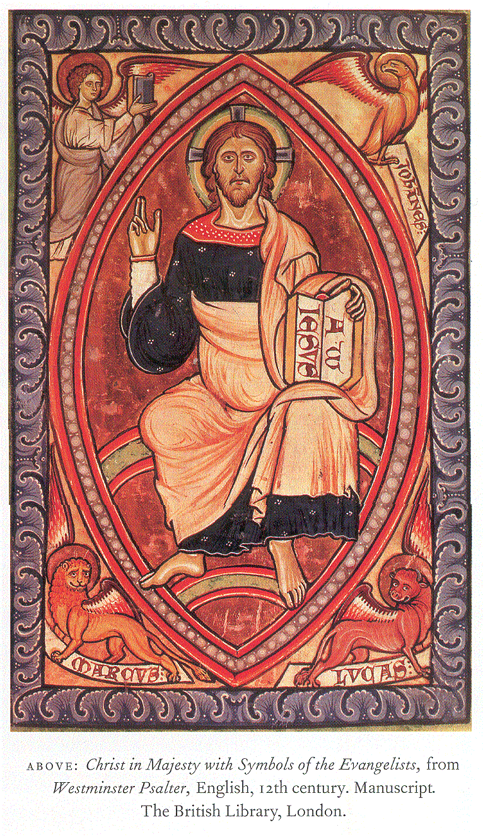
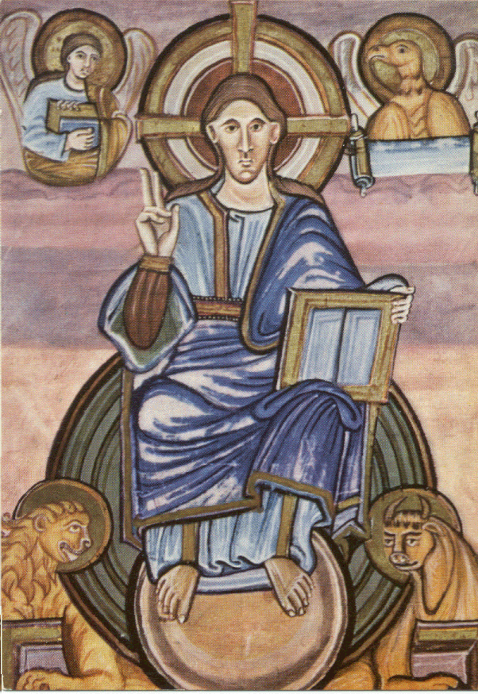

Slide 3

Lectionary for Mass
Three-Year Sunday Cycle:
  “Year A”: MATTHEW
  “Year B”: MARK
  “Year C”: LUKE
  Together called “Syn-optic” Gospels
Why no “Year D” with John’s Gospel?
  JOHN used esp. in Lent & Easter
  Very different in literary style
  Fewer but longer stories
  Not easy to break up into 52 weeks

Slide 4
Lectionary for Mass
Weekday Readings:
  “Two-year Cycle” applies only to
  First Readings & Resp. Psalms
  in Ordinary Time
  Not in Advent, Christmas, Lent, or Easter
  Gospels - same each year
Weekday Gospels in Ordinary Time
  Weeks 1-9: MARK
  Weeks 10-21: MATTHEW
  Weeks 22-34: LUKE

Slide 5
Luke’s Composition History
Date: mid/late 80’s of 1st century
Attributed Author: physician, companion of Paul?
Actual Author: well-educated “historian”;
2nd generation Gentile-Christian convert
Original Readers: Christians with Gentile heritage, incl. some wealthier folks
Place of Composition: Antioch in Syria?
or a Greek city where St. Paul had founded a church?
Literary Prologue (1:1-4): one sentence!
careful investigation, orderly account; for Theophilus

Slide 6
Beginnings of the Four Gospels:
Mark: “The beginning of the gospel of Jesus Christ,
the Son of God.” (1:1; followed by preaching of John Baptist)
Matthew: “The book of the genealogy of Jesus Christ, the son of David, the son of Abraham...” (1:1-17)
LUKE: “Since many have undertaken to compile a narrative of the things which have been accomplished among us…” (1:1-4 – Literary/Historical Prologue)
John: “In the beginning was the Logos, and the Logos was with God, and the Logos was God…” (1:1-18, Prologue)

Slide 7
One Jesus, Four Gospels
Four Gospels: different “portraits” of Jesus
Mark: Son of God, suffering Messiah/Christ
  Disciples: Remain faithful amid hardship, persecution
Matthew: great teacher/interpreter of God’s law
  Disciples: Be best students possible, in action
LUKE: anointed prophet; good news for the poor
  Disciples: Form communities inclusive of all
John: revealer of God’s love, in word & deed
  Disciples: believe in Jesus, become children of God

Slide 8
The Gospel according to Luke
Four Gospels: Same Jesus, Different Emphases:
  Luke’s “Good News” about Jesus as Christ, Lord, Savior, Prophet, Healer,…
  Gospel of Prayer: blessing, praising, repenting, giving thanks; daily, insistent, fearless prayer
  Gospel of Hospitality: sharing meals, welcoming outcasts, aiding the poor, loving enemies
  Gospel of the Holy Spirit: directs, guides, inspires all actions, incl. Jesus himself
  Gospel for All Peoples: Jews & Gentiles, rich & poor,
  men & women, righteous & sinners

Slide 9
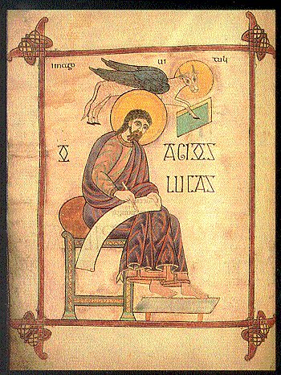
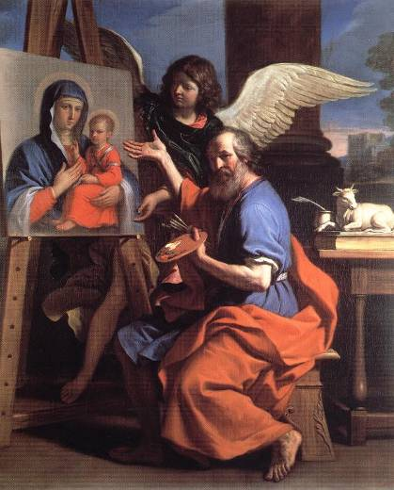
Luke the Evangelist

Slide 10
Luke’s Prologue (1:1-4)
Since many have undertaken to set down an orderly account of the events that have been fulfilled among us,
² just as they were handed on to us by those who from the beginning were eyewitnesses and servants of the word,
³ I too decided, after investigating everything carefully from the very first, to write an orderly account for you, most excellent Theophilus,
⁴ so that you may know the truth concerning the things about which you have been instructed.

Slide 11
Luke’s Prologue (1:1-4)
Finely crafted literary intro; one sentence!
  Stages of “traditions” (handing on):
  Initial Eyewitnesses & Ministers of the word
  Luke to Theophilus (“Lover of God” = “Christian”)
Content & Purpose:
  Events fulfilled (by Jesus); many previous narratives
  Accurate inquiry; written account; orderly sequence
  To give certainty for teachings already received

Slide 12
Structural Outline of Luke
A) Literary Preface & Infancy Narrative: 1:1 – 2:52
B) Preparatory Events: 3:1 – 4:13
C) Jesus’ Ministry in Galilee: 4:14 – 9:50
D) Jesus’ Journey to Jerusalem: 9:51 – 19:27
C') Jesus’ Ministry in Jerusalem: 19:28 – 21:38
B') Passion Narrative: 22:1 – 23:56
A') Resurrection Appearances & Ascension: 24:1-53

Slide 13
Structure & Contents of Luke
Luke follows Mark’s geographical structure overall:
  only one-year public ministry of Jesus
    vs. multi-year ministry in John’s Gospel
  only one journey to Jerusalem
    last week of Jesus’ life, when he is arrested and killed
Luke keeps much of Mark’s material
(making small improvements):
  Luke 3:1–9:17, 18-50 parallels Mark 1:3–6:44; 8:27–9:40
    but omits Mark 6:45–8:26 (Jewish concerns & repeated stories)
  Luke 18:15 – 24:11 mostly parallels Mark 10:13–16:8
    Jesus’ last week in Jerusalem; his passion & death

Slide 14
Structure & Contents of Luke
Luke rearranges some of Mark’s material
(to make an “orderly account”):
  Moves up Jesus’ visit to Nazareth (Mark 6:1-6a) to Luke 4:16-30 (becomes the “Inaugural Event” in Luke)
  Postpones call of first disciples (Mark 1:16-20) to Luke 5:1-11
Luke adds much new material:
  Prologue, Infancy Narrative, Parables, Healings, Resurrection Appearances, etc.
  Luke also continues with a second volume:
  The Acts of the Apostles

Slide 15
“Inaugural Events” in Four Gospels
First Major Event in Jesus’ Public Ministry:
  Mark: Exorcism at Capernaum (Mark 1:21-28)
  Matthew: Sermon on the Mount (Matt 5 – 7)
  LUKE: Synagogue at Nazareth (Luke 4:16-30)
  John: Wedding Feast at Cana (John 2:1-11)
Luke’s Emphases:
  Jesus’ Ministry enlivened by God’s Spirit
  Jesus’ is Messianic Prophet / Prophetic Messiah

Slide 16
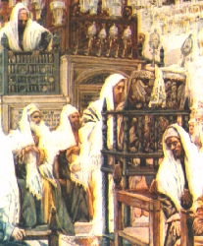
Jesus in the Synagogue
at Nazareth
James Tissot, 1883

Slide 17
Jesus at Nazareth
¹⁴ Jesus returned to Galilee in the power of the Spirit, and news of him spread throughout the whole region. ¹⁵ He taught in their synagogues and was praised by all.
¹⁶ He came to Nazareth, where he had grown up, and went according to his custom into the synagogue on the sabbath day. He stood up to read ¹⁷ and was handed a scroll of the prophet Isaiah.
He unrolled the scroll and found the passage where it was written:
¹⁸ “The Spirit of the Lord is upon me, because he has anointed me
to bring glad tidings to the poor. He has sent me to proclaim
liberty to captives and recovery of sight to the blind, to let the
oppressed go free, ¹⁹ and to proclaim a year acceptable to the Lord.”

Slide 18
Jesus at Nazareth
²⁰ Rolling up the scroll, he handed it back to the attendant and sat down, and the eyes of all in the synagogue looked intently at him.
²¹ He said to them,
“Today this scripture passage is fulfilled in your hearing.”
²² And all spoke [highly] of him and were amazed at the gracious words
that came from his mouth.
They also asked, “Isn’t this the son of Joseph?”
²³ He said to them, “Surely you will quote me this proverb, ‘Physician, cure yourself,’ and say, ‘Do here in your native place the things that we heard were done in Capernaum.’” ²⁴ And he said, “Amen, I say to you, no prophet is accepted in his own native place.

Slide 19
Jesus at Nazareth
²⁵ Indeed, I tell you, there were many widows in Israel in the days of Elijah when the sky was closed for three and a half years and a severe famine spread over the entire land. ²⁶ It was to none of these that Elijah was sent, but only to a widow in Zarephath in the land of Sidon.
²⁷ Again, there were many lepers in Israel during the time of Elisha the prophet; yet not one of them was cleansed, but only Naaman the Syrian.”
²⁸ When the people in the synagogue heard this, they were all filled with fury.
²⁹ They rose up, drove him out of the town, and led him to the brow of the hill on which their town had been built, to hurl him down headlong.
³⁰ But he passed through the midst of them and went away.

Slide 20
“The Spirit of YHWH Is Upon Me”
“Anointed” = Messiah (<Hebrew) = Christ (<Greek)
  Oil used to “anoint” kings, priests, prophets
  Like “inauguration ceremony” today
“Good news” for the poor:
  Eu-angelion = “gospel; glad tidings; good news”
  Freedom for prisoners, sight for the blind, salvation for all
  Jubilee Year = “year of God’s Favor” (see Lev 25)
  “Today this scripture is fulfilled in your hearing”

Slide 21
Jesus’ “Inaugural Sermon”
Townspeople’s reactions:
  First positive, then negative?
  Or, upset all along at his “gracious words”?
Jesus mentions Prophets from Hebrew Bible:
  Elijah & foreign widow (1 Kings 17)
  Elisha & foreign leper (2 Kings 5)
Quoting Isa 61, Jesus intentionally omits one phrase:
“…and a day of vindication by our God” (Isa 61:2b)!

Slide 22

Jesus’ Citation of Isaiah
Isaiah 61:1-2
The Spirit of the Lord GOD is upon me, because the LORD has anointed me
to bring good tidings to the afflicted;
he has sent me
to bind up the brokenhearted,
to proclaim liberty to the captives,
and the opening of the prison to those who are bound; to proclaim
the year of the LORD's favor,
and the day of vengeance of our God;
…
Luke 4:18-19
The Spirit of the Lord is upon me, because he has anointed me
to preach good news to the poor. He has sent me
to proclaim release to the captives
and recovering of sight to the blind, to set at liberty those who are oppressed, to proclaim
the acceptable year of the Lord.

Slide 23
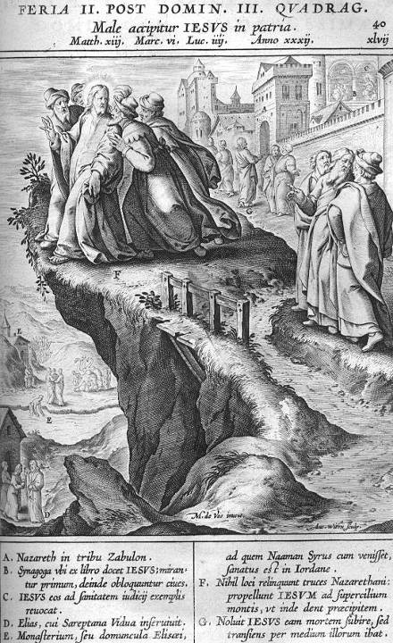
Jerome Nadal, 1595

Slide 24
Call of the First Disciples
MARK:
Baptism & Temptations
Preaching Intro
Call of Four Disciples
  1:16-20; pairs of brothers
  prior meeting?
Exorcism, Healings…
  5 full chapters of more teachings, parables,
  many other events!
Jesus at Nazareth (Mk 6)
LUKE:
Baptism & Temptations
Preaching Intro
Jesus at Nazareth
  4:16-30
  all one event?
Exorcism, Healings
Prayer, Journeys
Miraculous Fish Catch
  5:1-11
  ends with call of fishers

Slide 25
Miracles & Stories in Luke 4:31–6:11
(adapted from Mark 1:16–3:6)
Exorcism at Capernaum
Simon’s Mother-in-Law & Other Healings
Call of Simon the Fisher (5:1-11; cf. Mark 1:16-20)
Cleansing a Leper & Healing a Paralytic
Call of Levi
Debate about Fasting
Picking Grain on the Sabbath
Man with Withered Hand
Call of the Twelve

Slide 26
Catching Fish & Catching People
Mark 1:16-20 substituted with Luke 5:1-11
  Why? More “orderly” account (realistic/accurate)
Narrative Sequence (Luke 5:1-11):
  Jesus teaches the crowds (vv. 1-3)
  Catch of a great number of fish (vv. 4-7)
  Simon Peter’s reaction (vv. 8-10a)
  Jesus’ “call” of Simon & his partners (vv. 10b-11)
ICHTHYS = “fish” in Greek
  Iesous Christos Theou Huios Soter
  Jesus Christ, Son of God, Savior

Slide 27
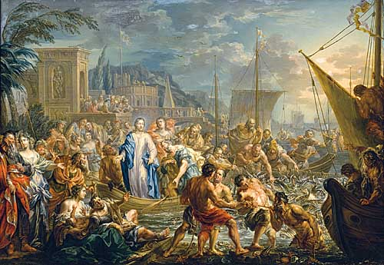
The Miraculous Catch of Fish (Luke 5)
Johann Georg PLATZER

Slide 28
Themes & Emphases of Luke
Theological Geography:
  Gospel begins & ends in Temple of Jerusalem;
  Jesus’ journey to Jerusalem is central
Contextualized History:
  Historical markers: 1:5 (days of King Herod);
  2:1-3 (census of Augustus); 3:1-2 (15th year of Tiberius)
Prominence of the Holy Spirit
  Drives all action in Luke’s Gospel
  With Zechariah, Elizabeth, John the Baptist, Mary, Jesus (esp. at beginning and end)

Slide 29
Themes & Emphases of Luke
Prayer and Praise, Thanksgiving and Joy:
  Hymns of praise
  Prayers of Jesus & of other characters
  Jesus’ teachings about prayer
More Parables than in any other Gospel:
  Focus on repentance/forgiveness/mercy (Luke 15)
  Use of wealth/possessions (Luke 16)

Slide 30
Themes & Emphases of Luke
Food & Meals:
  Luke’s Jesus is either at a meal, going to a meal,
  coming from a meal, or talking about food or drink
  Stresses importance of hospitality, community, sharing
  Eating your way through Luke’s Gospel (R. Karris, 2006)
  “Breaking of the Bread” (esp. Luke 24:35 & Acts 2:42)

Slide 31
Themes & Emphases of Luke
Prominence of Women
  Many more women than in other Gospels
  Both real women & fictional characters (in parables)
  Often in story pairs: male & female

Slide 32
Themes & Emphases of Luke
More attention to Poor & Lowly, Sick & Sinners, Slaves & Children, Samaritans & Gentiles
  Samaritan Villagers
  Parable of Good Samaritan
  Healing of 10 Lepers, esp. one Samaritan
Theme of Reversal :
  poor/rich, hungry/satisfied, weak/strong, lowly/proud, etc.
  Mary’s “Magnificat” (Luke 1:46-55)
  Beatitudes & Woes (Luke 6:20-26; contrast Matt 5:3-12)

Slide 33
Women in Luke’s Gospel
Many more than in other Gospels
  Elizabeth & Mary (throughout Luke 1—2)
  Widow of Nain (7:11-17)
  Sinful Woman who Anoints Jesus (7:36-50)
  Galilean Women Supporters (8:1-3)
  Martha & Mary of Bethany (10:38-42)
  Woman Crippled for 18 Years (13:10-17)
  Persistent Widow before a Judge (18:1-8)
  On Jesus’ Way to the Cross (23:26-31)

Slide 34
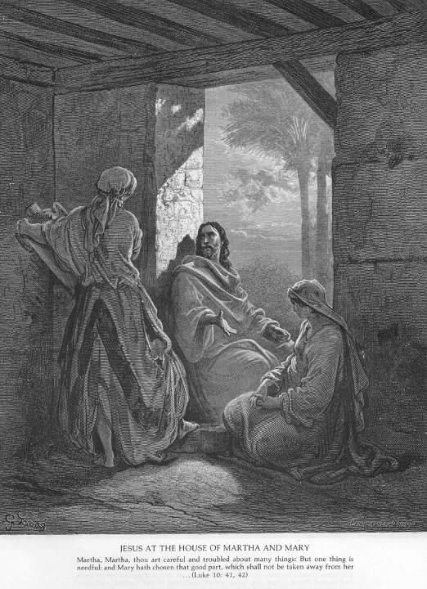
Jesus at the House of Martha & Mary, by Gustav Doré

Slide 35
Pairs of M/F Stories in Luke
Luke often parallels/balances a story of a man with a similar story of a woman:
  Healings of a Crippled Woman & a Sick Man, both on the sabbath (13:10-17 & 14:1-6)
  Parables of Mustard Seed & of Yeast (13:18-21)
  Parables of Lost Sheep & of Lost Coin (15:1-10)
  Examples of Two Men & Two Women (17:34-35)
  Many more…

Slide 36
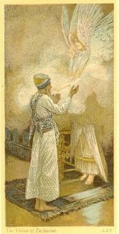
Pray-ers and Prayers in Luke
Well-known Examples
Lukan Texts:
  Hail Mary (combines 1:28 & 1:42)
  Magnificat, Benedictus, Nunc Dimittis
Biblical Characters:
  Zechariah, Elizabeth, Mary, angels
  Jesus, disciples, other characters
Jesus’ Instructions:
  Our Father & related sayings (esp. 11:1-13)
  Various parables (esp. 18:1-14)

Slide 37
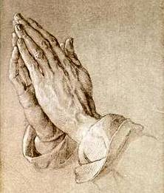
Types of Prayer
Ritual/Liturgical:
  Ancient Judaism: Temple Sacrifices, Pilgrimage Feasts, Circumcision, Purifications, etc.
Verbal/Personal: A.C.T.S. / P.P.T.P.
  Adoration/Praise
  Contrition/Penance
  Thanksgiving
  Supplication/Petition
  (all are found throughout Luke)

Slide 38
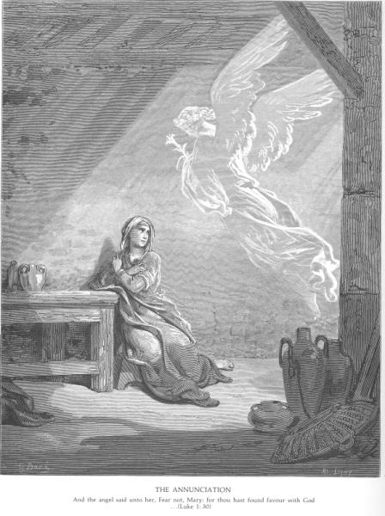
Annunciation
Luke 1:26-38
Gabriel & Mary
Hail, favored one!
God is with you!
May it be done
to me according
to your word.

Slide 39
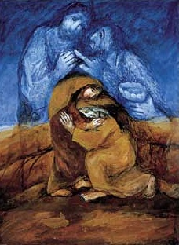
Visitation
Luke 1:39-56
Elizabeth & Mary
[John & Jesus]
“Blessed are you
among women,
and blessed is
the fruit of
your womb.”

Slide 40
Rejoicing and Blessing God
Luke’s Infancy Narrative:
  content, structure, message
  very different from Matthew 1–2
Parallels & Contrasts:
  Zechariah & Elizabeth // Mary & Joseph
  John the Prophet // Jesus the Savior
OT Influences:
  Praise of God, esp. story & prayer of Hannah,
  mother of prophet Samuel (1 Sam 1–2)

Slide 41
Hannah, Mother of Samuel
Story of Hannah (1 Sam 1)
  Childless woman prays for a son
  Vows to dedicate him to God as a Nazirite
  Hannah’s dialogue with the priest Eli
  Hannah conceives and gives birth: Samuel
Prayer of Hannah (1 Sam 2)
  "My heart exults in the LORD (YHWH);
  my strength is exalted in my God…”
  Theme of reversal: vindication over her detractors

Slide 42

God’s Name
In the Hebrew Bible:
  “God” = “El”; “Elohim”; “El-Shaddai” …
  “YHWH” = God’s proper name (Exod 3)
  “Adonai” = “The Lord” (and “Master”)
  If YHWH appears in the biblical text,
  it is substituted by “Adonai”
  sometimes written in all caps: “LORD”

Slide 43
Magnificat (Luke 1:46-55)
Mary’s Hymn of Praise (similar to Hannah’s)
  To begin, Mary rejoices & praises God
  with her whole being/soul/spirit:
  “Holy is God’s name”
  Why? For all God has done in the past
  and all God promises to do in the future!
Luke’s Theme of Reversal:
  proud dispersed / lowly lifted
  hungry filled / rich sent away empty

Slide 44
Benedictus (Luke 1:67-79)
Zechariah’s Blessing of God
  “Blessing” = “speaking good words” ≈ praise and thanks, for God’s covenantal faithfulness
  “God bless you/me” vs. “We bless God!”
    Ps 34 – “I will bless the Lord at all times…”
    Ps 103 & 104 – “Bless the Lord, my soul…”
    Ps 134; 135 – “Come, bless the Lord…”
    Many other Psalms give thanks, praise, glorify, etc.
  Jewish Berakah prayers: “Blessed are you,
  Lord our God, ruler of all, for you have…”

Slide 45

Infancy Narrative: Luke 2:1-20
Birth of Jesus
  Joseph & Mary go to Bethlehem
  Mary gives birth to her first-born
  Angels proclaim to shepherds:
    "Do not be afraid; for see--I am bringing you good news of great joy for all the people: to you is born this day in the city of David a Savior, who is the Messiah, the Lord.“
    "Glory to God in the highest heaven,
    and on earth peace among those whom God favors!"
  Shepherds visit the baby; return praising God!

Slide 46
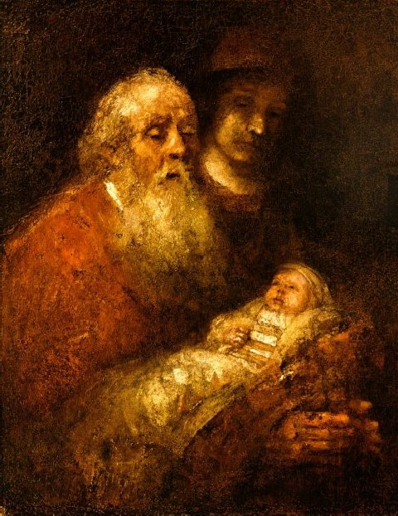
Luke 2:21-52
Circumcision &
Naming of Jesus
  On the 8th day
Purification &
Presentation
  Simeon & Anna
  “Lord, now let your
  servant go in peace”
[Boy Jesus in Temple at age 12]

Slide 47
God’s Spirit in the Ministry of Jesus:
The Holy Spirit prepares Jesus for Ministry (3:1-22)
Hb. Ruach = Gk. Pneuma
  Wind, Breath, Spirit, Life-Force
  Gen 1:2; Ezek 37:1-14; John 20:22
Manifestations or symbols of God’s Spirit:
  Wind, flame, dove, heavenly voice, etc.
  Related to “Torah” (instruction) and divine “Wisdom”
  Other divine manifestations: face of God, hand of God…

Slide 48
Prophecy
Greek pro-phemi = “to speak on behalf of”
  “Thus says the Lord”; God’s-eye view of events
  Not primarily to “predict” an inevitable future;
  but interpreting the past, present, and
  the conditional future (if you… then God…)
Prophets convey God’s messages:
  in words (warnings, promises, stories)
  and in actions (miraculous and/or symbolic)

Slide 49
Jesus’ Miraculous/Compassionate Actions
Four Types of “Miracles” in the Gospels:
  1) Healings (not just physical, but social)
  2) Exorcisms (casting out demons)
  3) Restorations (from death: physical & social)
  4) Nature Miracles (food, seas, trees, etc.)
  X) Evangelists’ Summaries of Jesus’ Healing Actions
Luke keeps most of Mark’s stories
  Luke only drops a few and adds a few

Slide 50
Gospel Miracles: Mark vs. Luke
Luke drops a few Markan miracle stories:
  Walking on Water (Mark 6:45-52)
  Syro-Phoenician Girl (Mark 7:24-30)
  Deaf Mute Demoniac (Mark 7:31-37)
  Feeding 4000 People (Mark 8:1-10)
  Blind Man at Bethsaida (Mark 8:22-26)
  Cursing a Fig Tree (Mark 11:12-14)
Why?
  Luke omits ALL of Mark 6:45 – 8:26
  Many of these stories seem a bit strange!

Slide 51
Gospel Miracles: Mark vs. Luke
Luke adds a few new miracle stories:
  Large Catch of Fish in Sea of Galilee (Luke 5:1-11)
  Healing a Centurion's Servant (Luke 7:1-10; also Mt)
  Raising a Widow's Son at Nain (Luke 7:11-17)
  Healing a Crippled Woman (Luke 13:10-17)
  Healing a Man of Dropsy (Luke 14:1-6)
  Healing Ten Men of Leprosy (Luke 17:11-19)
Why? What kind of stories are these?
  Mostly HEALINGS, except 5:1-11

Slide 52
Structure of Miracle Narratives
Five Stages of Most Healing Miracle Stories
  Introduction
  Conflict or Delay
  Healing Action
  Healing Confirmation
  Reaction (Praise or Accusations)
Luke Emphasizes Stage 5: Witnesses
glorify & praise God for Jesus’ actions!

Slide 53
Raising a Widow’s Son at Nain
Five Stages of Miracle Narratives (7:11-17)
  Intro: Town, Widow & Son, Crowd (vv. 11-12)
  Delay (slight): “Do not weep” (v. 13)
  Action: Jesus touches bier; “Arise!” (v. 14)
  Confirmation: Man sits up & talks (v. 15)
  Reaction (extended): Crowds fear, praise God, report spreads thru region (v. 16-17)

Slide 54
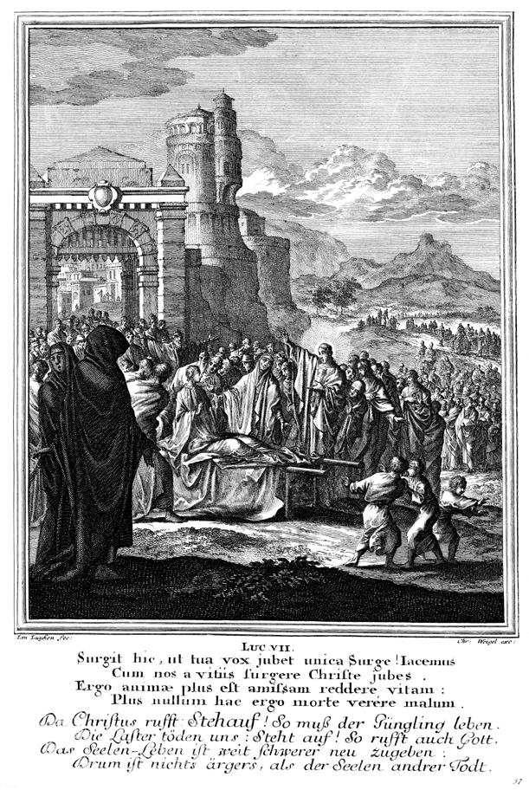
Luke 7:11-17
Jesus raises a widow’s son at Nain
Caspar LUIKEN

Slide 55
Repentance & Forgiveness
Jesus Teaches with Examples & Parables:
Jesus Dines in a Pharisee’s Home (7:36-50)
  A “sinful woman” anoints Jesus’ feet
  Jesus’ dialogue with Simon the Pharisee
Parable of Pharisee & Publican (18:9-14)
  Addressed to the self-righteous
  Contrasts the Pharisee’s “Thanks” with
  the Tax Collector’s humble plea for mercy

Slide 56
Lepers & Tax Collectors
Jesus cleanses lepers:
  Luke 5:12-16 (from Mark)
  Luke 17:11-19 (Ten Lepers; only in Luke)
Jesus dines with tax collectors:
  Luke 5:27-32 (from Mark)
  Luke 19:1-10 (Zacchaeus; only in Luke)

Slide 57
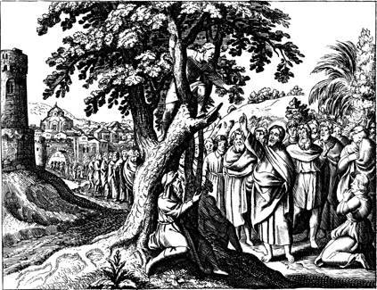
Luke 19:1-10 ~ Zacchaeus ~ Nicolas Fontaine

Slide 58
Sermon on the Plain (Luke 6:17-49)
Compare to Matthew’s Sermon on the Mount
  Different Setting (Plain vs. Mount)
  Much shorter (three full chapters in Matthew 5:1–7:27)
Content of Luke’s Version:
  Introduction / Setting (6:17-19)
  Beatitudes and Woes (6:20-26)
  Love your enemies (6:27-36)
  Stop judging (6:37-42)
  Good & evil fruits (6:43-45)
  Two foundations (6:46-49)

Slide 59
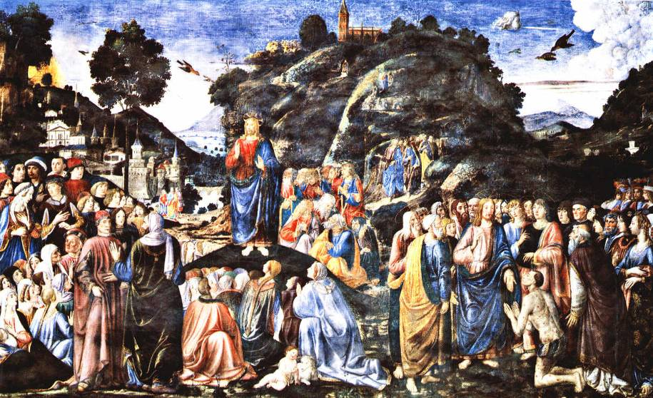
Sermon on the Plain, by Cosimo Rosselli

Slide 60
Four Beatitudes and Four Woes
Matthew 5:3-12
  Blessed are the poor in spirit…
  Blessed are those who mourn…
  Blessed are the meek…
  Blessed are those who hunger and thirst for righteousness…
  Blessed are the merciful…
  Blessed are the pure in heart…
  Blessed are the peacemakers…
  Blessed are those who are persecuted for righteousness' sake…
  Blessed are you when people revile you and persecute you…
[“Woes” in Matt 23]
Luke 6:20-26
  Blessed are you who are poor…
  Blessed are you who are hungry now…
  Blessed are you who weep now…
  Blessed are you when people hate you, and when they exclude you…
  But woe to you who are rich…
  Woe to you who are full now…
  Woe to you who are laughing now…
  Woe to you when all
  speak well of you…

Slide 61
Love of Enemies
Admonitions and Analogies
  Love enemies; do not retaliate; give freely
  Golden Rule: “Do unto others…”
  Great reward: “You’ll be children of the Most High”
Summary of Jesus’ Teaching:
  “Be merciful as God is merciful.” (Luke 6:36)
  “Be perfect as God is perfect.” (Matt 5:48)
  “Be holy as God is holy.” (Lev 19:2, etc.)

Slide 62
Jesus’ Teachings on Discipleship
Following Jesus’ first “Passion Prediction”:
  “Deny yourself and take up your cross daily
  and follow me” (9:22-27; cf. Mark 8:31-38)
  Brief related sayings
Three potential disciples (9:57-62; cf. Matt 8:19-22)
  “Foxes have dens and birds have nests…”
  “Let the dead bury their dead…”
  “No one who puts a hand to the plow
  and turns back is worthy…”
  (compare 1 Kings 19:19-21)

Slide 63
Jesus’ Teachings on Discipleship
Mission of the Seventy (only in Luke 10:1-20)
  Near beginning of Jesus’ Journey to Jerusalem
  Longer instructions and greater results than in the earlier Mission of the Twelve (9:1-9)
Commitment required for discipleship
  Luke 14:25-35 - Mostly unique to Luke
  No attachment to family (v. 26; Matt 10:37)
  Acceptance of persecution (v. 27)
  Assessment of hardships/costs (v. 28-32)
  No attachment to possessions (v. 33)

Slide 64
Story-Parables in the Four Gospels
Mark: only about 13 parables & related images
  Typical form: “The Kingdom of God is like…”
Matthew: total of 31 parables
  8 from Mark; 13 also in Luke; 10 in Matt alone
LUKE: upwards of 41 parables
  9 from Mark; 13 also in Matt; 19 in Luke alone
  More of these are “example stories” – to be imitated
John: no parables; only two related images (“paroimia”)
  John 10: Sheep & Shepherd
  John 15: Vine & Branches
  But in John, Jesus says, “I am…”

Slide 65
Parables ONLY in LUKE’s Gospel
“Physician, Heal Yourself” (4:23)
Two Debtors (7:41-43)
Good Samaritan (10:25-37)
Friend Asking for Help at Midnight (11:5-8)
Rich Fool (12:16-21)
Faithful Servants (12:35-38)
Barren Fig-Tree (13:6-9)
Closed Door (13:24-30)
Choice of Places at Table (14:7-1l)

Slide 66
Parables ONLY in LUKE (cont.)
Tower-Builder & King before Battle (14:28-32)
Lost Coin (15:8-10)
Lost/Prodigal Son (15:11-32)
Unjust Steward (16:1-8)
Rich Man & Lazarus (16:19-31)
Servant’s Reward (17:7-10)
Unjust Judge (18:1-8)
Pharisee & Publican (18:9-14)
Throne Claimant (19:12, 14, 15a, 27)

Slide 67
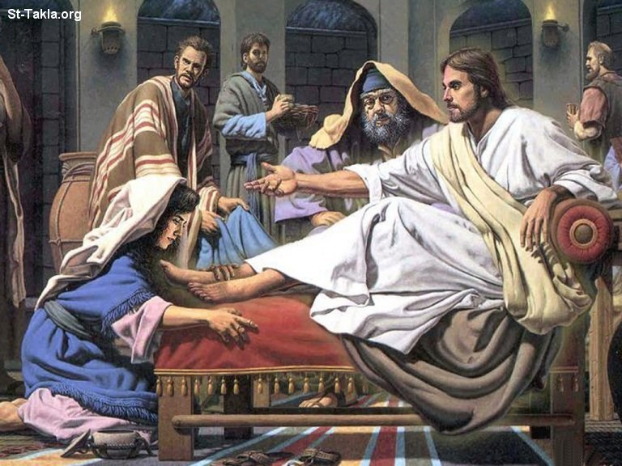
Two Debtors (7:41-43)

Slide 68
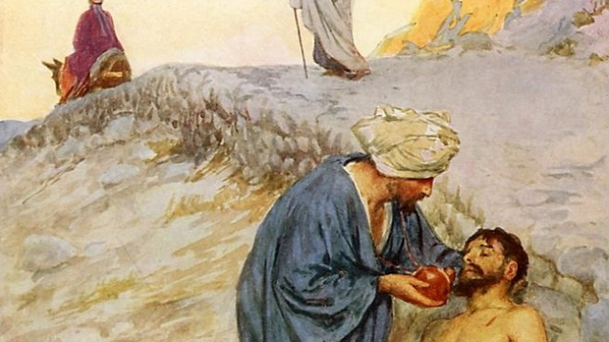
The Good Samaritan (10:25-37)

Slide 69
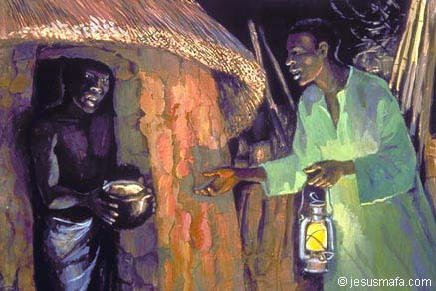
Friend Asking for Help at Midnight (11:5-8)

Slide 70
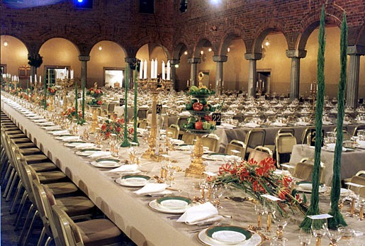
Choice of Places at Table (14:7-11)

Slide 71
Three “Lost” Parables (15:1-32)
Intro/Setting (vv. 1-3)
  Jesus with sinners & tax coll.; Pharisees & scribes object
Lost Sheep (vv. 4-7)
  What’s “strange” about this parable?
Lost Coin (vv. 8-10)
  What’s “strange” about this parable?
Lost/Prodigal Son (vv. 11-32)
  What’s “strange” about this parable?
Common Refrain: JOY!

Slide 72
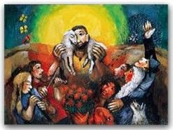
The Good Shepherd (15:4-7)

Slide 73
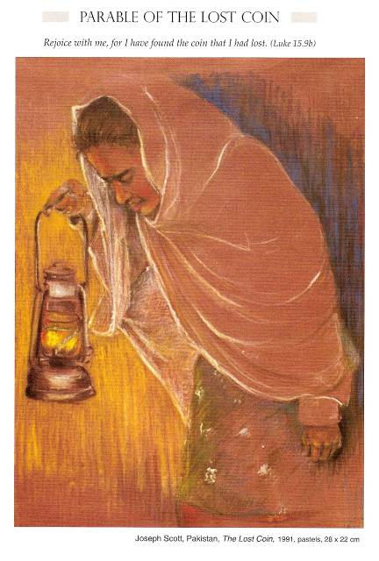
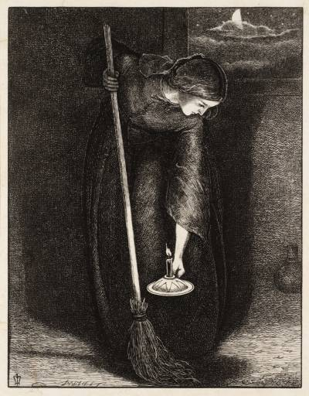
John Everett Millais Joseph Scott
The Lost Coin (Luke 15:8-10)

Slide 74
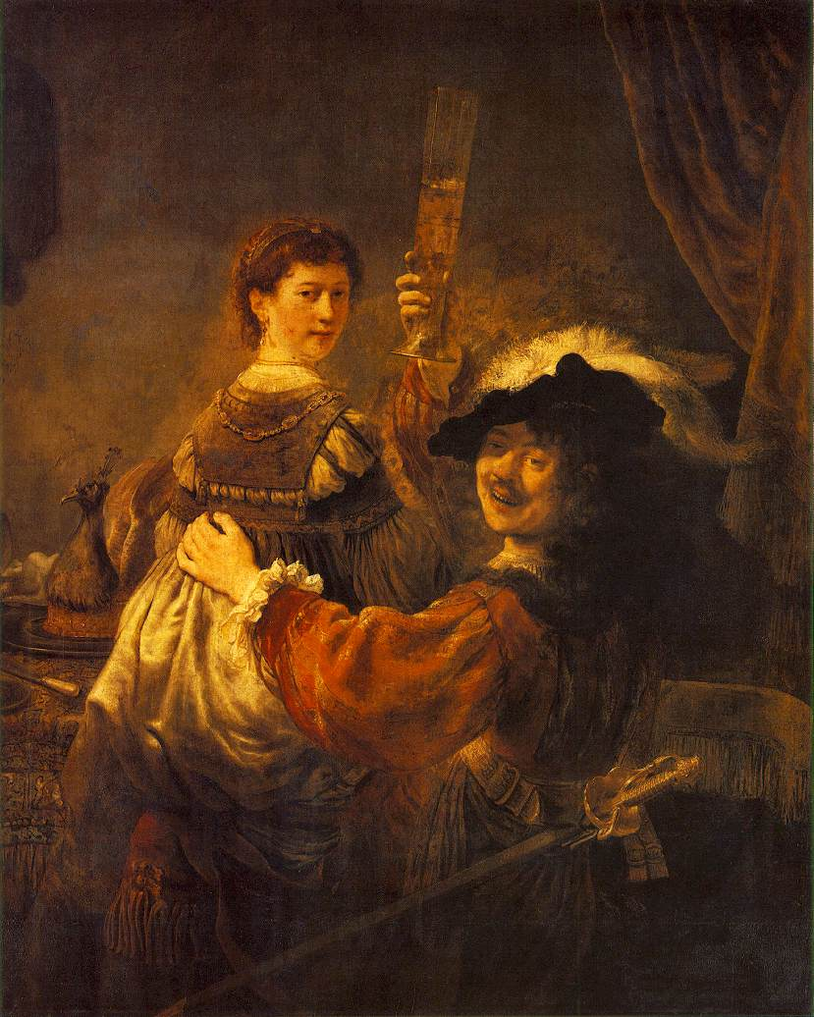
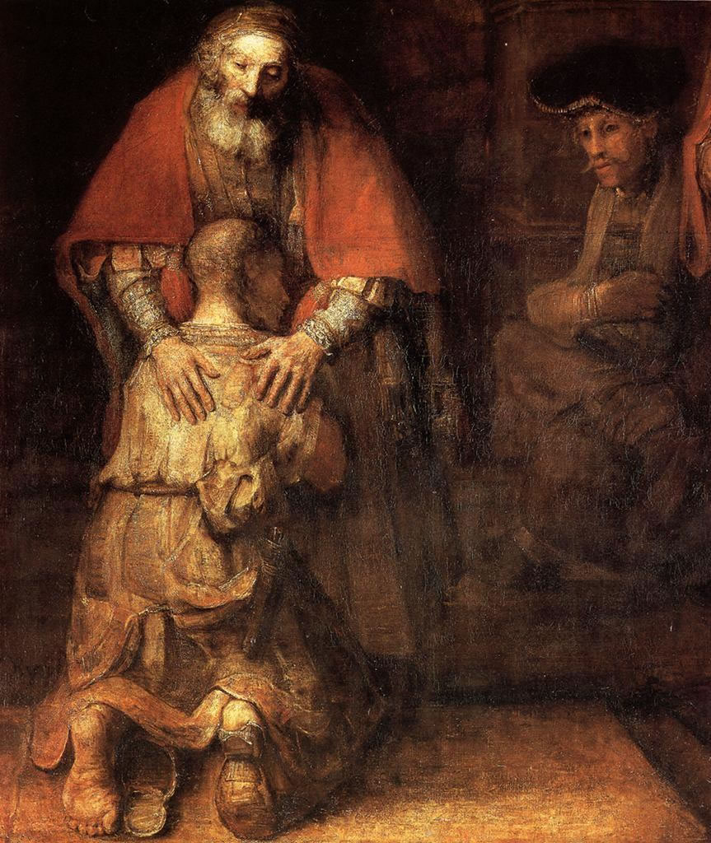
Rembrandt
The Prodigal Son (Luke 15:11-32)

Slide 75
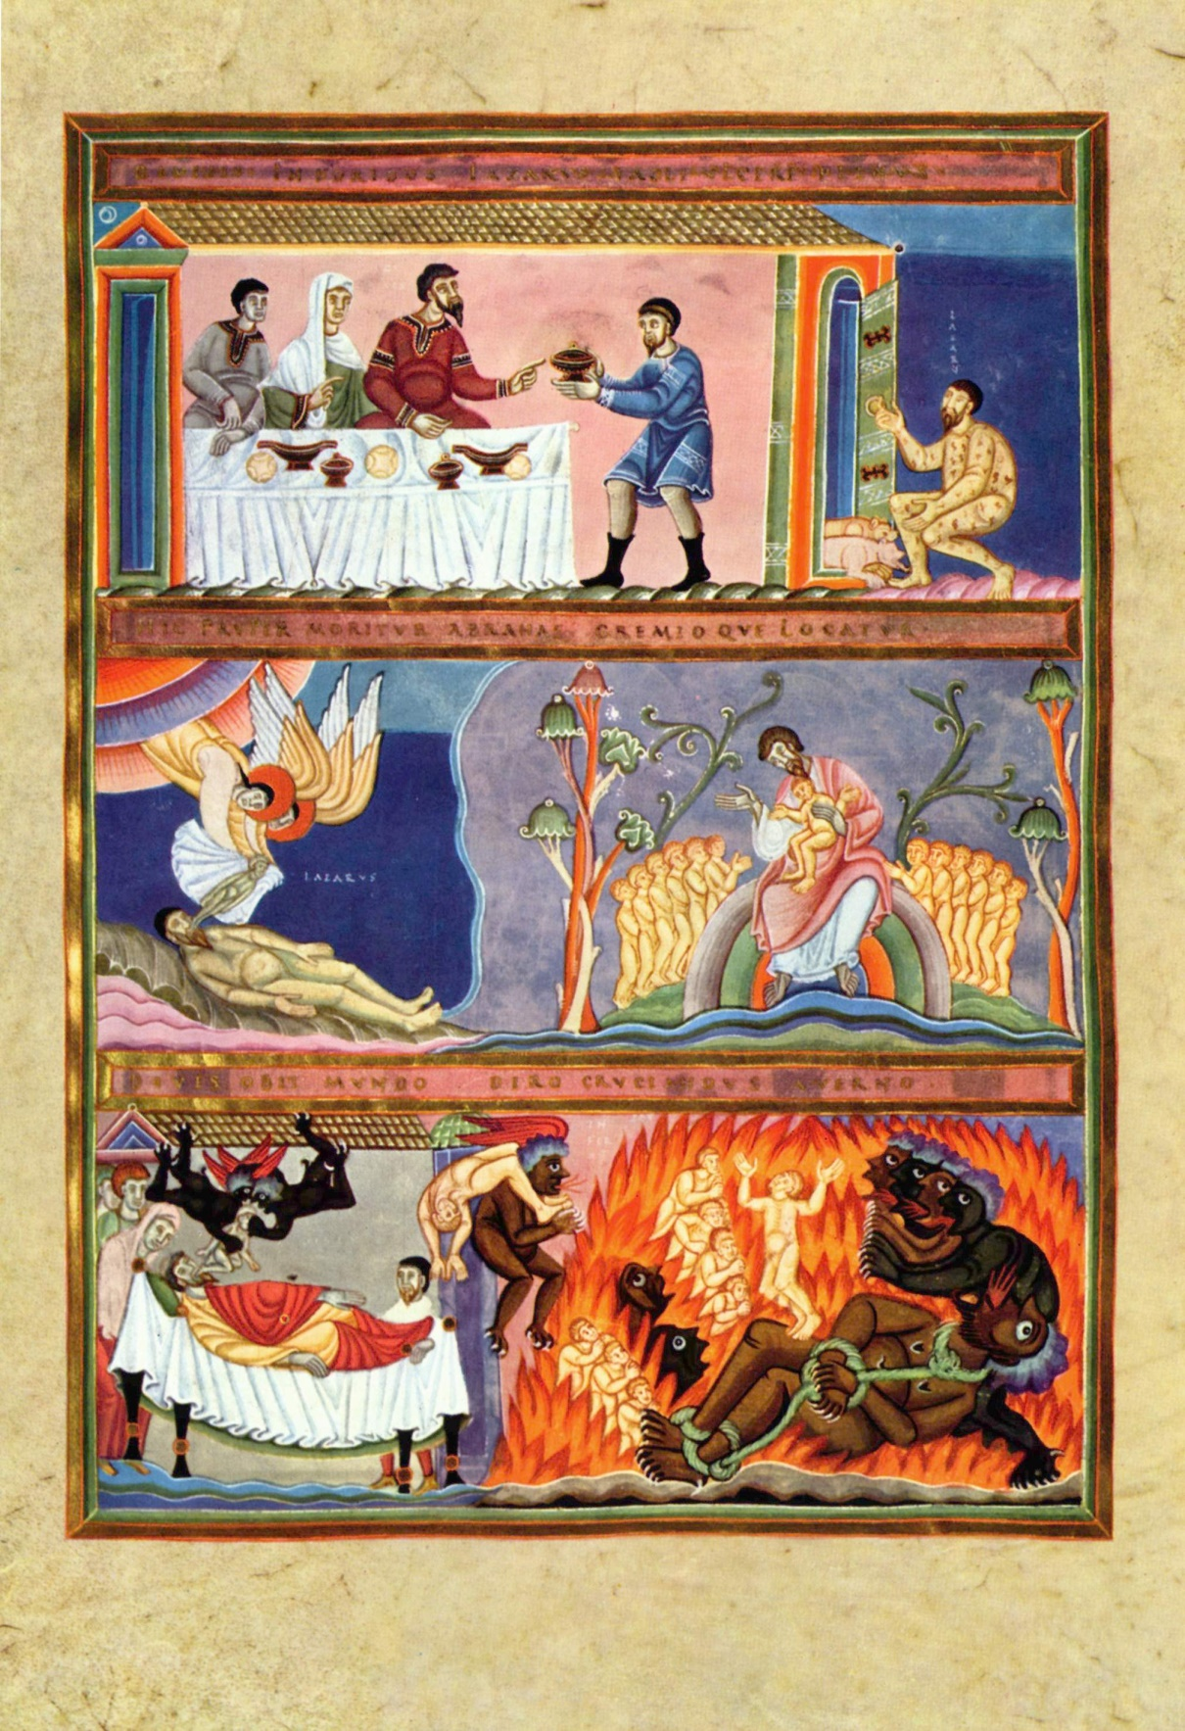
Rich Man
& Lazarus
(16:19-31)

Slide 76
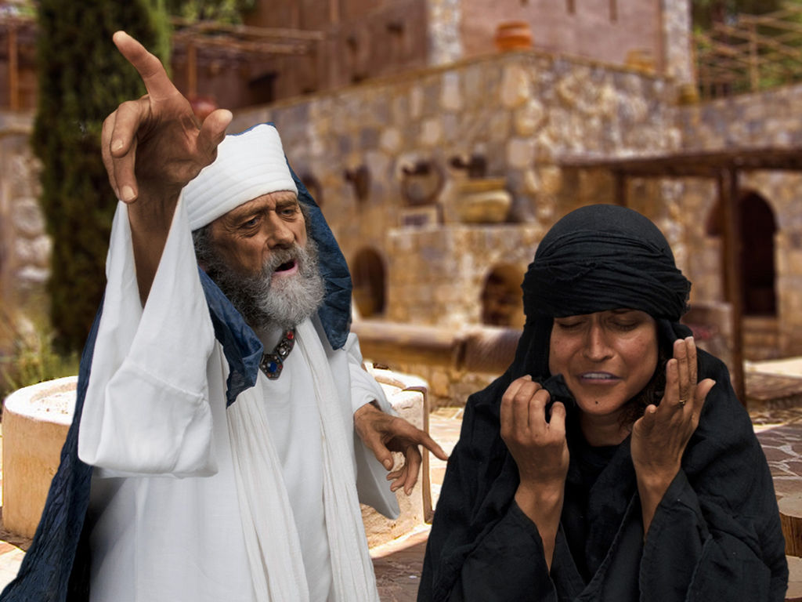
Widow & Unjust Judge (18:1-8)

Slide 77
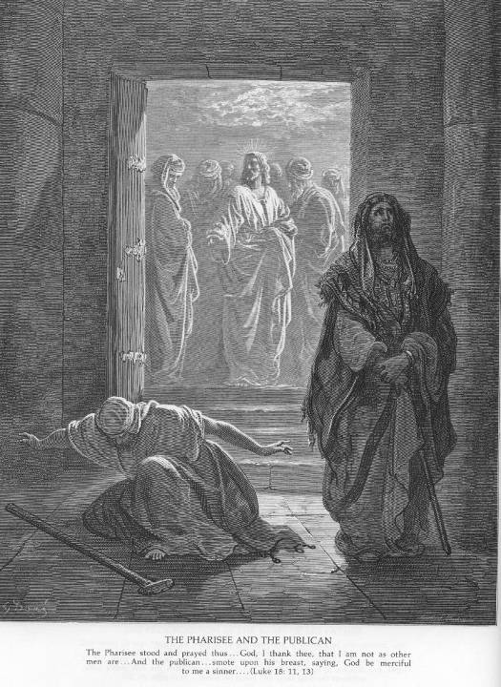
The Pharisee
& the Publican (18:9-14)
by Gustave Doré

Slide 78
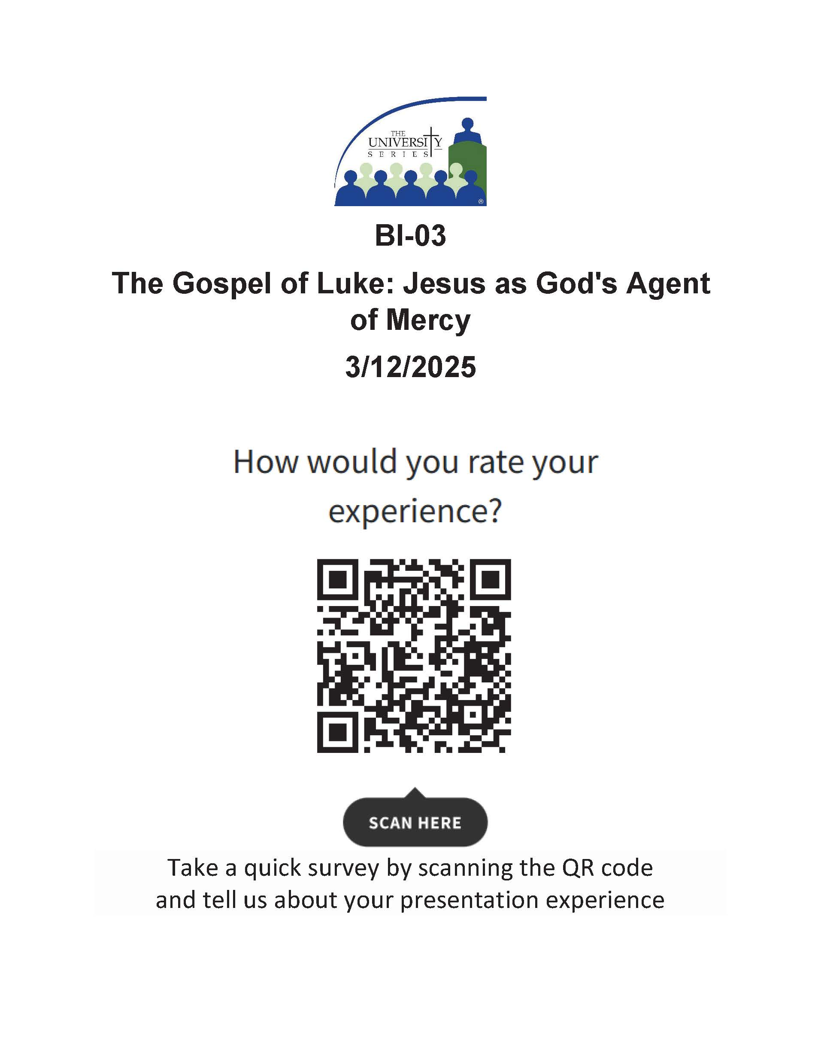

Slide 79
Questions?
THANKS for Participating!
Have a Blessed Lent!

Slide 82
Introducing John the Baptist
Mark 1:2-8
As it is written in Isaiah the prophet, “Behold, I send my messenger before thy face, who shall prepare thy way; the voice of one crying in the wilderness: Prepare the way of the Lord, make his paths straight.”
Luke 3:1-20
As it is written in the book of the words of Isaiah the prophet,
“The voice of one crying in the wilderness: Prepare the way of the Lord, make his paths straight. Every valley shall be filled, and every mountain and hill shall be brought low, and the crooked shall be made straight, and the rough ways shall be made smooth; and all flesh shall see the salvation of God.” (Isaiah 40:3-5)

Slide 83
John the Baptist (Luke 3:1-20)
Luke first sets the historical context (vv. 1-2, 19-20)
Stresses the preaching of John the Baptist (vv. 3-6, 18):
  A voice in desert: “Prepare the way of the Lord…
  and all flesh shall see salvation of God.” (cf. Isaiah 40:3-5)
John dialogues with specific groups (vv. 7-14):
  Crowds, tax collectors, soldiers (unique to Luke)
John contrasts himself with Jesus (vv. 15-17):
  “The coming one will baptize with Holy Spirit & fire”

Slide 84
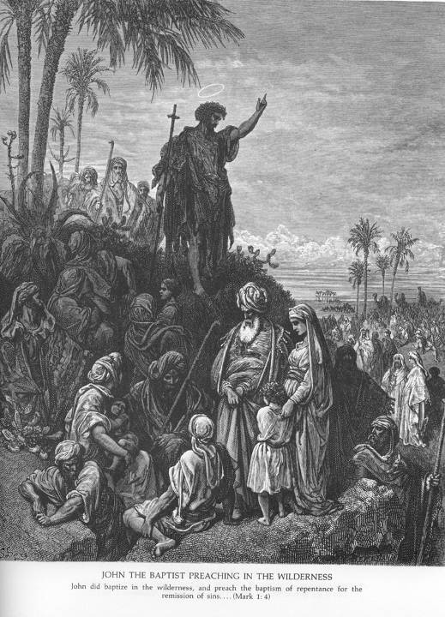
John the Baptist
Gustave Doré,
ca. 1865
Catholic-Resources.org

Slide 85
Baptism of Jesus (Luke 3:21-22)
Narrative Sequence vs. Historical Sequence:
  Herod (Antipas) puts John in prison (vv. 19-20)
  After all people had been baptized,
  and Jesus also had been baptized… (v. 21a)
  Luke does not explicitly say that John baptized Jesus!
The Holy Spirit and Heavenly Voice:
  As Jesus prays, heaven opens, holy Spirit descends;
  Voice from heaven says: “You are my beloved Son;
  with you I am well pleased.” (vs. Matt: “This is…”)

Slide 86
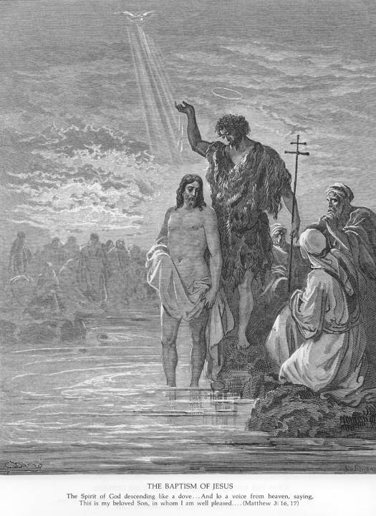
Baptism of Jesus
Usual depictions show John actually baptizing Jesus
E.g. Gustave Doré

Slide 87
Jesus with Women, Children, Lepers…
Similar to Mark & Matthew, Luke stresses that Jesus had much contact with women, embraced children, touched lepers, and associated with other “unclean” people.
But why were women and children considered “unclean”?
Need to know about ancient Jewish “purity” laws, as commanded in the Torah.

Slide 88
“Ritual Purity” in Judaism
Purpose:
  Most purity regulations originally affected priests serving in the Jerusalem Temple.
  But first-century Pharisees & other laymen also strove to remain ritually “clean” as a sign of devotion to God, obeying the whole Torah.
Main Sources of Impurity (Lev 11–18):
  Blood, Bodily Fluids, Lepers, Certain Animals, Corpses, Bones, Anything related to Death

Slide 89
“Ritual Purity” in Judaism
People Potentially Unclean:
  Women, Children, the Blind, the Deaf,
  Gentiles, Samaritans, Tax Collectors, etc.
  Those who don’t know or can’t follow purity laws, and those who are unavoidably unclean
View of Young Children:
  Not cute/innocent, but burdens! Unclean?
  Not valued until they contribute to family!
  Yet Jesus embraces them (9:46-49; 18:15-17)

Slide 90
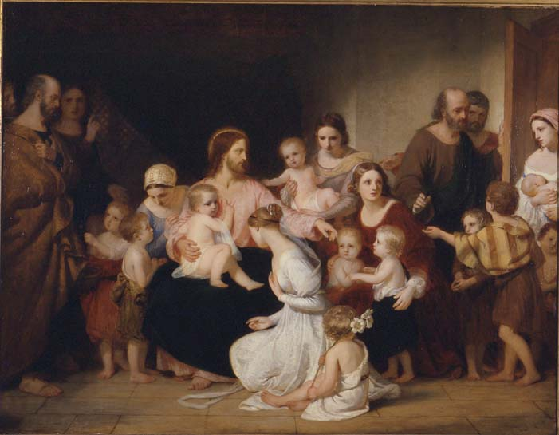
Luke 18:15-17 ~ Jesus Blessing Children ~ Sir Charles Locke Eastlake

Slide 91
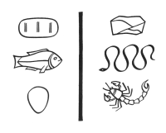
Petition & Repentance in Luke
Jesus’ Teachings & Examples of Prayer,
esp. focusing on Petition:
  The Lord’s Prayer (11:1-4)
  A related parable,
  stressing persistence
  in prayer (11:5-8)
  Related sayings (11:9-12)
“How much more will
God give the Holy Spirit
to those who ask?” (11:13)

Slide 92
The Lord’s Prayer
Matthew 6:9-13
Our Father in heaven, hallowed be your name.
Your kingdom come.
Your will be done, on earth as it is in heaven. Give us this day our daily bread.
And forgive us our debts,
as we also have forgiven our debtors.
And do not bring us to the time of trial, but rescue us from the evil one.
Luke 11:2-4
Father,
hallowed be your name.
Your kingdom come.
Give us
each day our daily bread.
And forgive us our sins,
for we ourselves forgive everyone indebted to us. And do not bring us to the time of trial.

Slide 93
Praying on Retreat
Various Styles of Prayer:
  Verbal Meditation –
  Imaginative Contemplation –
  Reflective Journaling –
  Active Journeying –
  Creative Expression –
  Contemplative Prayer –
  Liturgical Worship –

Slide 94
Luke’s Prologue (adapted)
“Gather ‘Round This Table,” by Marty Haugen
from The Feast of Life: Stories from the Gospel of Luke
For two thousand years people have remembered
and sung and told and danced and lived and written down the events that God has fulfilled in our midst.
The story has been handed down to us from all those who were eyewitnesses and servants of the Word.
So we, too, remember and sing and dance and pass the story on so that you may know the truth.

Slide 95

“Gather ‘Round This Table” (cont.)
Come, gather ’round this table
– all you from far and near,
gather ’round this table,
for all are welcome here,
yes, all are welcome here.
O come and join the banquet,
holy and happy feast.
God has spread a banquet
where the greatest shall be least,
the greatest shall be least.
Blessed are they who will feast in the Reign of God.
Blessed are they who will share the bread of life.

Slide 96
“Gather ‘Round This Table” (cont.)
And here we taste salvation,
break now the blessed bread,
joined with all creation,
every hunger shall be fed, all hungers shall be fed.
The cup of God’s own gladness,
sweet and abundant wine,
Saved from sin and sadness,
let your spirit brightly shine,
all spirits brightly shine. (Refrain)
And here we share the story, ancient and ever new,
cross and crown and glory, our death and life anew, our death and life anew.

Slide 97
“Gather ‘Round This Table” (concl.)
Sing me a song about Jesus, tell me a story that’s true.
What did he teach us? What did he do?
What did he sing to the children he knew?
Sing me a song about Jesus, stories of hunger and meal,
words that can feed us, tales that can heal,
songs that will challenge and help us to feel.
What shall I tell you? What shall I sing?
Sing me a song of the time he was born.
Sing me a song of that great Christmas morn.
Sing me a song about Jesus.

Slide 98
For Prayer & Reflection:
How has my life been lately? What is going on inside me? Where has God been present?
How closely have I been journeying with Jesus? How attentive have I been to the Spirit?
Reading just the Prologue (1:1-4), what might Luke want to say to me right now?
What are my deeper needs and desires?
What do I desire from this retreat?

Slide 99
Magnificat (John Michael Talbot)
My soul proclaims the greatness of the Lord
And my spirit exults in God my Savior.
For He has looked with mercy on my lowliness
And my name will be forever exalted.
For the mighty God has done great things for me
And His mercy will reach from age to age.
And Holy, Holy, Holy is His name.
And Holy, Holy, Holy is His name.

Slide 100
Magnificat (John Michael Talbot)
He has mercy in ev'ry generation,
He has revealed His power and His glory.
He has cast down the mighty in their arrogance,
And has lifted up the meek and the lowly.
He has come to help His servant Israel;
He remembers His promise to our fathers.
And Holy, Holy, Holy is His name.
And Holy, Holy, Holy is His name.
And Holy, Holy, Holy is His name.

Slide 101
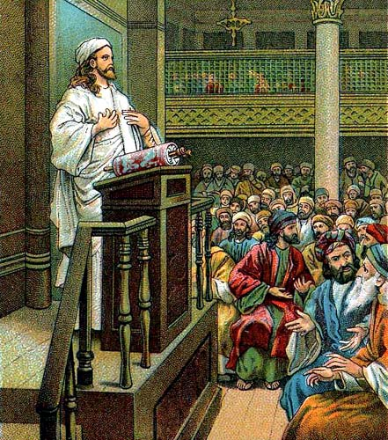
“Bible Card”
Artist & Date Unknown

Slide 102
God Has Anointed Me (Luke 4:16-21)
(by Gary Daigle, from “The Feast of Life”)
Jesus journeyed home, came to Nazareth one day,
entered on the Sabbath to the synagogue to pray.
There he took the scroll, unrolled it, and proclaimed:
“The Spirit of God is upon me.”
REFRAIN: God has anointed me
to bring the Good News to the poor.
God has anointed me to comfort those who mourn.
Let the trumpet sound, proclaim the Jubilee
– the Spirit of God is upon me.

Slide 103
God Has Anointed Me (cont.)
Healing for the broken, sight for all who long to see;
on the day of justice, God will set the captives free.
A year of favor from the God of liberty
– the Spirit of God is upon me.
REFRAIN: God has anointed me
to bring the Good News to the poor.
God has anointed me to comfort those who mourn.
Let the trumpet sound, proclaim the Jubilee
– the Spirit of God is upon me.

Slide 104
God Has Anointed Me (cont.)
Every eye was fixed on him; the room was hushed and still.
Jesus said, “I come to bring the Reign that God has willed;
on this very day, this reading is fulfilled,
for the Spirit of God is upon me.”
REFRAIN: God has anointed me
to bring the Good News to the poor.
God has anointed me to comfort those who mourn.
Let the trumpet sound, proclaim the Jubilee
– the Spirit of God is upon me.

Slide 105
For Prayer and Reflection:
How do the words of Luke 4:18-21 apply to me?
How has the Spirit of God “anointed” me?
What has God asked me to do and proclaim
in my life and ministry? What is God asking now?
Who are my “enemies”? What do I really want God to do for them? Do I want God to save them?
When more blessings seem to come to others (esp. to enemies or strangers) than to me or my friends, how do I feel? How do I react? (angry? resentful? hurt?) What does Jesus say to me about this?

Slide 106
For Your Prayer & Reflection:
On Luke’s Prologue (1:1-4):
How can Luke speak to me, as a modern “Theophilus”?
What do I desire to receive from Luke’s “Good News”? What assurance does it give me?
Which type(s) of prayer do I use most often?
Which types do I neglect? Since prayer is basically “communication” and “relationship” with God,
how can I deepen my prayer?
Meditation: Hear Gabriel say to me,
“Hail, (my name), full of grace! The Lord is with YOU!”
and Elizabeth say, “Blessed are YOU among (wo)men!”

Slide 107
For Your Prayer & Reflection:
Which character do I identify with most closely: Hannah? Elizabeth? Zechariah? Mary? Why?
Does my prayer always begin with praise & blessing of God, as modeled by Mary & Elizabeth?
Creative Exercise: Write your own Magnificat or Benedictus, your own prayer of praise and blessing for all that God has done, based on the models of Mary or Zechariah.

Slide 108
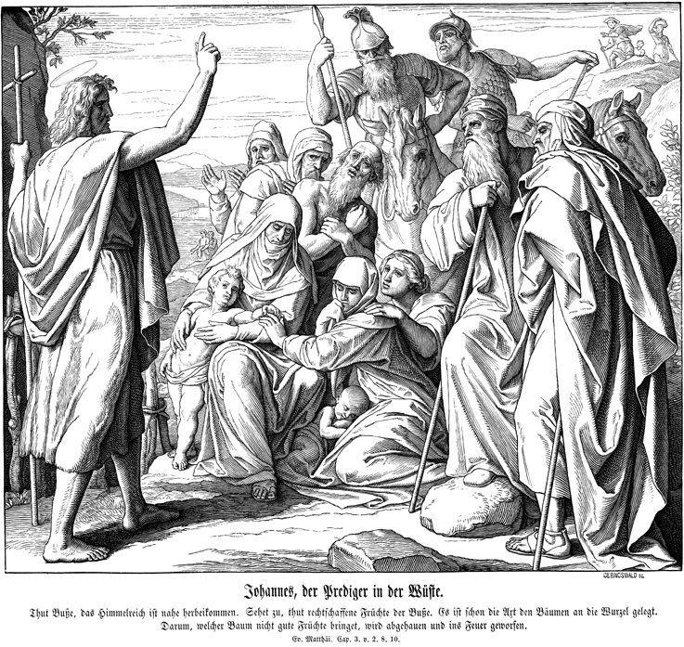

Slide 109
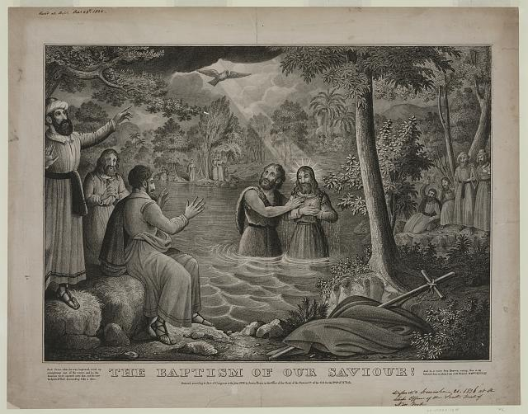

Slide 110
For Prayer and Reflection:
What does John’s message say to me today about my own need to welcome Jesus into my life? In what ways am I called to repent? How can I better prepare for the coming God in my life?
Where and how am I myself called to be a “prophet,”
to convey God’s message in my words & deeds?
Awareness Prayer: Breathe calmly, attentively, in & out: God’s spirit within, enlivening me.
Meditation: Hear God say to me: “You are my beloved son/daughter; with you I am well pleased”

Slide 111
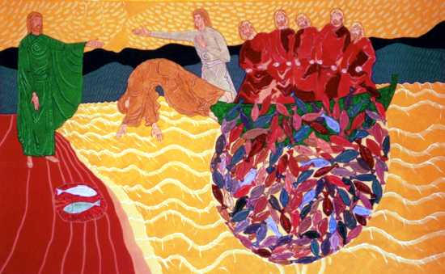
Bertrand BAHUET
The Miraculous Catch of Fish (John 21)

Slide 112
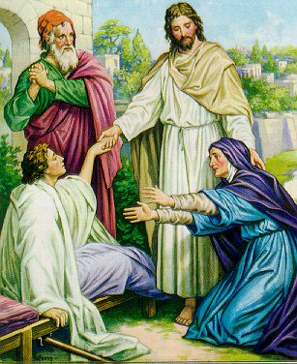
Luke 7:11-17
Jesus raises a widow's son at Nain
Date & Artist Unknown

Slide 113
Jesus’ Merciful/Radical Teachings
Parables of Jesus
  Luke has 37 parables (Mark only 10; Matthew has 28)
What is a Parable?
  “At its simplest a parable is a metaphor or simile
  drawn from nature or common life,
  arresting the hearer by its vividness or strangeness,
  and leaving the mind in sufficient doubt
  about its precise application
  to tease it into active thought.”
  (C. H. Dodd, 1961. The Parables of the Kingdom.)
“Parables” by James C. Christensen

Slide 114
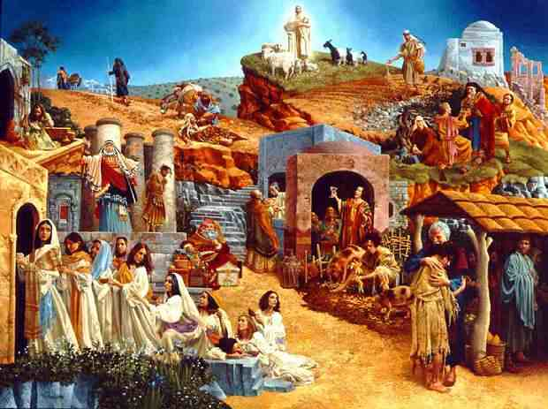

Slide 115
For Prayer and Reflection:
Choosing one of the discipleship “Call” stories: Which character can I imagine myself as?
What does Jesus say to me when he “calls” me to follow him? How do I respond?
How has God’s healing touch manifested itself in my life recently? How have I reacted?
In what ways do I need Jesus’ healing action now? Physically? Emotionally? Spiritually?

Slide 116
“Take Up Your Cross” (Marty Haugen)
The Feast of Life, by Marty Haugen
Jesus began to tell his friends that he was going down to Jerusalem. He said, “The Son of Man will suffer grievously, he will be rejected and be put to death, and on the third day, he will rise.” Then he said to all of us, “This is how you shall be my followers.” (cf. Luke 9:51, 22-23)
Deny yourself, take up your cross, and follow me;
deny yourself, take up your cross, and follow.
Through grief and fear, through pain and loss,
come follow me;
deny yourself, take up your cross, and follow.

Slide 117
“Take Up Your Cross” (Marty Haugen)
If you try to save your life, you will lose it,
all your striving comes to nothing in the end;
Offer up your life to me, and let me use it,
and I will give your life to you again. (Luke 9:24)
(Refrain)
As they were going along the road, a man said to Jesus,
“I will follow you wherever you go.” And Jesus said to him,
“Foxes have holes, and birds of the air have nests,
but the Son of Man has nowhere to lay his head.”
(Luke 9:57-58)

Slide 118
“Take Up Your Cross” (Marty Haugen)
Another said, “I will follow you, Lord;
but first let me say farewell at home.”
Jesus said to him, “No one who puts a hand to the plow and looks back is fit for the kingdom of God.” (Luke 9:61-62)
(Refrain)
And if you should gain the world in all its glory,
all the power and the riches and the fame,
when you face the day of death, what is your story?
And what becomes of all that you have claimed?
(Luke 9:25)
(Refrain)

Slide 119
For Prayer and Reflection:
Rereading Luke’s version of Jesus’ beatitudes & woes, what strikes me (6:20-26)? Why?
When do I tend to condemn, and when to forgive? What are the “planks” in my eyes (6:37-42)?
What is holding me back from a greater commitment to living my Christian vocation?
What attachments do I need to let go of in order to live as a devoted disciple of Jesus?

Slide 120
“God’s Spirit Is Upon Me”
A Retreat with the Gospel of Luke
Tuesday, July 17:
Jesus Reaches Out to Women & Children,
Lepers & Outcasts, Tax Collectors & Sinners

Slide 121
For Prayer and Reflection:
What kinds of people do I consider “unclean” today? Whom do I sometimes try to avoid? Why? What does Jesus tell me about my relationships with these people?
Do some people avoid me, treat me like an outcast, or see me as “unclean” in some way? Why? How does Jesus reach out to me, embrace me, accept me? How do I feel when he touches me?
Contemplation: I imagine myself as the woman in one of the above stories from Luke’s Gospel, and hold a dialogue with Jesus. What do I say to him, and how does he respond to me?

Slide 122
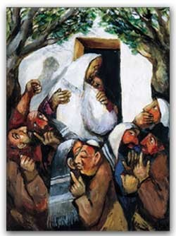
Jesus & Zachaeus by Sieger Köder

Slide 123
Other Themes in Luke
Eschatology (end of time; reign of God)
  Belief in the Resurrection of the Dead
Use of Money & Possessions
  Illustrated in many parables
Giving & Receiving Hospitality
  Esp. the dinner and parables of 14:7-24

Slide 124
The Banquet (by Marty Haugen)
The Reign of God is like a banquet,
and the host says to the servants,
“Go and call those invited, and say to them,
‘Come, for everything is ready now.’”
“A deal’s come up for some real estate,
and there’s a meeting; I can’t be late.
My apologies, but I just can make it.”
“Just got a brand new SUV –
I got to break it in gingerly.
My apologies, but I just can’t make it.”

Slide 125
The Banquet (by Marty Haugen)
“We’ve just been married a week or two.
We’ve got important things to do.
You must understand that we just can’t make it.”
The Reign of God is like a banquet, and the host says,
“If they will not come, go and welcome everyone.
Go out to the lanes and byways, alleyways and open highways; welcome every person that you meet.
Gather all the poor & lame, robbed of power, class & name, those who make their homes on curb and street –
they shall make my banquet hall complete.

Slide 126
The Banquet (by Marty Haugen)
When you come to the banquet in the Reign of God,
remember, the greatest shall be least.
All are equal and holy in the eyes of God;
all are welcome and treasured at this feast.
Only those who are thirsty taste the Reign of God,
only those who are hungry shall be fed;
those who hunger for peace, those who thirst after justice,
they shall taste the goodness of our God,
taste the wondrous banquet feast of God.
The Reign of God is like a banquet.

Slide 127
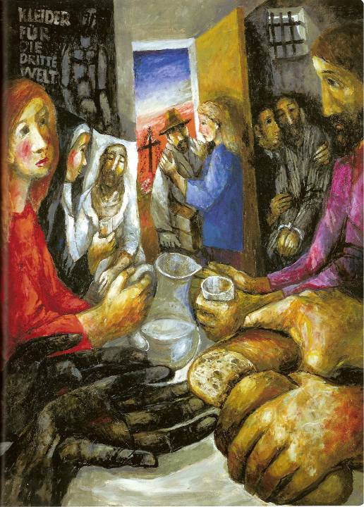

Slide 128
For Prayer and Reflection:
How important is prayer in my life? Am I persistent in petitioning God for what I need? What is my attitude during prayer? Do I really believe God will answer my prayers? Why or why not?
Contemplative Imagination: In what ways am I sometimes like the Pharisee in 7:36-50, or the one in 18:9-14? What is my attitude toward those who are obvious “sinners”? Do I treat them as Jesus would?
How “hospitable” am I really? With whom do I dine? With whom do I spend my time and energy? Only with my friends, or also with those in need?

