Slide 1
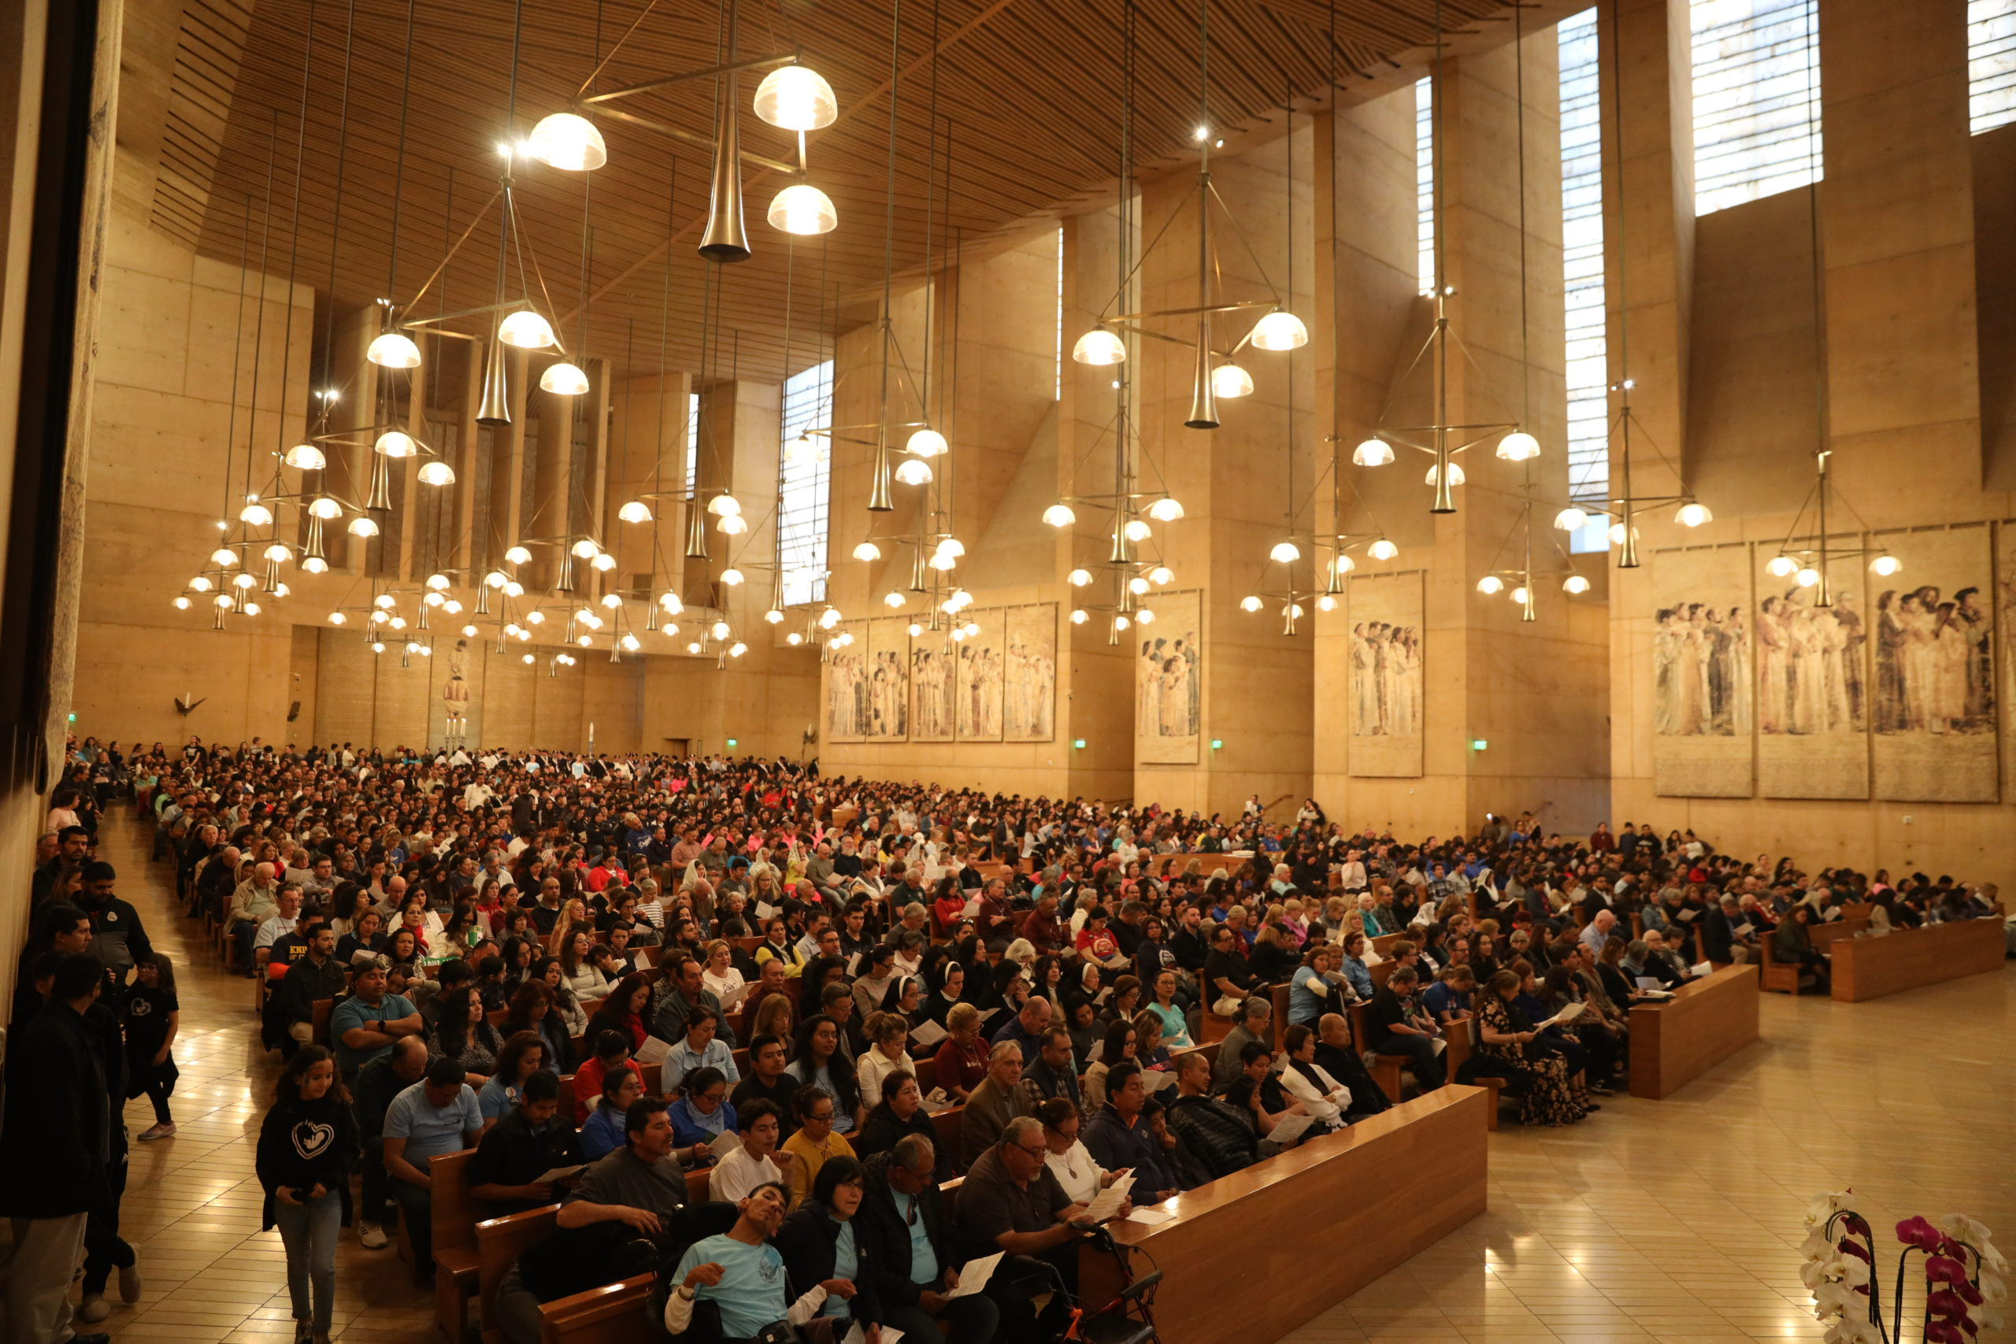
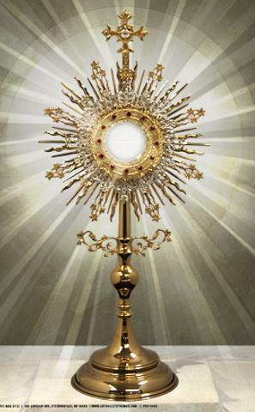
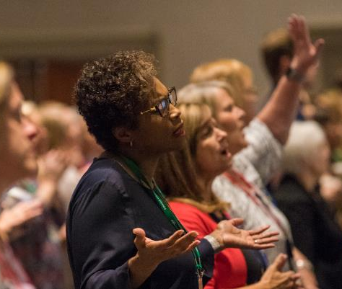
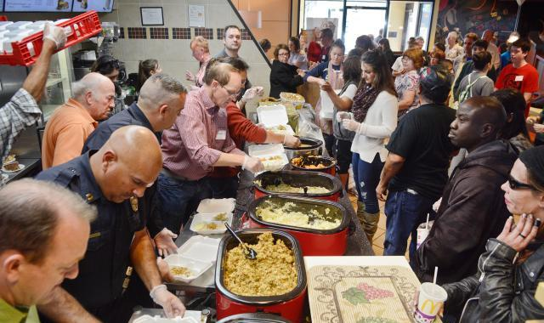
What Does
“Eucharist”
Really Mean?
Fr. Felix Just, S.J., Ph.D.
https://catholic-resources.org

Slide 2
Different Referents of Word “Eucharist”
Verbal Prayer:
  Giving Thanks, esp. to God; cf. “Preface” & “Eucharistic Prayer” at Mass
Early Christian Gatherings
  Reading the Scriptures and Sharing a Meal; “Breaking of the Bread”
Today’s Liturgy/Mass/Sacrament:
  “Liturgy of the Eucharist” (whole Mass? or just 2nd Half?); Communion
Eucharistic Worship:
  Consecrated Bread, Body-Blood-Soul-Divinity of Christ, “Blessed Sacrament”
  Host displayed in Monstrance, for Eucharistic Adoration & Procession

Slide 3
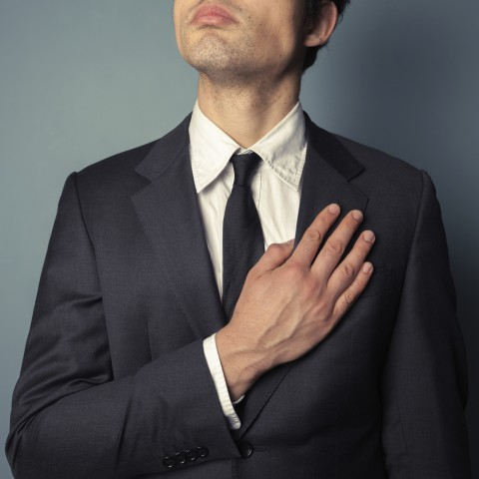
Meaning of the WORD: “Eucharist”
Greek verb εὐχαριστέω (eucharisteō) = “to give thanks; to be grateful”: 6x LXX, 38x NT
  Prefix eu = “good” & noun charis = “gift” or “grace” or “favor”
Related words and expressions:
  noun εὐχαριστία (eucharistia; “thanksgiving; gratitude”): 4x LXX, 15x NT
  adjective εὐχάριστος (eucharistos; “thankful; grateful”): 1x LXX, 1x NT
  χάρις τῷ θεῷ (charis tō theō; “thanks be to God”): 6x NT
  χάριν ἔχω τῷ θεῷ (charin echō tō theō; “I am grateful to God”): 1x NT
  ἔχωμεν χάριν (echōmen charin; “let us give thanks”): 1x NT
  εἰ ἐγὼ χάριτι μετέχω (ei egō chariti metechō; “If I partake with thankfulness”); 1x NT
Other Greek verbs that can mean “thanksgiving”
  εὐλογέω (eulogeō; “to bless”; esp. Mark 6:41 & par.)
  ἐξομολογέω (exomologoumai; “to confess, acknowledge, praise” – Matt 11:25 & Luke 10:21)

Slide 4

“Thanks” in the NT, esp. Gospels & Paul
See white HO: “Eucharist: Thanksgiving, Meal, Liturgy, Sacrament”
  Jesus Thanks/Praises God
  Jesus Feeds Multitudes
  Parable of Pharisee & Tax Collector
  Jesus Prays before Raising Lazarus
  Jesus’ Words at the Last Supper
“Thanks” in rest of NT:
https://catholic-resources.org/Bible/Thanks.htm

Slide 5
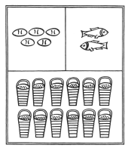
The Feeding of the 5000
Mark 6:41 - "Taking the five loaves and the two fish,
he looked up to heaven, and blessed and broke the loaves,
and gave them to his disciples to set before the people;
and he divided the two fish among them all."
Matt 14:19 - "Taking the five loaves and the two fish,
he looked up to heaven, and blessed and broke the loaves,
and gave them to the disciples,
and the disciples gave them to the crowds."
Luke 9:16 - "And taking the five loaves and the two fish,
he looked up to heaven, and blessed and broke them,
and gave them to the disciples to set before the crowd."
John 6:11 - "Then Jesus took the loaves,
and when he had given thanks, he distributed them to those who were seated;
so also the fish, as much as they wanted."

Slide 6
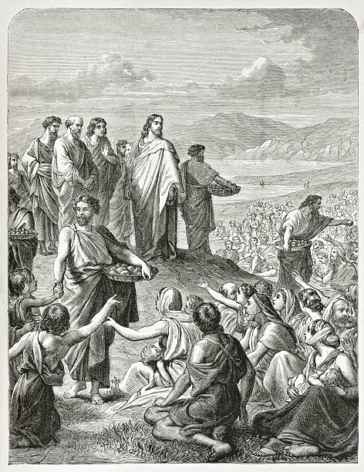
The Feeding of the 4000
Only in Mark and Matthew, not Luke or John:
Mark 8:6 - "...and he took the seven loaves,
and after giving thanks he broke them
and gave them to his disciples to distribute;
and they distributed them to the crowd."
Matt 15:36 - "...he took the seven loaves and the fish;
and after giving thanks he broke them
and gave them to the disciples,
and the disciples gave them to the crowds."

Slide 7
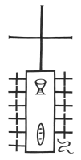
The Last Supper
Narrated in the Synoptic Gospels and mentioned by Paul; but very different in John's :
Mark 14:22-24 - "While they were eating, he (Jesus) took a loaf of bread,
and after blessing it he broke it, gave it to them,
and said, 'Take; this is MY BODY.'
Then he took a cup, and after giving thanks he gave it to them,
and all of them drank from it. He said to them,
'This is MY BLOOD of the covenant, which is poured out for many.' "
Matt 26:26-28 - "While they were eating, Jesus took a loaf of bread,
and after blessing it he broke it, gave it to the disciples,
and said, 'Take, eat; this is MY BODY.'
Then he took a cup, and after giving thanks he gave it to them,
saying, 'Drink from it, all of you;
for this is MY BLOOD of the covenant, which is poured out for many
for the forgiveness of sins.' "

Slide 8
The Last Supper (cont.)
Luke 22:17, 19-20 - "Then he took a cup, and after giving thanks
he said, 'Take this and divide it among yourselves;...'
Then he took a loaf of bread,
and when he had given thanks, he broke it and gave it to them, saying,
'This is MY BODY, which is given for you. Do this in remembrance of me.'
And he did the same with the cup after supper,
saying, 'This cup that is poured out for you is the new covenant in MY BLOOD.' "
1 Cor 11:23-26 - "For I (Paul) received from the Lord what I also handed on to you,
that the Lord Jesus on the night when he was betrayed took a loaf of bread,
and when he had given thanks, he broke it and said,
'This is MY BODY that is for you. Do this in remembrance of me.'
In the same way he took the cup also, after supper,
saying, 'This cup is the new covenant in MY BLOOD.
Do this, as often as you drink it, in remembrance of me.'
For as often as you eat this bread and drink the cup,
you proclaim the Lord's death until he comes."

Slide 9
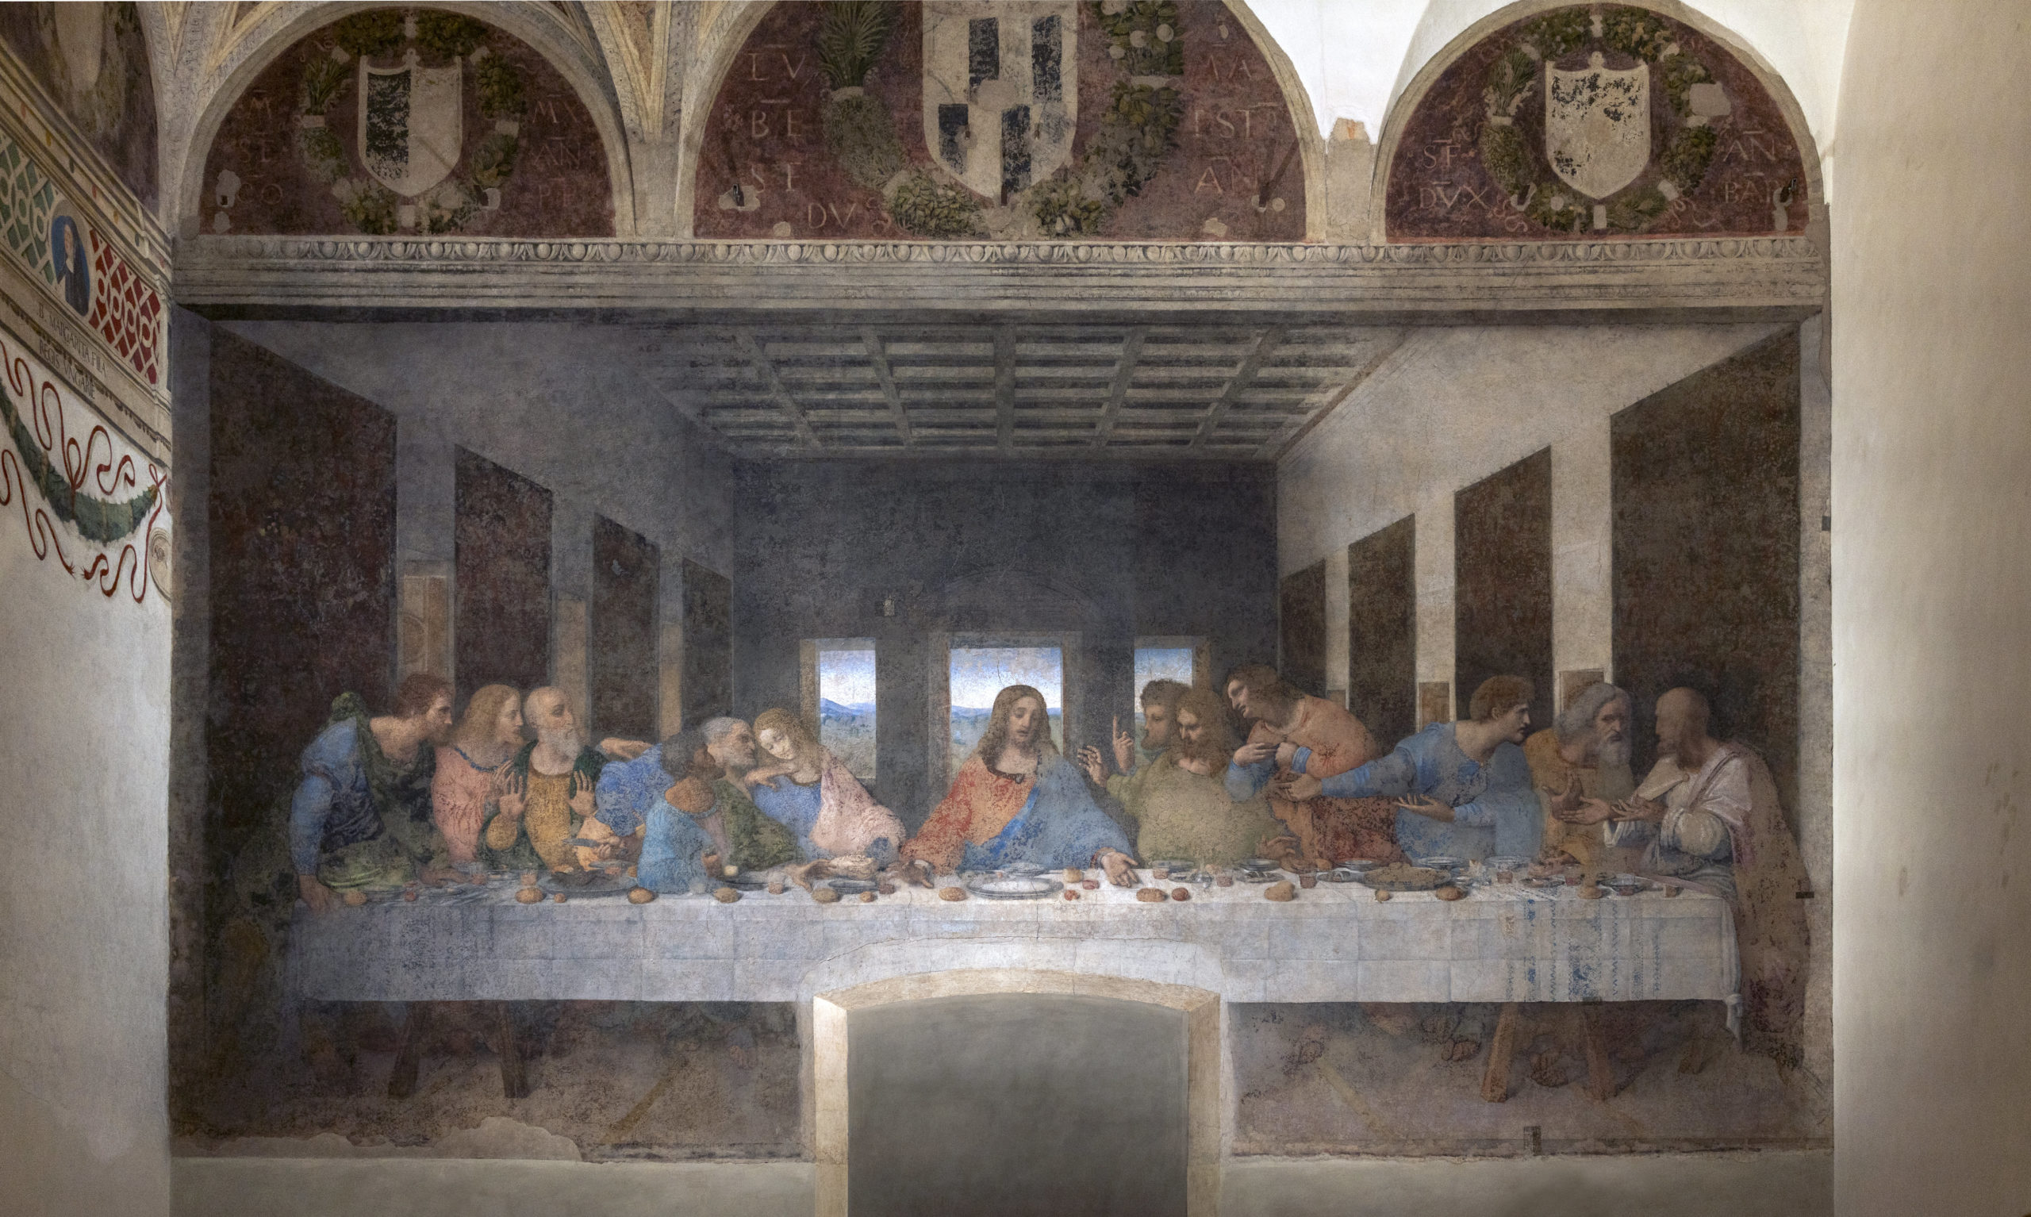

Slide 10
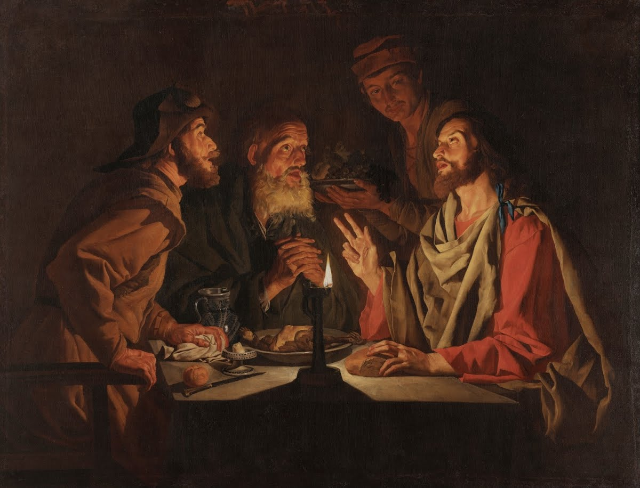
The Supper at Emmaus
Only in Luke 24 (vv. 30-31, 33, 35)
  "When he was at table with them, he took bread,
  blessed it, and broke it, and gave it to them.
  Then their eyes were opened, and they recognized him;
  and he vanished from their sight...
  That same hour they got up and returned to Jerusalem;
  and they found the eleven and their companions gathered together...
  Then they told what had happened on the road,
  and how he had been made known to them in the breaking of the bread.“
Cf. Paul in Acts 27:35
  (Paul speaks to everyone on a ship after fourteen days of riding out a storm at sea) -
  "After he had said this, he took bread;
  and giving thanks to God in the presence of all, he broke it and began to eat."
Matthias Stom – ca. 1635

Slide 11
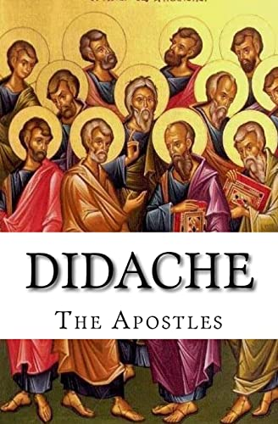
Didache 9
The Teaching of the Twelve Apostles (ca. 80-120 AD):
“And concerning the Eucharist (Περὶ δὲ τῆς εὐχαριστίας),
hold Eucharist thus (οὕτως εὐχαριστήσατε):
First concerning the Cup, ‘We give thanks to thee (Εὐχαριστοῦμεν σοι),
our Father, for the Holy Vine of David thy child,
which thou didst make known to us through Jesus thy child; to thee be glory for ever.’
And concerning the broken Bread: ‘We give thee thanks (Εὐχαριστοῦμεν σοι), our Father, for the life and knowledge which thou didst make known to us through Jesus thy Child. To thee be glory for ever. As this broken bread was scattered upon the mountains, but was brought together and became one, so let thy Church be gathered together from the ends of the earth into thy Kingdom, for thine is the glory and the power through Jesus Christ for ever.’ ”

Slide 12
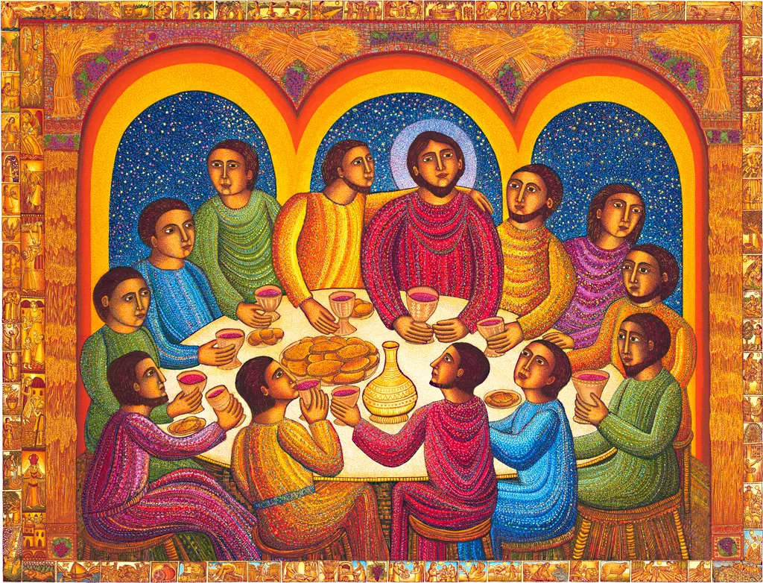
The Early Christian Ritual Meal
Biblical Terms
  “Passover” & “Unleavened Bread”
  “Last Supper”
  “Lord’s Supper”
  “Breaking of the Bread”
  “Eucharist”
  “Liturgy”
  “Communion”
  “Mass”
  See www.catholic-resources.org/Bible/Eucharist.htm
John August Swanson – Last Supper

Slide 13
Catholic Eucharist/Mass Today
Apply the “BOTH / AND Approach”:
Two Halves of Mass: Both Liturgy of Word AND Liturgy of Eucharist
  Jesus Presence in both Presider (Ministerial priesthood) AND Assembly (Baptismal priesthood)
  Mass is both Remembrance of Last Supper AND Celebration of Lord’s Supper
  Eucharist is both a Meal AND a Sacrifice
  Leader is both a Presbyter (Cmty elder) AND a Priest (Cultic)
  Material is both “Bread & Wine” at Table AND “Host & Blood” on Altar
  We need both reverent silence AND communal singing
  Participation needs to be both external / communal AND internal / individual

Slide 14
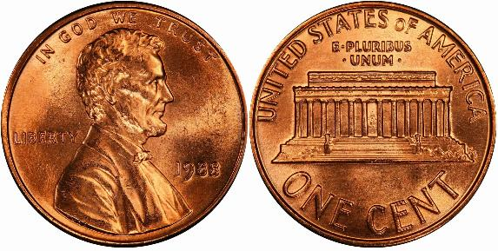
BOTH / AND Approach in Catholicism
Proper Catholic Answer to ALL Theological Questions:
  Both A and B (and C and D…)
  Not only A, but also B (and C and D…)
Avoid One-Sided Over-emphases:
  Only A, not B – or – Only B, not A
  Either extreme is wrong (leads to “heresies”!)
  “Half-truths” are misleading / wrong!

Slide 15
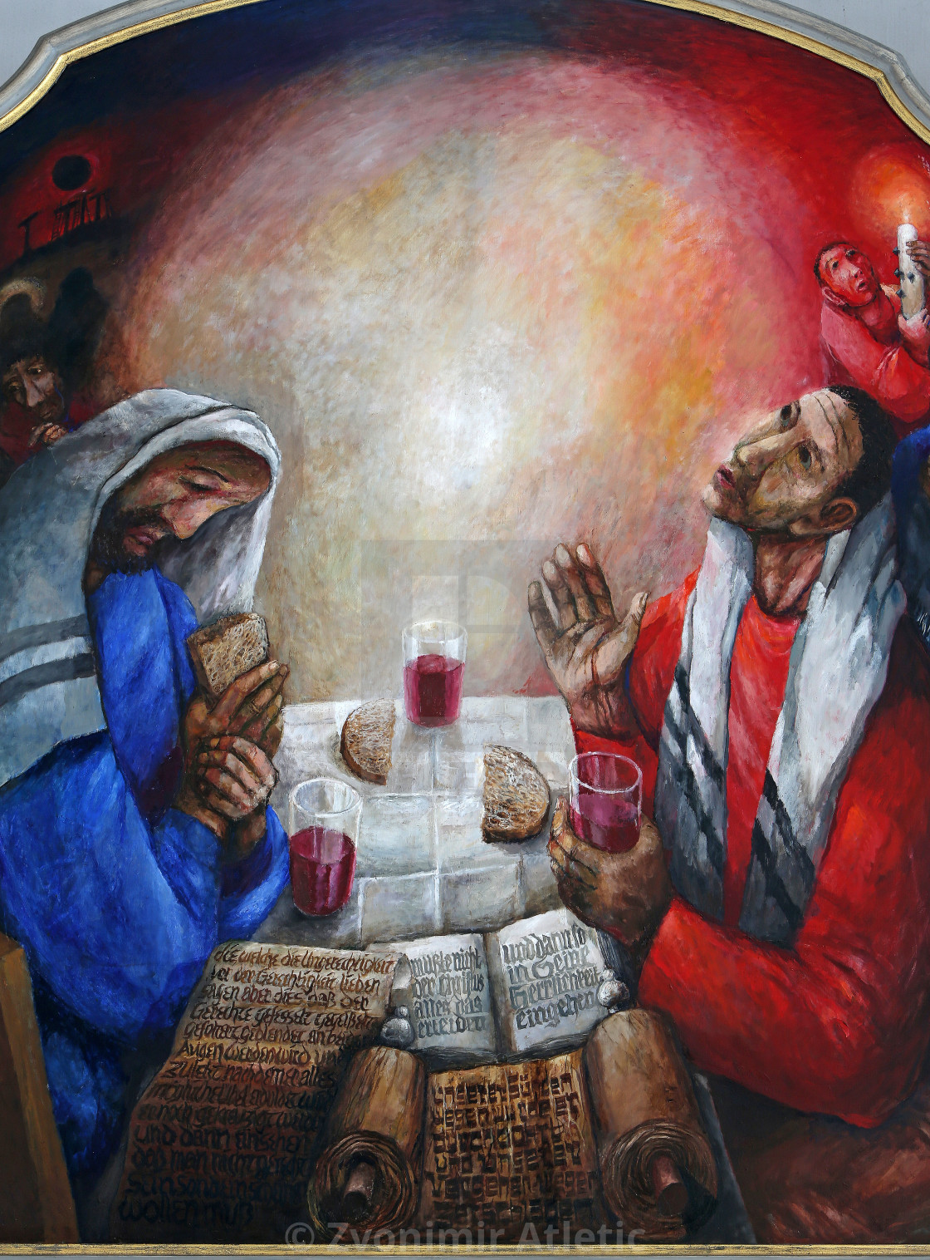
“Thanksgiving” in the Catholic Mass
See white HO:
Instructions in the GIRM
Words used at each Mass:
  Introductory Rites
  Liturgy of the Word
  Liturgy of the Eucharist
  Concluding Rites
More Focus on Thanksgiving:
  Texts in some Masses: Antiphons and Presidential Prayers
  Special Masses: Easter Vigil, “Various Needs and Occasions”; Thanksgiving Day (USA)

Slide 16
Four-fold “Presence” of Christ in the Liturgy
Vatican II: Sacrosanctum Concilium §7
To accomplish so great a work, Christ is always present in his Church, especially in her liturgical celebrations. He is present in the sacrifice of the Mass, not only in the person of his minister, “the same now offering, through the ministry of priests, who formerly offered himself on the cross,” but especially under the Eucharistic species. By his power he is present in the sacraments, so that when someone baptizes it is really Christ himself who baptizes. He is present in his word, since it is he himself who speaks when the holy scriptures are read in the Church. He is present, lastly, when the Church prays and sings, for he promised: “Where two or three are gathered together in my name, there am I in the midst of them” (Matt 18:20)
Role of the Tabernacle during Mass?
Genuflect only at beginning and end of Mass.

Slide 17
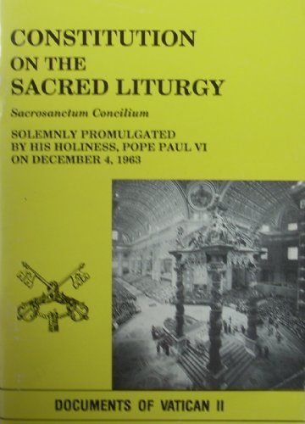
“Full, Conscious, and Active Participation”
Blue HO: Vatican II:
Sacrosanctum Concilium
Chap. I:
“General Principles…” (§§15-46)
Chap. II:
“The Most Sacred Mystery
of the Eucharist” (§§47-58)

Slide 18
What is the “Body of Christ”?
FJ’s 2023 RECongress presentation
Incarnation
  Physical/Mortal Body of the Human Jesus
Resurrection
  Glorified/Eternal Body of the Resurrected Christ
Sacrament
  Real/Present Body of Christ: The Eucharist
Church
  Mystical/Ecclesial Body of Christ: The Church
Our Spiritual Life
  Spirit of Christ Dwells in our Mortal Bodies

Slide 19
Catechism of the Catholic Church, Glossary (USCCB, 2000)
BODY OF CHRIST:
The human body which the Son of God assumed through his conception in the womb of Mary and which is now glorified in heaven (467, 476, 645).
This same Body and Blood, together with the soul and divinity, of our Lord Jesus Christ are sacramentally present in the Eucharist under the appearances of bread and wine (1374).
The Church is called the (mystical) Body of Christ because of the intimate communion which Jesus shares with his disciples; the metaphor of a body, whose head is Christ and whose members are the faithful, provides an image which keeps in focus both the unity and the diversity of the Church (787, 790, 1396).

Slide 20
Real Presence of Christ?
Pew Survey 2019 – claimed that only about 1/3 of Catholics believe
Was this survey accurate? Has belief declined so much?
Be careful with imprecise/sloppy language, esp. in theology!
Distinguish between faith and theology!
  FAITH: Real Presence (belief that Christ is truly present, body & blood, soul & divinity)
  THEOLOGY: Transubstantiation (explains why it still appears as ordinary bread & wine)
    Only CCC 1376 (and “In Brief, 1413”)

Slide 21
Pew Research Surveys: 2011 vs. 2019
2011: more precise theological language:
Which of the following statements best describes the Catholic teaching about the bread and wine used for communion?
1. The bread and wine really become the body and blood of Jesus Christ.
2. The bread and wine are only symbols of the body and blood of Jesus Christ.
Do you believe that at the Consecration during a Catholic Mass, the bread and wine really become the body and blood of Jesus Christ?
1. Yes, believe.
2. No, don't believe.
2019: formulated the two questions differently:
Which of the following best describes Catholic teaching about the bread and wine used for Communion?
The bread and wine…
1. Actually become the body and blood of Jesus Christ
2. Are symbols of the body and blood of Jesus Christ
3. Not sure.
Regardless of the official teaching of the Catholic Church, what do you personally believe about the bread and wine used for Communion? During Catholic Mass, the bread and wine…
1. Actually become the body and blood of Jesus Christ.
2. Are symbols of the body and blood of Jesus Christ.

Slide 22
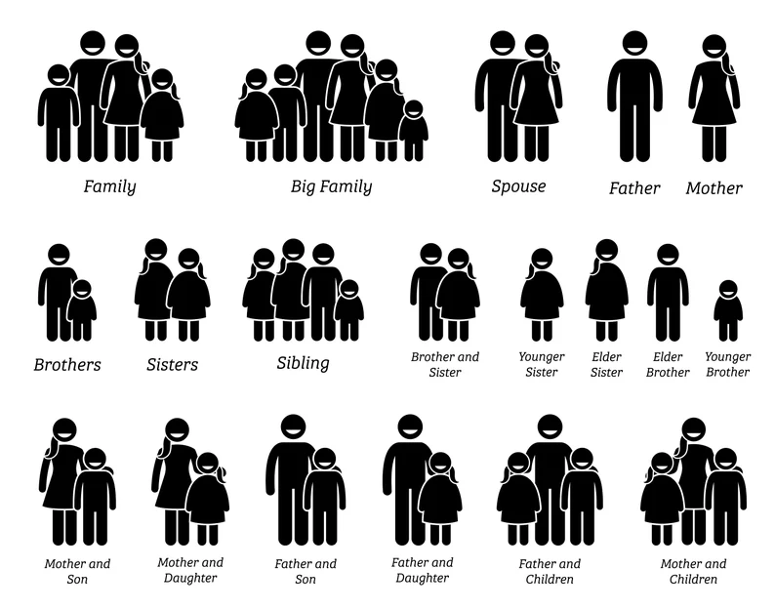
“REAL” vs. “Actual”?
Physical?
Biological?
Chemical?
Genetic?
Historical?
Legal?
Spiritual?
Conventional?

Slide 23
SYMBOL?
Flannery O’Connor (letter, Dec. 1955):
“Well, toward morning the conversation turned on the Eucharist, which I, being the Catholic, was obviously supposed to defend. Mrs. Broadwater said when she was a child and received the Host, she thought of it as the Holy Ghost, He being the ‘most portable’ person of the Trinity; now she thought of it as a symbol and implied that it was a pretty good one. I then said, in a very shaky voice, ‘Well, if it’s a symbol, to hell with it.’ That was all the defense I was capable of but I realize now that this is all I will ever be able to say about it, outside of a story, except that it is the center of existence for me; all the rest of life is expendable.”
“If it’s a mere symbol.” / “If it’s only a symbol…” / “If it’s nothing but a symbol…”
But could it be a “Real Symbol”?

Slide 24

Mere Symbol vs. Real Symbol?

Slide 25
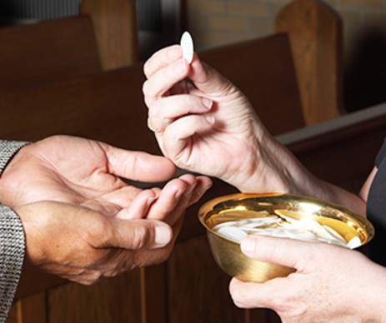
Words at Communion: “The Body of Christ”

Slide 26
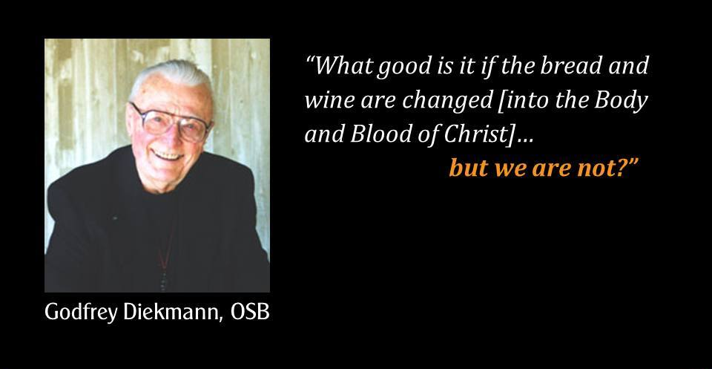

Slide 27
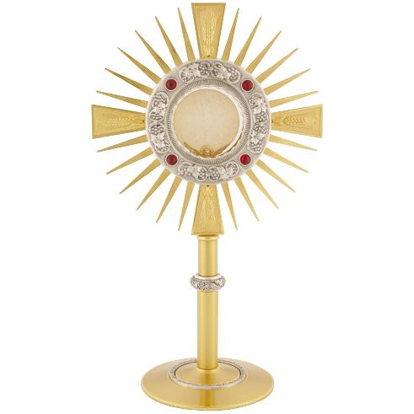
Eucharistic Worship
Historical Roots:
  Preserving some Eucharist after Mass: Communion for the Sick and Homebound
Place of Reservation:
  Church / Sanctuary / Tabernacle
Eucharistic Worship:
  Public: Processions, Benedictions
  Private: Individual Adoration
Eucharistic Connections:
  Adoration (private) must lead to Celebration (community)
  Celebration (Liturgy) must lead to Service (Life)

Slide 28
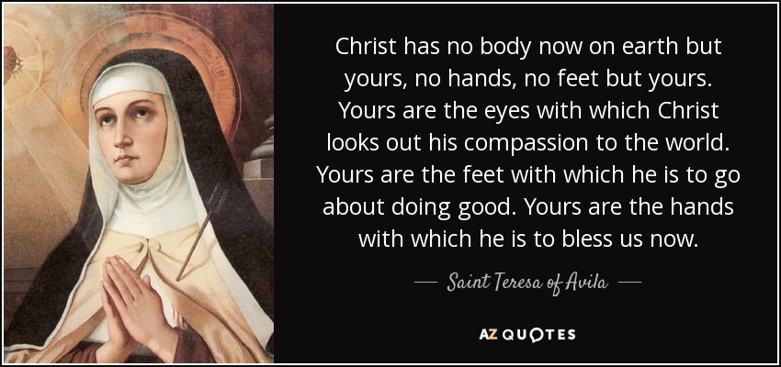

Slide 29
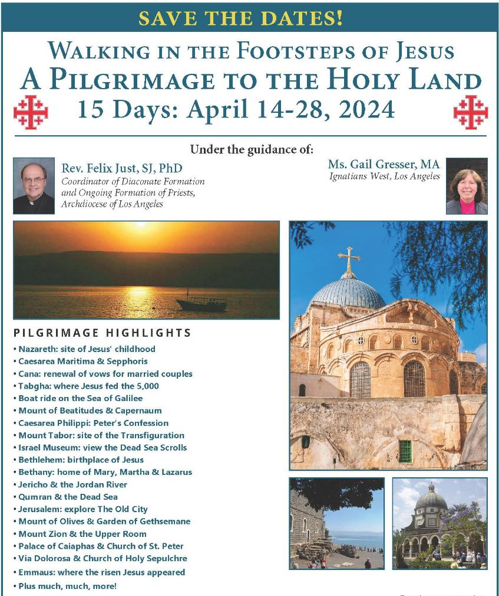
Holy Land Pilgrimage
April 14-28, 2024
Other Biblical Pilgrimages
May 2025, 2026, 2027
God Willing! https://catholic-resources.org

Slide 30
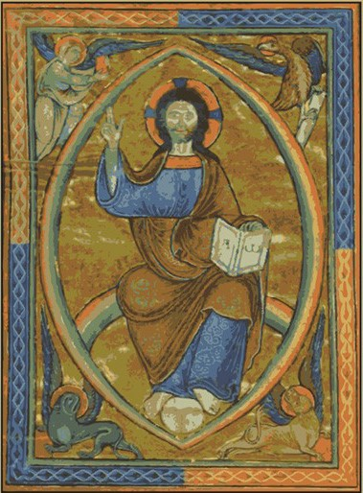
Audio CD Programs by Fr. Felix
The New Testament: A Guided Tour
The Lectionary: A Treasure for Liturgy & Prayer
What Is Faith? Gift, Mystery, Life!
A Retreat with the Gospel of Matthew
A Retreat with the Gospel of Mark
A Retreat with the Gospel of Luke
A Retreat with the Gospel of John
Available from Fr. Felix
or “Learn25.com"

Slide 31
THANKS for COMING!
Questions?
Discussion?
Evaluation:
To provide feedback on the University Series and this session

