Slide 1
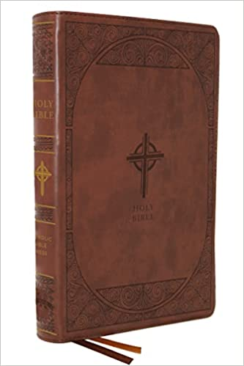
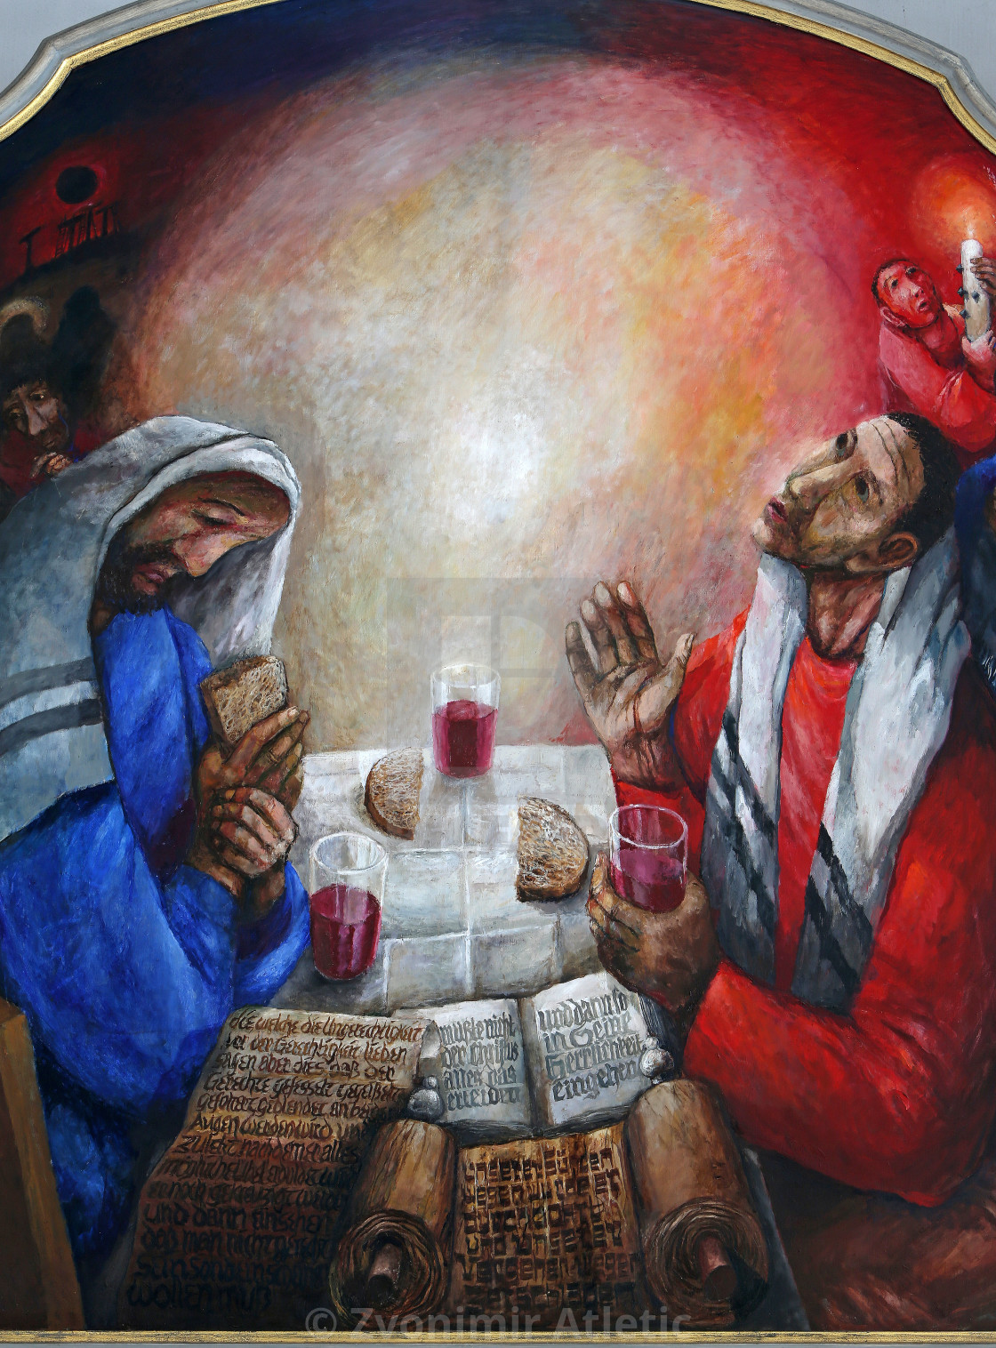
Biblical
Foundations of the Mass
Fr. Felix Just, S.J., Ph.D.
https://catholic-resources.org

Slide 2
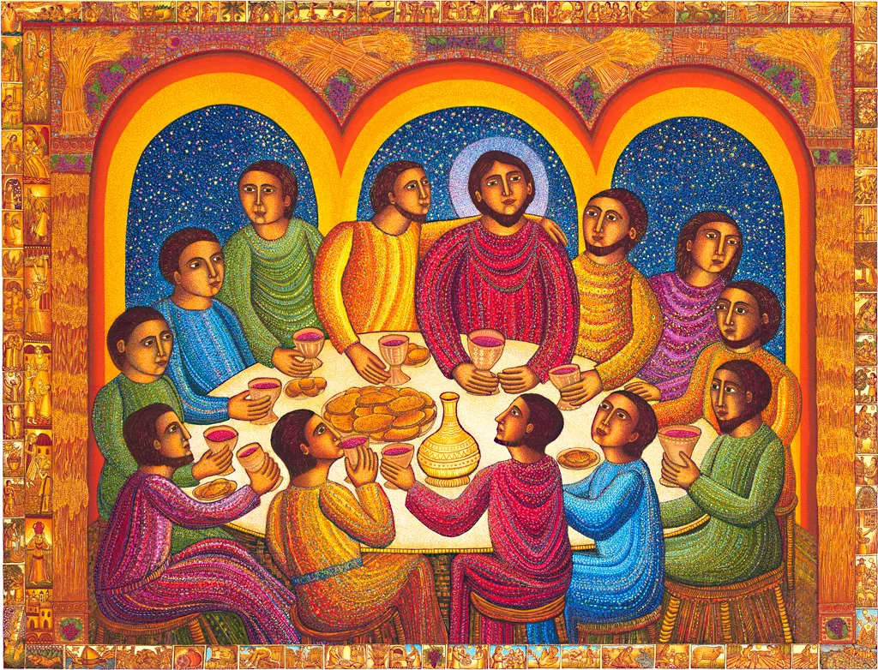
The Early Christian Ritual Meal
Biblical Terms
  “Passover” & “Unleavened Bread”
  “Last Supper”
  “Lord’s Supper”
  “Breaking of the Bread”
  “Eucharist”
  “Liturgy”
  “Communion”
  “Mass”
  See www.catholic-resources.org/Bible/Eucharist.htm
John August Swanson – Last Supper

Slide 3
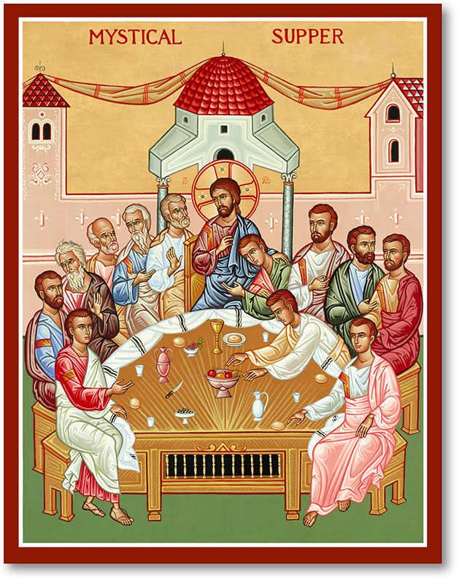
The Early Christian Eucharist
Historical Basis?
  The Jewish Passover?
  Jesus’ Last Supper?
Theological Meaning?
  Is it primarily celebrating a Meal of the Community?
  Or primarily commemorating the Sacrifice of Jesus?
Catholic-Christian answer:
  BOTH / AND !

Slide 4
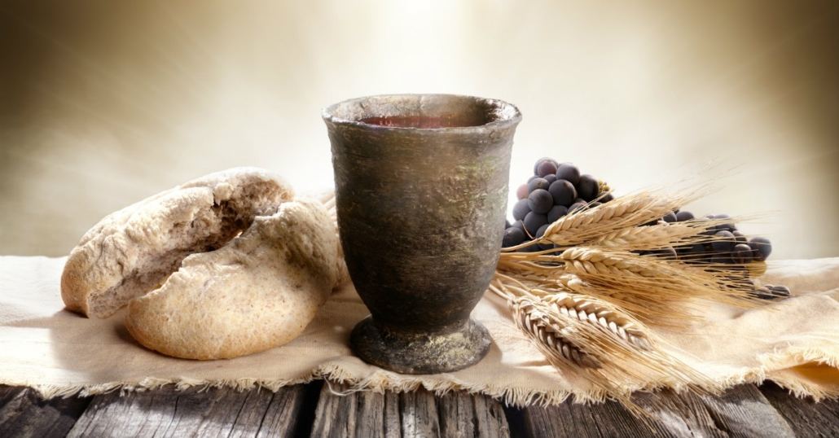
Early Christian "Breaking of Bread"
1 Cor 10:16-17 - "The cup of blessing that we bless,
is it not a sharing in the BLOOD of Christ?
The bread that we break,
is it not a sharing in the BODY of Christ?
Because there is one bread, we who are many
are one body, for we all partake of the one bread."
1 Cor 11:17-21 (Paul scolding early Christians in Corinth for not conducting the Lord's Supper properly) -
"...when you come together it is not for the better but for the worse. For, to begin with,
when you come together as a church, I hear that there are divisions among you...
When you come together, it is not really to eat the Lord's supper.
For when the time comes to eat, each of you goes ahead with your own supper,
and one goes hungry and another becomes drunk." (see also 11:23-34)

Slide 5
Early Christian "Breaking of Bread"
Acts 2:42, 46 - "They (the community of believers in Jerusalem) devoted themselves
to the apostles' teaching and fellowship, to the breaking of bread and the prayers...
Day by day, as they spent much time together in the temple,
they broke bread at home and ate their food with glad and generous hearts..."
Acts 20:7, 11 - "On the first day of the week, when we met to break bread,
Paul was holding a discussion with them; since he intended to leave the next day,
he continued speaking until midnight...
Then Paul went upstairs, and after he had broken bread and eaten,
he continued to converse with them until dawn; then he left."

Slide 6
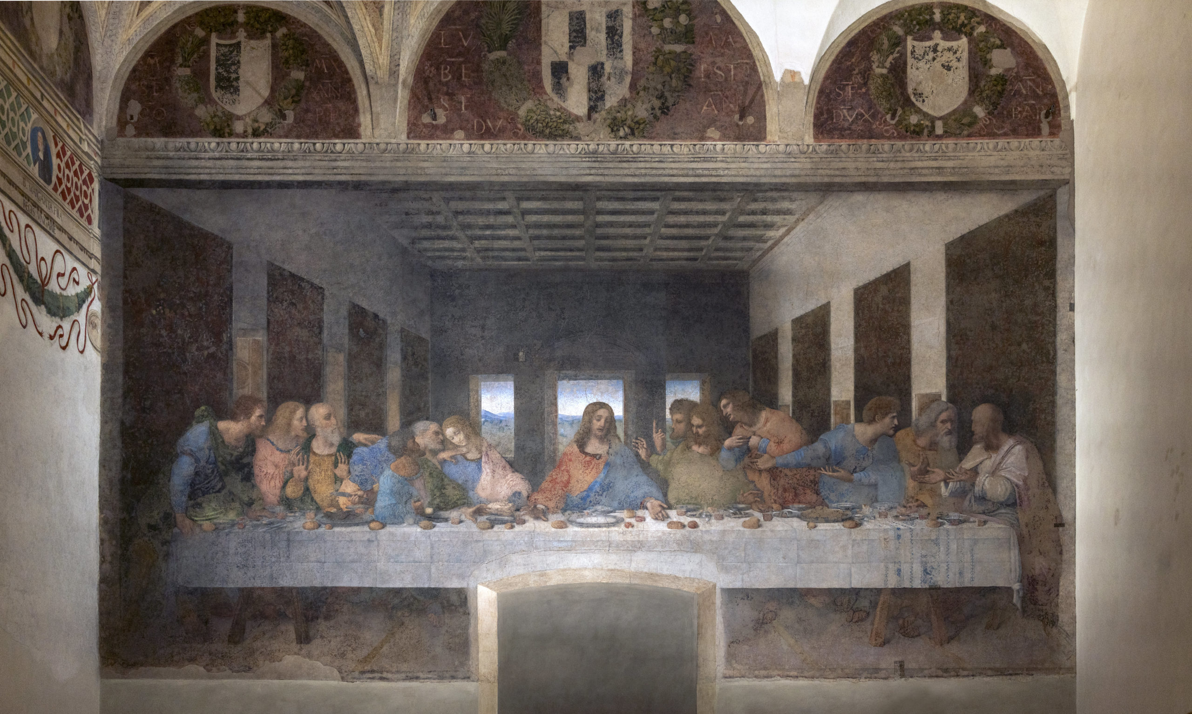

Slide 7
Bible vs. Mass?
Popular (Mis-)Understanding:
Protestants use the Bible
Catholics have the Mass

Slide 8
Biblical Background for Christian Eucharist:
Mass is not only based on the “Last Supper” Jesus had with his disciples,
but also influenced by many special meals celebrated by ancient Jews and early Christians – before, during, and after the lifetime of Jesus.
OLD TESTAMENT:
  Abraham and Melchizedek share bread and wine (Gen 14:18-20)
  Abraham provides a meal for the Three Visitors (Gen 18:1-8)
  Israelites in Egypt celebrate the first Passover (Exod 12:1-28)
  Israelites yearly share Passover meals (Exod 12:43-51; Lev 23:4-14; Num 9:1-14; 28:16-25; Deut 16:1-8)
  Israelites yearly celebrate feast of Unleavened Bread (Exod 12:14-20; 13:3-10; 23:14-15; 34:18; etc.)
  Prophet Elisha feeds 100 men with little food (2 Kings 4:42-44)
Even more OT texts on the bottom of https://catholic-resources.org/Bible/Eucharist.htm

Slide 9
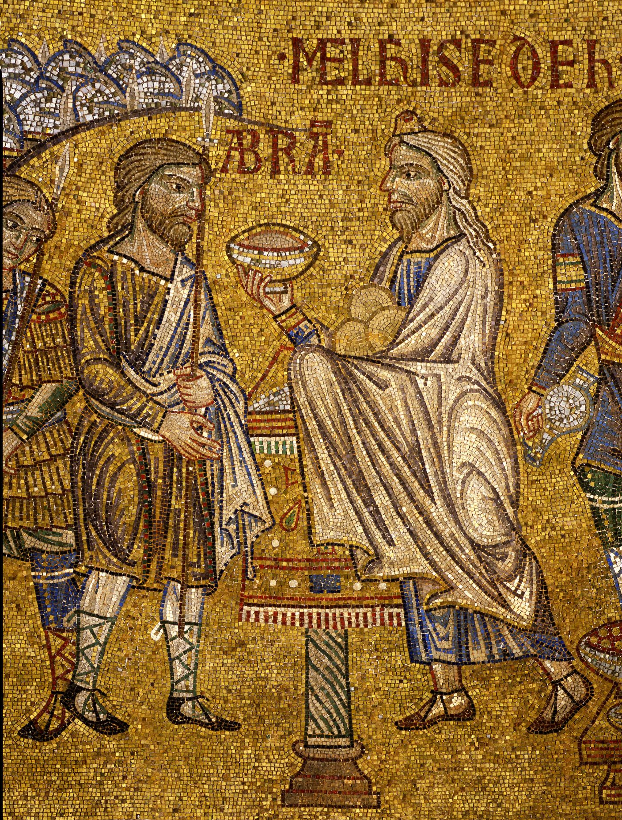
Abram and Melchizedek
Abram and Melchizedek share Bread and Wine (Genesis 14:17-20):
  After his [Abram's] return from the defeat of Chedorlaomer and the kings who were with him, the king of Sodom went out to meet him at the Valley of Shaveh, that is, the King's Valley. / And King Melchizedek of Salem brought out bread and wine;
  he was priest of God Most High. / He blessed him and said,
  "Blessed be Abram by God Most High, maker of heaven and earth; /
  and blessed be God Most High, who has delivered your enemies
  into your hand!" And Abram gave him one tenth of everything.
Compare Psalm 110:4
  "The LORD has sworn and will not change his mind:
  You are a priest forever according to the order of Melchizedek."
  See also Hebrews 5:5-10; 6:20; 7:1-28

Slide 10
Biblical Background for Christian Eucharist:
NEW TESTAMENT:
  Jesus feeds 5000 people in Galilee (Mark 6:30-44; Matt 14:13-21; Luke 9:10-17; John 6:1-14)
  Jesus feeds another crowd of 4000 people (Mark 8:1-10; Matt 15:32-39)
  Jesus tells many parables involving meals and banquets (Matt 22:1-14; 25:1-13; Luke 12:35-40; 14:15-24; etc.)
  Jesus has many meals with disciples and others (Mark 2:15-20; 14:3-9; Luke 14:1-14; etc.)
  Jesus shares his Last Supper with his disciples (Mark 14:12-27; Matt 26:17-30; Luke 22:7-39; cf. 1 Cor 11:23-25)
  The Risen Jesus shares a meal with two disciples at Emmaus (Luke 24:13-35)
  The Risen Jesus has breakfast with disciples at the Sea of Galilee (John 21:1-14)
  Early Christians in Jerusalem share in the “Breaking of the Bread” (Acts 2:42-47)
  Early Christians in Troas “break bread” with Paul (Acts 20:5-11)
  Early Christians in Corinth celebrate the “Lord's Supper” (1 Cor 10:16-17; 11:17-34; cf. Rev 19:9)

Slide 11
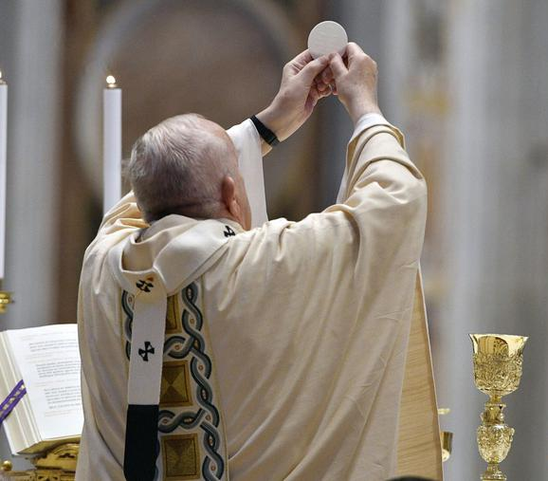
What Is the “High Point” of the Mass?
The Consecration?
Trick Question! – TWO “High Points”!
Two Halves of the Mass:
  Liturgy of the Word:
      High Point = GOSPEL (& Homily)
  Liturgy of the Eucharist:
      High Point = EUCHARISTIC PRAYER (& Communion)

Slide 12
Use of Scripture in Early Christian Worship:
From the start, Christian worship has not only involved the sharing of bread and wine
in a ritual meal, but also included readings from the sacred scriptures (cf. synagogue). Early Christians read from Jewish scriptures, but soon also some Christian writings:
  Books of Moses have been read aloud in Jewish synagogue services for many generations (Acts 15:21)
  Jesus reads from the book of Isaiah during a synagogue service (Luke 4:16-22, citing Isa 61:1-2)
  Risen Jesus explains the meaning of OT scriptures to two disciples on road to Emmaus (Luke 24:25-47)
  Apostles base their preaching on the (OT) scriptures (Acts 2:14-36; 7:2-53; 17:1-11)
  Christians read from the books of “the Law and the Prophets” (Acts 13:15-44)
  Christians sing the Psalms and other hymns in their worship (Col 3:16; Eph 5:18-20)
  The scriptures are applied to all aspects of Christian life (1 Tim 4:13; 2 Tim 3:16-17)
  The letters of Paul are already considered “scripture” (2 Peter 3:15-17; cf. 1 Thess 5:27; Col 4:16)

Slide 13
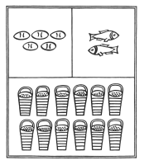
The Feeding of the 5000
Mark 6:41 - "Taking the five loaves and the two fish,
he looked up to heaven, and blessed and broke the loaves,
and gave them to his disciples to set before the people;
and he divided the two fish among them all."
Matt 14:19 - "Taking the five loaves and the two fish,
he looked up to heaven, and blessed and broke the loaves,
and gave them to the disciples,
and the disciples gave them to the crowds."
Luke 9:16 - "And taking the five loaves and the two fish,
he looked up to heaven, and blessed and broke them,
and gave them to the disciples to set before the crowd."
John 6:11 - "Then Jesus took the loaves,
and when he had given thanks, he distributed them to those who were seated;
so also the fish, as much as they wanted."

Slide 14
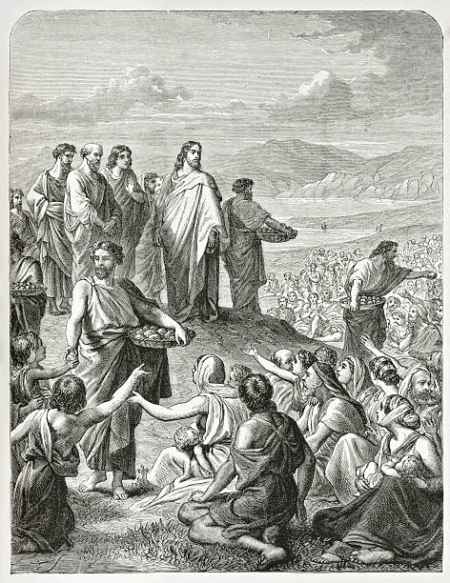
The Feeding of the 4000
Only in Mark and Matthew, not Luke or John:
Mark 8:6 - "...and he took the seven loaves,
and after giving thanks he broke them
and gave them to his disciples to distribute;
and they distributed them to the crowd."
Matt 15:36 - "...he took the seven loaves and the fish;
and after giving thanks he broke them
and gave them to the disciples,
and the disciples gave them to the crowds."

Slide 15
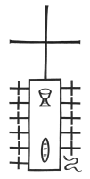
The Last Supper
Narrated in the Synoptic Gospels and mentioned by Paul; but very different in John's :
Mark 14:22-24 - "While they were eating, he (Jesus) took a loaf of bread,
and after blessing it he broke it, gave it to them,
and said, 'Take; this is MY BODY.'
Then he took a cup, and after giving thanks he gave it to them,
and all of them drank from it. He said to them,
'This is MY BLOOD of the covenant, which is poured out for many.' "
Matt 26:26-28 - "While they were eating, Jesus took a loaf of bread,
and after blessing it he broke it, gave it to the disciples,
and said, 'Take, eat; this is MY BODY.'
Then he took a cup, and after giving thanks he gave it to them,
saying, 'Drink from it, all of you;
for this is MY BLOOD of the covenant, which is poured out for many
for the forgiveness of sins.' "

Slide 16
The Last Supper (cont.)
Luke 22:17, 19-20 - "Then he took a cup, and after giving thanks
he said, 'Take this and divide it among yourselves;...'
Then he took a loaf of bread,
and when he had given thanks, he broke it and gave it to them, saying,
'This is MY BODY, which is given for you. Do this in remembrance of me.'
And he did the same with the cup after supper,
saying, 'This cup that is poured out for you is the new covenant in MY BLOOD.' "
1 Cor 11:23-26 - "For I (Paul) received from the Lord what I also handed on to you,
that the Lord Jesus on the night when he was betrayed took a loaf of bread,
and when he had given thanks, he broke it and said,
'This is MY BODY that is for you. Do this in remembrance of me.'
In the same way he took the cup also, after supper,
saying, 'This cup is the new covenant in MY BLOOD.
Do this, as often as you drink it, in remembrance of me.'
For as often as you eat this bread and drink the cup,
you proclaim the Lord's death until he comes."

Slide 17
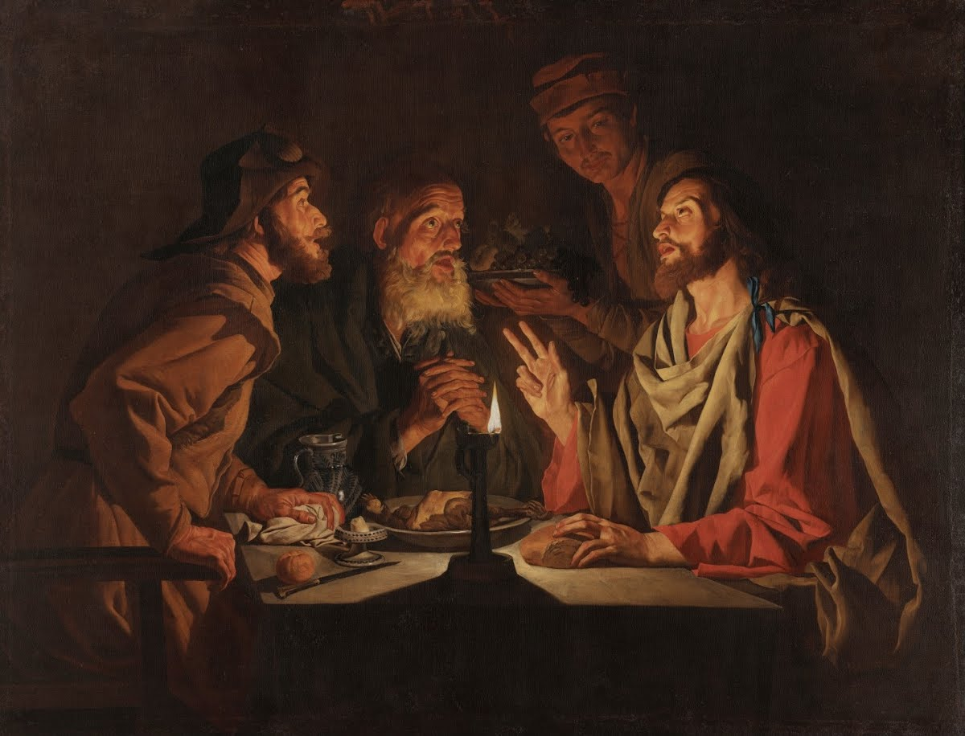
The Supper at Emmaus
Only in Luke 24 (vv. 30-31, 33, 35)
  "When he was at table with them, he took bread,
  blessed it, and broke it, and gave it to them.
  Then their eyes were opened, and they recognized him;
  and he vanished from their sight...
  That same hour they got up and returned to Jerusalem;
  and they found the eleven and their companions gathered together...
  Then they told what had happened on the road,
  and how he had been made known to them in the breaking of the bread.“
Cf. Paul in Acts 27:35
  (Paul speaks to everyone on a ship after fourteen days of riding out a storm at sea) -
  "After he had said this, he took bread;
  and giving thanks to God in the presence of all, he broke it and began to eat."
Matthias Stom – ca. 1635

Slide 18
The “Words of Institution”
. | Jesus’ Words over the Bread | Jesus’ Words over the Cup
Mark 14 | "Take; this is my body." | "This is my blood of the covenant, which is poured out for many."
Matt 26 | "Take, eat; this is my body." | "Drink from it, all of you; for this is my blood of the covenant, which is poured out for many for the forgiveness of sins."
Luke 22 | "This is my body, which is given for you. Do this in remembrance of me." | [third cup]: "Take this and divide it among yourselves;..." [fourth cup]: "This cup that is poured out for you is the new covenant in my blood."
1 Cor 11 | "This is my body that is for you. Do this in remembrance of me." | "This cup is the new covenant in my blood. Do this, as often as you drink it, in remembrance of me."
Roman Missal (2011) | "Take this, all of you, and eat of it: For this is my body which will be given up for you." | "Take this, all of you, and drink from it: For this is the chalice of my blood, the blood of the new and eternal covenant, which will be poured out for you and for many for the forgiveness of sins. Do this in memory of me."

Slide 19
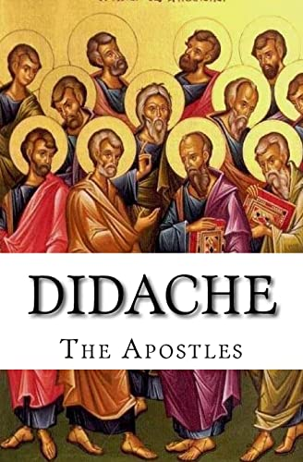
Didache 9
The Teaching of the Twelve Apostles (ca. 80-120 AD):
“And concerning the Eucharist (Περὶ δὲ τῆς εὐχαριστίας),
hold Eucharist thus (οὕτως εὐχαριστήσατε):
First concerning the Cup, ‘We give thanks to thee (Εὐχαριστοῦμεν σοι),
our Father, for the Holy Vine of David thy child,
which thou didst make known to us through Jesus thy child; to thee be glory for ever.’
And concerning the broken Bread: ‘We give thee thanks (Εὐχαριστοῦμεν σοι), our Father, for the life and knowledge which thou didst make known to us through Jesus thy Child. To thee be glory for ever. As this broken bread was scattered upon the mountains, but was brought together and became one, so let thy Church be gathered together from the ends of the earth into thy Kingdom, for thine is the glory and the power through Jesus Christ for ever.’ ”

Slide 20
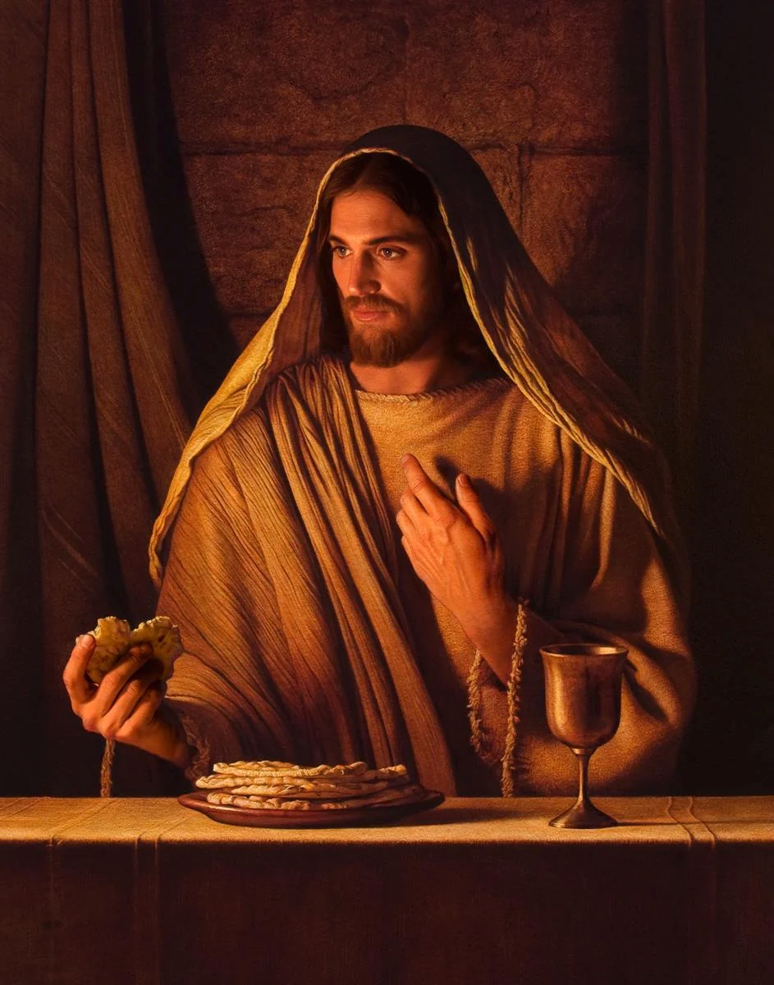
Bread of Life Discourse (John 6)
John 6:35, 47-58 (Johannine teaching about Eucharist, at end of “Bread of Life Discourse”) –
Jesus said to them, “I am the bread of life. Whoever comes to me will never be hungry,
and whoever believes in me will never be thirsty...
Very truly, I tell you, whoever believes has eternal life. I am the bread of life. Your ancestors ate the manna in the wilderness, and they died. This is the bread that comes down from heaven, so that one may eat of it and not die. I am the living bread that came down from heaven. Whoever eats of this bread will live forever; and the bread that I will give for the life of the world is my flesh.”
The Jews then disputed among themselves, saying, “How can this man give us his flesh to eat?”
So Jesus said to them, “Very truly, I tell you, unless you eat the flesh of the Son of Man and drink his blood, you have no life in you. Those who eat my flesh and drink my blood have eternal life, and I will raise them up on the last day; for my flesh is true food and my blood is true drink. Those who eat my flesh and drink my blood abide in me, and I in them. Just as the living Father sent me, and I live because of the Father, so whoever eats me will live because of me. This is the bread that came down from heaven, not like that which your ancestors ate, and they died. But the one who eats this bread will live forever.”

Slide 21
Biblical Background of Liturgical Texts:
The words spoken by the priests and the people during the Catholic Mass and other Christian liturgies are not only based loosely on the Bible; many of them are direct quotations from particular biblical texts.
See Handout
  MASS: Liturgy of the Word & Liturgy of the Eucharist
  Liturgy of the Hours (Morning Prayer, Daytime Prayer, Evening Prayer, Night Prayer, Office of Readings)
  Rosary (and other popular devotions)
Details at https://catholic-resources.org/Bible/Biblical-Mass-Texts.htm

Slide 22
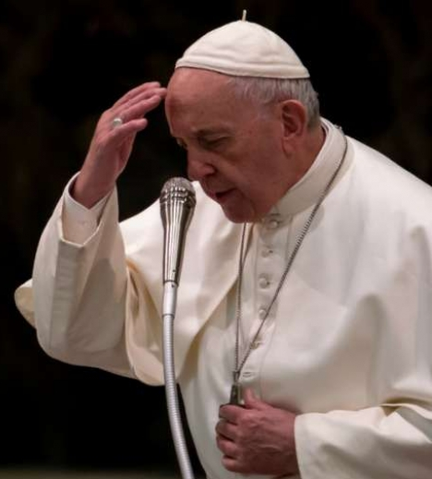
Introductory Rites:
Sign of the Cross:
  “In the name of the Father, and of the Son, and of the Holy Spirit.”
  (Matt 28:19; cf. John 14:13-14; Acts 2:21)
Liturgical Greeting:
  “The grace of our Lord Jesus Christ, and the love of God,
  and the communion of the Holy Spirit be with you all.” (2 Cor 13:14)
  “Grace to you and peace from God our Father and the Lord Jesus Christ” (Phil 1:2; Eph 1:2)
  “The Lord be with you.” (2 Tim 4:22; cf. Matt 1:23; 28:20)

Slide 23
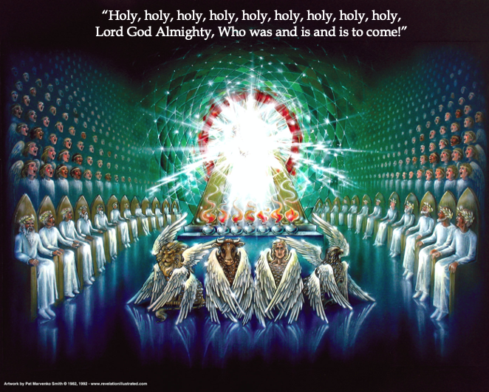
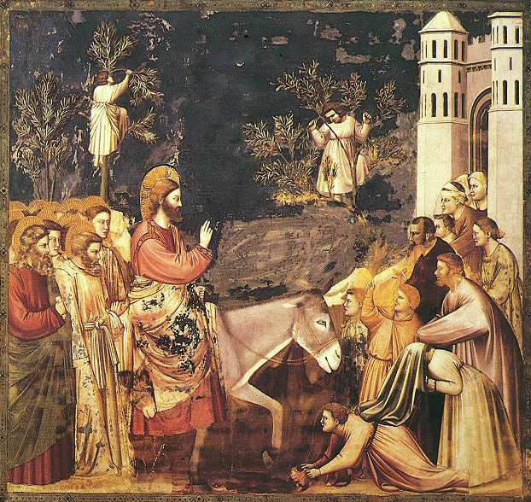
Euch. Acclamations: SANCTUS & BENEDICTUS
“Holy, Holy, Holy Lord God of hosts...”
  (Isa 6:3; Rev 4:8)
“Heaven and earth are full of your glory.”
  (cf. Hab 3:3; Ps 19:1; 57:5; 1 Cor 15:40-41)
“Blessed is he who comes in the name of the Lord.”
  (Ps 118:26; Mark 11:9; Matt 21:9; Luke 19:38; John 12:13)
“Hosanna in the highest.”
  (Mark 11:10; Matt 21:9; cf. Luke 19:38)

Slide 24
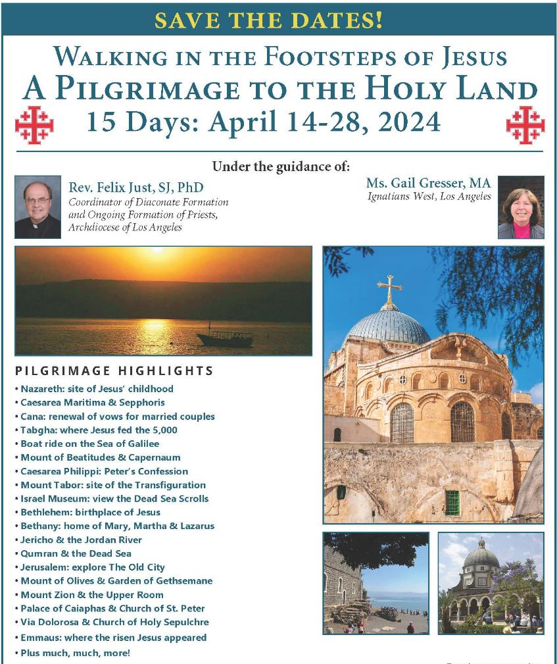
Holy Land Pilgrimage
April 14-28, 2024
Other Biblical Pilgrimages
May 2025, 2026, 2027
God Willing! https://catholic-resources.org

Slide 25
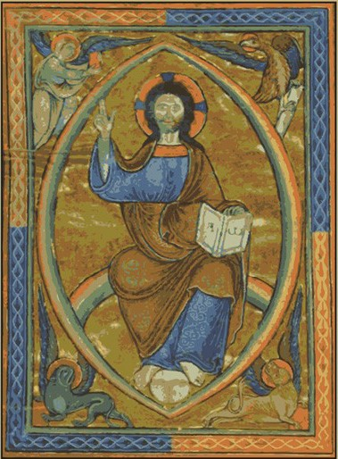
Audio CD Programs by Fr. Felix
The New Testament: A Guided Tour
The Lectionary: A Treasure for Liturgy & Prayer
What Is Faith? Gift, Mystery, Life!
A Retreat with the Gospel of Matthew
A Retreat with the Gospel of Mark
A Retreat with the Gospel of Luke
A Retreat with the Gospel of John
Available from Fr. Felix
or “Learn25.com"

Slide 26
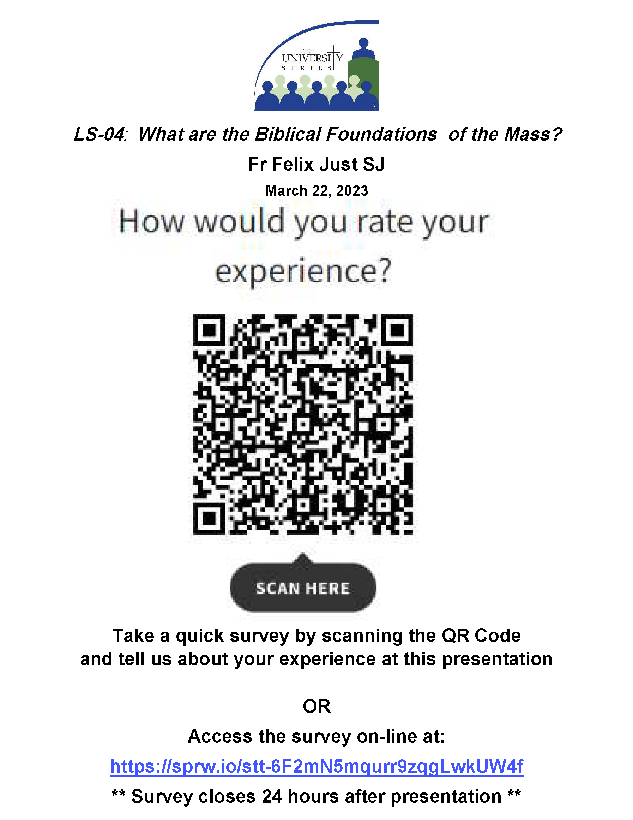
THANKS for COMING!
Questions?
Discussion?
Evaluation:
To provide feedback on the
University Series and this session:

