Slide 1
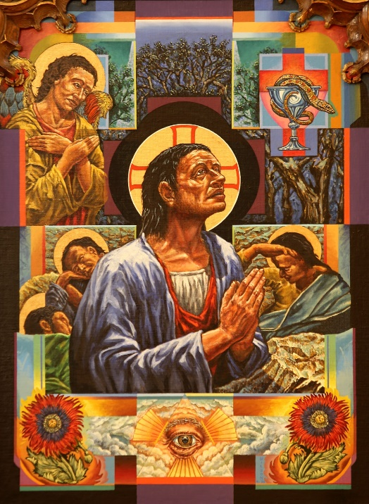
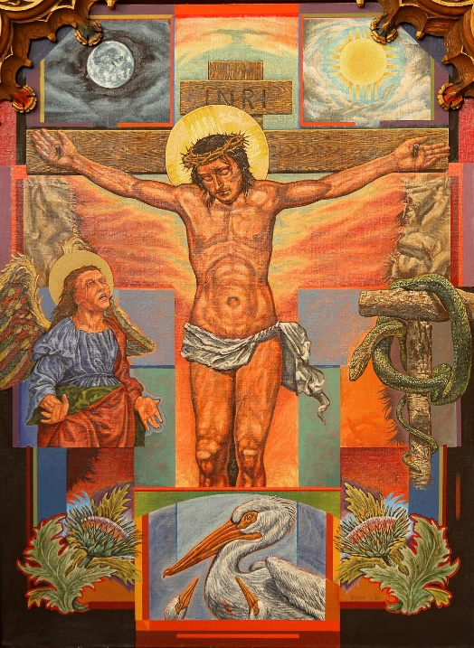
Scriptural Stations of the Cross with Artwork from the Cathedral of the Madeleine, Salt Lake City, Utah

Slide 2
Scriptural Stations – Intro
From https://www.usccb.org/prayer-and-worship/prayers-and-devotions/stations-of-the-cross/scriptural-stations-of-the-cross
“The following Stations of the Cross are based on those celebrated by Pope John Paul II on Good Friday 1991. They are presented here as an alternative to the traditional stations and as a way of reflecting more deeply on the Scriptural accounts of Christ's passion.”
“The presiding minister may be a priest, deacon, or layperson. This minister prays the opening and closing prayers, leads the acclamation, announces the stations, and says the prayer that concludes each station. One or more readers may read the Scriptural reflections. A period of silence should be observed between the Scripture reading and the prayer. A crossbearer and two candlebearers may stand in front of each station as it is announced. As the ministers move between the stations, all may sing a verse of an appropriate song.”
Scripture excerpts are taken from the New American Bible with Revised New Testament, Copyright © 1986, 1970, Confraternity of Christian Doctrine, Inc., Washington, DC. Used with permission. All rights reserved. Permission is hereby granted to reproduce these excerpts in free distribution of these stations. United States Conference of Catholic Bishops, 3211 4th Street, N.E., Washington, DC 20017.

Slide 3
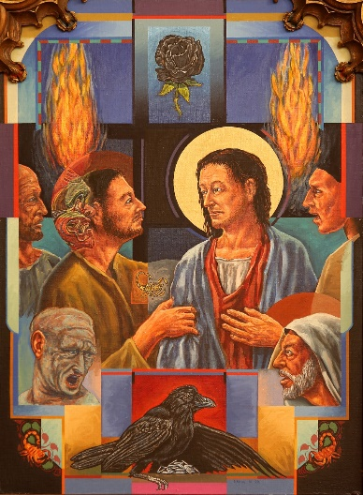
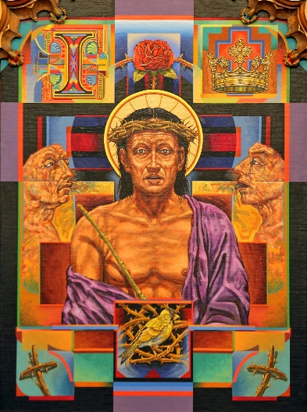
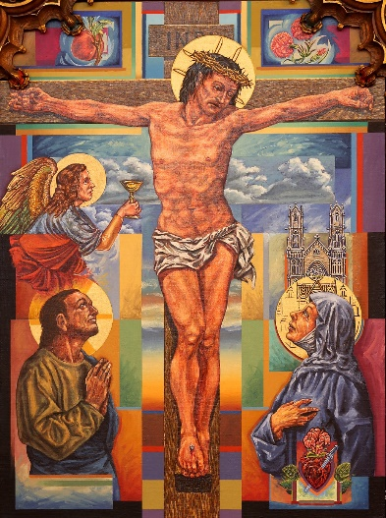
Artwork by Roger (Sam) Wilson
In the Cathedral of the Madeleine, Salt Lake City, UT
  https://utcotm.org/about/pictoral-tour
  Used here with permission of the Cathedral of the Madeleine.
The fourteen Stations of the Cross were painted by Utah artist Roger (Sam) Wilson in 1992 and 1993. They replace a set of stations painted in 1918 which had since deteriorated badly. The new stations, starting at the northeast end of the building, begin with Jesus in the Garden of Olives and end with the burial of Christ. They generally follow a revised (and more biblical) version of the stations produced by the Vatican in 1975 and issued in various versions since then.
The stations combine elements of traditional iconography and American Southwestern coloration within a postmodern style. In developing each scene, the artist uses flowers, animals and various symbolic elements to draw out its meaning and significance. The frames of the stations were carved and installed in 1918 by William F. Ross and Company of East Cambridge, MA.

Slide 4
Music – Suggestions by USCCB
Beginning:
  Lord, Who throughout These Forty Days
  No Greater Love
  Take up Your Cross
  There’s a Wideness in God’s Mercy
  We Walk by Faith
Between the Stations
  At the Cross Her Station Keeping (Stabat Mater)
  Be with Me, Lord
  Behold the Cross
  Eye Has Not Seen
  Jesus, Remember Me
  Now We Remain
  Adoramus Te (Taizé)
  We Remember
  Were You There
From https://www.usccb.org/resources/way-cross-suggested-hymns

Slide 5
Scriptural Stations of the Cross
Before each station:
  Presider: We adore you, O Christ, and we bless you.
  All: Because by your holy cross you have redeemed the world.
After each station:
  All: Lord Jesus, help us walk in your steps.
Opening Prayer:
Presider: God of power and mercy, in love you sent Jesus, your Son, that we might be cleansed of sin and live with you forever. Bless us as we gather to reflect on his suffering and death that we may learn from his example the way we should go. We ask this through that same Christ, our Lord.
All: Amen.

Slide 6

1st Station: Jesus in the Garden of Gethsemane
Reader: Then Jesus came with them to a place called Gethsemane, and he said to his disciples, “Sit here while I go over there and pray.” He took along Peter and the two sons of Zebedee, and began to feel sorrow and distress. Then he said to them, “My soul is sorrowful even to death. Remain here and keep watch with me.” He advanced a little and fell prostrate in prayer, saying, “My Father, if it is possible, let this cup pass from me; yet, not as I will, but as you will.” When he returned to his disciples he found them asleep. He said to Peter, “So you could not keep watch with me for one hour? Watch and pray that you may not undergo the test. The spirit is willing, but the flesh is weak.” (Matthew 26:36-41)
Presider: Lord, grant us your strength and wisdom, that we may seek to follow your will in all things.
All: Lord Jesus, help us walk in your steps.

Slide 7

2: Jesus, Betrayed by Judas, Is Arrested
Reader: Then, while [Jesus] was still speaking, Judas, one of the Twelve, arrived, accompanied by a crowd with swords and clubs, who had come from the chief priests, the scribes, and the elders. His betrayer had arranged a signal with them, saying, “the man I shall kiss is the one; arrest him and lead him away securely.” He came and immediately went over to him and said, “Rabbi.” And he kissed him. At this they laid hands on him and arrested him. (Mark 14:43-46)
Presider: Lord, grant us the courage of our convictions that our lives may faithfully reflect the good news you bring.
All: Lord Jesus, help us walk in your steps.

Slide 8
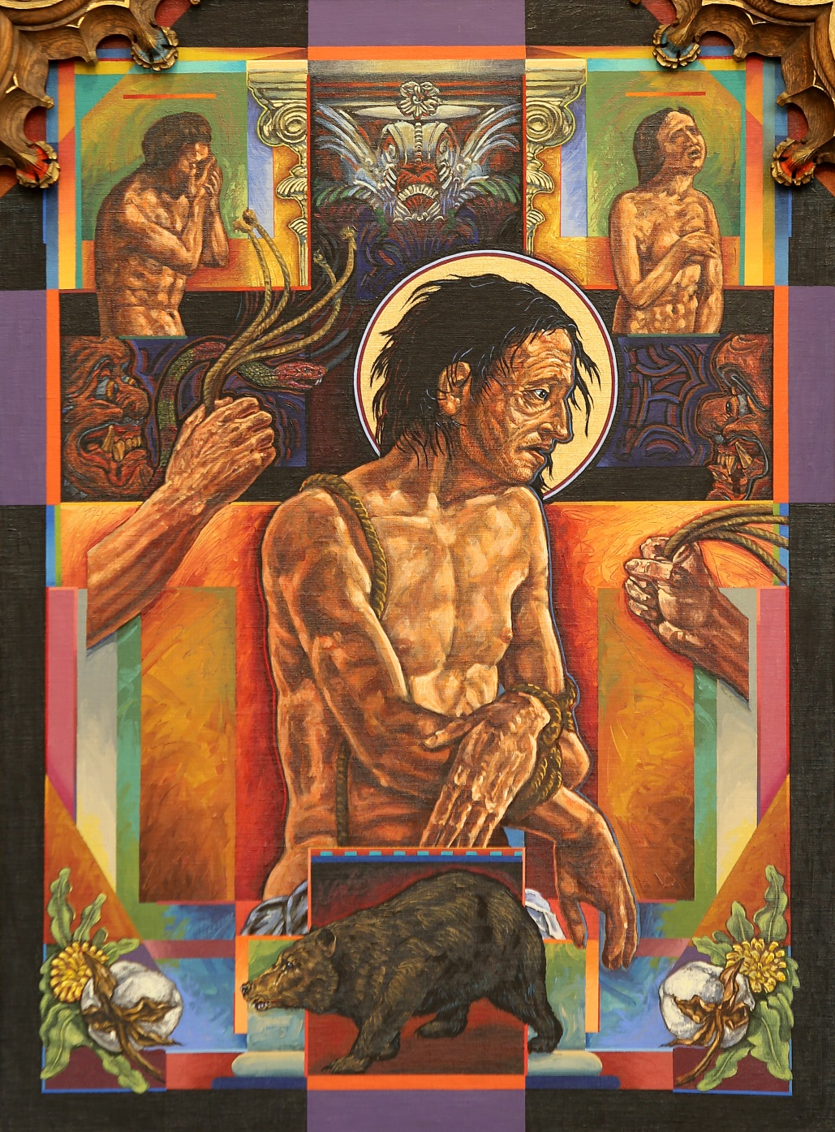
3: Jesus Is Condemned by the Sanhedrin
Reader: When day came the council of elders of the people met, both chief priests and scribes, and they brought him before their Sanhedrin. They said, “If you are the Messiah, tell us,” but he replied to them, “If I tell you, you will not believe, and if I question, you will not respond. But from this time on the Son of Man will be seated at the right hand of the power of God.” They all asked, “Are you then the Son of God?” He replied to them, “You say that I am.” Then they said, “What further need have we for testimony? We have heard it from his own mouth.”
(Luke 22:66-71)
Presider: Lord, grant us your sense of righteousness that we may never cease to work to bring about the justice of the kingdom that you promised.
All: Lord Jesus, help us walk in your steps.

Slide 9
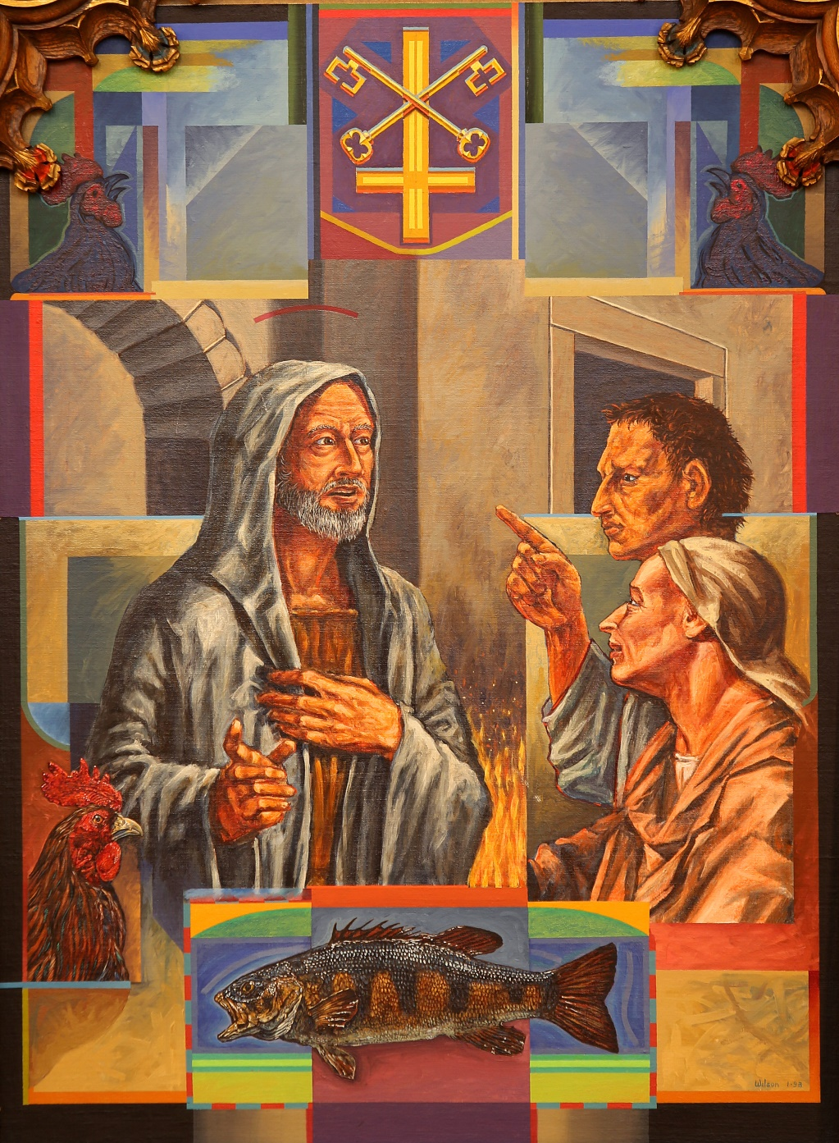
4th Station: Jesus Is Denied by Peter
Reader: Now Peter was sitting outside in the courtyard. One of the maids came over to him and said, “You too were with Jesus the Galilean.” But he denied it in front of everyone, saying, “I do not know what you are talking about!” As he went out to the gate, another girl saw him and said to those who were there, “This man was with Jesus the Nazorean.” Again he denied it with an oath, “I do not know the man!” A little later the bystanders came over and said to Peter, “Surely you too are one of them; even your speech gives you away.” At that he began to curse and to swear, “I do not know the man.” And immediately a cock crowed. Then Peter remembered the word that Jesus had spoken: “Before the cock crows you will deny me three times.” He went out and began to weep bitterly. (Matthew 26:69-75)
Presider: Lord, grant us the gift of honesty that we may not fear to speak the truth even when difficult.
All: Lord Jesus, help us walk in your steps.

Slide 10
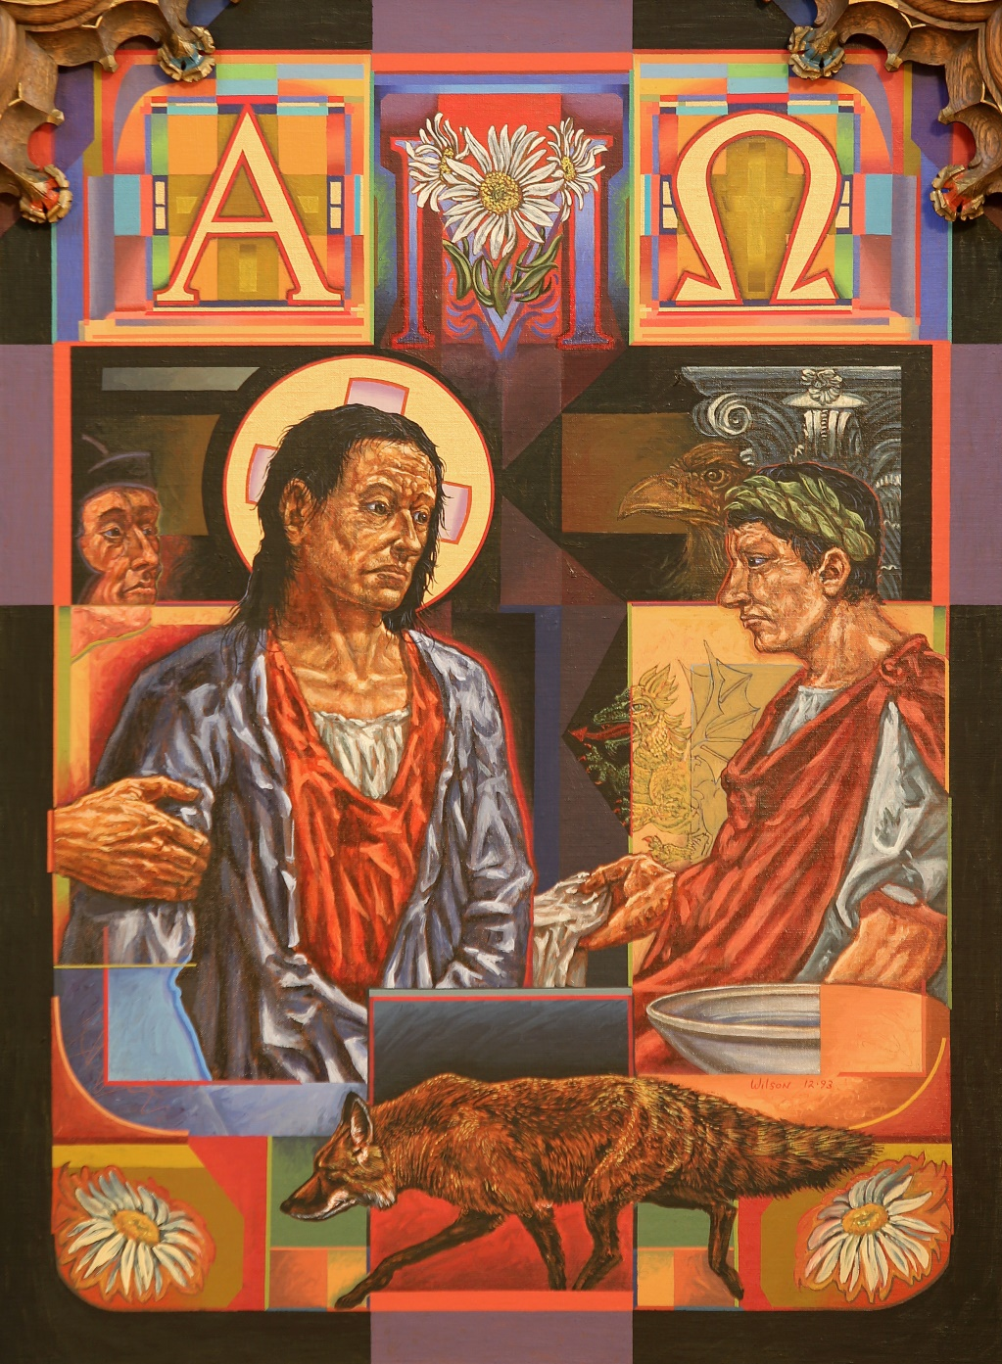
5th Station: Jesus Is Judged by Pilate
Reader: The chief priests with the elders and the scribes, that is, the whole Sanhedrin, held a council. They bound Jesus, led him away, and handed him over to Pilate. Pilate questioned him, “Are you the king of the Jews?” He said to him in reply, “You say so.” The chief priests accused him of many things. Again Pilate questioned him, “Have you no answer? See how many things they accuse you of.” Jesus gave him no further answer, so that Pilate was amazed.... Pilate, wishing to satisfy the crowd, released Barabbas... [and] handed [Jesus] over to be crucified. (Mark 15:1-5, 15)
Presider: Lord, grant us discernment that we may see as you see, not as the world sees.
All: Lord Jesus, help us walk in your steps.

Slide 11
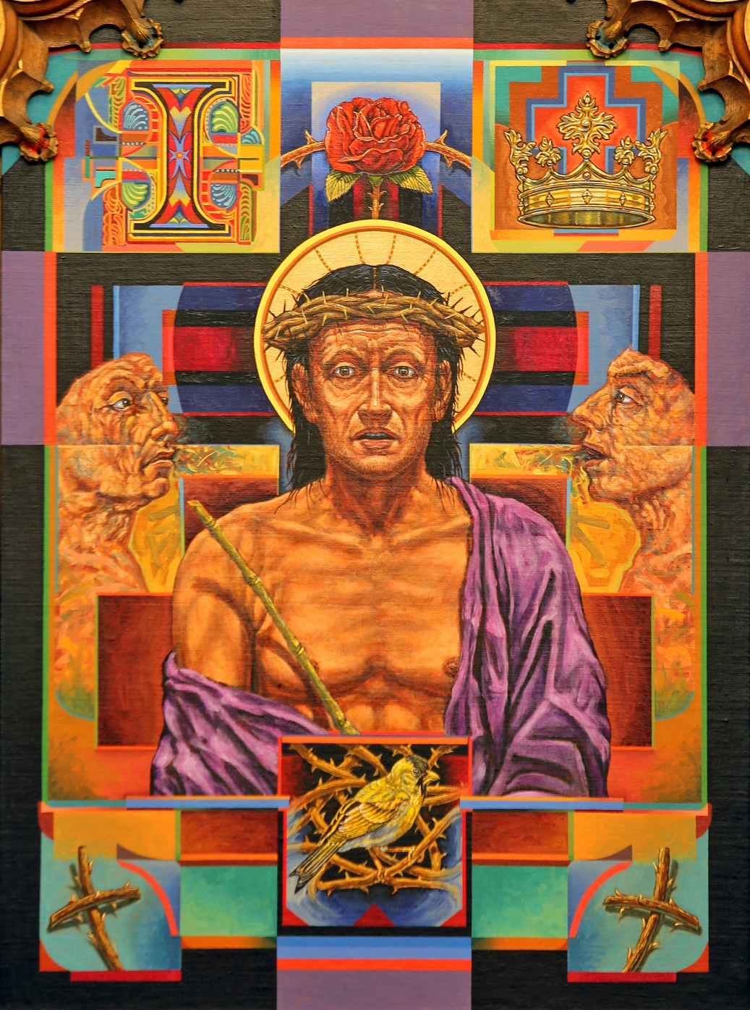
6: Jesus Is Scourged & Crowned with Thorns
Reader: Then Pilate took Jesus and had him scourged. And the soldiers wove a crown out of thorns and placed it on his head, and clothed him in a purple cloak, and they came to him and said, “Hail, King of the Jews!” And they struck him repeatedly. (John 19:1-3)
Presider: Lord, grant us patience in times of suffering that we may offer our lives as a sacrifice of praise.
All: Lord Jesus, help us walk in your steps.

Slide 12
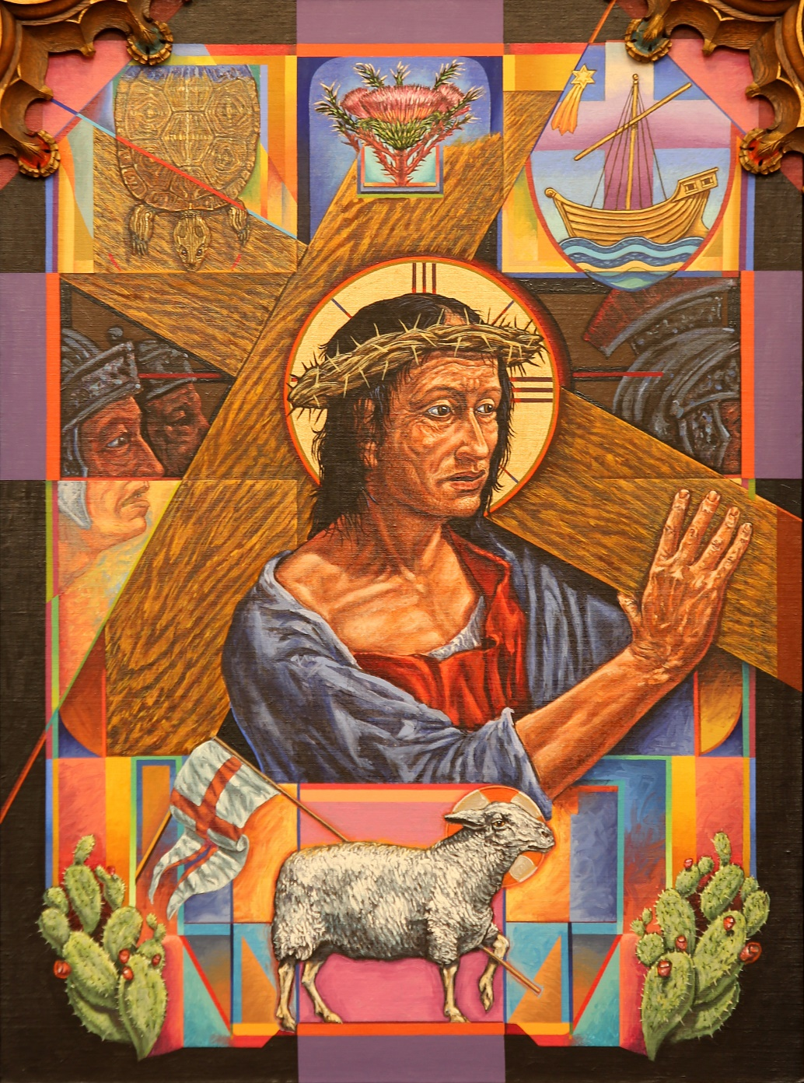
7th Station: Jesus Bears the Cross
Reader: When the chief priests and the guards saw [Jesus] they cried out, “Crucify him, crucify him!” Pilate said to them, “Take him yourselves and crucify him. I find no guilt in him.” ... They cried out, “Take him away, take him away! Crucify him!” Pilate said to them, “Shall I crucify your king?” The chief priests answered, “We have no king but Caesar.” Then he handed him over to them to be crucified. So they took Jesus, and carrying the cross himself he went out to what is called the Place of the Skull, in Hebrew, Golgotha. (John 19:6, 15-17)
Presider: Lord, grant us strength of purpose that we may faithfully bear our crosses each day.
All: Lord Jesus, help us walk in your steps.

Slide 13
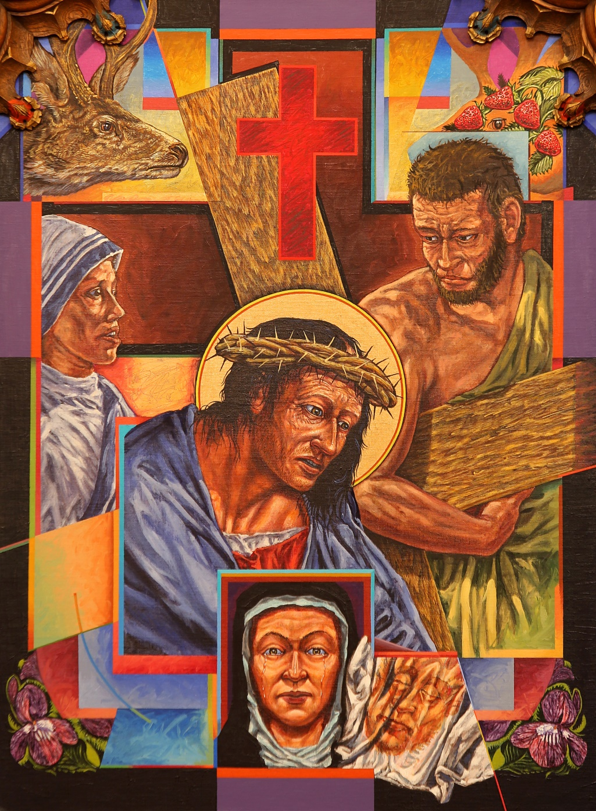
8: Simon the Cyrenian Helps to Carry the Cross
Reader:
They pressed into service a passer-by, Simon, a Cyrenian, who was coming in from the country, the father of Alexander and Rufus, to carry his cross.
(Mark 15:21)
Presider: Lord, grant us willing spirits that we may be your instruments on earth.
All: Lord Jesus, help us walk in your steps.

Slide 14
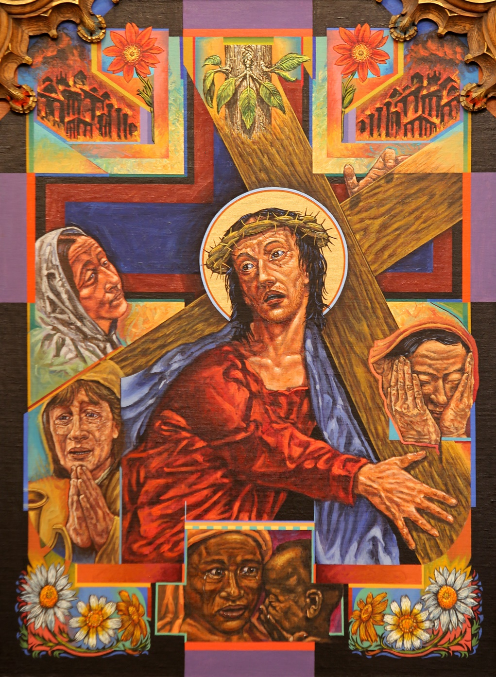
9: Jesus Meets the Women of Jerusalem
Reader: A large crowd of people followed Jesus, including many women who mourned and lamented him. Jesus turned to them and said, “Daughters of Jerusalem, do not weep for me; weep instead for yourselves and for your children, for indeed, the days are coming when people will say, ‘Blessed are the barren, the wombs that never bore and the breasts that never nursed.’ At that time, people will say to the mountains, ‘Fall upon us!’ and to the hills, ‘Cover us!’ for if these things are done when the wood is green what will happen when it is dry?” (Luke 23:27-31)
Presider: Lord, grant us gentle spirits that we may comfort those who mourn.
All: Lord Jesus, help us walk in your steps.

Slide 15
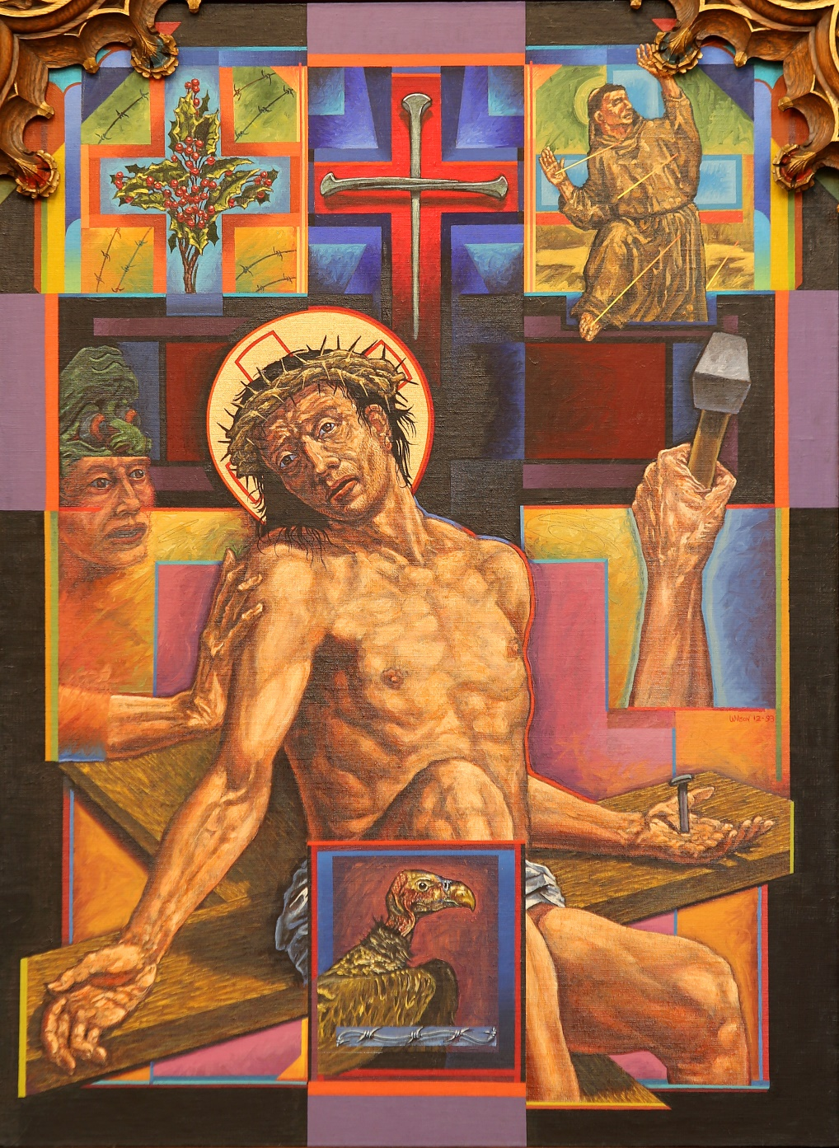
10th Station: Jesus Is Crucified
Reader: When they came to the place called the Skull, they crucified him and the criminals there, one on his right, the other on his left. Then Jesus said, “Father, forgive them, they know not what they do.” (Luke 23:33-34)
Presider: Lord, grant us merciful hearts that we may bring your reconciliation and forgiveness to all.
All: Lord Jesus, help us walk in your steps.

Slide 16
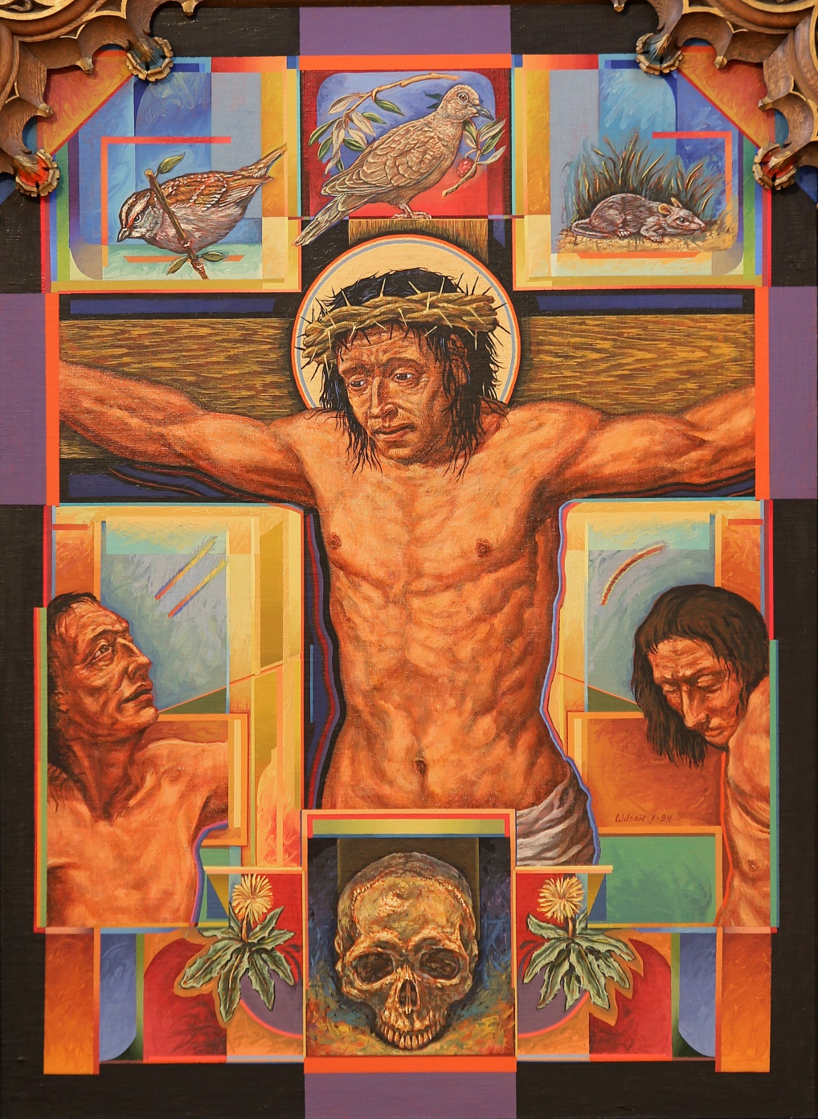
11: Jesus Promises Paradise to the Good Thief
Reader: Now one of the criminals hanging there reviled Jesus, saying, “Are you not the Messiah? Save yourself and us.” The other, however, rebuking him, said in reply, “Have you no fear of God, for you are subject to the same condemnation? And indeed, we have been condemned justly, for the sentence we received corresponds to our crimes, but this man has done nothing criminal.” Then he said, “Jesus, remember me when you come into your kingdom.”
He replied to him, “Amen, I say to you, today you will be with me in Paradise.”
(Luke 23:39-43)
Presider: Lord, grant us perseverance that we may never stop seeking you.
All: Lord Jesus, help us walk in your steps.

Slide 17
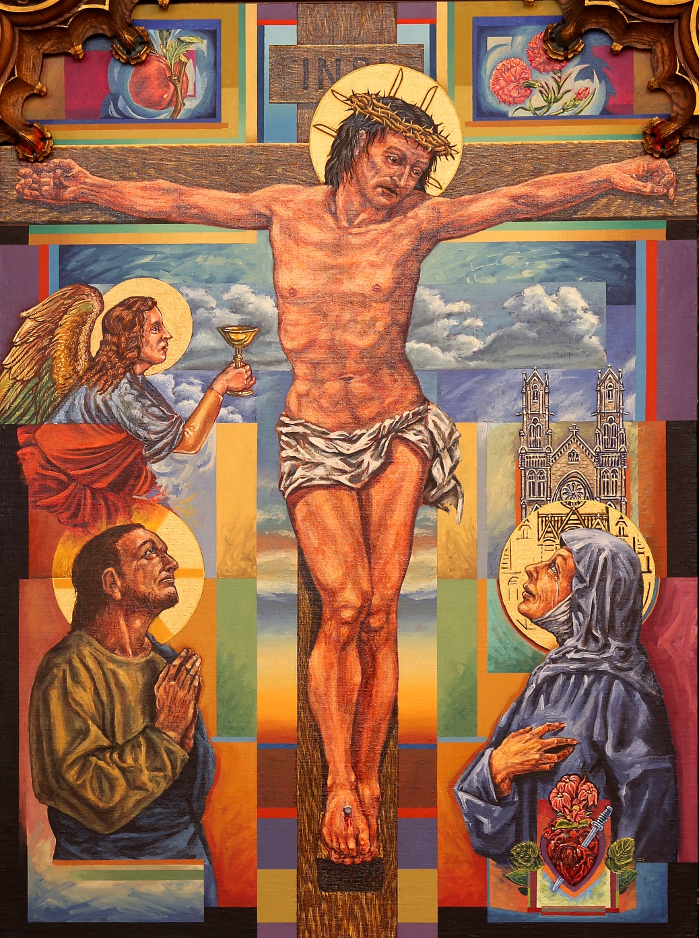
12: Jesus Speaks to His Mother and the Disciple
Reader: Standing by the cross of Jesus were his mother and his mother’s sister, Mary the wife of Clopas, and Mary of Magdala. When Jesus saw his mother and the disciple there whom he loved, he said to his mother, “Woman, behold, your son.” Then he said to the disciple, “Behold, your mother.” And from that hour the disciple took her into his home.
(John 19:25-27)
Presider: Lord, grant us constancy that we may be willing to stand by those in need.
All: Lord Jesus, help us walk in your steps.

Slide 18

13th Station: Jesus Dies on the Cross
Reader: It was now about noon and darkness came over the whole land until three in the afternoon because of an eclipse of the sun. Then the veil of the temple was torn down the middle. Jesus cried out in a loud voice, “Father, into your hands I commend my spirit”; and when he had said this he breathed his last. (Luke 23:44-46)
Presider: Lord, grant us trust in you
that when our time on earth is ended
our spirits may come to you without delay.
All: Lord Jesus, help us walk in your steps.

Slide 19
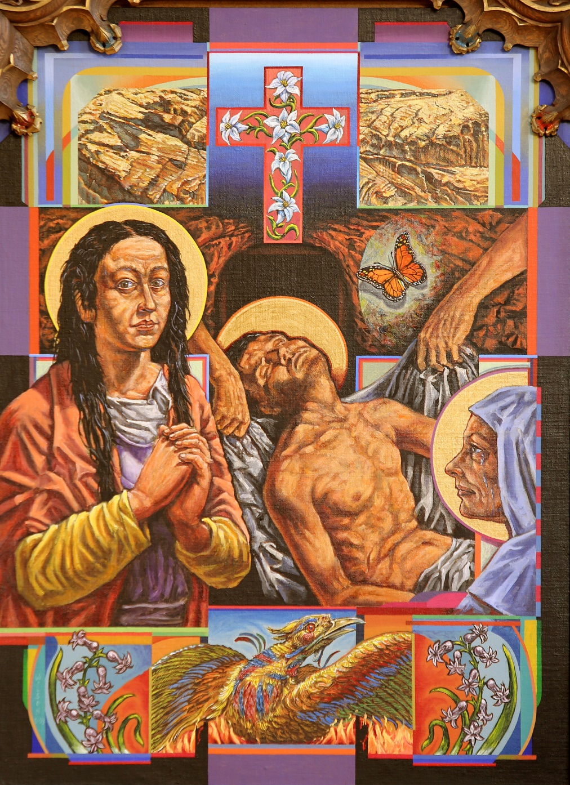
14th Station: Jesus Is Placed in the Tomb
Reader: When it was evening, there came a rich man from Arimathea named Joseph, who was himself a disciple of Jesus. He went to Pilate and asked for the body of Jesus; then Pilate ordered it to be handed over. Taking the body, Joseph wrapped it [in] clean linen and laid it in his new tomb that he had hewn in the rock. Then he rolled a huge stone across the entrance to the tomb and departed. (Matthew 27:57-60)
Presider: Lord, grant us your compassion that we may always provide for those in need.
All: Lord Jesus, help us walk in your steps.

Slide 20
Conclusion
Closing Prayer
  Presider: Lord Jesus Christ, your passion and death is the sacrifice that unites earth and heaven and reconciles all people to you. May we who have faithfully reflected on these mysteries follow in your steps and so come to share your glory in heaven where you live and reign with the Father and the Holy Spirit one God, for ever and ever.
  All: Amen.
Final Blessing
Concluding Hymn (suggestions by USCCB)
  Crown Him with Many Crowns (choir & organ; contemporary band)
  Lift High the Cross (children’s choir w/ piano; adult choir w/ organ)
  What Wondrous Love Is This (choir & organ; contemporary video)
  The Glory of These Forty Days (choir & organ)

Slide 21
Further Resources
Related Prayer Texts:
  https://www.usccb.org/prayer-and-worship/prayers-and-devotions/stations-of-the-cross/scriptural-stations-of-the-cross
  https://www.usccb.org/resources/scriptural-way-cross-lent
  https://www.usccb.org/resources/way-cross-suggested-hymns
  https://www.usccb.org/resources/ecumenical-stations-cross
  https://www.usccb.org/resources/stations-cross-overcoming-racism
Other “Scriptural Stations” Artwork:
  https://www.julielonneman.com/
  http://julielonneman.blogspot.com/
  https://www.trinitystores.com/artist/julie-lonneman
Cathedral of the Madeleine, Salt Lake City, UT
  https://utcotm.org/about/pictoral-tour
  Thanks to the Cathedral staff for permission to use their artwork here!

