Slide 1
PILGRIMAGE TO turkey:
ARCHAEOLOGICAL REMAINS
~ Part 3 ~
MSMC Ecclesia Series
Fr. Felix Just, S.J., Ph.D.
http://catholic-resources.org

Slide 2
THURS, MAY 23, DAY 11:
KUSADASI to SMYRNA to PERGAMUM to AYVALIK:
Izmir (ancient Smyrna), one of the oldest cities of the Mediterranean basin (5000 years old).
  Smyrna was a center of 1st cent. Christianity, and is one of the Seven Churches of Revelation (Rev. 1:11; 2:8-11).
  Church of St. Polycarp, a 2nd century bishop of Smyrna, who was burned at the stake in Smyrna’s stadium around 156 AD.
Pergamum, another of the 7 Churches of Revelation (2:12-17).
  Pergamum held four of the most important Greco-Roman cults of the day: Zeus, Athene, Dionysios, and Asklepios (aka “Savior”).
  Because of worship of Asklepios, a god of healing, Pergamum became a center of medicine.
  We visit the ruins of the ancient Asklepion, the Altar of Zeus, the Temples of Athena, Trajan, and Dionysus, an a 10,000-seat theatre.
We continue to the seaside resort town of Ayvalik.
  Dinner at our hotel.

Slide 3
IZMIR/SMYRNA
http://www.sacred-destinations.com/turkey/izmir.htm
Izmir Agora
  The ancient market of Smyrna lies in the center of modern Izmir. Originally constructed under Alexander the Great, it was rebuilt under the Romans in the 2nd century.
Izmir Archaeological Museum
  An impressive collection of ancient and Roman artifacts recovered from area excavations, including Bergama, Iasos, Bayrakli (Izmir's original settlement), and Izmir's Agora.
St. Polycarp Church
  Although reconstructed in 1620, this church is the oldest in Izmir. It honors St. Polycarp, who was bishop of Smyrna and was martyred on a nearby hill in 155 AD.

Slide 4
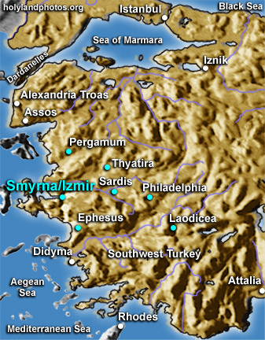
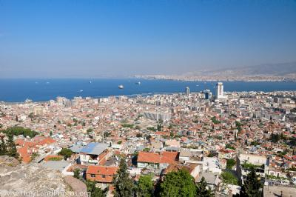
SMYRNA / IZMIR

Slide 5
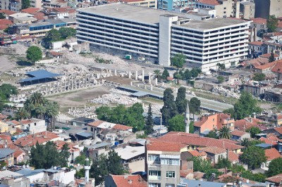
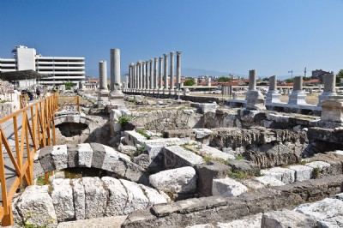
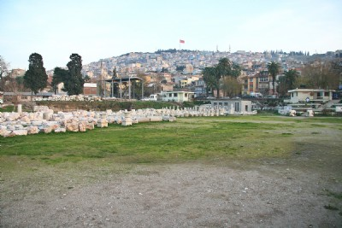
SMYRNA:
Agora &
View to
Citadel

Slide 6
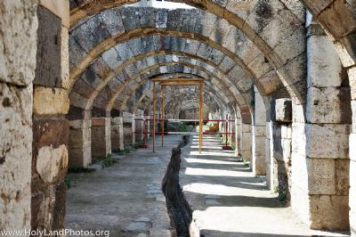
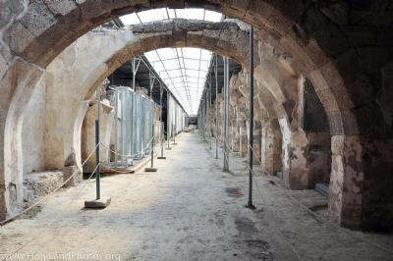
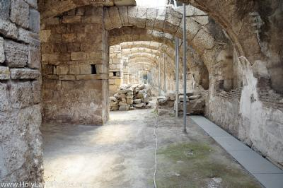
SMYRNA:
Under- ground
Agora

Slide 7
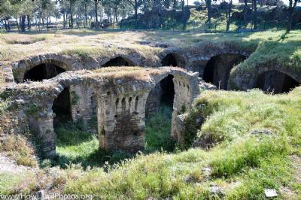
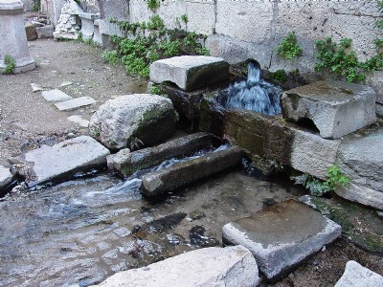
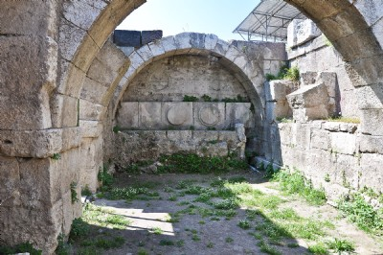
SMYRNA:
Citadel
Cisterns,
Spring,
Nymphaeum

Slide 8
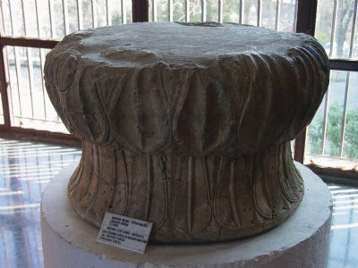
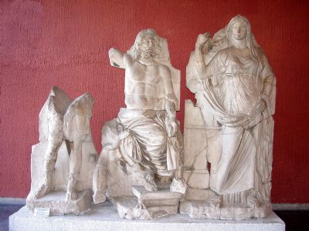
IZMIR: Arch. Museum:
Artemis, Poseidon, Demeter

Slide 9
PERGAMUM
http://www.sacred-destinations.com/turkey/pergamum
Asklepion
  A famed 2nd cent. temple and medical center dedicated to Asklepius, the god of healing. Some treatments used a sacred water source that was later discovered to have radioactive properties.
Zeus Altar
  Constructed by Eumenes II (d.159 BC) as a memorial of his victory against the Galatians. The altar is now in Berlin's Pergamon Museum, but the original site gives a sense of its size and spectacular location.
Temples of Athena, Trajan, and Dionysus
10,000-seat theatre
[Pergamum Archaeological Museum]
  Several interesting artifacts from ancient Pergamum help bring the ruins to life. There is even a faithful replica of the Zeus Altar.
[Red Basilica / Temple of Serapis]
  This huge brick edifice was built in the 2nd century as a Roman temple to the god Serapis and later converted into a Byzantine church.

Slide 10
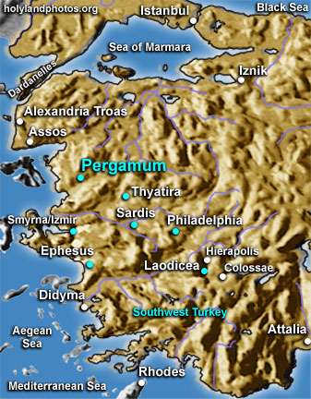
PERGAMUM

Slide 11
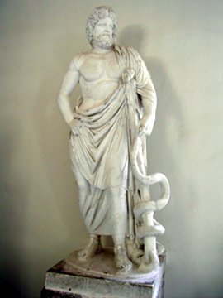
PERGAMUM:
Asklepion

Slide 12
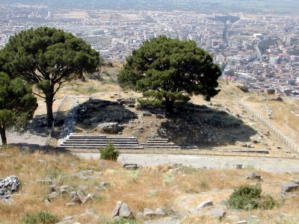
PERGAMUM: Zeus Altar

Slide 13
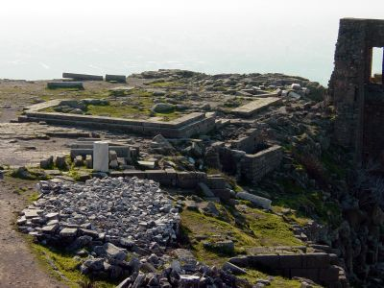
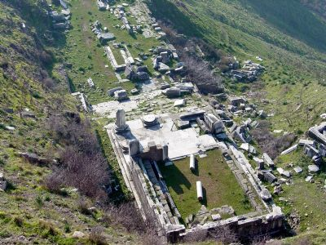
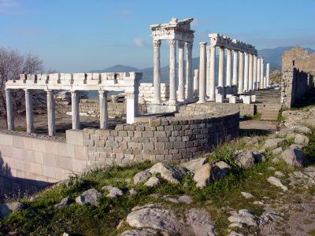
PERGAMUM:
Temples to
Athena,
Dionysius,
Trajan, etc.

Slide 14
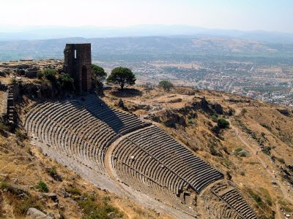
PERGAMUM: Acropolis Theater

Slide 15
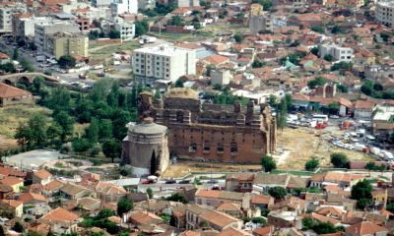
PERGAMUM: Red Basilica

Slide 16
PERGAMUM
http://www.holylandphotos.org/
http://www.sacred-destinations.com/ turkey/pergamum

Slide 17
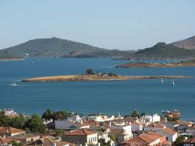
AYVALIK

Slide 18
FRI, MAY 24, DAY 12:
AYVALIK to BURSA: ULU CAMI MOSQUE & SILK BAZAAR:
We travel to the town of Bursa and visit the Ulu Cami Mosque
  Built between 1396 and 1400 AD, this mosque has one of the world’s greatest examples of Islamic calligraphy from the Ottoman period.
Some time to shop at the Silk Bazaar before going to our hotel for dinner and the evening.

Slide 19
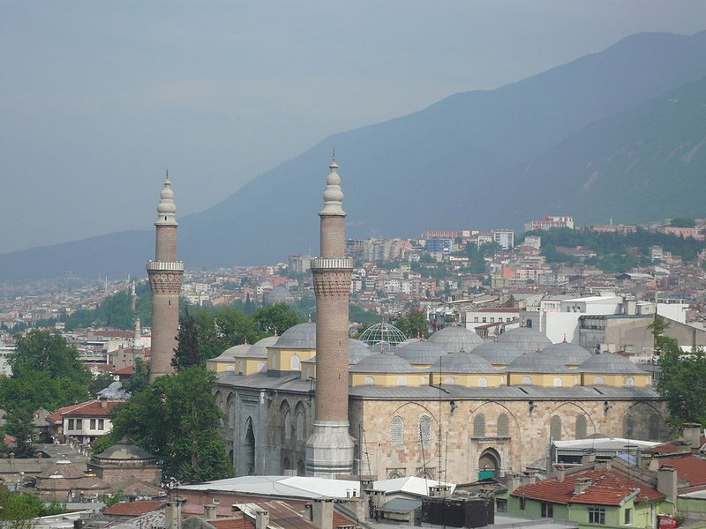
BURSA: ULU CAMI MOSQUE

Slide 20
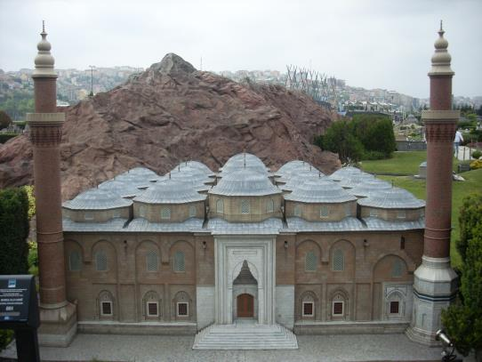
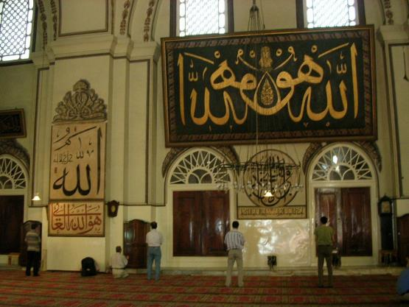
BURSA:
ULU CAMI
MOSQUE

Slide 21
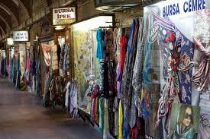
BURSA: SILK BAZAAR

Slide 22
SAT, MAY 25, DAY 13:
From BURSA to IZNIK/NICAEA to ISTANBUL:
We head to Iznik, ancient Nicaea.
  The First Council of Nicaea was held in 325 AD, during the reign of Emperor Constantine. It defined more clearly the concept of the Trinity and drew up the Nicene Creed. In 787 AD, Empress Irene also convened the 7th Ecumenical Council in Iznik
  We see the massive medieval walls and the ruins of Iznik’s Hagia Sophia Church, scene of the 7th Council, and visit the museum.
Then, we board a ferry boat to go to Istanbul (ancient Constantinople) for an orientation tour of the city often called “Earth’s Pearl.”

Slide 23
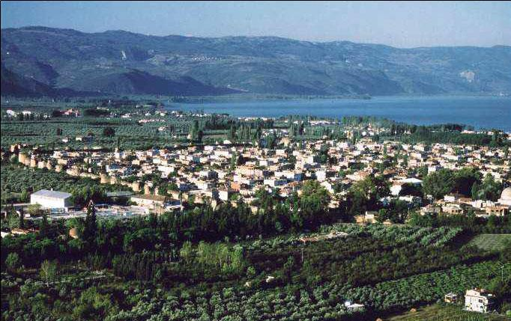
Iznik, ancient Nicaea

Slide 24
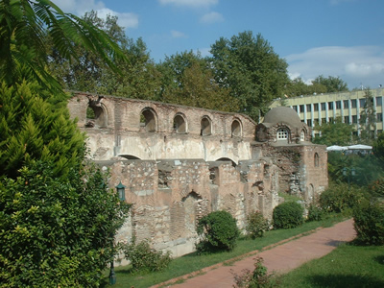
Iznik/Nicaea: Hagia Sophia Ruins

Slide 25
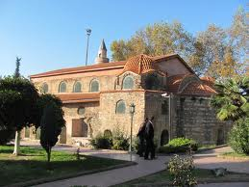
Iznik/Nicaea: Hagia Sophia rebuilt?
http://www.sacred-destinations.com/turkey/nicea-iznik.htm

Slide 26
SUN, MAY 26, DAY 14: Istanbul
ROMAN HIPPODROME, HAGIA SOPHIA, BLUE MOSQUE, BASILICA CISTERNS, TOPKAPI PALACE:
  Constantinople (Istanbul) became the capital of the Roman Empire under Constantine in 330 AD, and it remained as capital of the Byzantine Empire until 1453, when the Ottoman army under Sultan Mehmet II conquered it. We begin today by visiting the site of the Roman Hippodrome, built by the Roman Emperor Septimius Severus in 203 AD. The hippodrome stadium served as a meeting place for politicians, chariot races, wrestling, boxing, and other athletic activities.
  We then visit the magnificent Hagia Sophia of Istanbul, first a basilica, then a mosque, now a museum. Built in the 6th century by Emperor Justinian, this extraordinary masterpiece of Byzantine architecture is still covered in splendid mosaics from the 11th and 12th centuries.
  We also visit the nearby Mosque of Sultan Ahmet, known as the Blue Mosque for its marvelous interior decoration of turquoise tiles.
  Next, we visit the Basilica Cistern, the largest of several hundred ancient cisterns that lie beneath the city.
  Our day concludes at the Topkapi Palace Museum, site of the residence of the Ottoman sultans for nearly four centuries. We celebrate Mass at St. Antonie Church. Tonight we enjoy a special dinner at a Hamdi restaurant, famous for its Turkish kitchen. (B, D)

Slide 27
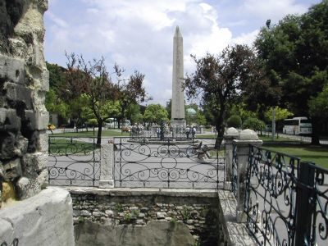
ISTANBUL: ROMAN HIPPODROME

Slide 28
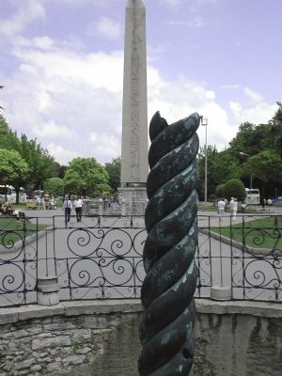
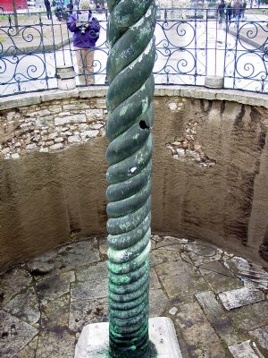
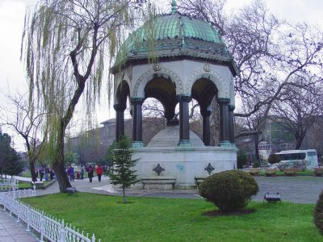
ISTANBUL:
ROMAN
HIPPO-
DROME

Slide 29
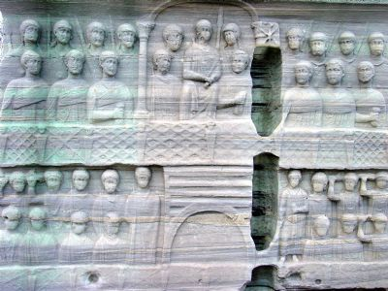
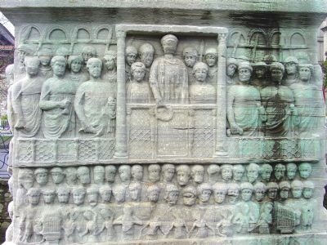
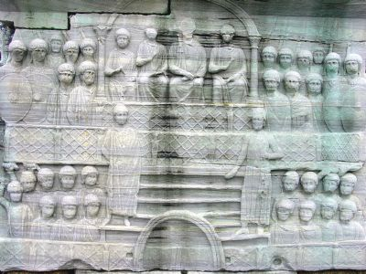
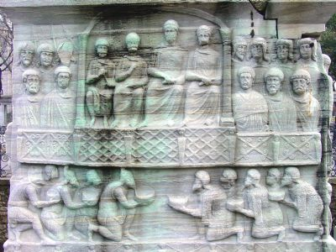
ISTANBUL: ROMAN HIPPODROME

Slide 30
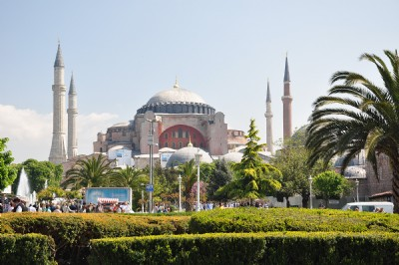
ISTANBUL: HAGIA SOPHIA

Slide 31
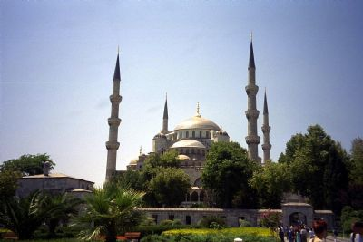
ISTANBUL: BLUE MOSQUE

Slide 32
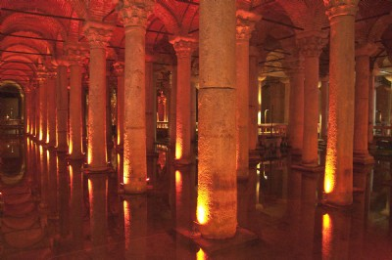
ISTANBUL: BASILICA CISTERNS

Slide 33
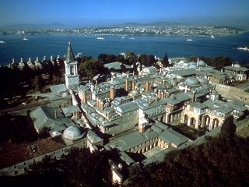
ISTANBUL: TOPKAPI PALACE

Slide 34
MON, MAY 27, DAY 15: Istanbul
BOSPHORUS CRUISE, ST. SAVIOUR IN CHORA, MOSQUE OF SULEIMAN, GRAND BAZAAR, SPICE MARKET:
Mass at the Church of Santa Maria Draperis.
Cruise on the Bosphorus Strait, which divides Europe and Asia, to better appreciate the position of this beautiful and historic city along the passage to the Black Sea.
Church of St. Saviour in Chora, also known as the Kariye Museum, famous for its early mosaics.
Mosque of Suleiman the Magnificent, known as the climax of Ottoman architecture, reflecting the Golden Age of the Ottoman Empire at the height of its political and military power.
The rest of the afternoon is open.
This evening we have our final dinner at a local restaurant.

Slide 35
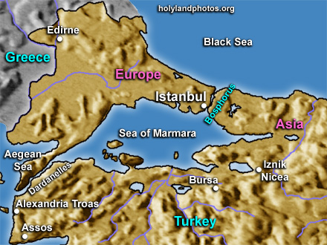
ISTANBUL: BOSPHORUS CRUISE

Slide 36
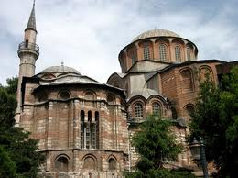
ISTANBUL: ST. SAVIOUR IN CHORA

Slide 37
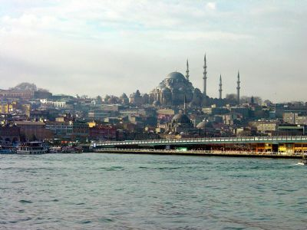
Mosque of Suleiman the Magnificent

Slide 38
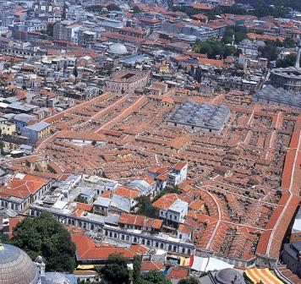
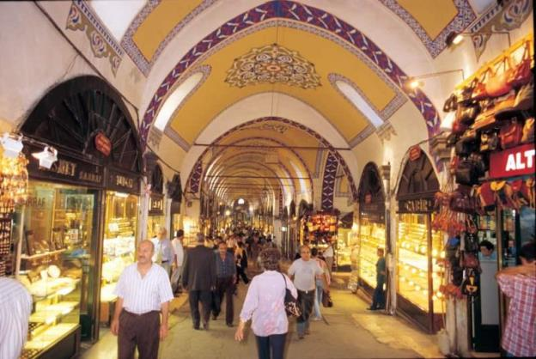
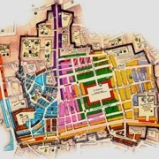
ISTANBUL:
Grand Bazaar
& Spice Market

Slide 39
TUES, MAY 28, DAY 16:
RETURN TO THE USA:
  After breakfast, depart for Istanbul Airport
  12:45 p.m. – depart on Turkish Airlines #9
  4:30 p.m. (CA time) – arrive in Los Angeles
Hurray, we made it!
  Time to sort the photos and story the memories!
  And… When and where is the next Pilgrimage?

Slide 40
Image Sources / Credits
http://www.holylandphotos.org/
  Includes most biblical cities and towns
http://www.sacred-destinations.com/turkey/
  Antioch, Aphrosisias, Ephesus, Konya, Pergamum, Istanbul, etc.

