Slide 1
PILGRIMAGE TO turkey:
ARCHAEOLOGICAL REMAINS
~ Part 2 ~
MSMC Ecclesia Series
Fr. Felix Just, S.J., Ph.D.
http://catholic-resources.org

Slide 2
SUN, MAY 19 (Pentecost) DAY 7:
ANTALYA: breakfast at hotel
Ancient Perga: one of best-preserved stadium-theatres in Turkey.
  Barnabas & Paul passed thru Perga on their way to/from Antioch (Acts 13:13-14; 14:25).
Antalya: Archaeology Museum, one of the finest in modern Turkey.
Aspendos: Ancient theatre
Antalya: back to hotel for dinner

Slide 3
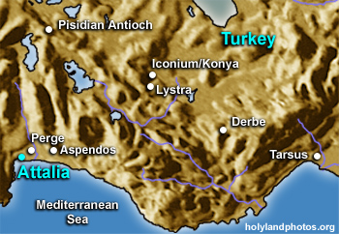
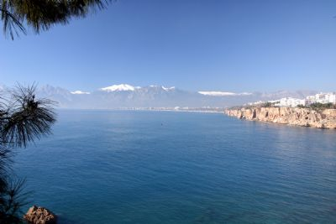
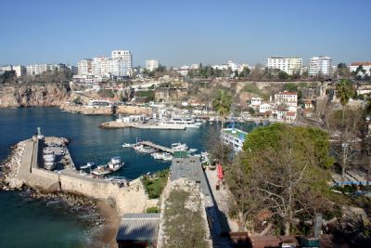
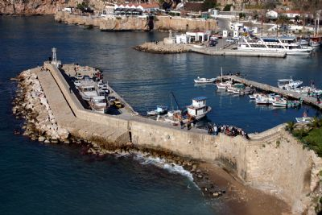
ANTALYA

Slide 4
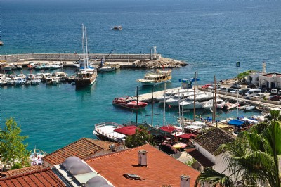
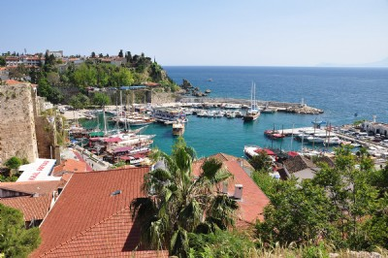
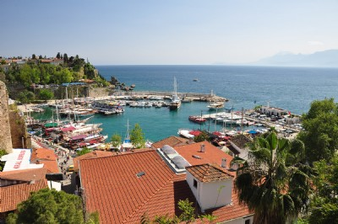
ANTALYA

Slide 5
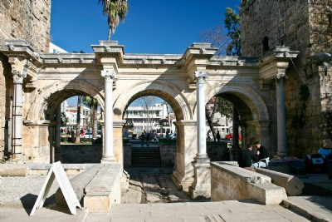
ANTALYA: Hadrian’s Gate

Slide 6
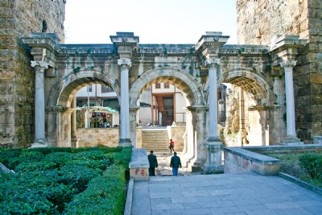
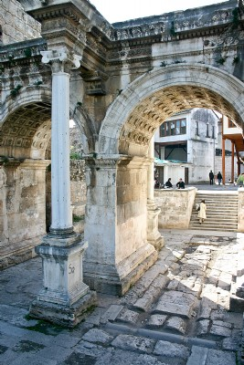
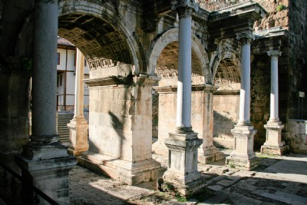
ANTALYA: Hadrian’s Gate

Slide 7
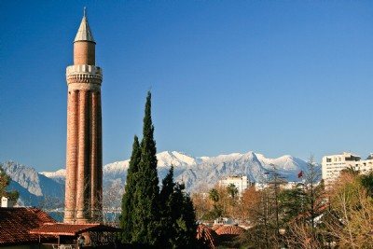
ANTALYA: Yivli Minaret (“fluted”) & Taurus Mountains

Slide 8
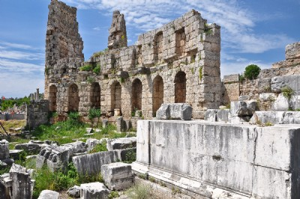
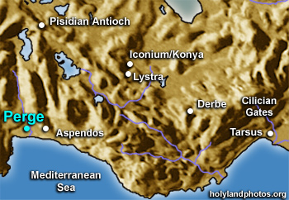
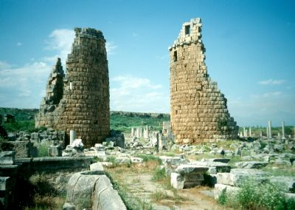
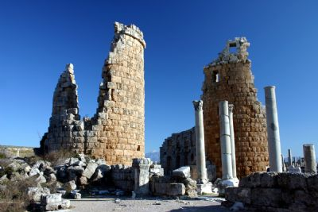
PERGA/E

Slide 9
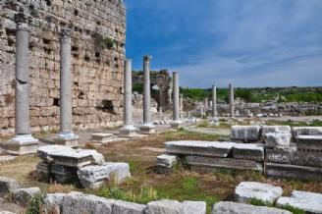
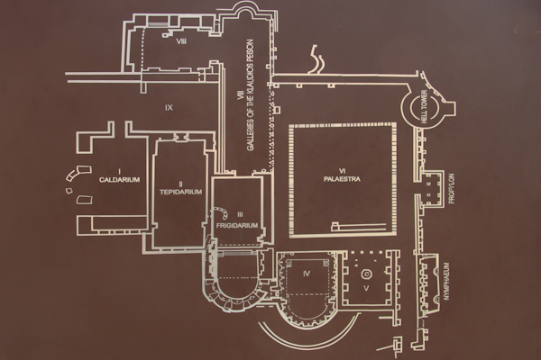
PERGA: Southern Bath

Slide 10
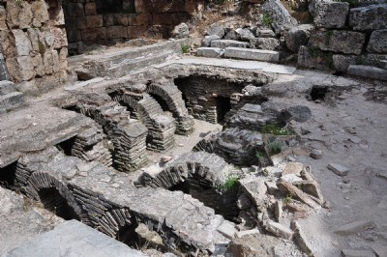
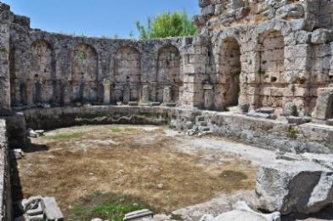
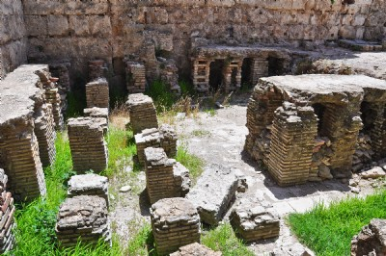
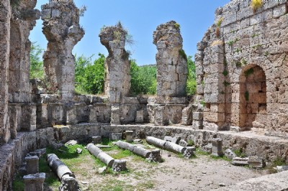
PERGA: Bath

Slide 11
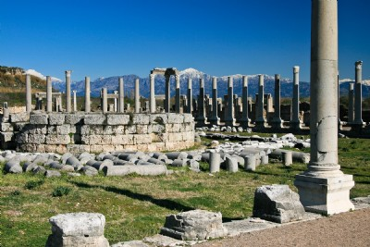
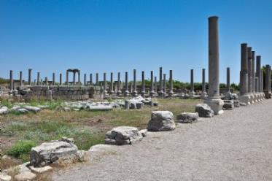
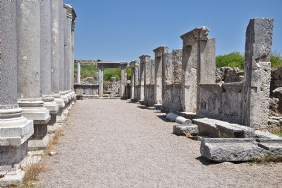
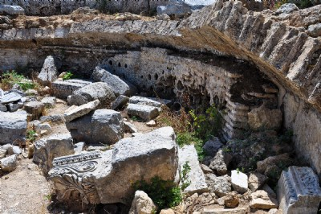
PERGA: Forum

Slide 12
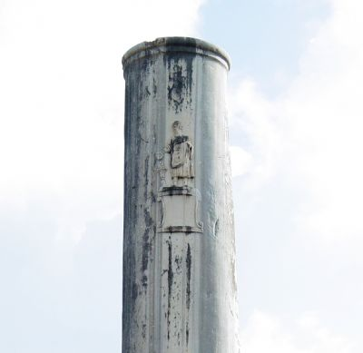
PERGA: Cardo
(Main Street)

Slide 13
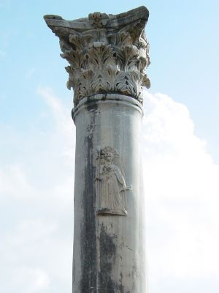
PERGA: Cardo (Column with Artemis)

Slide 14
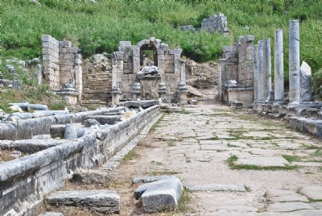
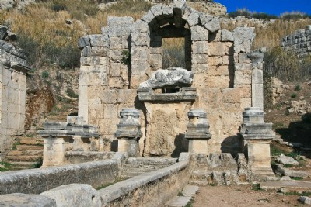
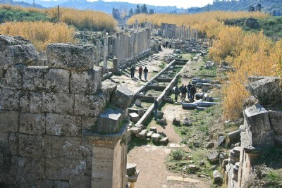
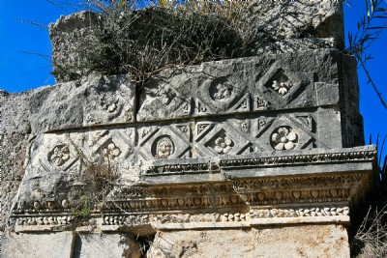
PERGA: Nymphaeum (water fountain)

Slide 15
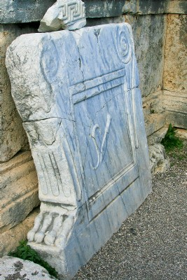
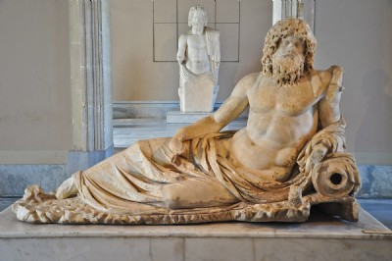
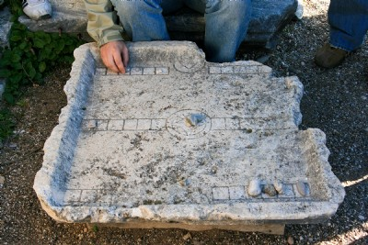
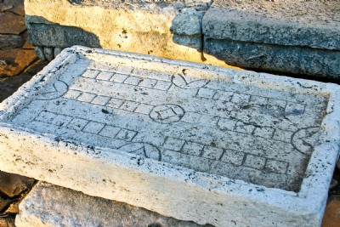
PERGA: Oceanus, game board, & butcher’s table

Slide 16
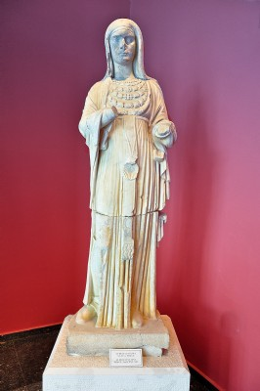
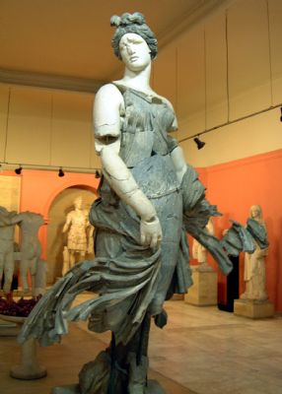
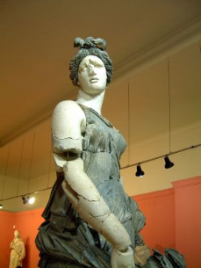
PERGA: Dancer &
Priestess of Artemis

Slide 17
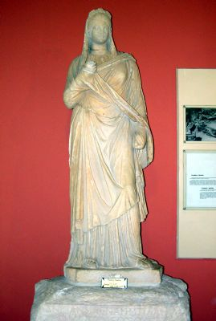
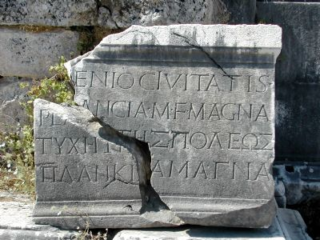
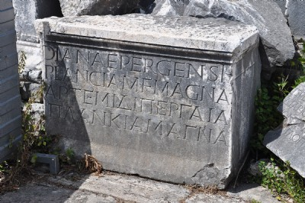
PERGA: Statue & Inscriptions of Plancia Magna, city benefactress

Slide 18
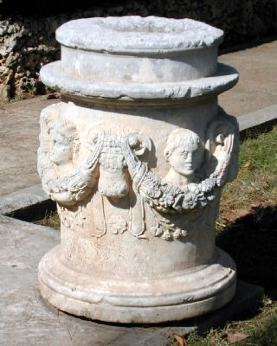
PERGA: Incense Altar

Slide 19
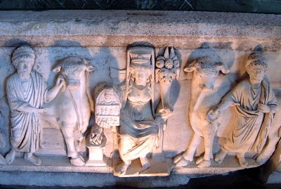
PERGA: Frieze from Theatre

Slide 20
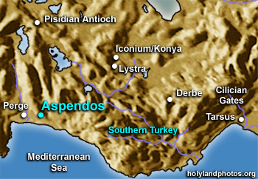
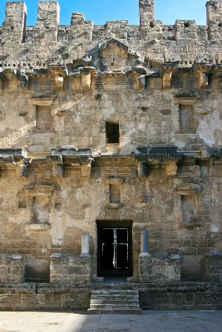
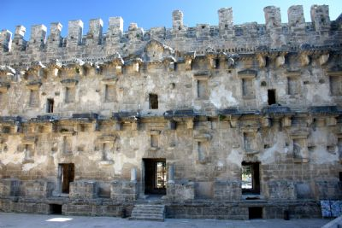
ASPENDOS: Theatre stage

Slide 21
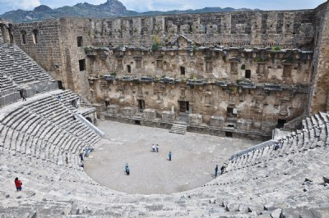
ASPENDOS: Theatre

Slide 22
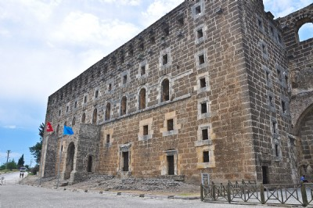
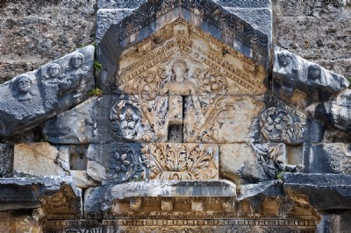

Asp. Theatre: Keystone of Dionysus, entrance & exterior

Slide 23




ASPENDOS: Diazoma ("Belt Walkway") & Theatre Seating

Slide 24


ASPENDOS:
Nymphaeum

Slide 25



ASPENDOS:
Street & Gate;
Acropolis
& Temple

Slide 26




ASPENDOS: Aqueduct

Slide 27



ASPENDOS: Aqueduct & stadium

Slide 28



ASPENDOS: Selçuk Bridge (13th Cen.) at Köprüçay River
(ancient Eurymedon)

Slide 29
MON, MAY 20, DAY 8:
ANTALYA to LAODICEA to COLOSSAE to HIERAPOLIS
Morning travel to Laodicea, a site largely unexcavated.
  The church here received a letter from Paul (Col 4:16)
  One of the seven churches of the Book of Revelation.
  Site of an important regional church council held in 367 AD.
We then visit ruins of ancient Colossae.
  Paul himself never visited, but Epaphras, one of his associates and a citizen of Colossae, founded the Colossian church (Col 1:7; 4:12).
  Paul later tells Philemon of his hope to visit there upon being freed from prison (Phlm 1:22).
Next, we visit the ruins of Hierapolis (Col 4:13)
  UNESCO World Heritage Site, in present day Pamukkale
  St. Philip was martyred here in 80 AD.
Our hotel in Pamukkale offers thermal spring waters laden with minerals. The waters falling over a plateau edge created a cascade of dazzling white petrified basins.

Slide 30



LAODICEA: Column w/Cross & Menorah

Slide 31




LAODICEA: Cardo, Drainage, Exedra

Slide 32



LAODICEA Baths: Ionic Temple (?) with baptismal font (?)

Slide 33


LAODICEA:
Stadium

Slide 34



LAODICEA:
Large Theatre

Slide 35



LAODICEA:
Small Theatre
& Gymnasium

Slide 36




LAODICEA: Byz. Church, Gym. Interior, Water Siphon, & Pipes

Slide 37



LAODICEA: Water Tower & Pipes

Slide 38


LAODICEA:
Odeum &
Excavators

Slide 39


COLOSSAE

Slide 40




COLOSSAE: Acropolis

Slide 41




COLOSSAE: Theatre & Stream

Slide 42



COLOSSAE: Lycus Valley,
Opium poppies, Collosae in snow

Slide 43



HIERAPOLIS/Pamukkale: Travertine

Slide 44

HIERAPOLIS/Pamukkale: Travertine

Slide 45



HIERAPOLIS: Thermal Pool

Slide 46




HIERAPOLIS: Water Channels,
Gate of Domitian, Latrine

Slide 47




HIERAPOLIS: Temple of Apollo
& the Plutonium

Slide 48



HIERAPOLIS: Northern Baths & Cardo

Slide 49


HIERAPOLIS:
Theatre

Slide 50



HIERAPOLIS: Theatre Stage

Slide 51



V.I.P. Seats &
Fish decoration

Slide 52



HIERAPOLIS:
Necropolis &
Sarcophagus w/Menorah

Slide 53


HIERAPOLIS: Tomb w/Menorah of Marcus Aurelius Philoumeno Streneion (2nd Cen)

Slide 54

HIERAPOLIS: Monumental Tomb

Slide 55


HIERAPOLIS: Tomb w/ Inscription of merchant
Flavius Zeuxis

Slide 56




HIERAPOLIS: Tomb Complex; Freestanding Tomb w/Inscription

Slide 57


HIERAPOLIS: Tumulus Tomb
& Sarcophagus Tomb

Slide 58




HIERAPOLIS: Tomb Church & Martyrium of Philip

Slide 59



HIERAPOLIS: Church of Philip w/Apse

Slide 60



HIERAPOLIS: Tomb & Church
Tomb Interior; Overview

Slide 61




HIERAPOLIS: Martyrium Interior; West Entrance (Lower Right)

Slide 62




Martyrium Entrance w/ Pilgrims' Room“ (top left); “Pilgrim’s Path”

Slide 63




Pilgrim’s Path (cont.); Pilgrim Purification Building (low-l); "Pilgrims’ Rooms" (low-r)

Slide 64



HIERAPOLIS: Chapel Apse attached to Martyrium; Martyrium Carvings

Slide 65
TUES, MAY 21, DAY 9:
To APHRODISIAS to MILETUS to KUSADASI:
Depart Pamukkale for ruins of ancient Aphrodisias.
  Sacred site since 5800 BC: Neolithic peoples came here to worship goddess of fertility and crops.
  Greek era: site dedicated to Aphrodite, goddess of love & fertility. Great temple built in 1st cent. AD.
  Area remained a stronghold of pagan beliefs for centuries
  Eventually Christianity spread and the city was renamed Stauropolis (“city of the cross”).
Travel to seaside city of Miletus.
  Not wanting to delay his travels by going to Ephesus, Paul called Ephesian elders to Miletus to bid farewell (Acts 20). From here, he sailed to Jerusalem to celebrate Pentecost.
Dinner and overnight in resort of Kusadasi

Slide 66

APHRODISIAS
http://www.sacred-destinations.com/turkey/aphrodisias

Slide 67




APHRODISIAS

Slide 68


APHRODISIAS

Slide 69



MILETUS
(mod. Balat)

Slide 70




MILETUS: Theater

Slide 71



MILETUS: Theatre w/Inscriptions; Low-R God-Fearer Insciption

Slide 72




MILETUS: Gladiator Reliefs & Processional Way

Slide 73




MILETUS: Ionic Stoa, Lion Harbor,

Slide 74

KUSADASI

Slide 75
WED, MAY 22, DAY 10:
EXCURSION TO HOUSE OF MARY & EPHESUS:
  We begin with Mass at the House of Mary, believed to be the last home of Jesus’ mother. This peaceful site, sacred to both Christians and Muslims, was visited by Popes Paul VI, John Paul II, and Benedict XVI.
Our day’s focus is on EPHESUS, capital of the Roman province of Asia Minor, largest city and main harbor on the western coast.
  Today’s shoreline is over four miles west of Roman-era harbor.
  St. Paul founded the Church in Ephesus in 53-56 AD.
  Great Theatre where Paul addressed the crowds (Acts 19:29).
  Ruins of Church of the Virgin Mary (“Council Church”): 4th cent. church with a baptistery and bishop’s residence. The Third Ecumenical Council, which affirmed Mary as “Theotokos”, met here in 431 A.D.
  Early Xn tradition believes John the Apostle wrote his Gospel in Ephesus.
  The Basilica of St. John, built by Justinian in the 6th cent., is believed to house the tomb of St. John.
Return to hotel in Kusadasi with dinner at a local restaurant.

Slide 76

EPHESUS: House of Mary

Slide 77

EPHESUS: Great Theatre

Slide 78
Add More Pics on Ephesus
Main Street
Public Latrine
Library of Celsus
Etc.

Slide 79

EPHESUS: Council Church

Slide 80

EPHESUS: Basilica & Tomb of John

Slide 81
EPHESUS
For more on Ephesus, see the following sites:
http://www.sacred-destinations.com/turkey/
  Ephesus
http://www.holylandphotos.org/
For Days 11-16 of our Pilgrimage, see Part 3.

