Slide 1
PILGRIMAGE TO turkey:
ARCHAEOLOGICAL REMAINS
~ Part I ~
MSMC Ecclesia Series
Fr. Felix Just, S.J., Ph.D.
http://catholic-resources.org

Slide 2
Image Sources / Credits
http://www.holylandphotos.org/
  Includes most biblical cities and towns
http://www.sacred-destinations.com/turkey/
  Antioch, Aphrosisias, Ephesus, Konya, Pergamum, Istanbul, etc.

Slide 3
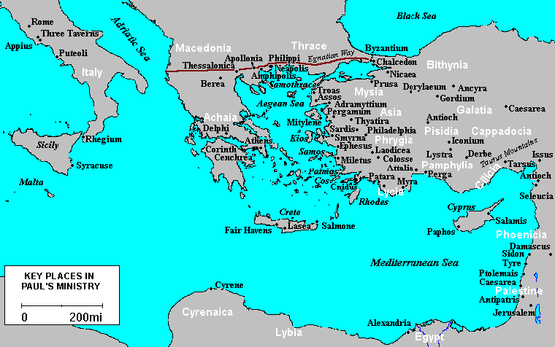

Slide 4
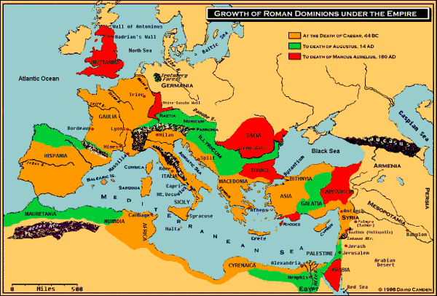

Slide 5
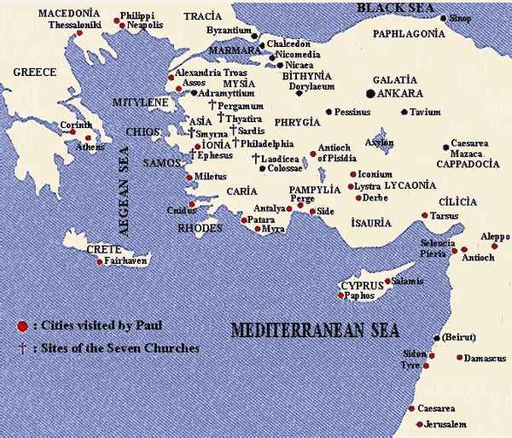

Slide 6
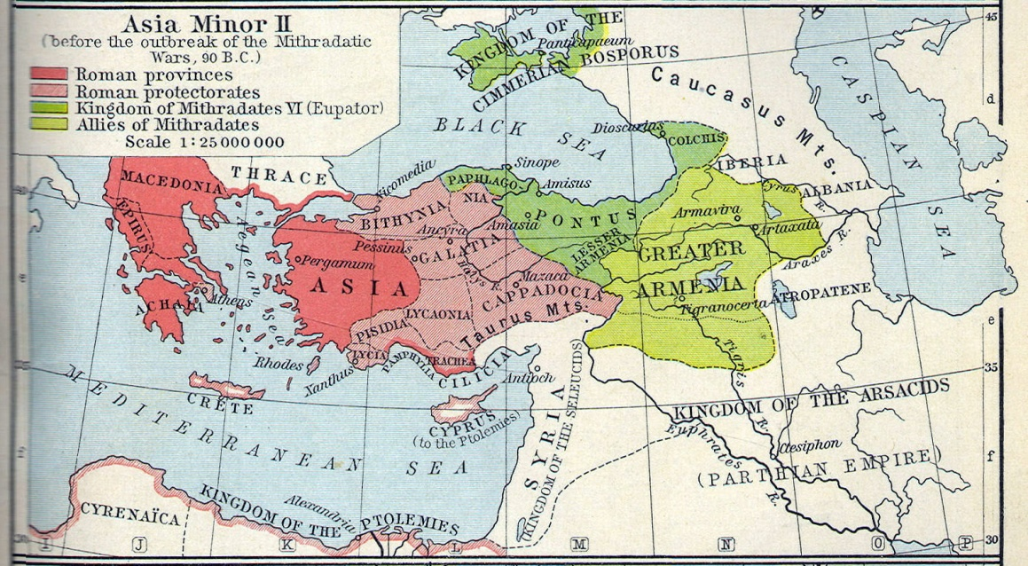

Slide 7
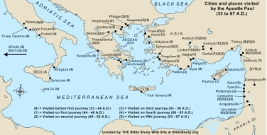
See www.BibleStudy.org

Slide 8
Early Ecumenical Councils
Nicea 325
Constantinople I 381
Ephesus 431
Chalcedon 451
Constantinople II 553
Constantinople III 680-681
Nicea II 787
Constantinople IV 869

Slide 9
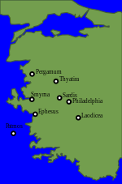
Seven Churches of Revelation
Ephesus
Smyrna
Pergamos
Thyatira
Sardis
Philadelphia
Laodicea

Slide 10
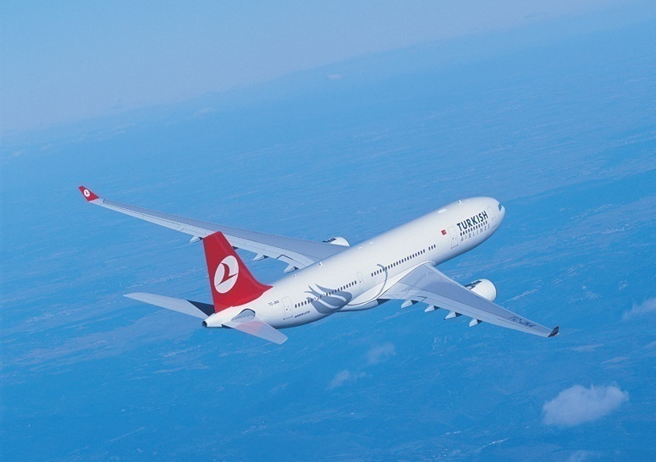
MON, MAY 13, DAY 1:
AFTERNOON DEPARTURE FROM LAX
  3:20 p.m. – Check-in
  6:20 p.m. – Turkish Airlines #10

Slide 11
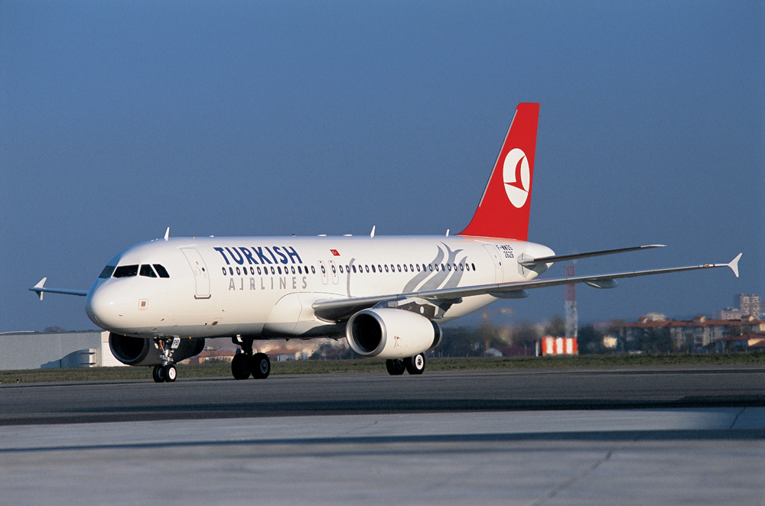
TUES, MAY 14, DAY 2:
AFTERNOON ARRIVAL IN ISTANBUL
  5:10 p.m. – Arrive in Istanbul
  Transfer to our hotel; Dinner at our hotel.

Slide 12
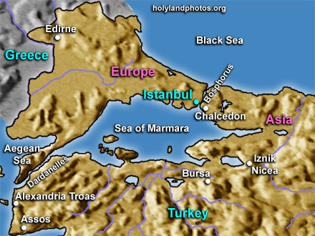
Istanbul

Slide 13
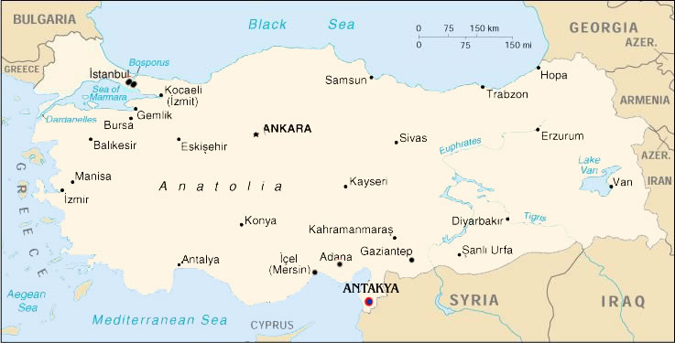
WED, MAY 15, DAY 3:
Flight from Istanbul to ANTAKYA:
  After breakfast we transfer to the Istanbul Airport
  10:00 a.m. – Turkish Airlines #2252
  11:45 a.m. – Arrival in Antakya

Slide 14
WED, MAY 15, Afternoon:
VISIT OF ANTAKYA/ANTIOCH & SELEUCIA:
  Capital of Seleucid-Greek Kingdom (as of 281 B.C.)
  Here, disciples first called “Christians“ (Acts 11:26)
  Church leaders include Paul and Barnabas; their missionary journeys begin here (Acts 13:1-4; 15:36).
  Early local traditions also report extensive activity by St. Peter in Antioch
  Grotto/Church of St. Peter, on slopes of Mt. Staurion
  [Roman] Mosaics Museum
  Seaside Samandag (Seleucia; Acts 13:4).
  We return to hotel for dinner and relaxing evening.

Slide 15
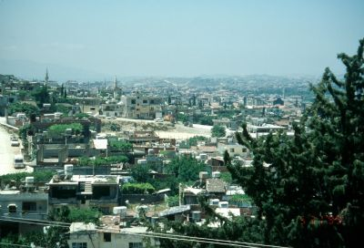
Antioch on the Orontes River

Slide 16
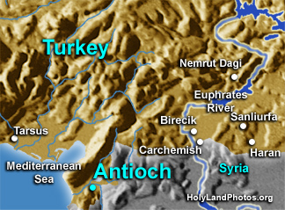
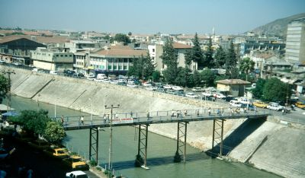
Antioch on the
Orontes River

Slide 17
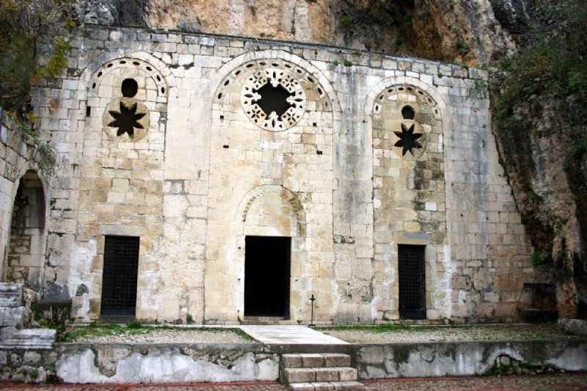
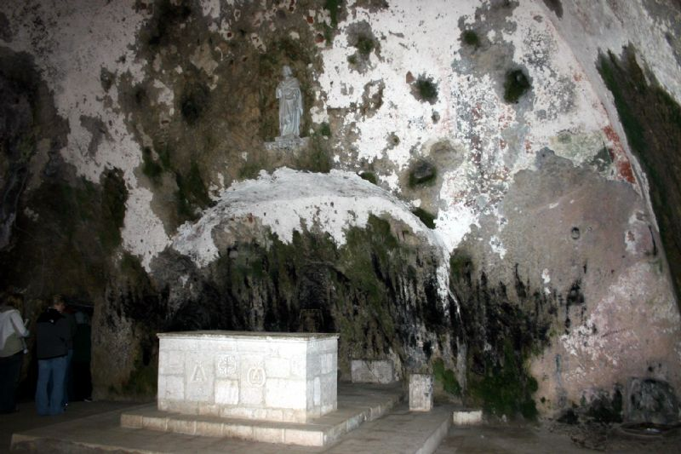
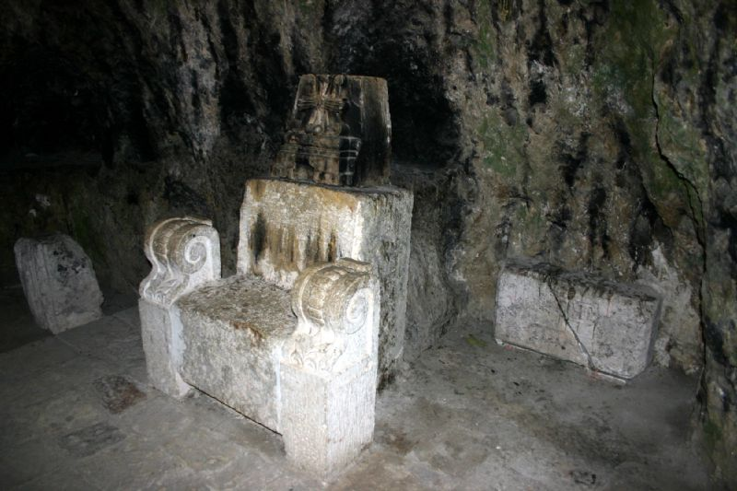
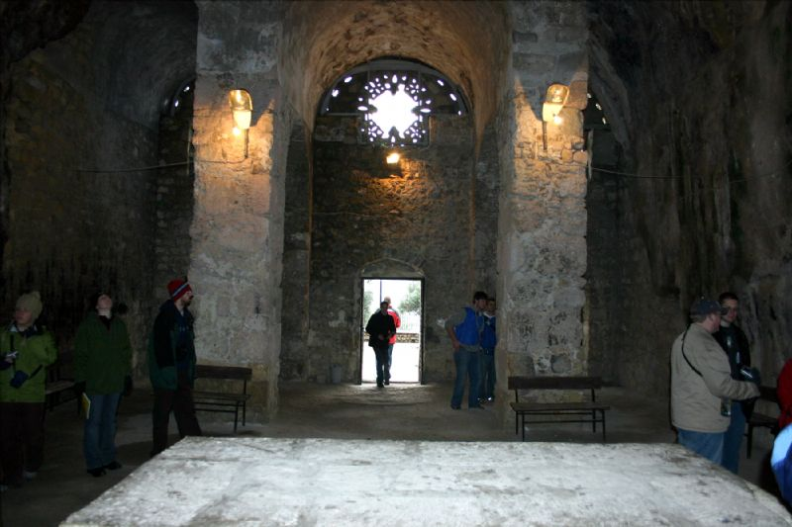
St. Peter’s Church & Bishop’s Throne

Slide 18
St. Peter’s Church

Slide 19
St Peter’s Church: Bishops’ Throne

Slide 20
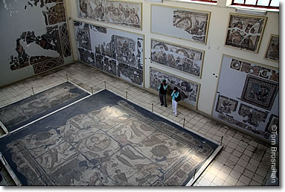
Antioch: Archaeological Museum

Slide 21
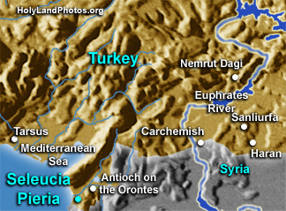
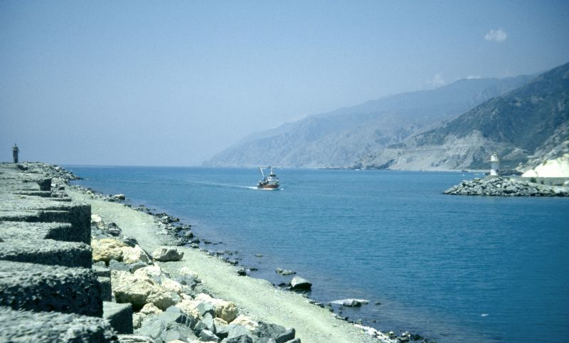
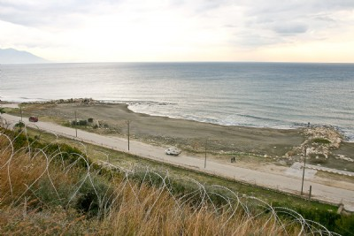
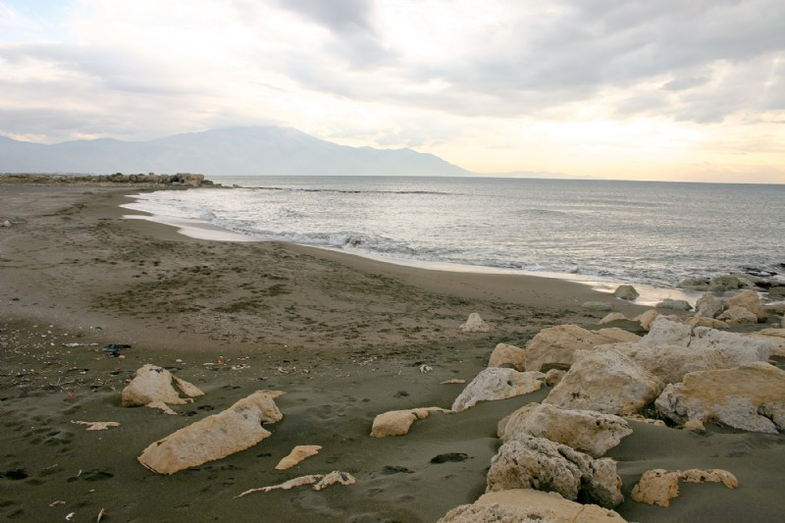
Seleucia Pieria (near Samandag)

Slide 22
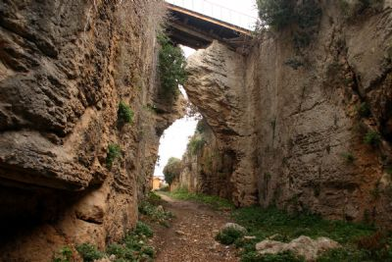
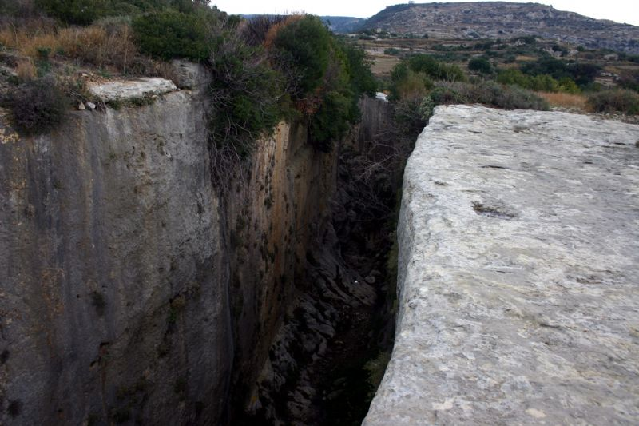
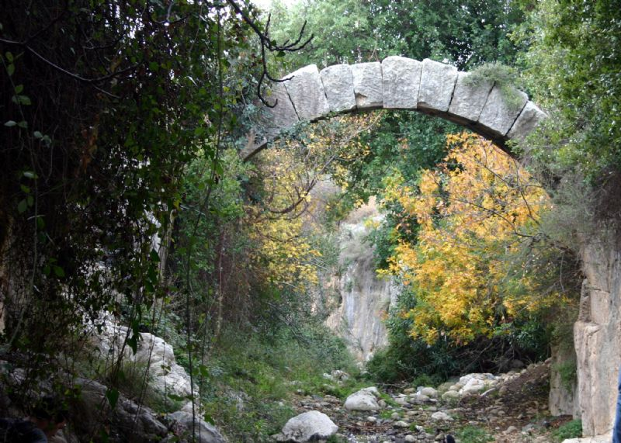
Seleucia Pieria: Roman Tunnel

Slide 23
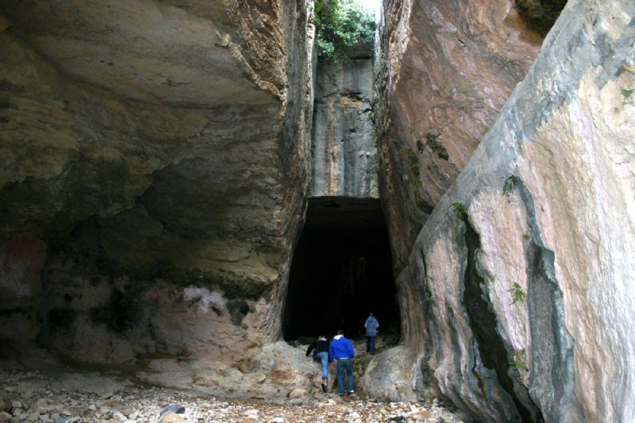
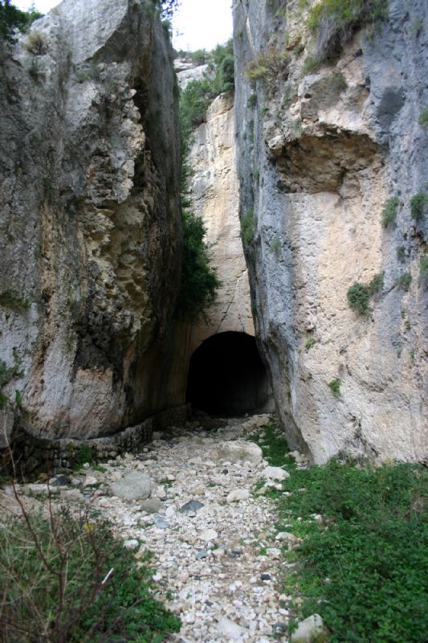
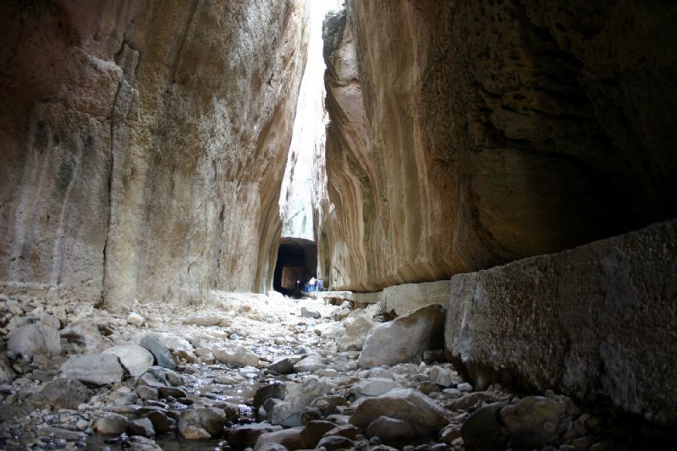
Seleucia: Vespasian/Titus Tunnel

Slide 24
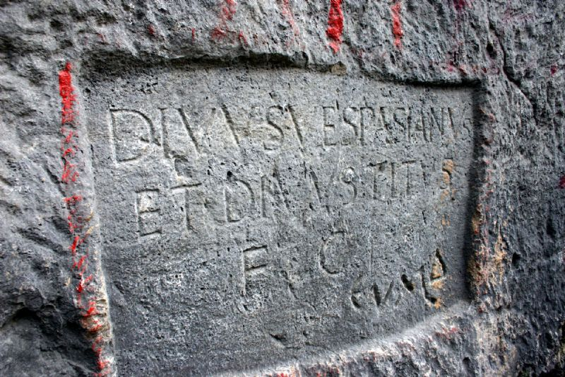
Seleucia: Vespasian/Titus Tunnel
Latin inscription on north wall: mentions
“Divine Vespasian” & “Divine Titus”
Greek graffiti in lower right

Slide 25
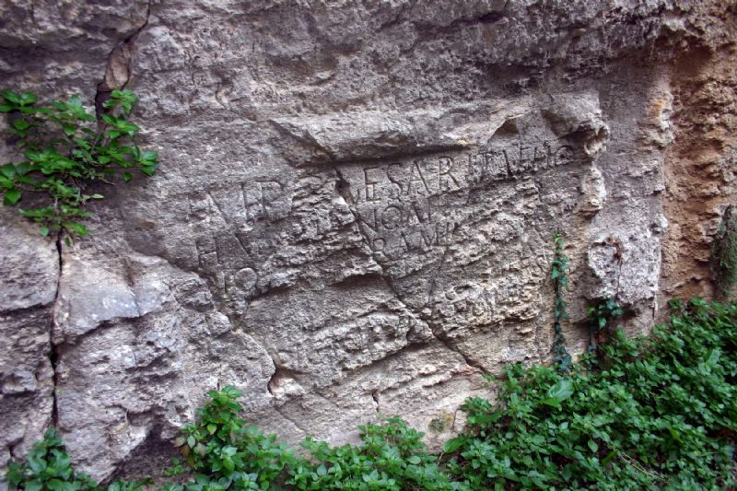
Latin Inscription on Southern Wall

Slide 26
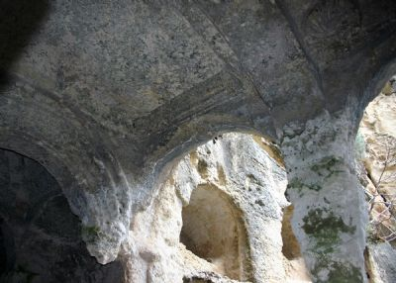
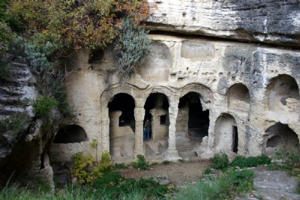
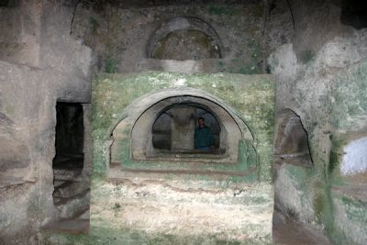
Seleucia:
Rock Tombs

Slide 27
THURS, MAY 16, DAY 4:
From ANTAKYA to TARSUS , CILICIAN GATES,
ESKI GUMUS MONASTERY, and CAPPADOCIA:
  Morning departure to Tarsus, birthplace of Paul.
    Capital of Roman province of Cilicia.
    Center of Greek culture and philosophy.
    “Free City” - people born there had legal rights & privileges as “Roman citizens” (see Acts 21:39; 22:25; and 25:10-12).
    St. Paul’s Well, in a courtyard thought to be site of St. Paul’s house. Archaeological layers from Roman, Byzantine, and Ottoman periods.
  We continue through the Taurus Mountains via Cilician Gates, a route taken by Paul and Silas going through Syria and Cilicia.
  Heading north toward Cappadocia, we stop to visit
  Eski Gumus Monastery, carved from rock in Gumusler.
    10th-century monastery, entered via a vaulted door, contains scenes from Jesus’ Infancy, portraits of Mary, saints, and angels.
  We arrive at our hotel in Cappadocia for dinner.

Slide 28
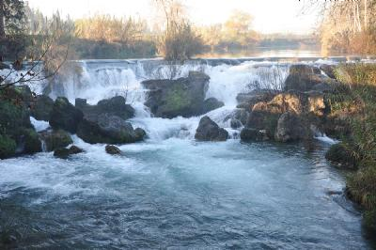
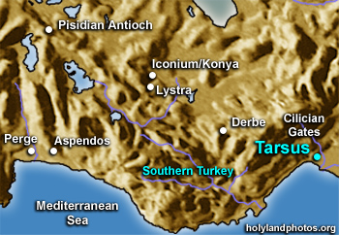
TARSUS (along Cydnus River)

Slide 29
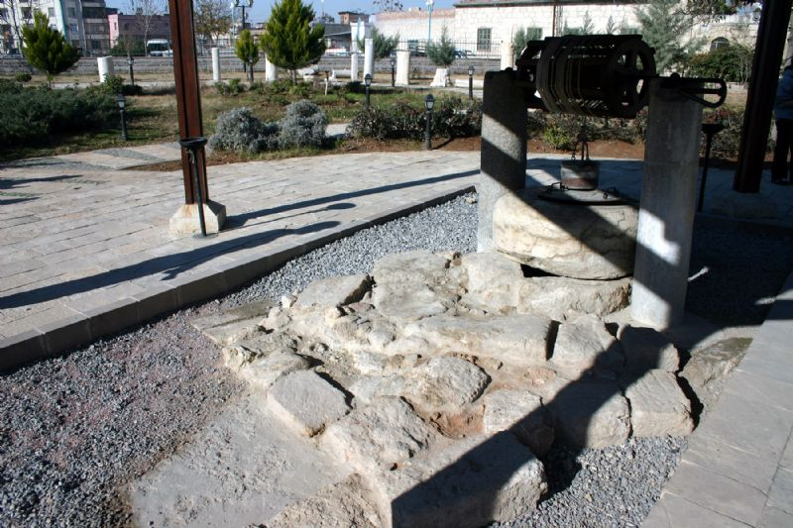
TARSUS (St. Paul’s Well)

Slide 30
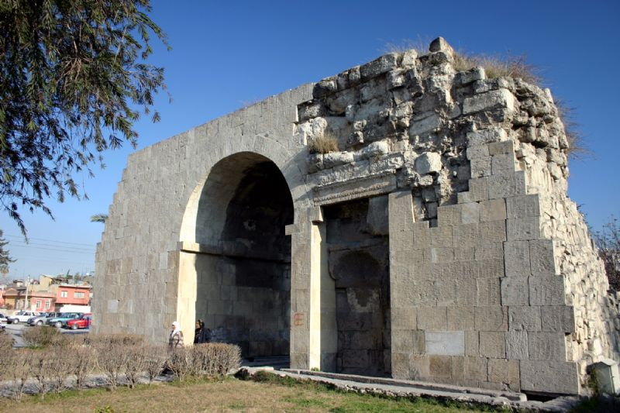
TARSUS (Cleopatra’s Gate)

Slide 31
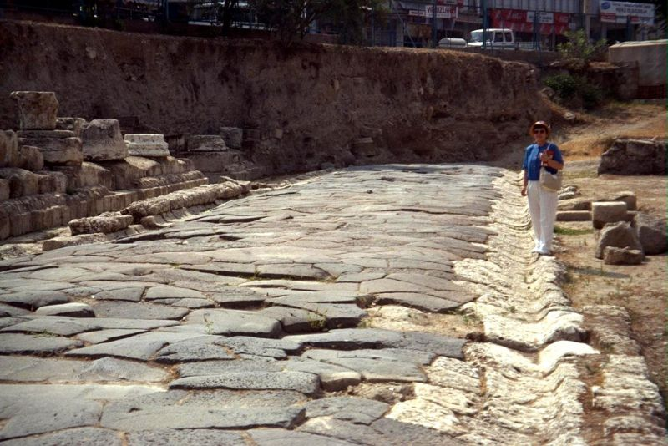
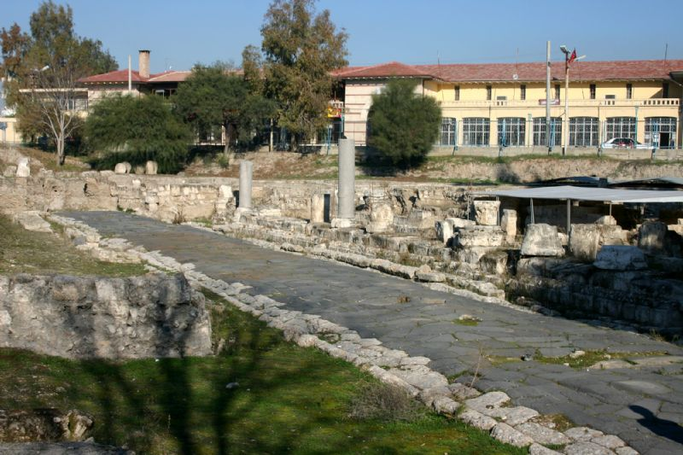
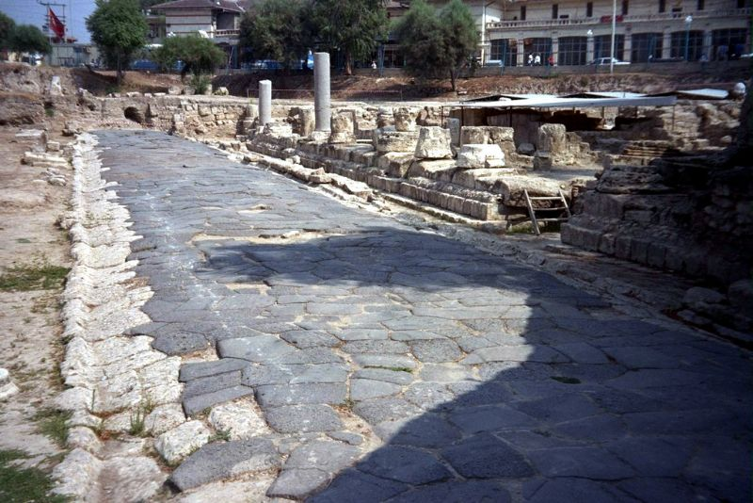
TARSUS: Roman Road

Slide 32
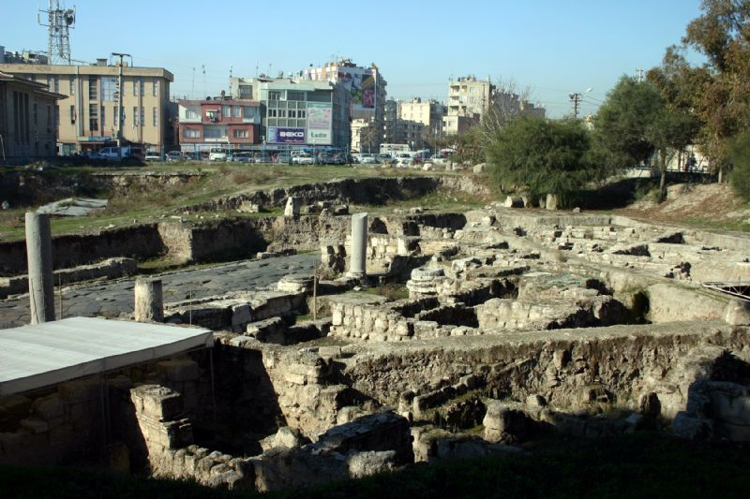
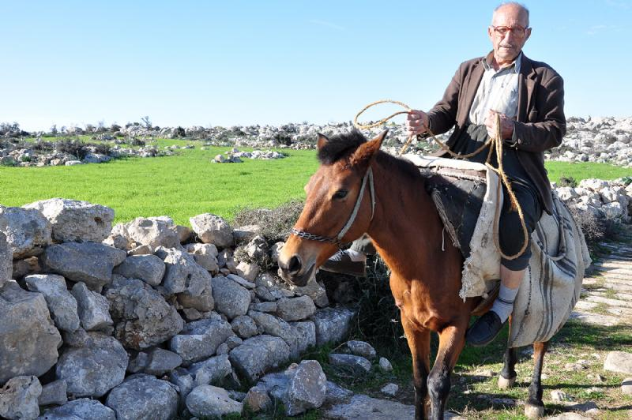
TARSUS

Slide 33
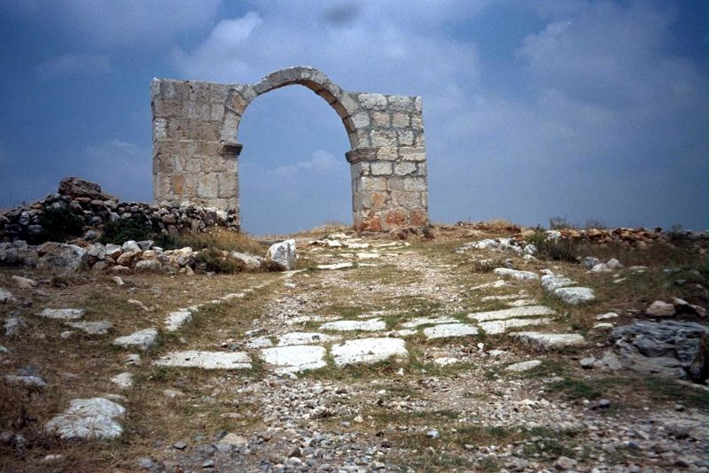
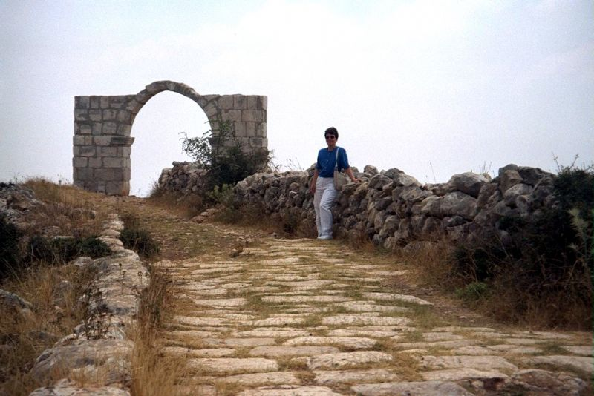
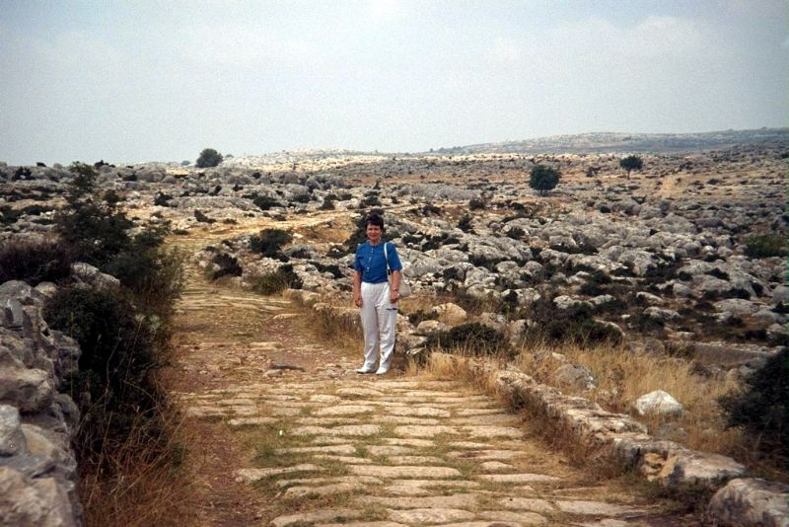
TARSUS:
Roman Road

Slide 34
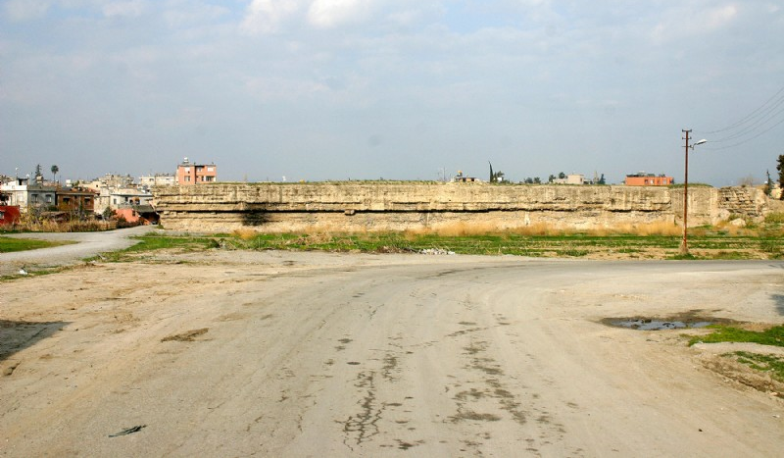
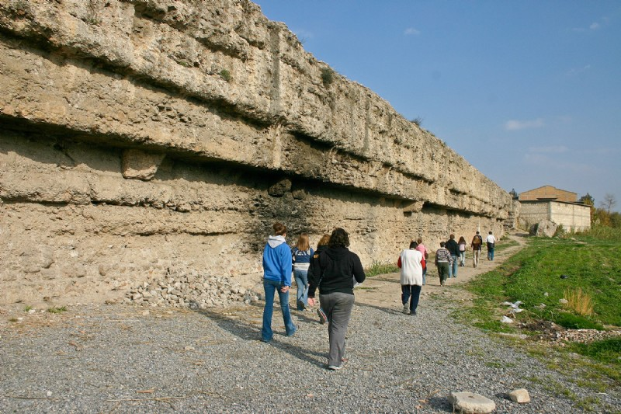
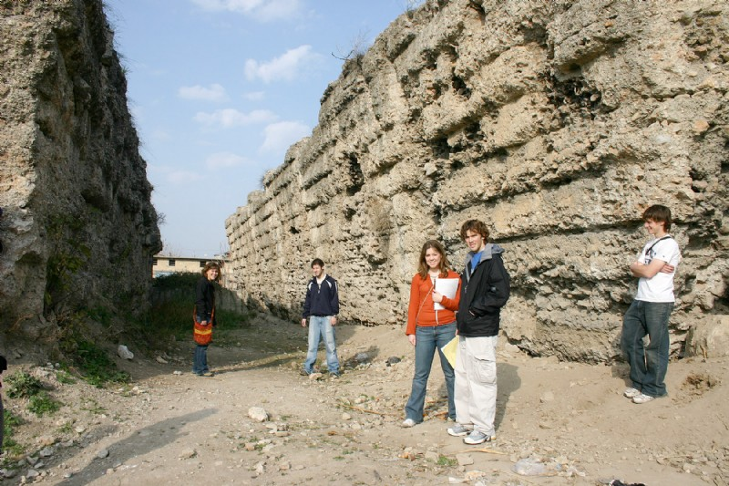
TARSUS: Roman Temple (Donuktash)

Slide 35
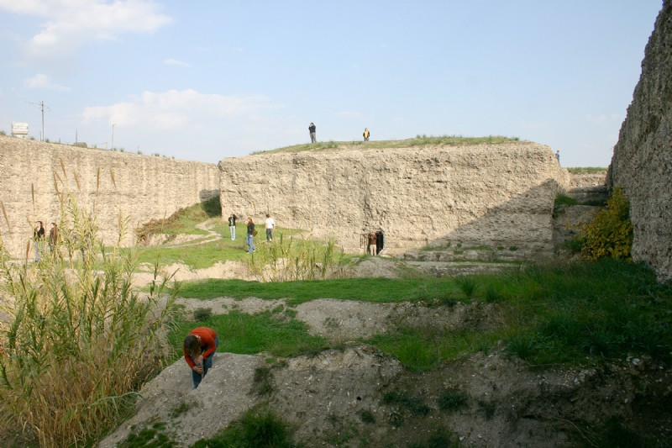
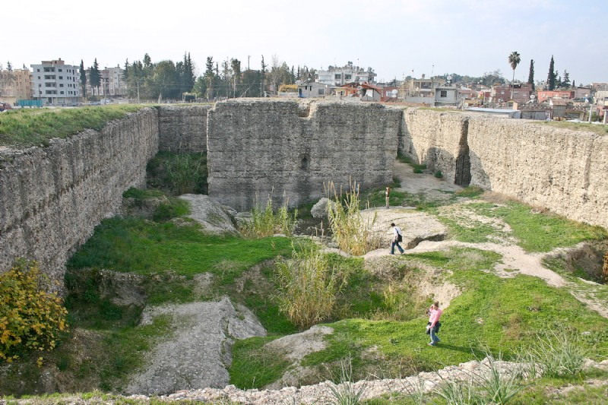


TARSUS: Donuktash

Slide 36




CILICIAN GATES

Slide 37



CILICIAN
GATES

Slide 38



CILICIAN GATES:
Pelit Tesisleri
(a service stop)

Slide 39

ESKI GUMUS MONASTERY
http://hollybibletours.com/Eski-Gumus-Monastery

Slide 40
FRI, MAY 17, DAY 5: Cappadocia
GOREME: ZELVE VALLEY: KAYMAKLI UNDERGROUND CITY: MONKS’ VALLEY:
Today in Cappadocia, we tour one of the most surreal and strange landscapes on earth, formed by thousands of years of erosion. We focus on the vicinity of Goreme Open Air Museum, a UNESCO World Heritage Site since 1984, and the Zelve Valley, one of the greatest Christian centers from the 4th to 10th centuries (although Christians probably have lived here since the 1st century).
This area has more than 600 so-called “cave churches,” hollowed out from the volcanic rock formations. Many of these churches are lined with frescoes dating back to the 11th and 12th centuries. Highlights of our visit include Tokali Kilise (“Church of the Buckle”), the largest church in Göreme; Karanlik Kilise (“Dark Church”), an 11th century monastic compound with newly restored frescoes that are the best preserved in all of Cappadocia; and Yilanli Kilise (“Snake Church”), a simple barrel-vaulted church named for the frescoes of St. Theodore and of St. George slaying the dragon (or snake, as depicted in the fresco).
Next, we visit Kaymakli Underground City, located within the citadel of Kaymakli. The houses in the village are constructed around the nearly 100 tunnels of the underground city. The ancient tunnels are still used today as storage areas, stables, and cellars.
Our final stop today is Pasabag or Monks’ Valley. The name was derived from some cones carved in tuff stones which stand apart. Some of these cones split into smaller cones in their upper sections, in which the Cappadocian hermits once hid. They hollowed out the chimneys from bottom to top, creating rooms high above the ground.
After our visit, we return to our hotel for dinner and the evening.

Slide 41

CAP.: Goreme Open Air Museum
http://hollybibletours.com/Goreme_Open_Air_Museum

Slide 42

CAPPADOCIA: ZELVE VALLEY

Slide 43

KAYMAKLI UNDERGROUND CITY:

Slide 44

MONKS’ VALLEY / PASABAG:

Slide 45
SAT, MAY 18, DAY 6:
Morning departure from Cap. toward Ankara
Stop at 13th cent. Seljuk Caravanserai “Agzikarahan.”
  Trade along the Silk Road required roads, caravans, and inns where traders would stop for the evening.
  Agzikarahan is one of most beautiful, best preserved inns. These fortified inns always had mosques.
Evening Flight from Ankara to Antalya:
  Turkish Airlines #7026 (dep. 7:00; arr. 8:10 pm)
  To hotel for dinner and quiet evening.

Slide 46

Caravanserai “Agzikarahan”
See also http://www.pbase.com/denise_jtl/caravanserai_of_agzikarahan

Slide 47

Ankara Airport: Flight to Antalya

Slide 48



Fly Over:
Iconium/Konya

Slide 49



Fly Over:
Lystra

Slide 50


Lystra: “Spring of St. Paul”

Slide 51


Lystra: Shaduf
(Arabic “Well”)

Slide 52




Lystra: ???

Slide 53




Fly Over: Derbe

Slide 54



Derbe: ???

Slide 55
Evening Arrival in Antalya
We are flying over Pisidian Antioch, Iconium, Lystra, and Derbe, since very few ancient archaeological remains can be seen today.
To learn about the activities of Barnabas and Paul in these cities, read Acts 13—14.
For Days 7-10 of our Pilgrimage, see Part 2.
For Days 11-16 of our Pilgrimage, see Part 3.

